Slide 1

Area Based Durable Solutions Planning
Training

Slide 2
Regional Durable Solutions Secretariat (ReDSS)
Goal: To improve programming and policy in support of durable solutions processes so that displacement affected communities live in safety and dignity in East and Horn of Africa
Consortium of 14 organizations hosted by DRC and steering committee NRC, IRC, DRC
Coordination and information hub – not an implementing agency
Research, analysis & Knowledge Management
Policy Dialogue
Program support and capacity development
Coordination
Notes:
This slide is aimed to introduce ReDSS and its main pillars of activities.
How to get information about ReDSS
ReDSS website (www.regionaldss.org)
Social media - Twitter account (ReDSS_HoA)
Bi- monthly newsletter – Register on website home page
ReDSS Secretariat contacts
Regional: Aude Galli (a.galli@regionaldss.org )
Somalia: Rufus Karanja (r.karanja@regionaldss.org) and Salma Abdillahi(s.abdillahi@regionaldss.org)
Ethiopia: Jason Bell (j.bell@regionaldss.org)

Slide 3
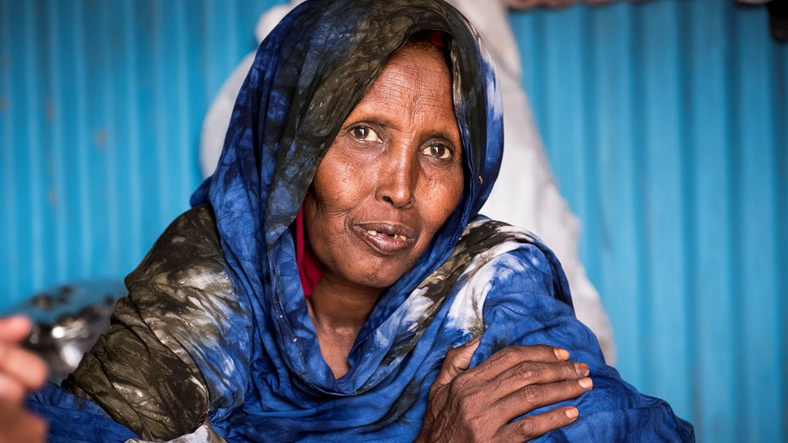
Welcome and Introduction
Notes:
Ideally the workshop will start with a welcome address from either the organizing agency or a relevant national or local authorities, or both. It should not last more than 10 minutes.

Slide 4
Overview of content
About the training workshop
Objectives and content
Who and how? Introduction, methodology and house rules
About the displacement context: global, regional, national and local
Notes:
This is the structure of the first session for the participants to know what will come in the next 80 minutes.
Main message: the introduction session is divided into two parts: one about the training workshop itself and the second one about the displacement context at global, regional, national and local level. You can eventually already announce who will be presenting on the national and local context.

Slide 5
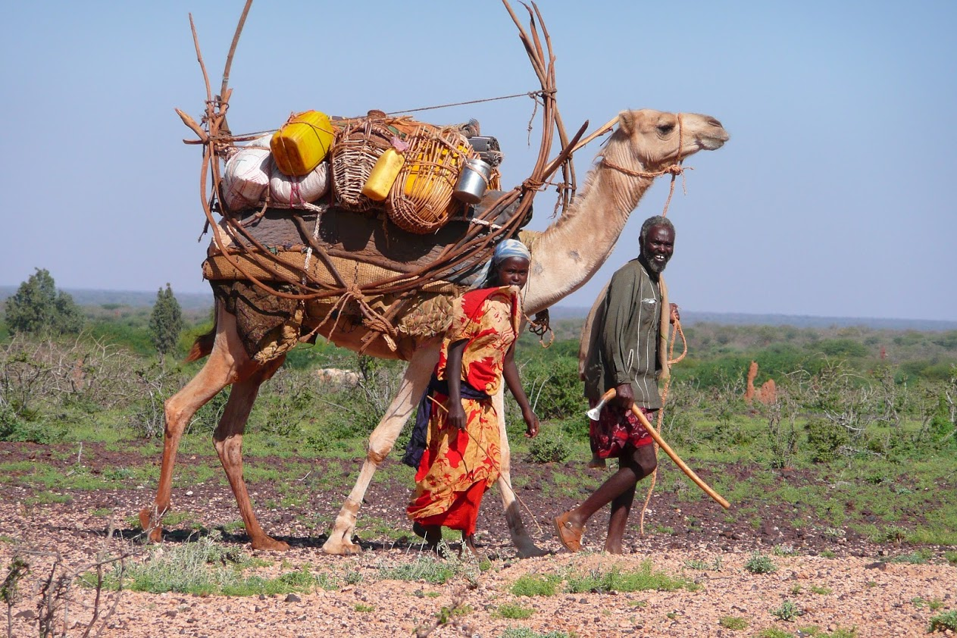
About the training workshop
Notes:
You can start this part with an icebreaker by asking the participant to draw an emoticon describing their state of mind as we start the workshop on a blank sheet of paper and to place it in front of them.

Slide 6






Priority policy processes
Objectives of the workshop
What is it?
How to do it?
Monitoring and Evaluation
A step by step methodology
Area-Based Solutions Planning
Planning
Preparation
Notes:
These are the main objectives of the workshop. You can also write them down on a flip chart paper and stick it on the wall to make it visible throughout the workshop.
Main message:
- The first two/three parts will be dedicated to unpacking what Durables solutions, ABA (an potentially social cohesion and conflict sensitive planning) are…answering the question: “What are we talking about?” and that the last three sessions will be more the “how do we do it?” with a step by step methodology from preparation to monitoring. The last session of the workshop will be “their” session, an opportunity to develop their recommendations on “what to do next to apply an ABA to their context.

Slide 7

Methodology
Participatory
Practical
Based on your context
Notes:
Key message:
- The workshop is participatory, and participants are expected to contribute to the proposed discussions and activities;
- Discussions and activities are based on the local context (to be clearly defined for each workshop) and progressively lead to recommendations to be agreed on in each context.

Slide 8
Who are you?
Who are we?
Notes:
Activity 1: Introductions.
- If there are less than 20 participants, you can organize an introduction of the participants that includes their expectations from the workshop. Ask them to write a maximum of two expectations in a maximum of 4 words for each expectation on post-it notes, one expectation per note and to read them loud after introducing themselves. Stick the notes o a flip chat paper clustering them by theme as you collect them. You can then summarize them all and explain what will and what won’t be covered during the workshop. Your role will also be to take these expectations into account and try to accommodate them to the extent possible, for those fitting with the training objectives.
If there are more than 20 participants, it is recommended not to add the expectation activity to the introduction of participants. It would take too long. Let them introduce themselves quickly (name + professional role). You can always ask them to tell “how they feel this morning” with an emoticon dawned on a sheet of paper. If you really want to know more about their expectation, ask them to right them on post it notes or pieces of paper that you collect and analyze during the first coffee break.
You can add a slide with the pictures and titles of facilitators and resource persons involved in the workshop if there are more than two.

Slide 9

House Rules
Notes:
In plenary, ask the participants to collectively set some rules for the smooth running of the workshop and write them down on a flip-chart paper once they are formally adopted.
Examples of house rules:
Mobile phones on mute/plane mode
Freedom of speech and no judgement
Active but well-organised participation
Respect for others
Punctuality
You can suggest to elect or select a chief of village who will be tasked with enforcing the rules.

Slide 10

About the context
Notes:
Slide to be adapted to the context with a flag or a map of the country or region where the workshop is held.
The following slides are also to be adapted to the context and to the objectives of the workshop. Guidance on the types of information that can be presented are provided in the note boxes.

Slide 11
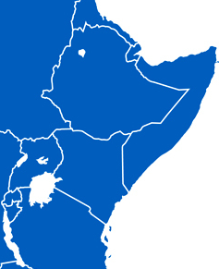
Setting the scene
1,6 million IDPs / 307 000 household
66% displaced by conflict
26,5% by drought
2,2% by seasonal floods
Ethiopia
735, 204 registered refugees
From: South Sudan, Somalia, Eritrea, Sudan, Yemen…
Host population: 548,334
Notes:
This slide is meant to set the scene of the displacement situation in the country where the workshop is held. Provide some key data and figures about the displacement situation in the country:
Number of IDPs and causes of displacement
Number of refugees, countries of origins, estimated DAC etc.
Figures and map to be updated to the context and whenever new data is available.
Sources: For IDPs. IOM DTM Round 19; October 2019 accessible here: https://data.humdata.org/dataset/ethiopia-baseline-assessment-data-iom-dtm
Refugees: UNHCR. January 2020

Slide 12
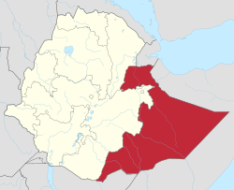
Somali Regional State: mapping activity
Notes:
Activity 3: Group activity: Displacement mapping at local level.
Divide the participants in four to five groups depending on their number and give them the following instructions:
In your groups, map the refugee and IDP presence in the Somali regional State of Ethiopia. Their number, location, length of stay, type of settlement and main characteristics.
Quickly debrief with one group and ask the others to complete.
Try and find the latest figures available at the local, disaggregated by age and sex if possible before the workshop to cross check the numbers provided by the participants during the mapping exercise.
Try and find the latest figures available at the local, disagregated by age and sex if possible, to cross checked the ones provided during the mapping exercise.
Potential sources: IOM Ethiopia National Displacement Report and UNHCR.
You can use different visuals for the debriefing.
Draw a map on two flip chart papers stuck on a wall and complete it with the figures and information provided by the participants. You can add a flip chart paper on the side if you don’t have enough space on the map.
Use a different flip chart paper for each zone/area or population group

Slide 13
A MOMENTUM- displacement as a global priority
The 2030 Agenda for Sustainable Development : displacement included in development agenda and plans
CRRF and Global Refugee Compact
  Ethiopia among the leading and pilot countries
IGAD Summit on durable solutions for Somali refugees
  Political re-engagement at the regional level
  Declaration on Durable Solutions for Somali Refugees.
  Comprehensive Plan of Action
2016 World Humanitarian Summit’s core commitment :
“Leave no one behind”:
Including refugees, IDPs and host communities
Reduce internal displacement in a dignified and safe manner by 50 % in 2030.
Notes:
Displacement and durable solutions is at the heart of the humanitarian and development debates and long-term objectives! This slide is aimed to show the current momentum in the discussions and initiatives on displacement and durable solutions. It is key to emphasize on the global dynamic that is likely to have an impact at the regional, national and local level.
Insist on the humanitarian and development joint initiative as well as on the promising inclusion on displacement issues into the 2030 Agenda for Sustainable Development.
This workshop is a way to get prepared for it as area-based approach is part of the new way of working initiated by the World Humanitarian Summit and subsequent initiatives to promote resilience and self-reliance for displacement affected communities.

Slide 14
Main elements of the CRRF in Ethiopia
SDGs / International Commitments
National / Regional Development Plans (GTP II, III)
PLEDGES: 2016, GRF, IGAD, related projects (eg. EOP)
REFUGEE PROCLAMATION
Implementation Guidelines
NCRRS
CRRF
Road Map
National Action Plan
Secondary legislation
Iterative process
Community / Stakeholder consultations
Regional Action plans x 6
ARRA support to ‘All of Government Approach’
UNHCR and wider-UN / Development Partner support (technical, material, financial)

Slide 15

self-reliance and resilience
Integrated programming
Government-led and whole of society
Engagement of development actors
Long-term planning
participation of communities
Inclusion in national/local systems
The CRRF approach: a “new way of working”
Notes:
This slide sums up the main components of the CRRF approach that lead to adopt an area-based approach.
Key messages:
- The CRRF approach is contributing to positive changes with a stronger focus on self-reliance and resilience, integrated refugee-host community programming, government-led and whole of society approaches, engagement of development actors and a commitment to support stronger participation of communities in programing and policy processes.
- In order to realize the benefits of these progressive global and regional policy processes, it is critical for policy makers and practitioners to translate these efforts at the local level with tangible benefits for displacement affected communities.

Slide 16
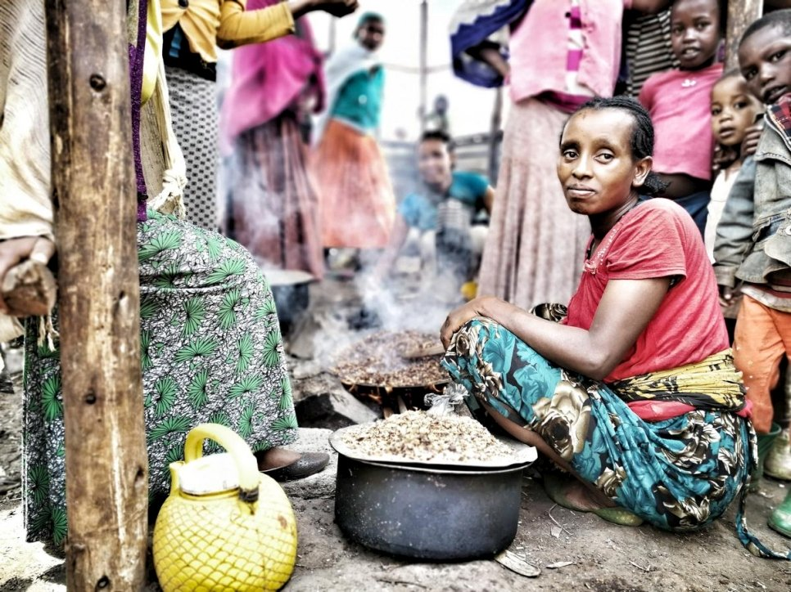
IDP initiatives and policies
National Durable Solutions Initiative
Ethiopia ratified the Kampala Convention on the Protection and Assistance to IDPs in 2020: implementation of its provisions should follow!
Notes:
Ethiopia has one of the world’s largest IDP populations, estimated to be 1.8 million individuals.
Ethiopia’s national Durable Solutions Initiative (DSI), which promotes conducive conditions for internally displaced persons (IDPs) to rebuild their lives, was launched in December 2019. The Initiative – developed by the Government of Ethiopia, the United Nations, international and national non-governmental organizations (NGOs) and donors – seeks to ensure internally displaced communities in the country are supported to either return, integrate or relocate voluntarily.
A short video is available here to familiarize yourself with the initiative. You can show it to the participants if relevant in the context and if you have time: https://www.youtube.com/watch?v=W68mcAI-dHU
Picture: A woman from the Gedeo community cooks at a site for displaced people in Ethiopia. © UNHCR/Anna Hellge

Slide 17
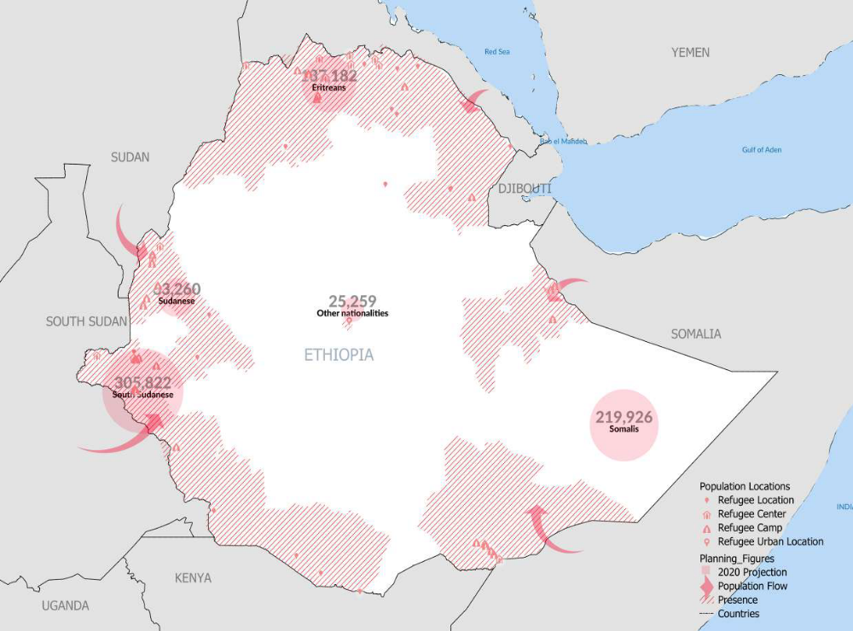
At the sub-regional and local level
Somali Regional State
Cross governmental CRRF coordination structures at regional and Woreda level for refugees based around Jijiga
CRRF Coordination Groups
Initial area-based capacity assessment plans
IDP durable solutions policy
Notes:
In this slide, you may add solutions/area-based initiatives taken at the local level and that are relevant with the objectives of the workshop.

Slide 18
Area-based approach is part of this « new way of working !
What is it?
Why adopting it?
How implementing this approach?
Notes:
Transition slide.
Explain that ABA is part of the new way of working as it is inclusive, enables the collaboration and partnership of a wide range of actors and the participation of DAC on a long-term bases.
Let’s discover more precisely what is it , who to do it and how to step by step implement it!
Key message:
- Area-based planning is part of the “new way of working” and related international, regional and national frameworks aiming at strengthening the capacities of national and local authorities to develop long-term planning for Displacement Affected Communities (DAC).

