Slide 1

Area Based Durable Solutions Planning
Training

Slide 2
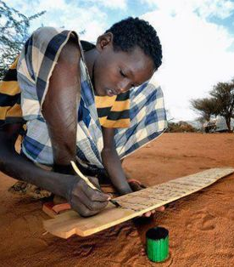
Session 1: Durable solutions and Area-based approach. What is it?

Slide 3




Priority policy processes
Objectives
Define durable solutions
What is the added value of this approach?
Know more about Displacement Affected Communities
Durable solutions and area-based approach
Explain what an area-based approach is

Slide 4
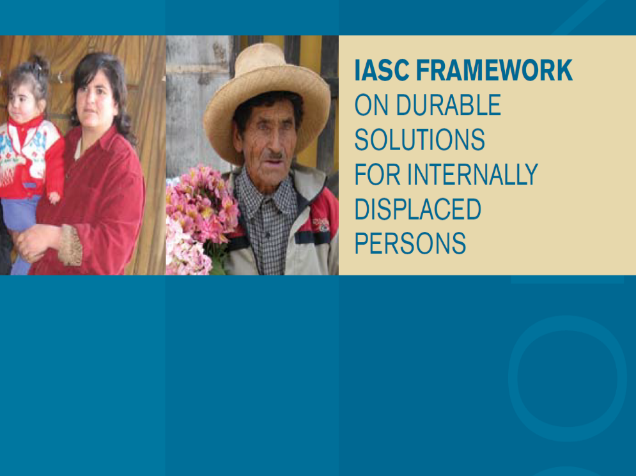
Durable Solutions Definition
A Durable Solutions is achieved when displaced persons:
No longer have protection and assistance needs related to their displacement
Have access to their rights without discrimination
Notes:
Show the IASC framework on Durable Solution and explain that the definition of durable solutions developed for IDPs in 2010, as well as the operational framework attached to it has gradually been adopted for all displaced persons , including refugees.
Activity 1: DS definition and small papers:
Then distribute the small papers: one envelop per group and ask the participants to put the papers in the right order to make the definition of durable solutions appear. You can help them by telling them that it is comprised of two parts.

Slide 5
It can be achieved through:
Sustainable reintegration at the place of origin: voluntary return
Local integration in areas where displaced persons take refuge
In another part of the country based on their choice or in another country (resettlement)
Sustainable (re) Integration
Notes:
Key messages:
-There are 3 equally valid “settlement options”. These 3 settlement options are NOT by themselves THE durable solutions.
- They all aim at achieving integration.

Slide 6
Durable Solutions process towards integration
8 criteria
Long-term safety and security
Adequate standard of living
Access to livelihoods and employment
Access to remedies and justice
Accessible mechanism for restoration of Housing Land and Property (HLP)
Personal and other documentation
Family reunification
Participation in public affairs
Program sup8 criteria port and capacity development
Solutions is a long-term process
The primary responsibility of States
Support by humanitarian and development actors
Policy Dialogue
Notes:
Key messages:
- Creating a conducive environment for the achievement of durable solutions is a long-term process and the primary responsibility of national authorities with the support of humanitarian and development actors.
- The 8 criteria set out as benchmark to measure the extent to which durable solutions are achieved are used have been used as a basis for the development of several joint durable solutions analysis tools such as the ReDSS framework and the interagency durable solutions indicators library that will be discussed in session 5.

Slide 7
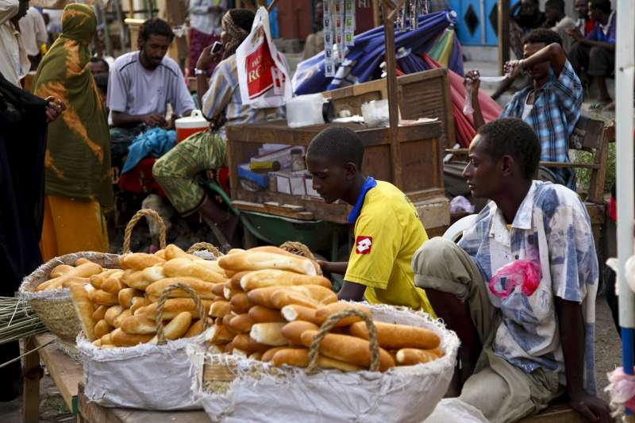
Displacement affected Communities (DAC)
IDPs
Host communities
Refugees
Returnees
Notes:
This slides shows the link between host communities, refugees, returnees and IDPs and migrants and their common interests in progressing toward durable solutions. Access to food market is a typical gateway towards livelihood and self reliance.
Key messages:
- Displacement affected communities involves all displaced populations and host communities as displaced people do not live in a vacuum
You can add that IDPs, refugees and poor population often leave in the same areas and share the same obstacles to access services or livelihood and employment. Adopting a DAC approach enables a more holistic and long-term response benefiting all and taking into account the impact of displacement on host communities while being aware and sensitive to the displacement related issues that IDPs and refugees might face.
A perfect example of this close linkage is the Somali Regional State; for instance, in Awbare Woreda, there are now refugees, IDPs, and host communities all settling within the same district area.

Slide 8
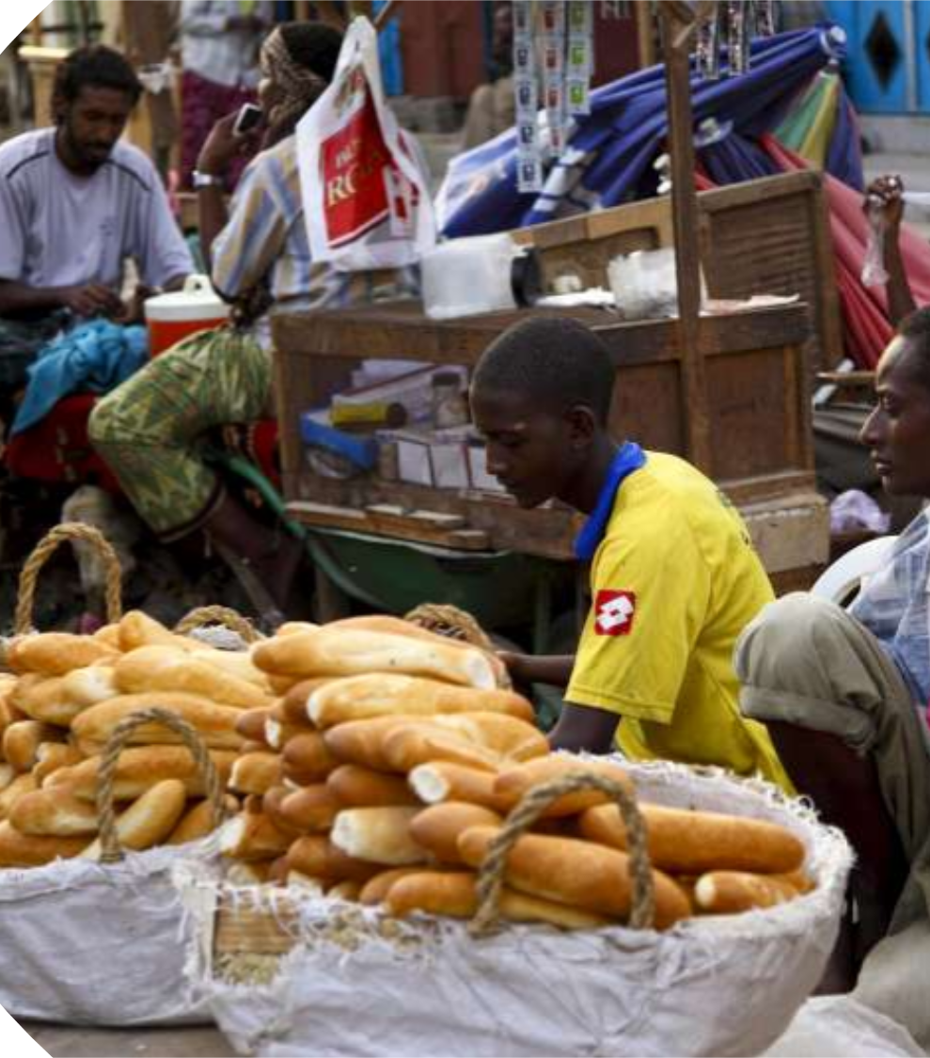
How can we respond to the needs of Displacement Affected Communities ?

Slide 9

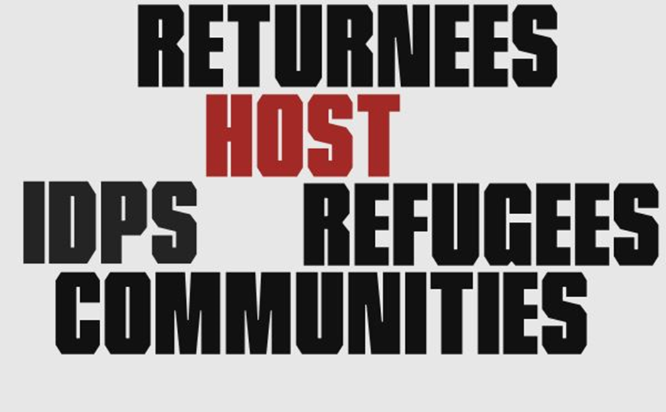
An area-based approach is an approach that responds to the whole population living in a specific geographic area
Notes:
- Area-based approach is an approach that responds to the whole population living in a specific geographic area
Activity 2: « cluster and name the components of the area-based definition”.
Show this slide and tell the participants that this is just a hint and that they will discover the full definition and all the dimensions of the ABA through an activity.
This activity is a group activity. Distribute the small papers in their envelop, without the title items in red and ask the participants to group them in a way that makes sense and find a title for each group.
Ask one group to tell their results and others to comment and/complete after.
Show the next two slides as a recap.

Slide 10
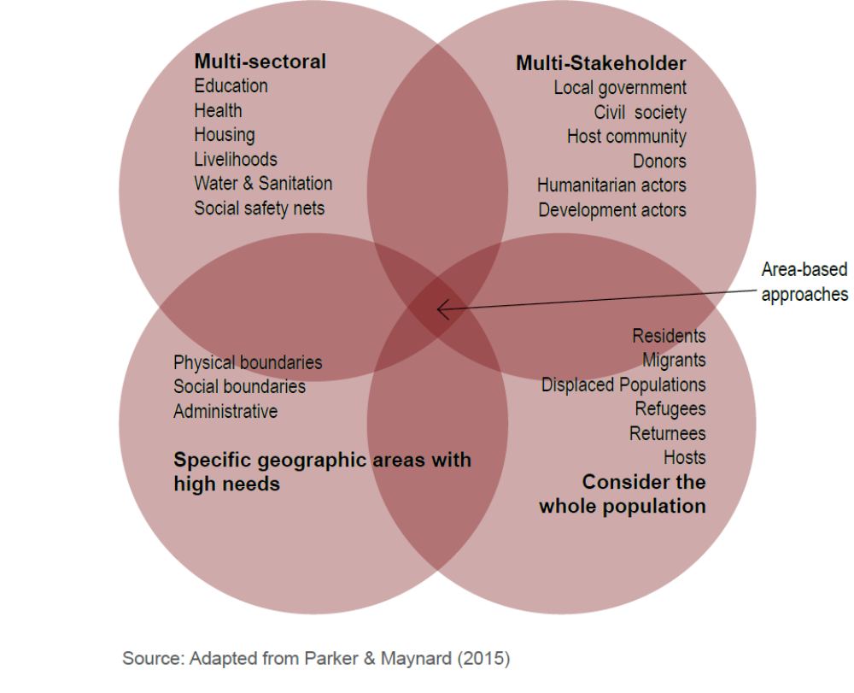
The four dimensions
Notes:
This slide is a recap of activity 3

Slide 11




Definition
“Area based approaches refers to an approach that defines the area, rather than a sector or target group, as the main entry point. All stakeholders, services and needs are mapped and assessed, and relevant actors mobilized and coordinated with”. (ReDSS/IRC)
Multi-stakeholder
The whole population
Multi-sectoral
An area with high needs
Notes:
Recap the definition with the one developed by IRC precising that there is no internationally agreed upon definition of area-based approach to date.
Activity 3: contextualize the four components. Optional group activity: Divide the participants in four groups, each group working on one of the four characteristics of the area-based approach definition. Give them 10 minutes to think of what does this characteristic means in their particular context:
- What are the obstacle(s) to apply such an approach?
What are the opportunities?
You can ask the participants to use the table “activity 3 table” to compile their results.
. Debrief in plenary by writing the results of each group in bullet points on flip chart papers. Show the following slide to recap.

Slide 12
Why adopting such an approach ?
“Area-based interventions led by local authorities or communities can have wide-ranging benefits, and should be encouraged” (IRC, 2015)
Notes:
Activity 4: plenary or group discussion on the expected benefits of are-based approach. Read the quote and ask the participants in plenary or in a group activity (about 7 minutes) what are the wide ranging benefits expected from an area-based approach according to them. In other words, why adopting an area-based approach?. Write or draw, using graphic facilitation, their answers on a flip chart before showing the following slide as the recap.

Slide 13
Because…
Reduce tensions and real or perceived inequalities and contribute to improving social cohesion
Create a ‘platform’ bringing together a diversity of actors with different capacities
Engage with Local Authorities
Bring targeted and contextualized durable solutions
Notes:
These are four arguments in favour of the adoption of an ABA, but there are many more that the participants will have highlighted during the brainstorming activity and that you will have summarized on a flip chart paper that you can now stick on the wall.
Key messages:
Area-based approaches can:
- Create a ‘platform’ which brings together a diversity of actors with different capacities to discuss the collective
response under the leadership of national or local authorities;
- Reduce tensions and real or perceived inequalities and contribute to improving social cohesion;
- Bring targeted and contextualized durable solutions;
- Enable community meaningful participation, consultation and involvement at all stage of the planning cycle;
- Capitalize on the availability, commitment and interest of local authorities to respond to long-term durable solutions needs and reinforce social cohesion (both horizontal and vertical dimensions)

Slide 14
Area-based versus cluster approach
Cluster approach
Emergency response
Humanitarian
Short-term
Population specific
Lack of involvement of national and local actors
Limited actors: humanitarian agencies
Gap/weaknesses in the transition with development actors
Area-based approach
Humanitarian and development
Long-term
Multistakeholder including development actors
Government led or co-led
Displacement Affected Communities: whole populations
Based on local structure and actors
Notes:
This slide shows the main differences between the cluster and the area-based approach. It is not meant to say that one approach should replace another but that both approaches are complementary. The cluster approach is before all meant to respond to emergency crisis and to ensure accountable, well – coordinated and principled humanitarian response. It is not designed to plan for long-term solutions planning involving a wide range of actors including development actors and the private sector, for instance. Likewise, the cluster system is not population specific as it is not designed to respond to refugee crisis although some coordination mechanisms between the inter-agency humanitarian response and the refugee operations.

Slide 15
Schematic: UNHCR conceptualizing the area of operations
Coordinator in chief
Embraces one operational area (comprehensively)
HoSO
Protection
Programme
Admin/Fin
HoSO
Data (SDGs), monitoring, partnership support
Host Communities
Protection
CRRF Officer
Refugee and Host Communities: One Eco-system
Programme
Admin/Fin.
Endeavours to put in place coord. mechanisms / meetings
Data on host communities
Capacity of local authorities
Supports partner missions
CRRF / Pledge reports
Updates to Addis
Refugee Camps
SDGs
Fig. 1
2018 - 2019
2020….
Notes:
This slide is borrowed from a UNHCR presentation that shows the shift of the organisation’s approach for the coming years to not only consider refugee camps as its area of operation but a larger “eco-system” comprised of refugees and host communities.

Slide 16
'Four system’ CHALLENGES
UN
UNHCR internal (HR, prog. cycle / financial, priorities)
UN agencies – capacities / ways of working
UNHCR / RCO (unexplored opportunities)
Government
Ongoing public sector reform
Change in actors
Capacities and roles
Plans and strategies
Funding: Donors / partners
Traditionally-driven agenda (project-style)
No ‘nexus’ funding platform
Development funds – subtracted from humanitarian resources
Society
Some efforts – eg. WB CDD
No formalized engagement
Community / refugee dialogue separate and minimal
Notes:
There are many challenges in the implementation of such an approach and it will take some time before all actors adapt to the new way of working and adopt area-based approach to plan for solutions. The obstacles are mainly due to the “old way” of working of the UN agencies, donors and partners, ongoing changes at the national level combined to lack of capacities and resources at local level. There might also be challenges at to community/society level where people are not ready/in favour of such an apporach or where interactions between refugees and host communities are still minimal due to previous encampment policy.

Slide 17
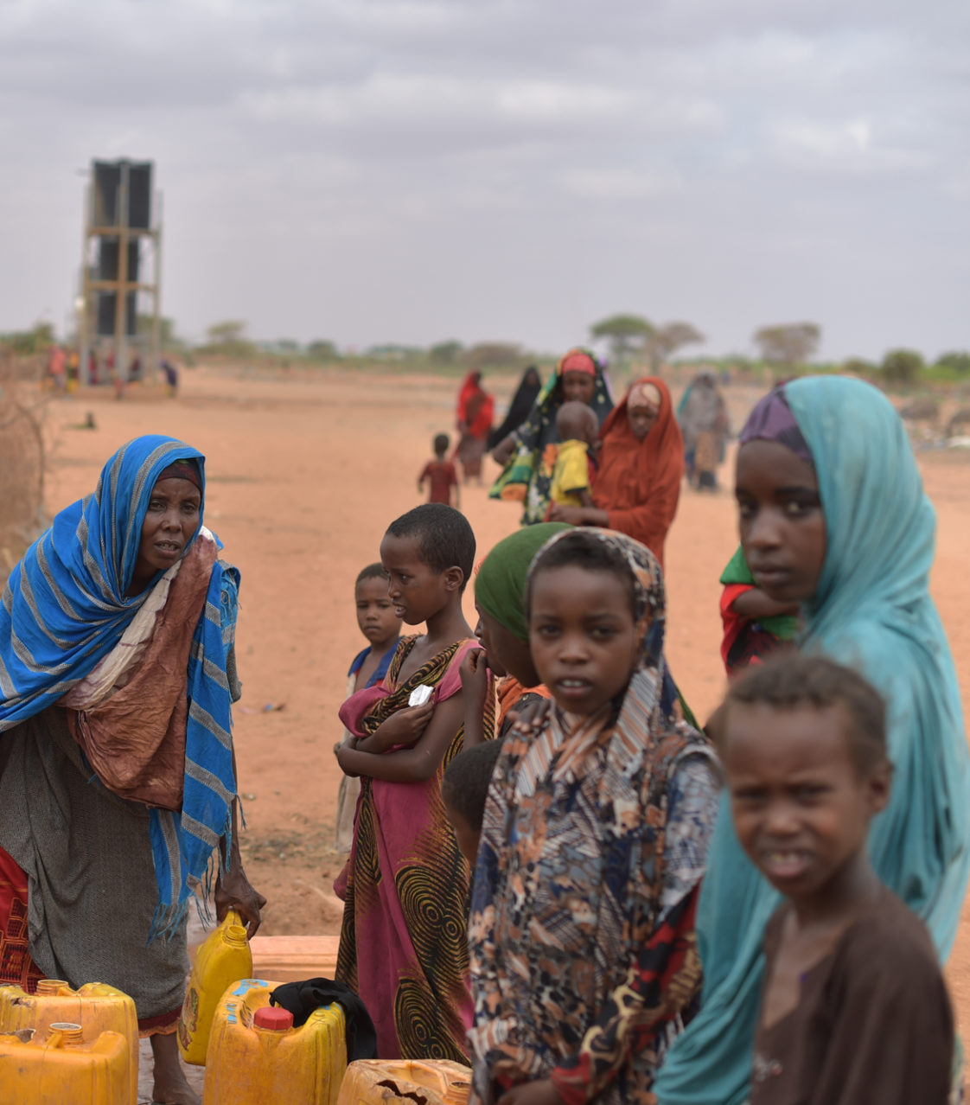
Focus on social cohesion
Notes:
This optional focus might require 30 to 45 minutes.

Slide 18

Social cohesion: what is it?
Strong, positive, integrated relationships and inclusive identities are perceived as indicative of high social cohesion
Weak, negative or fragmented relationships and exclusive identities are taken to mean low social cohesion.
Social cohesion is therefore a multi-faceted, scalar concept.
Notes:
His is a definition developed by World Vision.

Slide 19
Dimensions and dynamics
Relationship between the individual
and a superordinate institution
Belonging | Isolation
Inclusion | Exclusion
Participation | Non-involvement
Recognition | Rejection
Legitimacy | Illegitimacy
Trust | Mistrust
Inter-individual relationships
Notes:
Source: Social cohesion and forced displacement, a desk review to inform programming and project design, The World Bank Group, July 2018.
Key message:
Some coherence has been achieved in the more recent and more complex definitions of social cohesion, which have rooted themselves in five dynamics of social cohesion (see the 6 dynamics box), which have been developed by subsequent key authors1. This has included identifying both the vertical and the horizontal interactions among members of society as characterized by a set of attitudes and norms that includes trust, a sense of belonging and the willingness to participate and help, as well as their behavioral manifestations.
1. Bernard, P. La Cohesion sociale: a critique d’un
quasi-concept. Lien social et Politiques – RIAC 41,
1999. Chan, Joseph et al. Reconsidering Social
Cohesion: Developing a Definition and Analytical
Framework for Empirical Research. Social Indicators
Research, 75(2), 2006.
Activity 5: Potential group activity: Play with the dynamics.
Assign one dynamic set per group and ask them to find a local example for both elements based on their experience with displaced and host communities in their country/locality. Then ask them whether it belongs to the horizontal or vertical dimensions of the social cohesion definition.

Slide 20
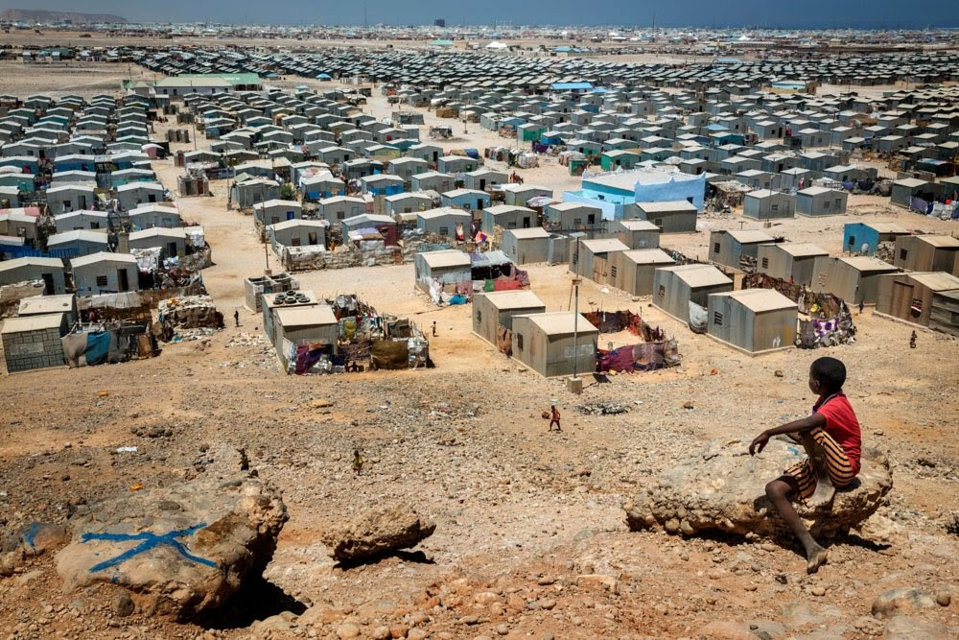
Impact of displacement on social cohesion
Population influx,
Harrowing stories
Humanitarian interventions,
Changes access to resources
Competition
Feeling threatened
Notes:
Activity 6: Potential activity in plenary: show the title of the slide first and ask the participants about the main impacts of displacement on host communities and on social cohesion. You can summarise the main points discussed as bullet points on a flip chart paper.
Only show the content of the slide after the discussion.

Slide 21
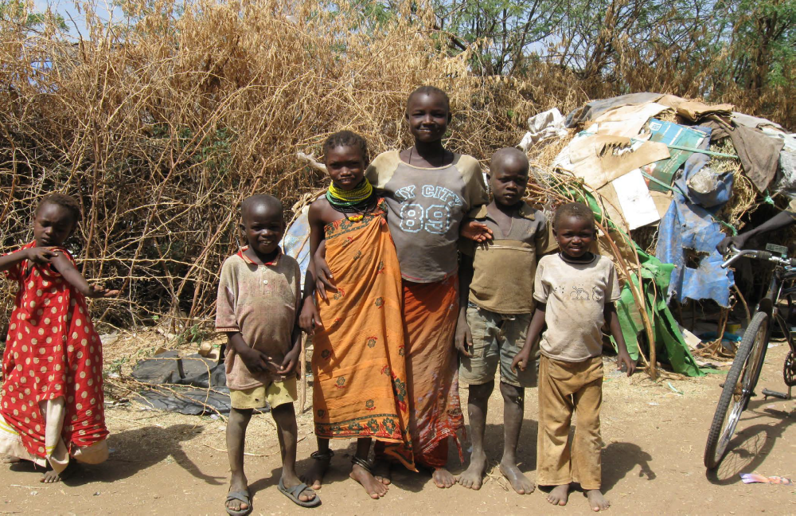

Mediated by:
Pre-existing narratives of social identity
Pre-existing relationships
Access to services
Economic situation
Duration, patterns of settlement
Other political stresses
Social flexibility
Perceptions
Case study: The historical and cultural
construction of narratives around refugee presence in North-east Kenya
Notes:
Case study taken from the World Bank Group report on the “Refugee Impacts on Turkana Hosts: A Social Impact
Analysis for Kakuma Town and Refugee Camp, Turkana County, Kenya”, World Bank, 2016.
The WBG report undertakes social impact analysis to unpack the historical and cultural construction of narratives around refugee presence in north-east Kenya. The metanarrative which prevails is that refugees are ‘other’ and ‘violent usurpers’ of the rights, land and resources of the Turkana hosts and are to be feared. One of the most important contributing narratives to this meta-narrative is the underlying sense of marginalization the Turkana experience from broader development processes in Kenya with a lack of trust in central and local government to include them or address their needs. In this context, refugees are perceived as yet another damaging incursion into an already disadvantaged situation. Meta-narratives of distrust are also enhanced in the event of violent or exploitative interactions between refugee and host. While inter-communal violence is relatively low, there are many firsthand experiences of hosts feeling cheated or threatened by refugees, which perpetuate the meta-narrative. Nevertheless, the report points out that in daily life, this meta-narrative is highly nuanced; it is mediated by the many individual and group interactions, which are positive and welcoming in nature, and the perceived opportunities of refugee presence. There are high levels of inter-group exchange, collaboration and mutual benefit and, thus, many sub-narratives prevail around the ‘goodness’ of refugees and their presence. Distance is a key factor; closer to the camps, hosts are more likely to refer to positive subnarratives and to positive interactions, while further away, hosts are more likely to subscribe to the negative meta-narrative.

Slide 22
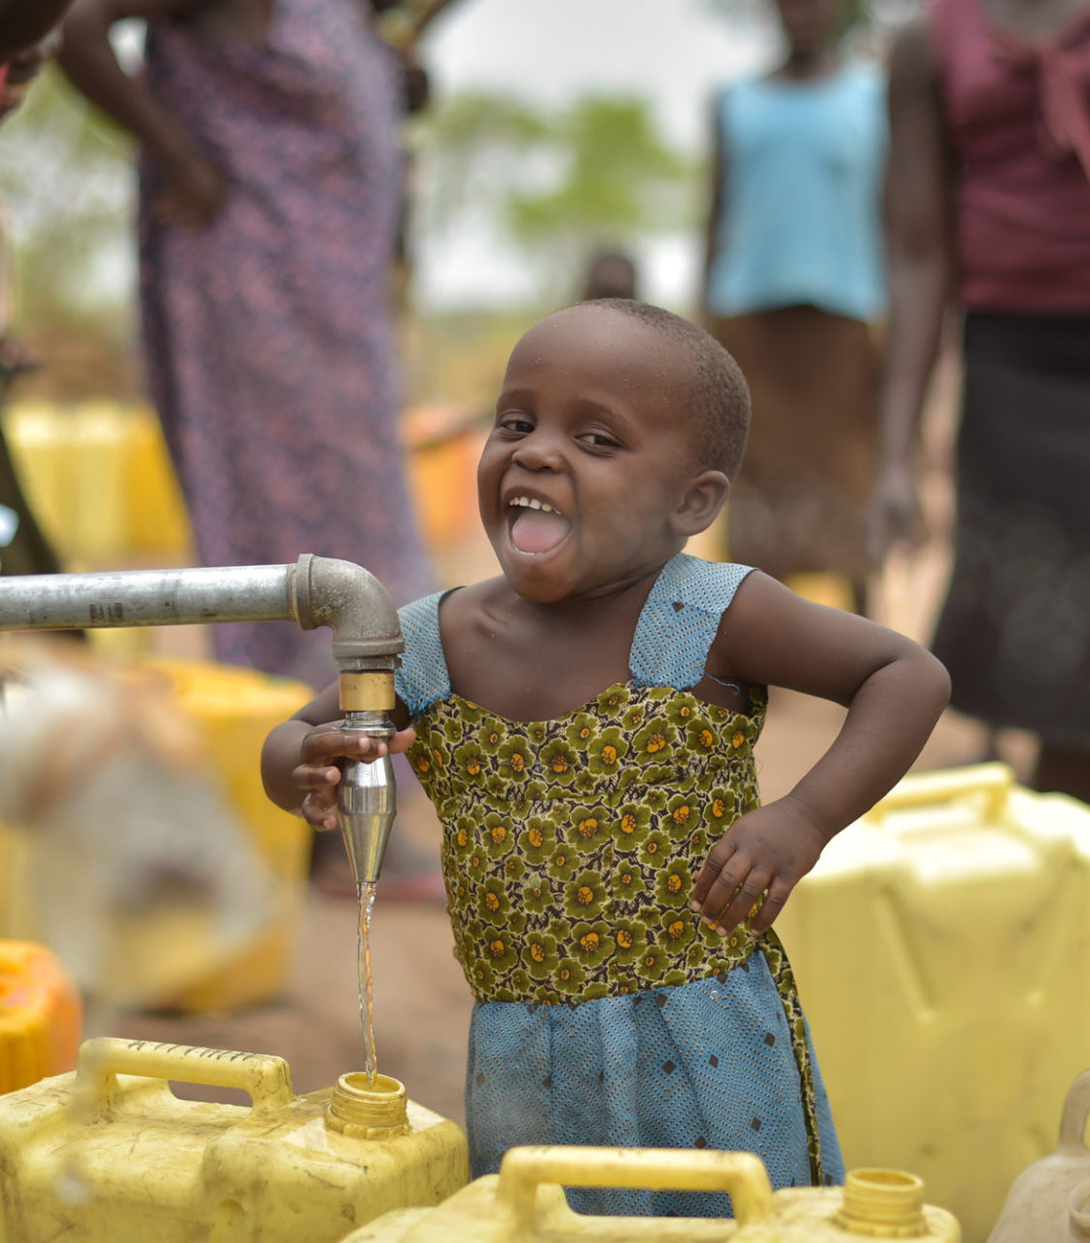
Focus on inclusion in national systems

Slide 23
What does it mean?
Displaced people and host communities are supported in an inclusive way and served through the same national systems:
Avoid the creation of parallel systems for displaced persons
Ensure their inclusion into national and local systems
Supporting local/national systems and host communities
“(…) We will take measures to improve their (refugees) integration and inclusion, as appropriate, and with particular reference to access to education, health care, justice and language training”.
New York Declaration:

Slide 24
Operationally speaking…
POC and hosts can access rights and related State, local private sector and local civil society services
National, local and sector plans and budgets
Data and Statistics
National and local capacity for service delivery
Representation and participation
Legal and policy frameworks
Oversight and enforcement
POCs are aware of and (financially) able to claim rights
Notes:
Based on UNHCR definition and operationalisation framework of inclusion in national systems.
« The infographic shows the seven aspects of inclusion that UNHCR operations should assess and potentially leverage, depending on the context to gradually work towards inclusion in country systems.
Important note:
The seven aspects of inclusion apply to all sectors (education, health, social safety net, access to work etc.)
They apply to all PoCs as well as their hosts;
There is no hierarchy between the seven elements. They are all equally important;
They are interdependent but don’t need to be all met for each sector;
Not all of the seven aspects might be possible to leverage for each and every sector but, depending on the context and based on a well-informed and strategic analysis, some of them will be identified as potential objectives for UNHCR and its partners in the field;
Inclusion is often not possible in emergency situations or when there is a lack of political will. Likewise, there is sometime a lack of capacity to do so immediately, when services are simply not existing.

