Slide 1

Area Based Durable Solutions Planning
Training

Slide 2
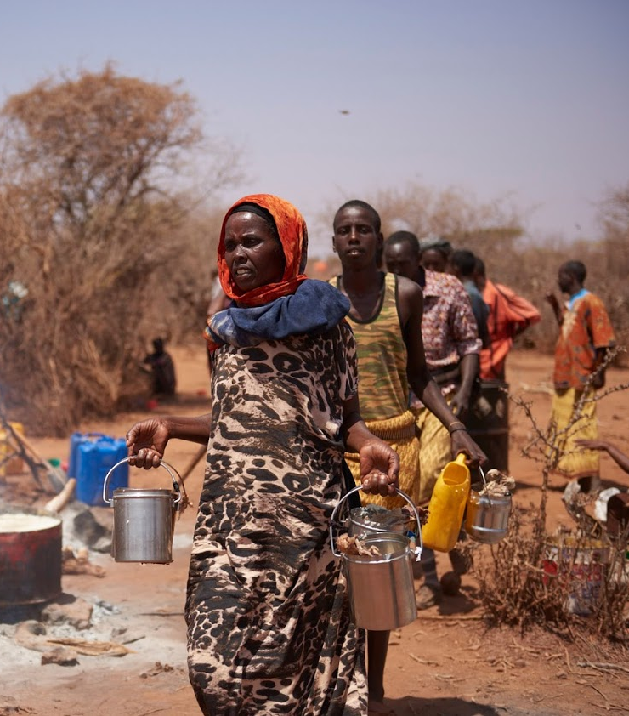
Session 2: Area-based approach. How do we do it?

Slide 3




Priority policy processes
Objectives
Examine the 10 elements of Area-based approach
What about your context?
How to delimitate the area?
Area-based approach
How to target population?

Slide 4
The ten elements of area-based approach
Focus on location
Multi-agency, multi-sectoral approach
Realistic timeframes
People-centered actions and planning
Work and invest in existing structures
Collaborating sectors and programmes
Flexible programming
Nimble internal systems
Plan for scaling-up
Measure contribution not attribution
Notes:
Only show the title of the slide before the end of activity 1 which aims to progressively discover the ten elements.
Before starting the activity, you can mention that there is no internationally agreed upon definition of area-based approach, nor is there a related operational framework. Nonetheless, research carried out on area-based planning initiatives in urban setting has resulted in the development of a set of 10 elements guiding the operationalization of this approach. In the absence of other clear guidance, ReDSS has adopted these useful elements that serve as valuable guiding principles for operational use. The ten principles for area-based recovery programmes are drawn from research undertaken as part of the Stronger
Cities Initiative (https://www.iied.org/stronger-cities-initiative ) involving World Vision, the Norwegian Refugee Council, the International Rescue Committee and the University of New South Wales (Sydney). You can refer to the following article for further guidance: https://odihpn.org/magazine/ten-principles-area-based-approaches-urban-post-disaster-recovery/
Activities:
1. Playing cards.
Distribute playing cards. One game per group and ask participants to make the title of each element match its description.
Keep the word version of the card game with you to check their results. The first group coming up with the right matches wins.
2. Group discussion. Select the 4 to 5 elements that you think are the more challenging or relevant in the context. Assign one element to each group and ask them to think about it from their own perspective, in their own context.
What would it mean in our displacement context?
Is it feasible?
Are there existing initiatives respecting this principle?
What are/would be the main obstacle for its implementation?
The debriefing can take different forms:
If the exercise is followed by a coffee break or if you feel that the participants may need a short break, ask the groups to summarize their discussion on two flip chart papers (one for each element) and organize a “marketplace”: Participants can go from one group to another to see what other groups have done and discuss with the “stand holder”.
If you have time, you can organize a debriefing, group after group giving two minutes for each group to present.

Slide 5

Focus on location: Delimitation
A specific area with specific needs
Physical boundaries
Administrative boundaries
Social boundaries
Mix of populations
Level of vulnerability of the DACs
Displacement-specific vulnerabilities
Existence of, or potential for locally owned area-based planning
Existing government administrative area or physical features of the urban environment
Aligning with the system : links to development planning and exit strategies
Notes:
Key messages:
Area based planning uses an area/geographical location as the main entry point. The area in which an area-based approach is implemented can be determined based upon a mix of different criteria:
Existing boundaries: physical, administrative and social (that will be defined in the Agora case study)
A number of factors:
-The mix of populations within this area: IDPs, refugees, returnees and host population;
- Level of vulnerability within the displacement affected communities (DACs) as a whole
- Existence of displacement-specific vulnerabilities
- Existence of, or potential for, locally owned area-based planning
- Existing government administrative area or physical features of the urban environment;
- Area that is recognized by its inhabitants as encompassing (1) a coherent socio-economic unit and (2) a network of predictable relationships between its stakeholders.
- Aligning with the system; links to development and exit strategies
Important to add is that a pragmatic approach should be adopted, and that the area might need to be a bit larger than planned to avoid creating frustrations and doing harm!

Slide 6

Promising practice in Bangui
Kokoro-Boeing and Plateau Recovery Planning
Notes:
This is an exerpt of a muti-sectoral and localized analysis of the demand and supply of services in cisis affected areas, Bangui ,CAR, Mai 2019.
This case study is about the area-based approach analysis carried out by REACH, using its AGORA methodology, in Bangui. The main aim of the project was to select crisis affected areas where to implement multi-sectoral recovery plans.

Slide 7
A two steps delimitation process
1
2
Why Kokoro-Boeing and Plateau?
Which areas in these locations?
Important destructions during the conflict
Not well integrated in the urban fabric
Important displacements movements during the crisis and returns
5 Participatory mapping workshops to identify a “population or neighborhood basin”:
A coherent socio-economic unity
A network of predictable relationships between its stakeholders
Notes:
This is a summary of the first steps of the analysis carried out by REACH team and relevant local actors in Bangui, including local authorities and relevant stakeholders (mayors, social actors, neighbourhood leaders, etc.)
There was a first round of discussions around the neighbourhoods where the recovery plan could take place. Two were selected based on the criteria in block 1.
The second phase was focused on the delimitation per se: which areas in these neighbourhoods: 5 participatory workshops were organised, involving all relevant local actors to determined “population or neighbourhood basin” where an area-based planning approach could be successful. The main criteria used where:
The existence of a coherent socio-economic unity;
A network of predictable relationships between its stakeholders
Note that security considerations were not taken into account not to exclude and discriminate against populations living in areas that are difficult to access due to security issues.
The report on the full recovery planning process can be found there (in French):

Slide 8
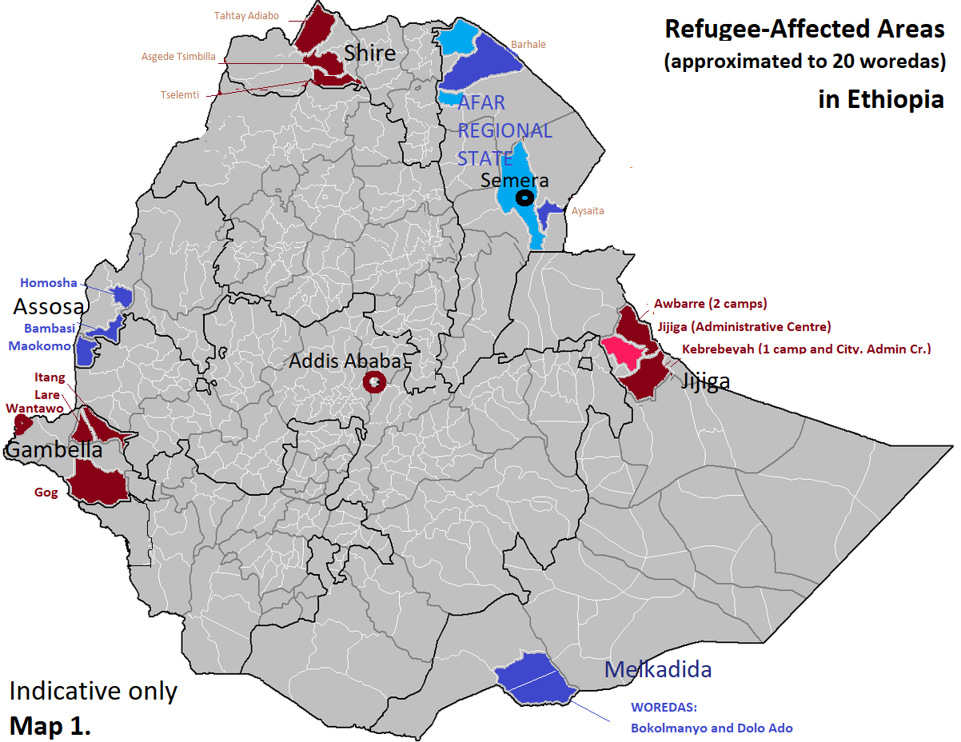
Notes:
This slides show the indicative UNHCR identified zones/refugee-Affected areas. where area-based approaches is planned to be implemented in Ethiopia.

Slide 9
“whole population” : How do we target?
An area-based approach is characterized by its focus on needs, capacities and vulnerabilities within a geographic area, rather than among a specific population group.
Notes:
An area-based approach is characterized by its focus on needs, capacities and vulnerabilities within a geographic area, rather than among a specific population group. Targeting should therefore be based predominantly on vulnerability, needs and capacity.
However a pragmatic approach that avoids doing harm should be adopted and some of the issues shared by the whole population should be taken into account.

Slide 10


Targeting in practice: discussion
Shall we opt for displaced/host quotas?
40/60?
30/70?
Move away from this differentiation approach to focus on both host community and displaced persons capacities, vulnerabilities and needs to be integrated in long-term development planning
Notes:
This slide is a way to discuss the modalities of the implementation of areas-based plans. Shall we target the population based on quotas displaced/hosts?
Show the first part of the slide first (question) to the participants and engage a discussion.
Only show the answer after a while, once the debate is well engaged.
The main message here is that area-based approach considers the “whole population” and targets based on the vulnerabilities, needs and capacities of the population based in the selected area. It entails that both displacement specific and common/shared needs between hosts and displaced population will be assessed and addressed. The following case studies will show concrete examples of targeting based on vulnerability, needs and capacities for area-based plans.
FYI information: The 30/70 quota is used in the West Nile sub-region where “host communities' benefit from the support to refugees through a 70:30 principle, where 30 percent of the support is provided to the host community, usually on the basis of quotas. While this principle helps ensure host communities benefit from the overall refugee response, its application is unclear and inconsistent, which gives rise to tensions. For example, there are different views about what constitutes a host community. NGOs and operational agencies also face challenges in reaching the 30 percent target, which is rarely achieved in practice. Even when they do meet it, they acknowledge high levels of duplication. Clearer guidance and more coordinated action on the implementation of the 70:30 principle is required.
When host communities are included in a refugee response, their specific needs tend to be treated as secondary considerations within that response, with implications for the relevance of the support that is provided. Moreover, host communities themselves are often treated as secondary at the point of service. An
overall assumption of benefit to refugee hosting also downplays the significant financial and opportunity costs to communities at large (for instance, in relation to serious environmental degradation) and to those specific individuals who are negatively affected by refugee hosting. These costs may become more pronounced as refugee stays become more protracted”. Source: ReDSS study on integrated access to services in Uganda:
https://regionaldss.org/wp-content/uploads/2019/03/ReDSS-Uganda-Report-FINAL-2019.pdf

Slide 11

Targeting in practice: Incubators approach in Somalia
“Incubator Locations”: at risk displacement affected communities selected through a local participatory process
Clusters of multiple IDP settlements and surrounding host community.
Targeted population involve all who live there: both displaced and non-displaced.
The programme prioritizes the most at risk sub-groups: female and male youth; vulnerable women; girls and boys; elderly and people from marginalized clans.

Slide 12
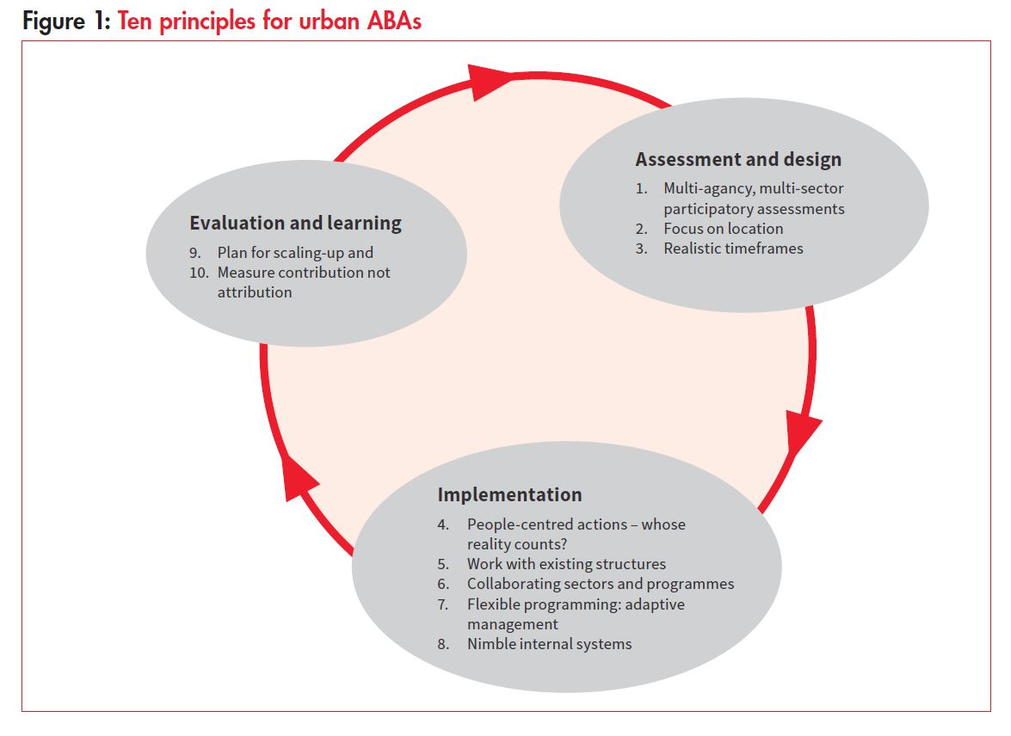
The 10 elements and the planning cycle
Notes:
You can use this slide as a transition to the second part of the training workshop that will be focused on a step by step methodology to apply an ABA approach that is based on the planning cycle.
Source: Ten principles for area-based approaches in urban post-disaster recovery, David Sanderson and Pamela Sitko, March 2018

