Slide 1
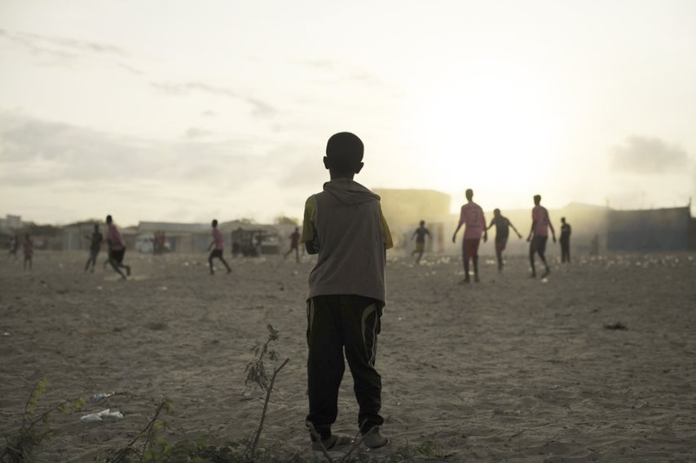
Xal waara in loo raadiyo bulshada uu sameeyey Barakaca ee Soomaaliya

Slide 2
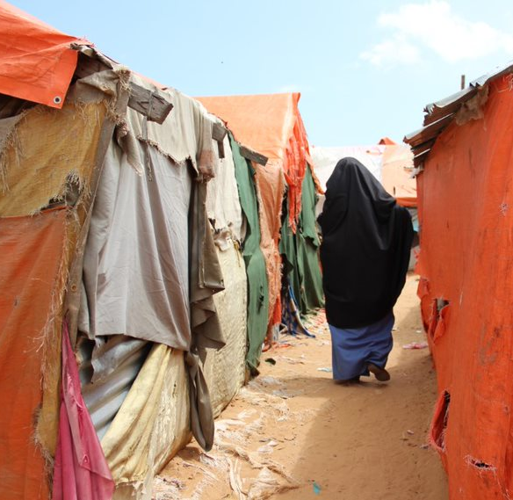
Kulanka 1aad: Waa maxay barakaca sidoo kale waa kuma bulshooyinka uu saameeyey barakaca?

Slide 3
Ujeedooyinka Kulanka
Program sup8 criteria port and capacity development
Dhamaadka kulankaan waxaad awoodi doontaa inaad:
Qeexdo qaybaha kala duwan ee dadyowga uu saameeyay barakaca
Qiimeeyso baaxadda barakaca Soomaaliya
Sharaxdo sida barakacu u saameeyo nolosha dadkan ku nool Soomaaliya
Qaadato qaab dhammaystiran oo isku dhafan oo ay ku jiraan dhammaan bulshooyinka barakacayaasha ay saameeyeen (DAC), iyadoo la waafajinayo siyaasadaha Soomaaliya
Policy Dialogue

Slide 4
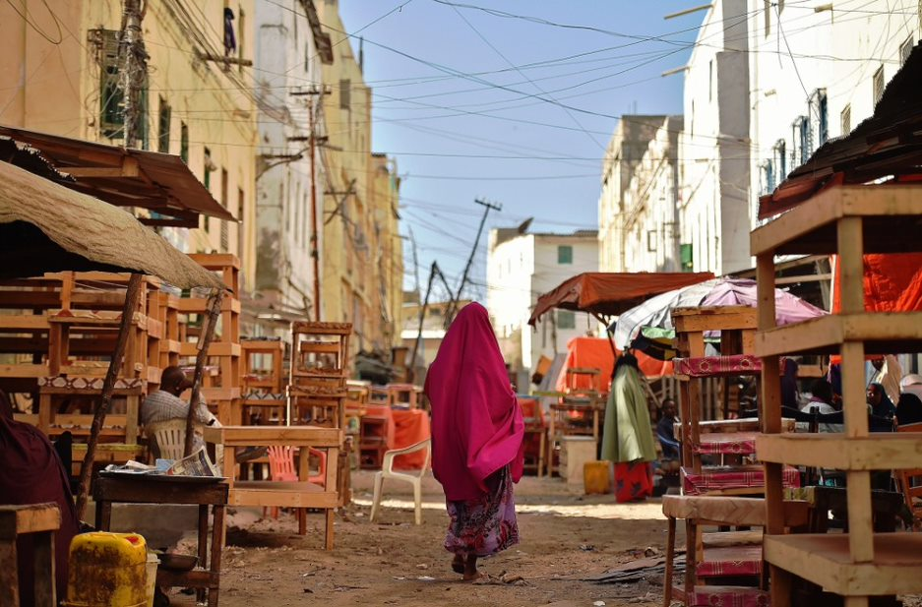
Howl:Socodka Awooda
Kooxdaada dhexdeeda, akhri oo ka wadahadla asalka dabeecada laguu xilsaaray
U xilsaar hal tabaruce oo ka mid ah socodka awooda kaa soo iska dhigi doona jilaaga

Slide 5

Howsha Socodka Awooda: jawaab celintaada iyo gabagabada
Program sup8 criteria port and capacity development
Laga soo bilaabo waxa aad dareentay markaad ku jirtay socodka awooda sidee ku tilmaami lahayd dareenka barakicinta khasabka ah?
Maxaad u maleyneysaa inay saameyneyso xal u raadinta barakaca?
Policy Dialogue

Slide 6
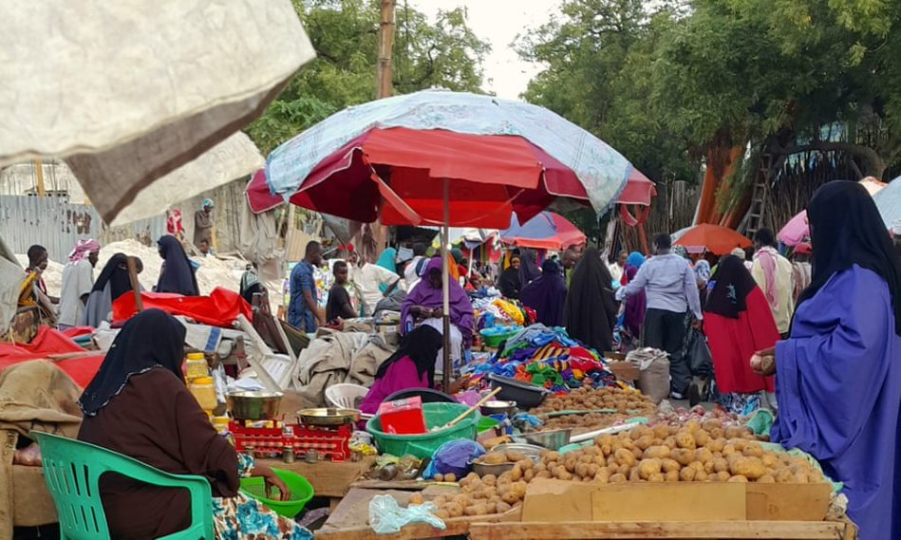
Waa kuwee bulshooyinka uu saameeyay barakaca?
Barakacayaasha
Dadka martida loo yahay
Qaxootiga
Dadka dalka ku soo laabtay
Notes:
This slides shows the link between host communities, refugees, returnees and IDPs and migrants and their common interests in progressing toward durable solutions. Access to food market is a typical gateway towards livelihood and self reliance.
Key messages:
- Displacement affected communities involves all displaced populations and host communities as displaced people do not live in a vacuum
You can add that IDPs, refugees and poor population often leave in the same areas and share the same obstacles to access services or livelihood and employment. Adopting a DAC approach enables a more holistic and long-term response benefiting all and taking into account the impact of displacement on host communities while being aware and sensitive to the displacement related issues that IDPs and refugees might face.
A perfect example of this close linkage is the Somali Regional State; for instance, in Awbare Woreda, there are now refugees, IDPs, and host communities all settling within the same district area.

Slide 7

Barakacyaasha iyo Qaxootiga
Barakacayaasha
Qaxootiga
Qof ka baxsan dalkiisa / dalkeeda
Ay haysato cabsi sal-adag leh uu ka qabo in loo cadaadidiyo sababaha la xiriira:
Isirkiisa,
diintiisa,
dhalashadiisha,
ra’yigiisa siyaasadeed ama
xubinnimada koox bulsho oo gaar ah.
Ka qaxayo dagaal gardaro oo dibedda ka yimi, xukun, dalka oo qabsado shisheeye ama dhacdooyinka sida xun u carqaladeeya nidaamka bulshada
Oo aan guriga ku noqon karin ama ka baqaya inuu noqdo.
Program sup8 criteria port and capacity development
Dad ama kooxo dad ah
Lagu qasbay ama lagu waajib yeelay inay ka qaxaan guryaha ama meelaha u ahaa deegaan caado ah
Natiijo ahaan, ama si looga fogaado:
Isku-dhac hubeesan
rabshadaha guud,
Xadgudubyada xuquuqda aadanaha,
Musiibooyinka
Majiro xuduud iskaga goosh
Policy Dialogue
Notes:
Videos to screen to complete this slide when the definition of each category is considered problematic:
IDP: https://www.unhcr.org/internally-displaced-people.html
Asylum seekers: https://www.youtube.com/watch?v=E1E_tiagn8Q
Refugees: https://www.youtube.com/watch?v=GvzZGplGbL8

Slide 8
Qof qaxooti ahaa, laakiin dhowaan ku soo laabtay dalkiisii hooyo
Ereyga waxaa loo isticmaali karaa barakacayaasha soo laabtay sidoo kale
Ka warran Dadka dalka ku soo laabtay ayaguna?

Slide 9
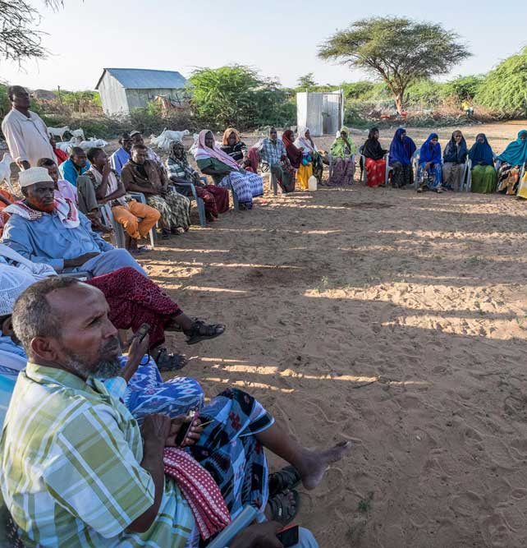
Bulshooyinka Martida loo yahay
Dadweynaha aan barakacayaasha ahayn ee ku nool meel u dhow barakacayaasha
Barakacayaasha waxaa badanaa lagu marti galiyaa meelaha liita islamarkaana la takooro ee saxmadooda badan tahay /ciriiriga ah
Saameynta togan iyo tan taban ee barakaca, dib u dejinta, ama Soo kabsiga dhaqaalaha, deegaanka, wadajirka bulshada, iyo helitaanka adeegyada bulshada ee dadka martida loo yahay waa in la tixgeliyaa.
Notes:
Somali refugees return to Somalia from Kenya – a short flight, but for many a journey of a lifetime. © UNHCR/A.Nasrullah
Quaraysh returned to her home country Somalia after fighting started in Yemen. Her return was made possible by the Danish Refugee Council supported by the European Commission. © DRC/Jennifer Harrison

Slide 10
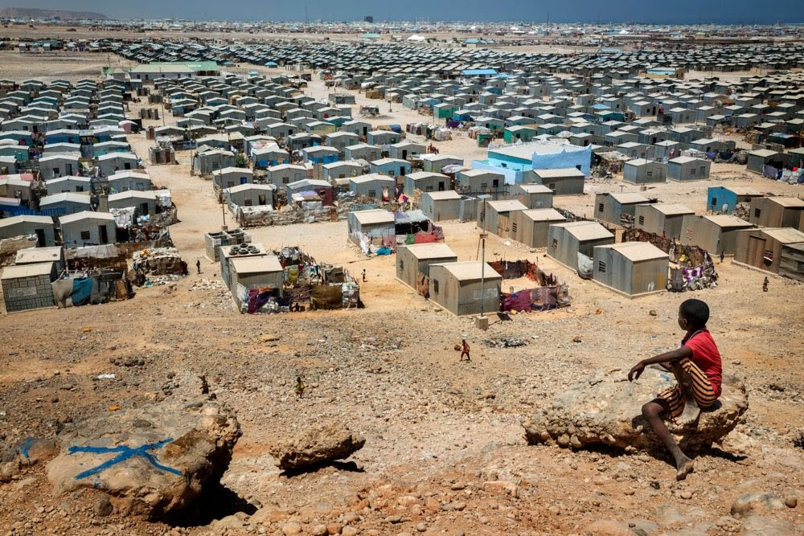
Saameynta barakaca ku yeesho bulshada
Qulqulka dadka
Waxqabadyada bani'aadamnimada
Helitaanka Kheyraadka oo is-beddela
Kororka / hoos u dhaca qiimaha
Dhaqdhaqayada isku dhaca qabaailada
Tartanka baahiyaha
Dareen amni daro / hanjabaad
Notes:
Activity 6: Potential activity in plenary: show the title of the slide first and ask the participants about the main impacts of displacement on host communities and on social cohesion. You can summarise the main points discussed as bullet points on a flip chart paper.
Only show the content of the slide after the discussion.

Slide 11
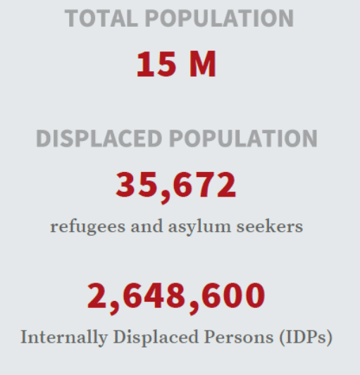
Bulshooyinka uu aafeeyey Barakaca ee dalka Soomaalia
Program sup8 criteria port and capacity development
Policy Dialogue
Notes:
Figure: UNHCR. January 2020.
Figures to be updated before each workshop.

Slide 12
Dhibaatooyinka la xiriira barakaca: xaqiiqooyinka iyo tirooyinka
“Barakacayaasha iyo dadka reer miyiga ah waxay leeyihiin heerarka ugu sarreeya ee saboolnimada lacageed”.
WB 2019.
«Waxaa jira hoos u dhac weyn oo ku yimaada heerka shaqo ee Barakacayaasha ka dib barakacooda sidoo kale wuxuu ku yimaadaa celcelis ahaan dakhliga bishii soo gala».IDMC. 2020
In ka badan seddex meelood meel ka mid ah bulshooyinka martida loo ahaa ee la wareystay ayaa sheegay inay yaraadeen helitaanka daryeelka caafimaad iyo inay sii xumaatay aragtidooda caafimaad ee jir iyo maskaxeed tan iyo markii ay yimaadeen barakacayaasha deegaanka. Tani waxay u badan tahay inay xiriir la leedahay buux-dhaafka xarumaha caafimaadka ». IDMC. 2020
«Ka-soocida, Astaan saboolnimo ayaa saameeyn ba’an ku yeelataa seddex kooxood marka laga hadlayo ka-qaybgalka dhaqaalaha: haweenka, barakacayaasha iyo dhalinyarada». WB. 2019
“Fursadaha dhaqaale waxaa lagu soo warramey inay ku kala duwan yihiin bulshada martida loo yahay iyo bulshada Barakacayaasha».IDMC 2020.
Sanadkii 2020, 65% qoysaska dib u soo laabtay waxay soo sheegeen in ilaha dhaqaalahoodu uusan ku filneyn inay daboolaan baahida qoyska. Saameynta dhibaatada caabuqa COVID-19 ee sanadkii 2020 waxay saameyn xoogan ku yeelatay fursadaha habnololeed ee dadka dalka dib ugu soo laabanaya ”. UNHCR 2020
Notes:
Source of these quotes: Somalia National Durable Solutions Strategy and UNHCR

Slide 13
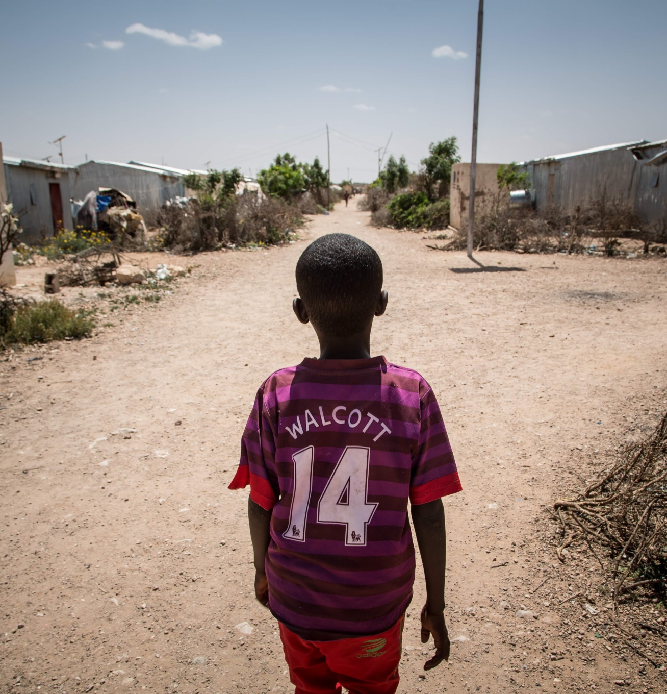
Howl:
5 koox: Barakacayaal, qaxooti, qaxooti soo laabtay, barakacayaasha soo laabtay iyo bulshada martida loo yahay.
Maxay yihiin sababaha ugu waawayn ee barakiciya qaybahaan barakacayaasha ah (marka laga reebo bulshooyinka martida loo yahay)
Maxay yihiin arrimaha ugu waaweyn ee la xiriira barakaca ee soo food saara xubin kasta oo ka mid ah Bulshooyinka uu Saameeyey Barakaca ee Soomaaliya / degaanka maxalliga ah?
Notes:
Activity 2:
Form 4 groups corresponding to the four components of the DAC: IDPs, refugees, refugee returnees and host communities.
Based on the context, ask the participants to answer these two main questions:
What are the main causes of displacement of these categories of displaced (apart from the host communities)?
What are the main displacement related issues faced by each member of the Displacement Affected Communities in Somalia/the local area?
Give the groups 15 to 20 minutes to complete the exercise.
Ask them to feedback – 3 minutes for each group.
Gather their answer on a flip chart paper
At the end show that some issues are common to all DAC members and that some are specific to IDPs, refugees or returnees. All these issues should be taken into account in the search for durable solutions.
bgb g b

Slide 14
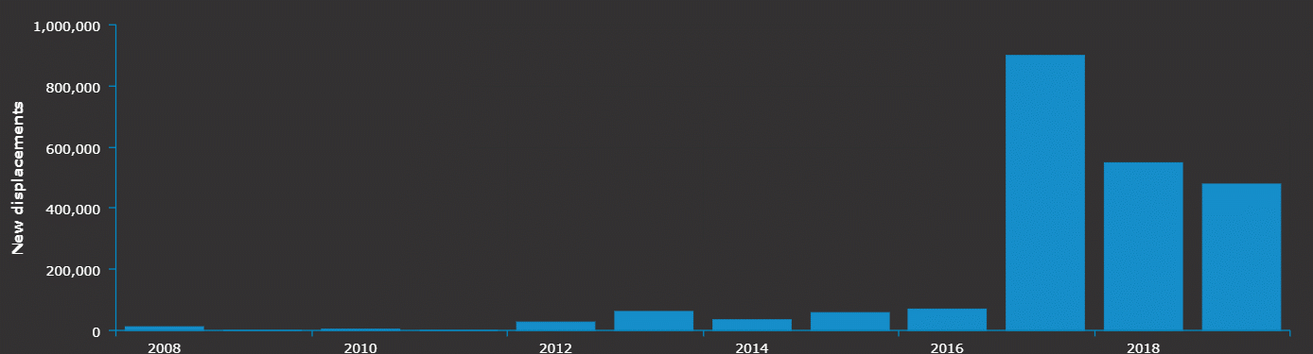
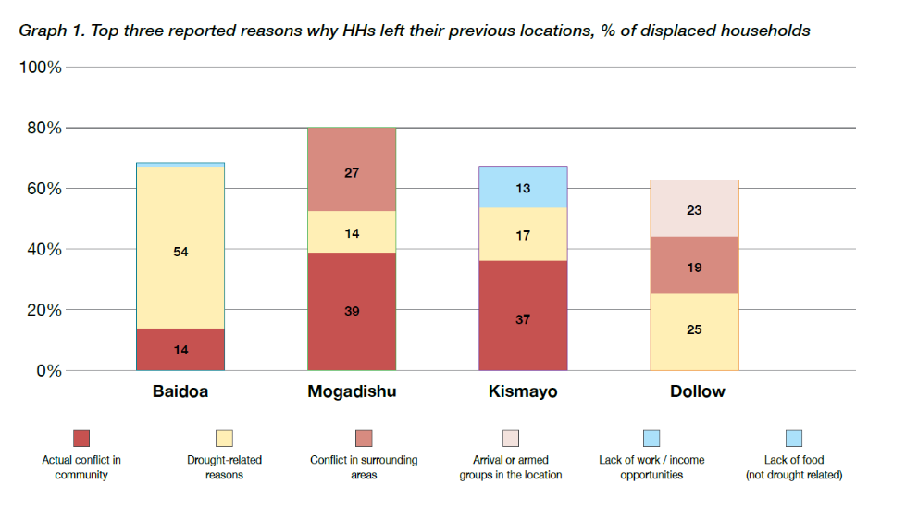
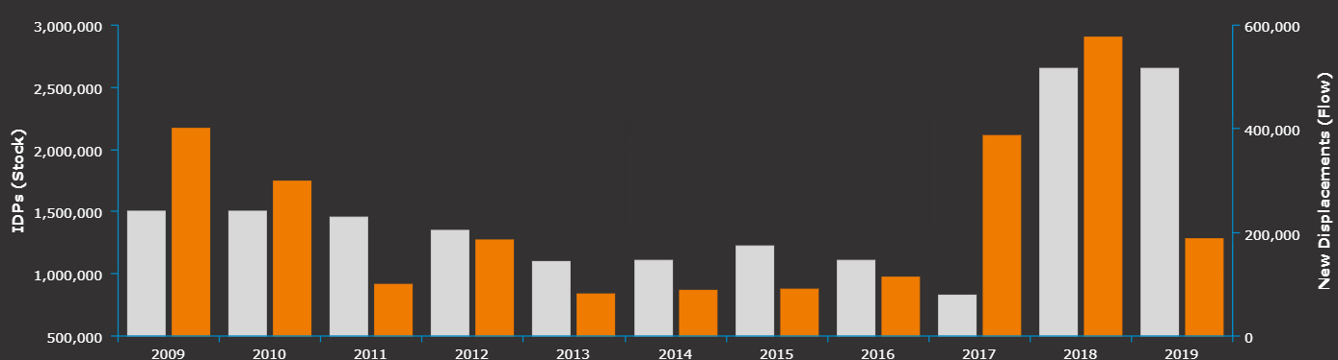
Xoga Xog ah oo ku saabsan sababaha barakaca gudaha ee Soomaaliya
Barakac Gudaha ah oo Cusub oo ay sababtay masiibo – IDMC.
Barakac Gudaha ah oo cusub oo daba dheeraaday oo uu sababay isku-dhac - IDMC
Xog uruurinti higsiga sanadka 2020 - ReDSS

Slide 15
Hababka Bulshooyinka uu saameeyay Barakaca: waa qaab dhammaystiran
“Waxqabadyadu waa inay wax ka qabtaan baahiyaha iyo nuglaanta dhamaan “ bulshooyinka uu barokaca saameeyey”oo ay ku jiraan barakacayaasha, dadka soo laabtay iyo bulshooyinka martida loo yahay si ay awood ugu yeeshaan dib-u-heshiisiin, ka fogaadaan abuurista xiisadaha una suurtageliyaan wada-jirka xubnaha bulshada »Istaraatiijiyadda Xalalka Waara ee Qaranka

Slide 16

Fariimaha muhimka ah
Barakacu wuxuu saameyn ku yeeshaa nolosha dadka lagu qasbay inay ka baxaan guryahooda sababo la xiriira isku dhac, rabshado cadaadis ah, isbeddelka cimilada ama musiibooyin, oo u dhaco siyaabo badan
Barakacayaasha, qaxootiga iyo dadka soo laabtay waxay la kulmaan arrimo gaar u ah barakaca oo u baahan in tixgelin la siiyo
Barakaca sidoo kale saameyn ayuu ku leeyahay bulshada martida loo yahay. Deegaanka martida loo yahay ee siyaasadeed, dhaqan iyo dhaqan-dhaqaale waa in lagu xisaabtamo marka la isku dayayo in xal loo helo barakaca
Qaadashada hab guud oo ay kujiraan dhammaan Bulshooyinka uu sameeyey Barakaca ayaa fure u ah raadinta xalalka waara ee barakaca.
Notes:
His is a definition developed by World Vision.

