Slide 1
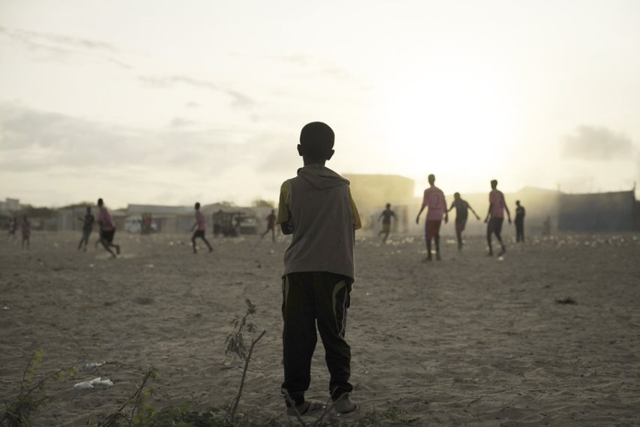
Xal waara uraadinta Bulshooyinka uu saameyey Barakaca ee Soomaaliya

Slide 2
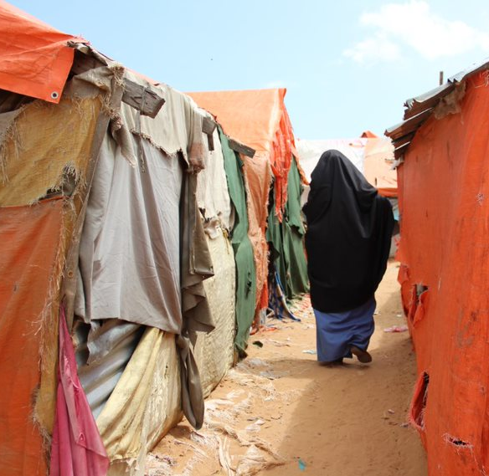
Kulanka 2aad: Maxaan uga jeednaa Xalalka Waara?

Slide 3
Ujeedooyinka Kulanka
Program sup8 criteria port and capacity development
Dhamaadka kulankan waxaad awoodi doontaa inaad:
Sharaxdo Xalalka waara
Sharaxdo qaybaha ugu muhiimsan, cabirrada iyo dhawrista geedi socodka xalalka waara
Soo bandhigto xalal waara oo ah geeddi-socodka muddada-dheer oo ka kooban ururo hawlwadeeno oo ballaaran ee dhinaca hawlaha bani'aadamnimo, horumarineed, iyo nabad-dhisida
Si fiican u aqoonsato xalalka waara ee ku jira nidaamka gargaarka.
Policy Dialogue

Slide 4

Goorma xalalka waara la gaaraa?
Program sup8 criteria port and capacity development
Policy Dialogue
Qiyaastaada!

Slide 5
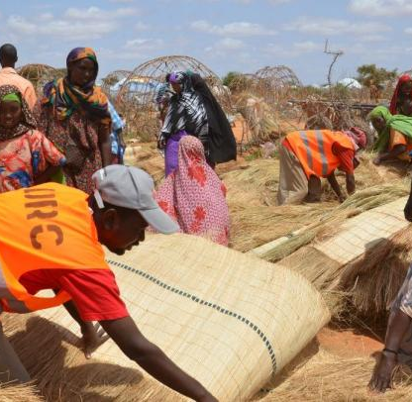
Hawl: xaashiyo yaryar
Qaybaha xaashida dib ugu celi si sax ah si aad u hesho qeexida xalalka waara
Notes:
Activity 1: This is a group activity. The goal is for each group to try and put the small papers back in the right order to unveil the durable solutions definition.
Distribute the small papers (document entitled Activity 1. DS definition) in an envelop. One envelop per group and ask them to wait until the official GO to open it and start.
The first group who finds the right definition wins.

Slide 6
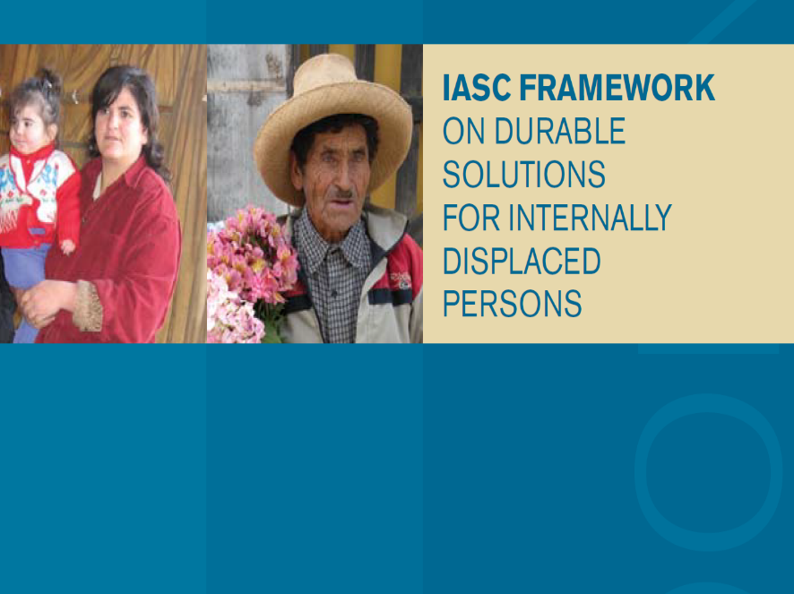

Qeexida Xalalka Waara
Xalal waara ayaa la gaaraa marka dadka soo barakacay
Ayna haysan difaac iyo baahiyaha gargaar ee la xiriira barakacooda
Ay helaan xuquuqdooda iyadoon lagu takoorin waxyaabo la xariira barakacooda
Notes:
Show the IASC framework on Durable Solution and explain that the definition of durable solutions developed for IDPs in 2010, as well as the operational framework attached to it has gradually been adopted for all displaced persons , including refugees and refugee returnees.
Tell the participants that this definition was adopted by the national authorities and that is sued as the DS definition in the national laws and policies on durable solutions and Refugee-returnees and IDPs ie. National Policy on the Refugee-Returnees and IDPs, the National Durable Solutions Strategy etc.
Ask the participants about their comments/feedback on this definition.

Slide 7

Qeexida xalalka waara: faallooyin iyo jawaab celinta
Qeexid ku saleysan xuquuq
Diiradda saareysaa baahiyaha gargaar iyo difaaca la xiriira barakaca
Kala sooc la'aanta u dhaxeysa barakacayaasha iyo dadka aan barakacin
Program sup8 criteria port and capacity development
Policy Dialogue
Notes:
At the end of the discussion, show the three main messages that we want to pass at this stage and ask the participants to formally adopt this definition through:
An informal poll: ask those in favour of adopting it to rise their hand or stand up;
Ask whether there are major opposition to the adoption of the definition:
Officially declaring that this definition will be ours until the rest of the training and in the coming years !

Slide 8
Saddexda dariiq ee loo maro Xalalka Waara:
Dib u dhexgal waara oo ka dhaca meesha / wadanka asalka ah
Dib-u-dhexgal waara oo ka dhaca aagagga / waddamada ay barokacayaasha magangelyo ka helaan
Dib-u-dhexgal waara oo laga helo qayb kale oo dalka ka mid ah iyadoo lagu saleynayo xulashadooda ama waddan kale
Isdhexgalka Maxali ah
B. Dib u dejin
C. Dib ugu noqosho dalki hooyo ama dib u celin oo ikhtiyaari ah
Notes:
Activity 2: Mix and match. In plenary, ask the participants to match each route and its description. It should not last more than one minute.
Results (animation)
1- C
2- A
3 - B
Key messages:
-There are 3 equally valid “settlement options”. These 3 settlement options are NOT by themselves THE durable solutions.
- They all aim at achieving integration.

Slide 9
Hadafka kama dambeyska ah ayaa ah:
Dib ugu noqosho dalki hooyo ama dib u celin oo ikhtiyaari ah
Isdhexgalka Maxaliga ah
Dib u dejin
Isdhexgal waara (dib)
Notes:
Key messages:
-There are 3 equally valid “settlement options”. These 3 settlement options are NOT by themselves THE durable solutions.
- They all aim at achieving integration.

Slide 10
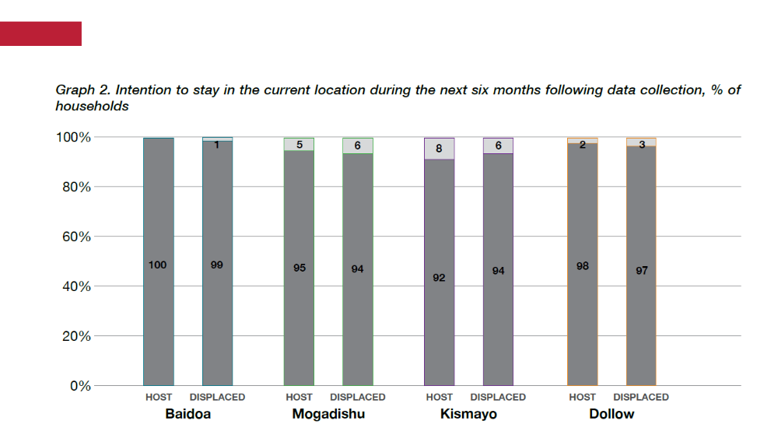
Kala sarreyn malaha!
Ma jiro kala-sarrayn ka mid ah dariiqooyinka / xulashooyinka xalka waara
Go'aanka waxaa lagu gaarayaa iyadoo lagu saleynayo xaaladda dadka soo barakacay iyo xaaladda dhabta ah ee jirta
Xaalad kasta waa in si keli kali ah wax looga qabtaa, oo xalalka la heli kara oo dhan si siman loo baaraa.
Sahanka Himilada ReDSS. 2020

Slide 11
HAWL: Aqoonso ilaalada iyo mabaadi'da muhiimka ah ee ay tahay inay xukumaan:
Dib ugu noqosho dalki hooyo ama dib u celin oo ikhtiyaari ah
Isdhexgalka Maxaliga ah
Dib u dejin
Notes:
Optional (15 minutes – 10 minutes debriefing) Based on the timing, the target audiance and objectives of the training workshop, you can opt for this activity of the following one (slide 14), or both of them.

Slide 12
Saddex mabda 'oo muhiim ah oo xukuma geedi socodka xalka waara
Ikhtiyaari
Go'aan qaadasho ka baaran deg leh
Badbaado
Jir ahaan muuqda
Waxyaabo
Sharaf
Soocelin shuruud la’aan ah majirto
Iyagoo ku socda xawaarahooda
Xorriyad dhaqdhaqaaq
Sharci `
Mamnuuca dib u celinta xooga ah
Majiro Kala geyn qoysas
Jaha wareeris malaha
Mabda '4aad ee Siyaasadda Qaranka ee Qaxootiga-soo-laabtayaasha iyo Barakacayaasha - FGS
Qaab dhismeedka qaran
Notes:
Activity 3: The routes and their safeguards: you can do it either as a group or a plenary activity depending on your objectives and timing.
The main goal of this activity is for the participants to try and find some of the safeguards or principles that should be guiding the choice of a route for durable solutions.
- If you opt for a group work let the group work for about 10 minutes and conduct the debriefing in plenary asking each group for 4 principles or safeguards. Write them down of a flip chart before showing the following slide.
- In plenary, ask the participant to think about safeguards individually for two minutes and lead the debriefing in plenary, writing down their answers on a flip chart before showing the following slide.
Key messages:
. -Voluntariness implies that the displaced persons freely decides to go back home, in the absence of any physical, psychological, or material coercion.
-Safety includes three dimensions:
o Physical safety (e.g. freedom from risk of persecution, unlawful detention, discriminatory treatment and sexual violence and other forms of exploitation);
o Legal safety (e.g. legal systems are in place to deliver justice, and there are no legal barriers preventing people from returning to and reintegrating in their countries);
o Material safety (e.g. returnees have access to a means of livelihood and basic services, such as potable water, sanitation facilities, health care and education).
-Dignity implies that the human rights of the individual are respected all the time, including the right to life, liberty, freedom of movement, and the unity of the family

Slide 13
Sideen u qiimeyn karnaa xalalka waara?
Program sup8 criteria port and capacity development
Policy Dialogue
Qiyaastaada!
Notes:
Alternative question: how do we know that Durable Solutions are achieved?

Slide 14
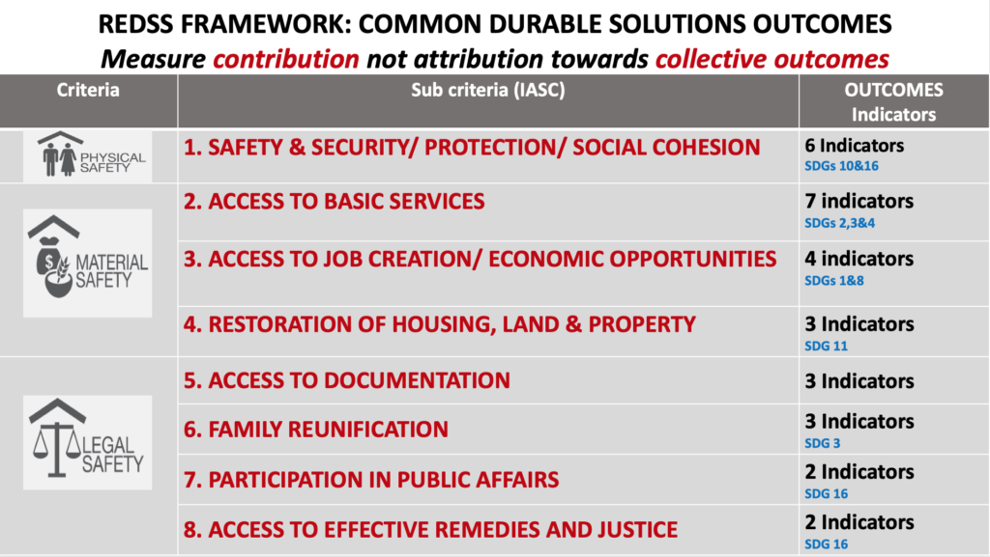
Saddexda Waji ee ugu waaweyn ee Xalalka Waara
Notes:
Activity 4: Potential group activity if you have time: world café (15 minutes – 10 minutes for the debreifing). Put a paper tablecloth or two flip chart papers on three tables. Assign one type of safety to each table and wight it on the tablecloth or paper. Assign one « barman/woman » for each table? Their role will be to stay at the table and moderate the table activities. The other participants can move from one table to another and write down what legal, physical and material safety means for displaced persons in Somalia/the location. The barman/bar woman will do the debriefing after the activity.

Slide 15
Shuruudaha xalalka waara - IASC
8 Shuruudood
Badbaado iyo amni muddo-dheer jira
Heer nololeed ku filan
Helitaanka habnololeed iyo shaqo
Helitaanka saxida qaladka iyo caddaalad
Nidaam la heli karo oo loogu talagalay dib u soo celinta Dhulka guriyeynta iyo Hantida
Diiwaangelinta shaqsiyeed iyo kuwo kale
Mideynta qoyska
Ka qayb qaadashada arrimaha bulshada
Program sup8 criteria port and capacity development
Policy Dialogue
Notes:
The conclusion of the previous activity is the 8 IASC criteria.
Introduce them as the main general benchmarks used to measure the progression toward durable solutions. Tell the participants that we will work in depth on these criteria later on.
For the time being ask the participants in plenary to put each criteria under the right safety before showing the following slide.

Slide 16
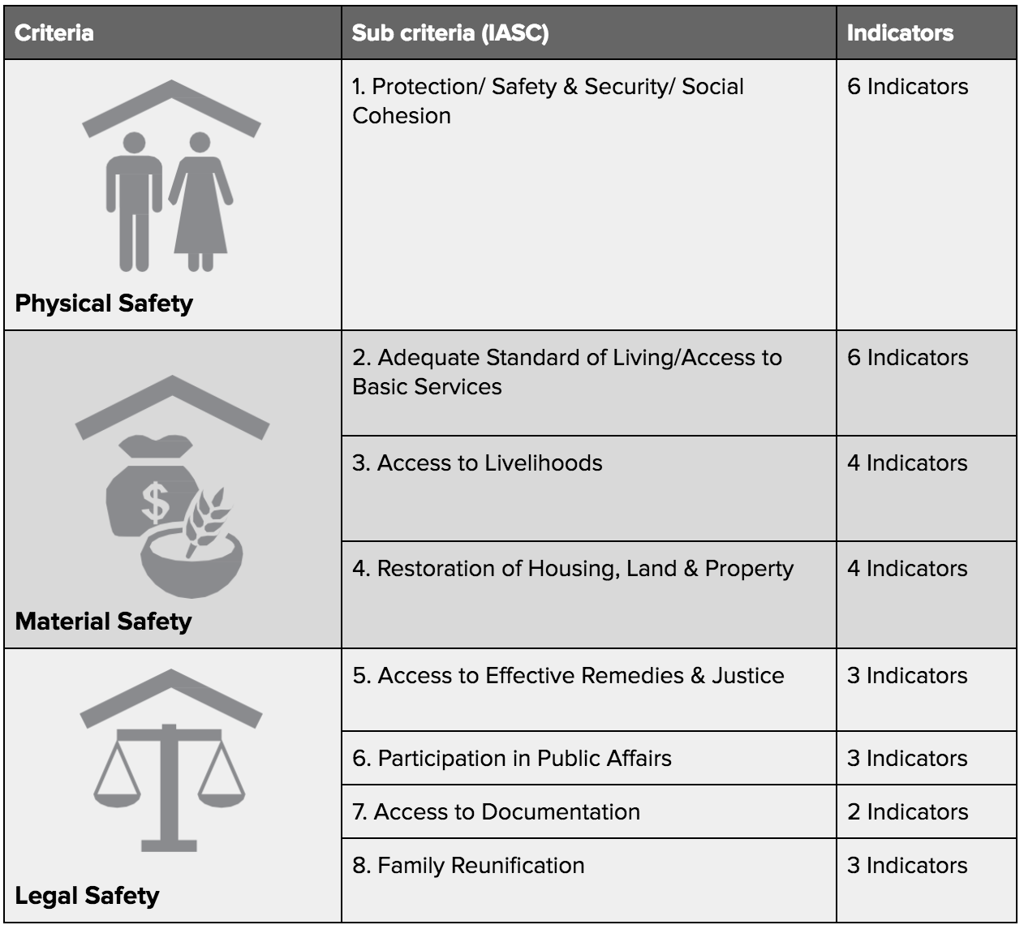
Qaab dhismeedka IASC
Notes:
You can make the framewok even more visible by sticking the three legal safety and corresponding criteria on the wall (using carton papers) and leaving it there throughout the workshop.

Slide 17
Dabeecaddaha Xalalka Waara
Horumar
Nabad-dhisid
Xalalka Waara
bani'aadamnimo,
Barakaca waxaa sababa saboolnimo, isku dhacyo iyo aafooyin
Barakaca wuxuu abuuraa saboolnimo iyo isku dhacyo iman kara
Xalalka waara ayaa ku saabsan wax ka qabashada baahiyaha kala duwan ee dadka uu saameeyey barakac.
Wuxuu isticmaalaa shuruudo noocyo badan oo bulsho, dhaqaale, iyo jireed
Waa geedi socod hawl bani'aadamnimo, nabad-dhisid iyo horumar.
Geedi socodka loo wajahayo xalalka waara waa mid muddo dheer soconaya oo dhinacyo badan taabanaya.
Notes:
We saw that displacement was caused by both conflict and disasters. Conflicts and violence are often caused by long-term and deeply anchored governance, inequality and development issues. Disasters, especially climate change and climate change adaptation are also development issues and can also be divers for conflict and violence. Likewise displacement generates poverty and potential for violence and conflicts.

Slide 18
Laga soo bilaabo bilowgii dhibaatada ilaa xal waara laga gaaro
Horumar
Xasilooni
bani'aadamnimo
Soo Kabashada Hore
Xalalka Waara

Slide 19
Xalalka waara iyo adkeysiga
Xalka waara waa geeddi-socod ujeedkiisu yahay xoojinta adkeysiga bulshooyinka ay saameeyeen barakaca, gaar ahaan helitaankooda habnololeed waara, adeegyo, iyo hoy.
Dhibaatooyinka u gaarka ah barakaca iyo halista la xariira difaaca sida badbaadada jirka, helitaanka diiwaangalin, mideynta qoysaska ayaa aad ugu badan fikirka xalka waara iyo geedi socodka
Adkaysigu waa qaab looga dan leeyahay in lagu xoojiyo awoodda dadka, qoysaska, bulshooyinka, waddammada iyo nidaamyo lagu yareeyo, loola qabsado loogana soo kabsado naxdinta iyo walbahaarka aafooyinka ayadoo loo marayo qaab hoos u dhiga u nuglaanta joogtada ah islamarkaana sahla kobaca loo dhan yahay.

Slide 20
Xalalka waara iyo adkeysiga
Astaamaha lagu aqoonsado
Waxay yihiin habraacyo diiradda saaraya «sida loo sameeyo» bedalki la oran lahaa «Maxaa la sameeyaa».
Waa habab kala duwan / heerar kala duwan leh
Waxay uruuriyaan ururada hawlwadeenada horumarka iyo samafalka arrimaha bin’adanimo
Waxay diiradda saaraan natiijooyinka muddada-dheer iyo dhexalgalka waara
Laakin….
Barnaamijyada adkeysiga weli laguma darin bulshooyinka ay saameeyeen barakacyada oo waxay diiradda saarayaan aagaga miyiga ah: is-dhammaystirka?
Xalalka raaga waxay udub dhexaad ka dhigaan difaaca dadka soo barakacay (badbaadada iyo amniga, mideynta qoysaska, helitaanka diiwaangelin, iwm.)
Xalalka waara waxay gaar u yihiin barokac gaar ah oo waxay fiiro gaar ah siiyaan arrimaha iyo halista gaarka u ah barakaca.

Slide 21

Fariimaha Muhimka ah
Xalka waara wuxuu ku saabsan yahay helitaanka xuquuqaha iyo adeegyada ayadoon jirin wax takoorid ah oo ku saleysan barakaca.
Waxaa lagu fulin karaa dib u noqosho ikhtiyaari ah, isdhexgal maxalli ah, ama dib u dejin, iyadoo loo hoggaansamayo ilaalinno iyo mabaadi'da hageysa geeddi-socodka xalalka waara.
Habsocodyada xalalka waara waxay u horseedaan is-dhexgal waara ama dib-u-dhexgal oo hubineysa badbaado alaab, sharci iyo mid jireed;
Abuuritaanka jawi ku habboon gaaritaanka xalalka waara waa geeddi-socod bani'aadamnimo, horumar, iyo nabadeed.
Tani waa geedi socod muddo dheer, dhinacyo badan iyo qaybo badan leh
Xalalka waara iyo habab adkaysiga waa ay is-dhameystiraan
Notes:
Activity 6: Potential activity in plenary: show the title of the slide first and ask the participants about the main impacts of displacement on host communities and on social cohesion. You can summarise the main points discussed as bullet points on a flip chart paper.
Only show the content of the slide after the discussion.

