Slide 1
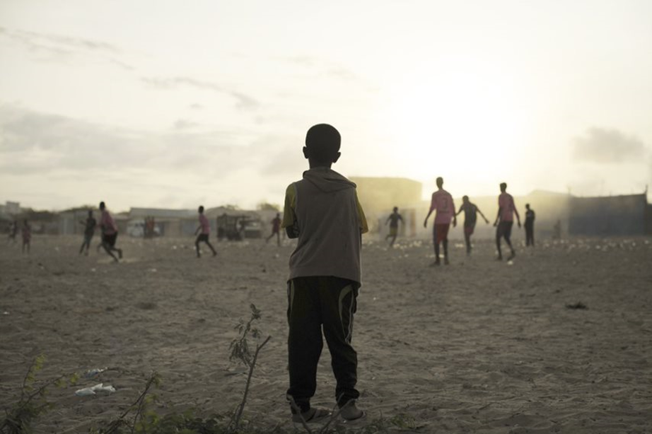
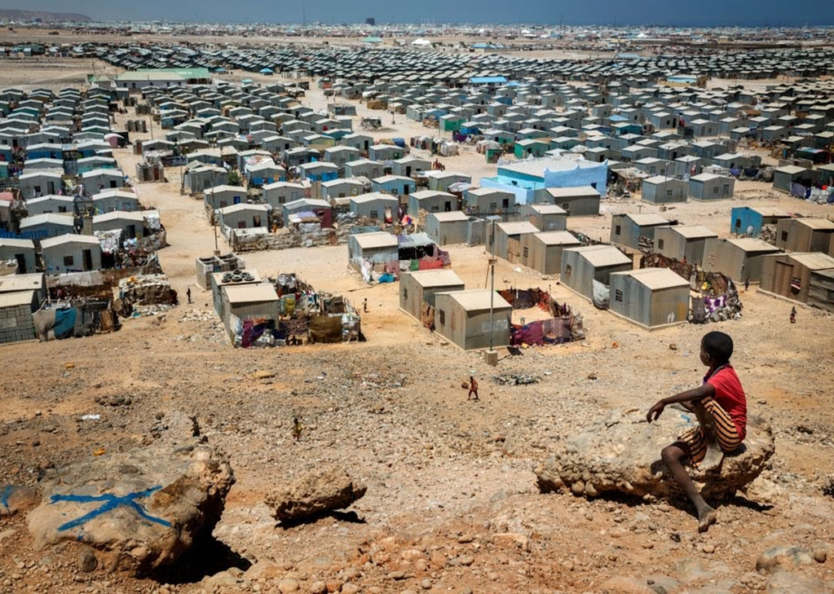
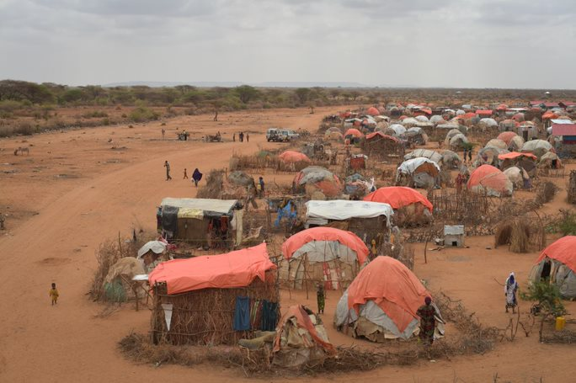
ReDSS durable solutions training of trainers workshop
Finding Durable Solutions for Displacement Affected Communities in Somalia

Slide 2
Session 3
What are the legal and policy frameworks underpinning durable solutions processes?

Slide 3
Objectives of Session
Adopt a right-based approach to durable solutions;
Present the main international frameworks, including human rights law, underpinning durable solutions;
Describe and use the national legal and policy framework governing durable solutions processes in Somalia
Align and draw a parallel between durable solutions and the Sustainable Development Goals and national development plans and engagements.

Slide 4


A Right-based approach
No longer have protection and assistance needs related to their displacement
Have access to their rights without discrimination
Policy Dialogue
Displaced persons are right holders
They must be aware of their rights
Their rights must be protected, fulfilled and respected.

Slide 5

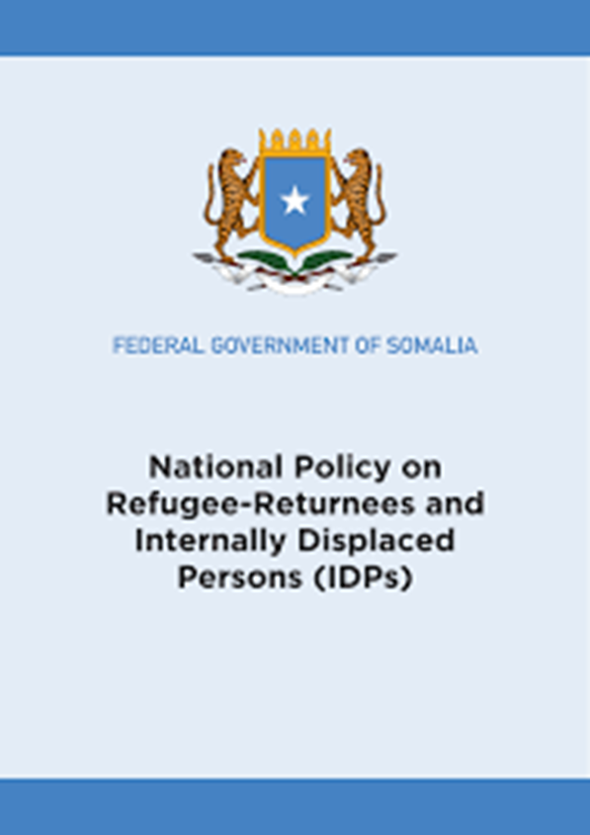
Human rights in Somalia frameworks
“The Constitution of the Federal Republic of Somalia promotes human rights, the rule of law, general standards of international law, justice (…)”
Policy Dialogue
“The major objective of this policy is to ensure that all refugee-returnees and IDPs enjoy full equality and obtain the same rights as those given to all citizens by the Somali National Constitution(…), as well as international humanitarian and human rights laws. Refugee-returnees and IDPs shall not be discriminated against in the exercise or enjoyment of any rights and freedoms”.

Slide 6
What are those rights that displaced persons should have access to without discrimination?
Criminal law
Human rights law
Program sup8 criteria port and capacity development
Durable solutions
Policy Dialogue
Humanitarian law
Refugee law

Slide 7



Focus on International Human Rights Law
Program sup8 criteria port and capacity development
Human Rights
Right holders
Duty bearers
The rights that a person has by the fact of being human: everybody without discrimination !
Policy Dialogue

Slide 8
Non discrimination at the heart of human rights
“The principle of non-discrimination seeks to guarantee that human rights are exercised without discrimination of any kind based on race, colour, sex, language, religion, political or other opinion, national or social origin, property, birth or other status such as disability, age, marital and family status, sexual orientation and gender identity, health status, place of residence, economic and social situation”.
Program sup8 criteria port and capacity development
Policy Dialogue
Any discrimination in access to rights for IDPs or other part of the somali population?
Notes:
Source of the quote: Committee on Economic, Social and Cultural Rights, General Comment No. 20, Non-discrimination in economic, social and cultural rights; 2009

Slide 9
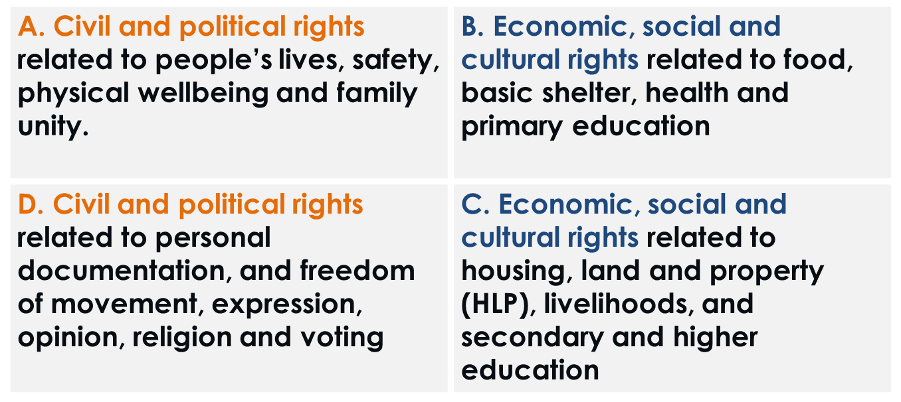
What human rights are we talking about?
Notes:
You can engage a short discussion on the relevant human rights that we are talking about and write them down on a flip chart are the participant mention them.

Slide 10
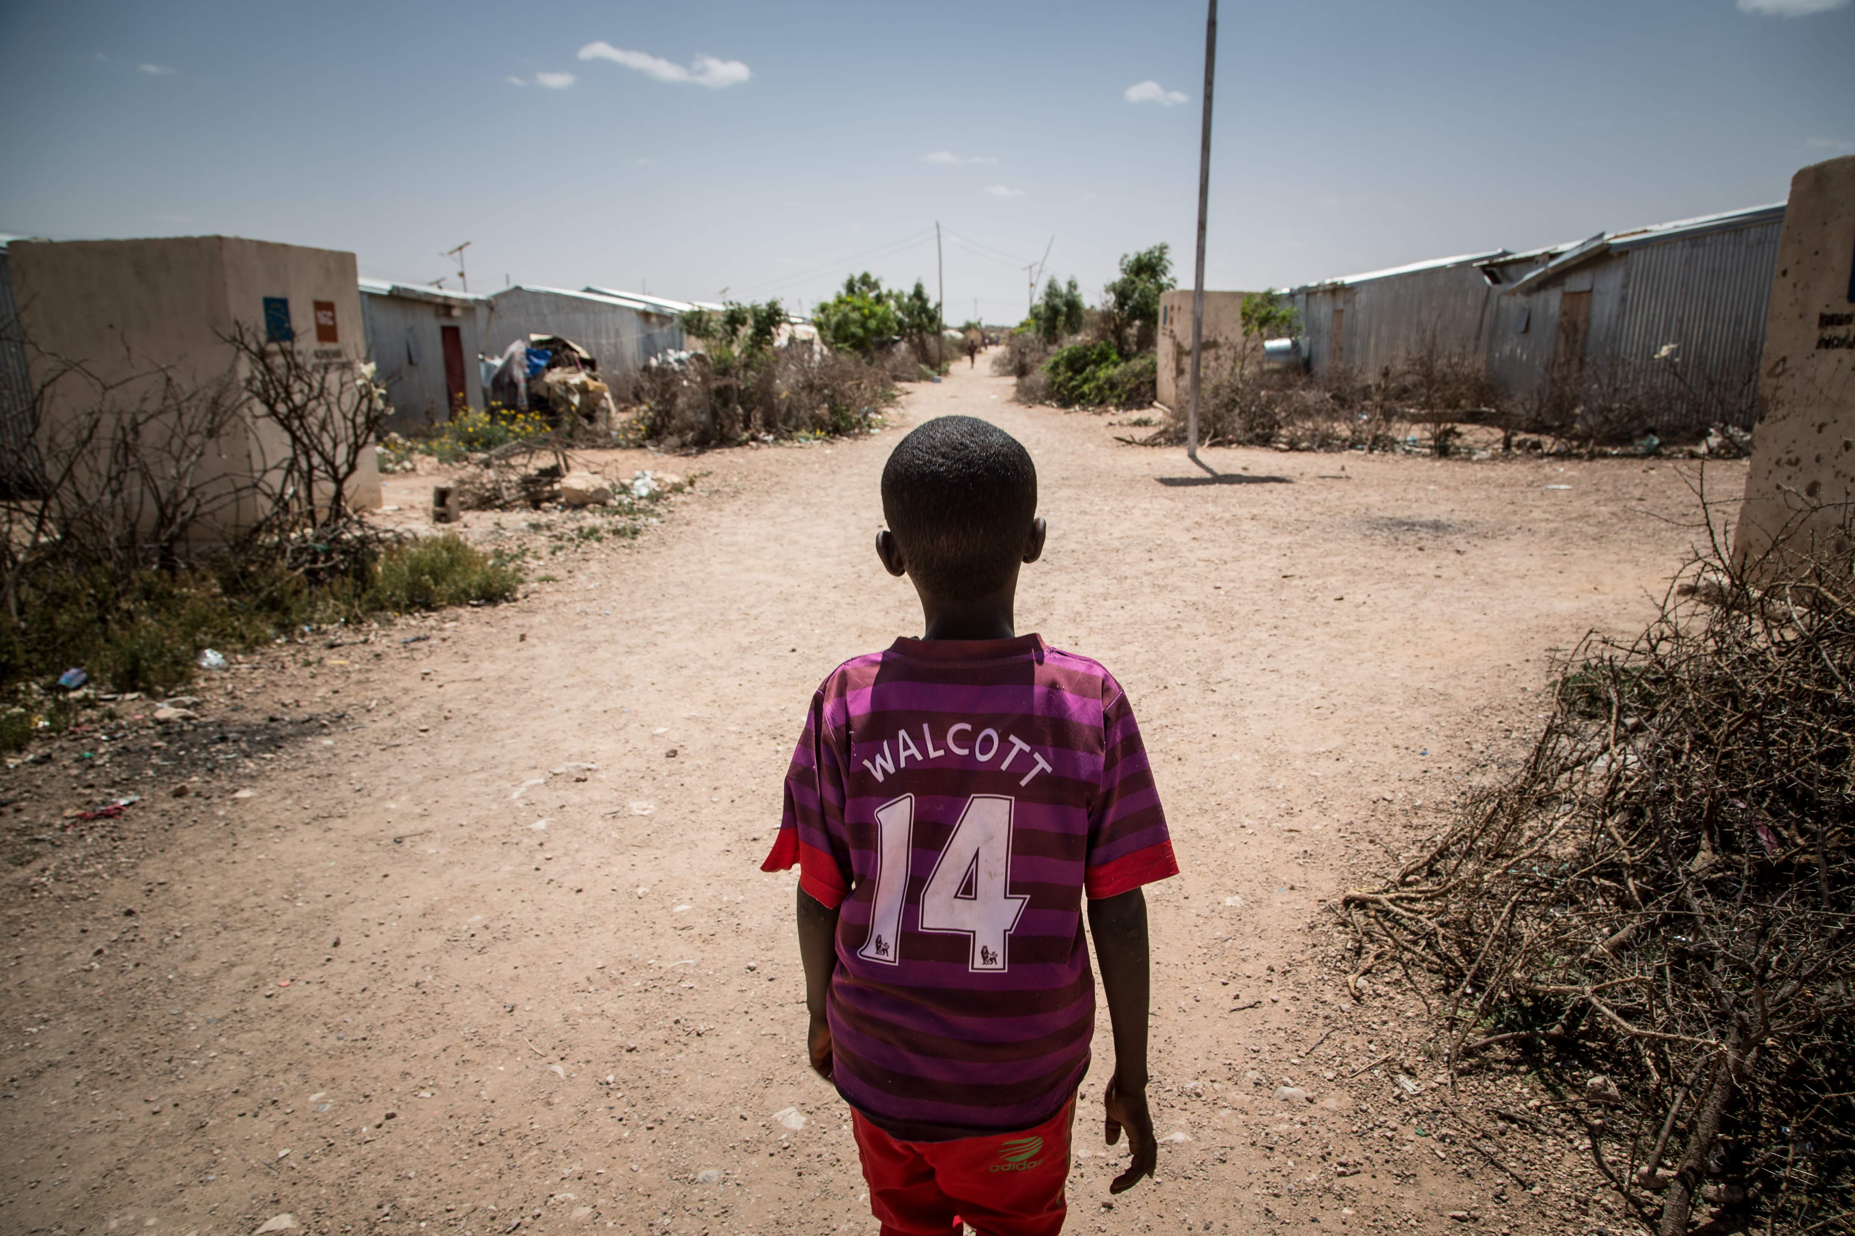
Activity
Displacement specific legal frameworks.
Make each treaty match its description

Slide 11
Displacement specific International frameworks in Somalia
Geneva Convention
Ratified in 1978
OAU Convention ratified in 1978
Kampala Convention ratified in 2019
Program sup8 criteria port and capacity development
Policy Dialogue

Slide 12
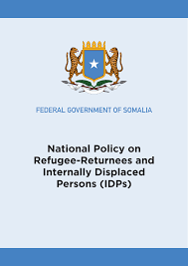
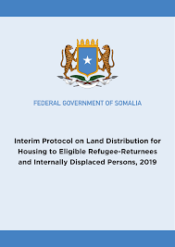

National frameworks on displacement and durable solutions
Program sup8 criteria port and capacity development
National DS strategy to be added
Notes:
Following its commitment, the Federal Government of Somalia has developed legislation. These include the National Policy on Refugee-Returnees and IDPs, the Interim Protocol on Land Distribution for Housing to Eligible Refugee-Returnees and IDPs, the national eviction guidelines and the IDPs and Refugee Act, which are in the final stages of enactment.

Slide 13
Durable Solutions: a roadmap towards ending displacement
Long-term safety and security and freedom of movement
Adequate standard of living: shelter, housing and basic services
Restoration of and access to Land, Housing and Property
Re-establishment of livelihoods and employment
Access to issuance or replacement of personal documentation
Promote and facilitate voluntary reunification of separated families
Participation in public affairs
Access to effective remedies and justice procedures
Stangards and Processes:
IASC definition, principles and framework
Conditions and support measures

Slide 14

Somalia development engagements
Notes:
You can show this slide during the activity if you don’t want to print the SDGs.

Slide 15
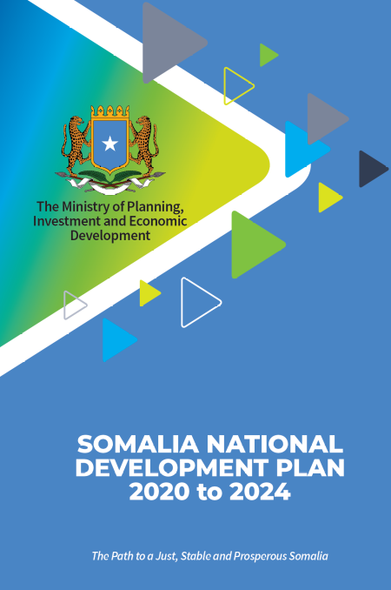
National Development Plan
NDP- 9 pillars
Inclusive and accountable politics
Improved security and rule of law
Inclusive economic growth
Impoved social development
Durable solutions is a cross cutting policy integrated in each of the pillar.

Slide 16
National Durable Solutions Strategy
Legal framework and vision
Durable Solutions Secretariat
Principles
Strategic priorities and priorities
Partnership, leadership and coordination
Monitoring and evaluation
Action Plan
To operationalize the National Policy and the National Development Plan - 9

Slide 17

National Durable Solutions Strategy: objectives
5 strategic objectives
To ensure equitable access to public services
To support the participation of DAC in peace and state building and access to legal identity
To enhance access to sustainable livelihood and employment for DACS and address obstacles to self-reliance
Ensure access to justice and rule of law, including access to documentation
Invest in long-term solutions and measures to prevent displacements caused by floods.

Slide 18
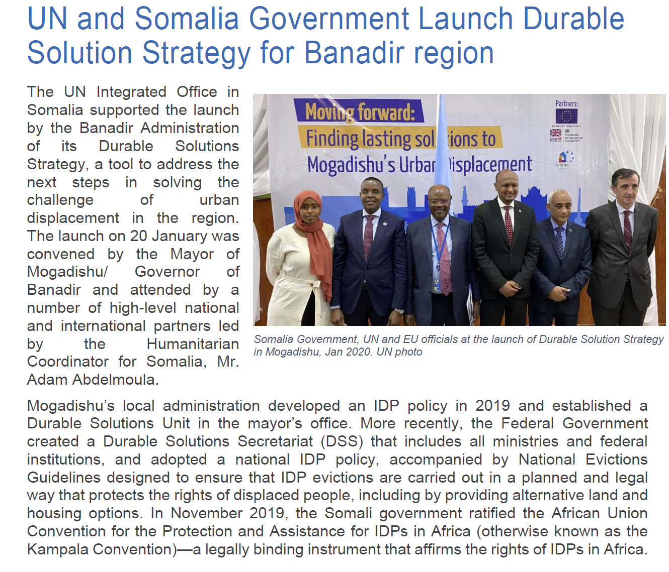
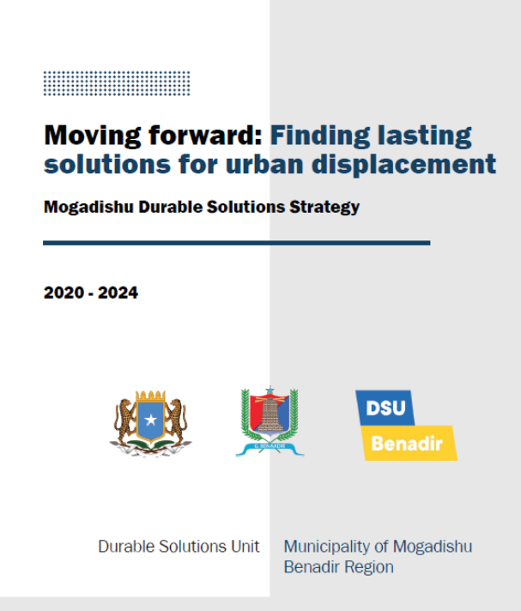
Local Durable Solutions strategies

Slide 19
Activity
For each of the 8 criteria identify:
  The corresponding human right(s)
  The corresponding SDG
  The corresponding National Development Plan Pillar
  The corresponding priority in the National Durable Solutions Strategy

Slide 20

Key messages
Displacement Affected Communities are right holders and the search for durable solutions is based on human rights, equality and non-discrimination principles.
Somalia’s Constitution protects and promotes to human rights and Somalia is a party to most of the international human rights instruments and has ratified the key displacement specific international frameworks.
Somalia has incorporated displacement specific frameworks and durable solutions provisions into its own legal instruments through policies, laws and strategies.
Durable solutions are integrated into Somalia National Development Plans.
Implementation of such instrument is key in the progression toward durable solutions for DACs.

