Slide 1
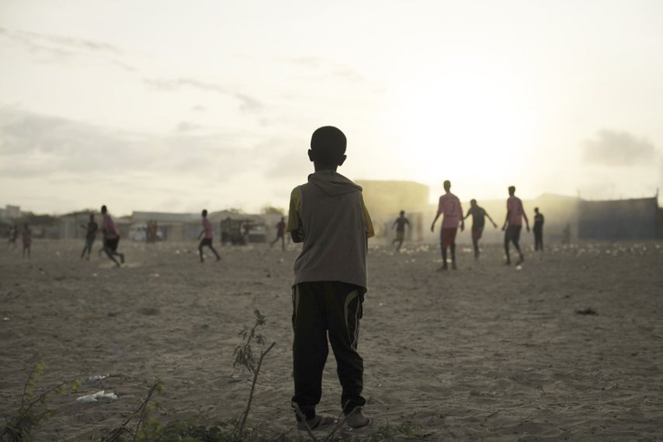
Xal waara in loo raadiyo bulshada uu sameeyey Barakaca ee Soomaaliya

Slide 2
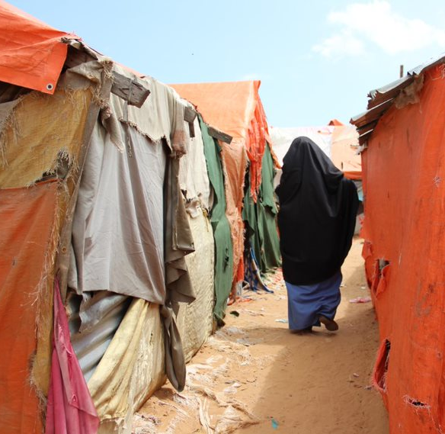
Kulanka 4aad: Maxay yihiin mabaadi'da iyo halbeegyada xukuma habraacyada geedi-socodka Xalalka waara ?

Slide 3
Ujeedooyinka Kulanka
Dhamaadka kulankaan waxaad awoodi doontaa inaad:
Ku dabakhdo mabaadi'da muhiimka ah ee hagaya geeddi-socodka xalalka waara iyo barnaamijyada ka socda Soomaaliya;
Sharaxdo 8da shuruudood ee la sameeyay si loo cabiro heerka horumarka loo qaadayo dhinaca xalalka waara
U adeegso 8da shuruudood inaad kubilaawdo fekerka ku saabsan caqabadaha ugu waaweyn ee hortaagan xalalka waara ee Soomaaliya / goobaha Soomaaliya.
Program sup8 criteria port and capacity development
Policy Dialogue

Slide 4
Mabaadi'da Barnaamijyada Xalalka Waara
Ay hogaamiso Dowlada
Laga wada qayb qaadanayo
Dhamaystiran
Ku saleysan Aago
Ku saleysan xuquuda iyo baahida
Wadajir ah iskuna dhafan
Sanado badan socda
Jinsiga / da'da / naafanimada iyo dadka in laga tirada badan yahay ee xasaasiga ah
Waara
Notes:
Activity: Ask the participants to work in pairs. Assign a principle to each pair and ask them to write down what it means for them and to think about an example illustrating it for 5 minutes. Distribute the handout on principles and do the debriefing, pair after pair asking each pair about their thoughts and potentially reading the description of each principle from the handout.

Slide 5

Shuruudaha Xalalka waara
Badbaado iyo amni muddo dheer jira iyo xorriyadda dhaqdhaqaaqa
Heer nololeed oo ku filan: hoyga, guriyeynta iyo adeegyada aasaasiga ah
Dib u soo celinta iyo marin u helka Dhul, Guriyeyn iyo Hanti
Dib-u-aasaasida habnololeedyada iyo shaqaalaynta
Marin uhelida bixinta ama beddelka diiwaangelinta shaqsiyadeed
Dhiirrigelinta iyo fududeynta isu-keenidda qoysaska kala tagay ee iskaaga ah
Ka qayb qaadashada arrimaha bulshada
Helitaanka saxitaan wax ku ool ah iyo nidaamyada caddaaladda
Takoor la'aan. Isbarbardhiga muwaadiniinta kale

Slide 6
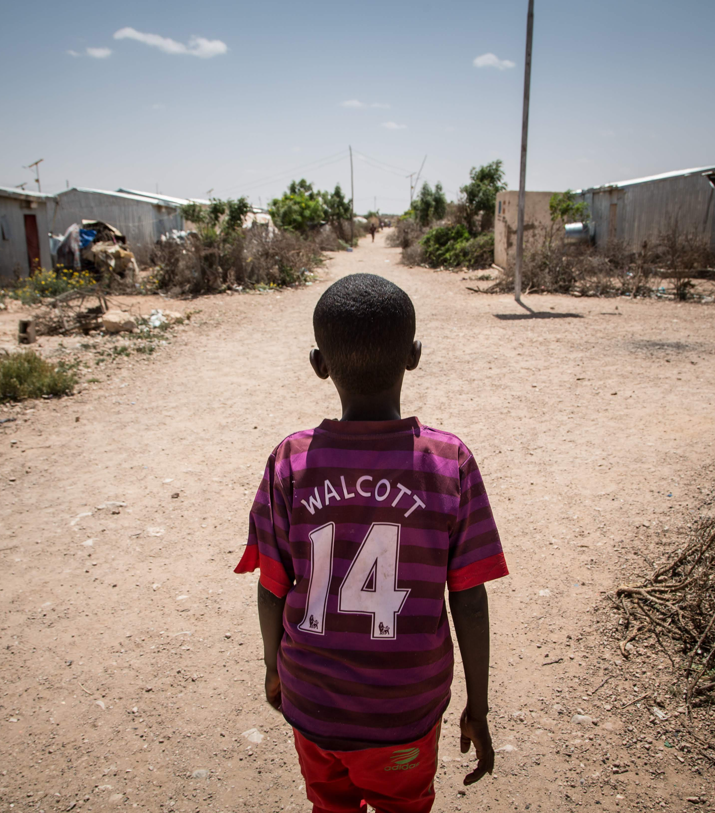
Activity: First national/local analysis
The 8 criteria in practice: the Somalia/local context
Notes:
Optional.

Slide 7
Howl: Shaxda Ku Celiska
Shuruuda | Qaxooti Soo laabte Bulshada martida loo yahay waa inay heli karaan…. kala sooc la'aan ku saleysan barakacooda/ barakaca. | Caqabada ugu weyn ee hortaagan ka mira dhalinta shuruudaha Soomaaliya / meesha aad joogto | Main actors concerned Ururada muhimka ahaa, wait their hots
 |  | Logu talagalay Barakacayaasha, soo noqday Bulshooyinka martida loo yahay
Program sup8 criteria port and capacity development
Policy Dialogue
Notes:
Activity 2: assign a criterion to each group (potentially two depending on the number of participants/groups and ask each group to:
- Explain in plain language what their criteria is about and to formulate it this way: Displacement affected communities should have access to (the criteria and its explanation) without discrimination due to their displacement;
- Identify what are the main obstacle to the achievement of this right for refugee-returnees/IDPs and potentially host communities.
- Start identifying the main actors that should be in charge of ensuring that these rights are accessed by DACS.
They can use the table template to list their response.
Timing of the activity: between 40 to 50 minutes for the group work and about 14 minutes for the debriefing.

Slide 8

5 minutes per group
4 daqiiqo kooxd kasta.
MAYA

Slide 9

Firkadaha
Mabaadi'da Barnaamijyada Xalka Waara waa inay hagaan hababka xalalka waara
Xalalka waara waxaa lagu gaaraa marka Bulshooyinka uu saameyey barakaca ay helaan xuquuqdooda iyo adeegyada la xiriira iyadoo aan loo kala eexanayn ayadoo lagu saleynayo barakacooda ama qaxitaankooda. Haddaba xaaladdooda waa in lala barbardhigaa xaaladda dadka intiisa kale / bulshada martida loo yahay.
Qiimeyntan iyo isbarbar dhiga waxaa lagu sameyn karaa iyadoo la adeegsanayo 8da shuruudood oo ah oo si guud in loo wacayo

