Slide 1





Samee ama isticmaal farsamooyinka isuduwidda jirta
Qiimaynta iyo cabirka xal waara
Ku lug lahaanshaha DAC iyada oo loo marayo qorsheynta ku saleysan Bulshada
Ansixinta qaab deegaan ku saleysan
Xal waara.Sidee u sameynaa
Ansixinta qaab hawleedyo badan iyo daneeyayaal badan
Notes:
Boggan waa soo koobistii waxqabadkii/shaqadii 3

Slide 2

1
Habka ku saleysan aaga ee xalalka waara

Slide 3
Objectives of Session
Qeex wa xa hab deegaan ku saleysan yahay.
Baadh waxyaabaha iyo qaybaha ugu muhiimsan ee habka ku saleysan aagga ee xalka waara
Baadhitaanka xadaynta iyo beegsiga habraacyada.

Slide 4
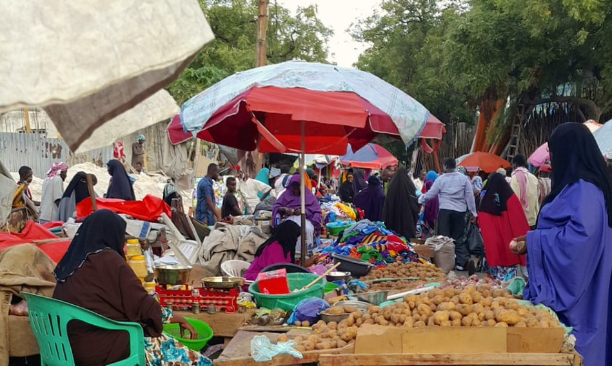

Habka ku saleysan aagga waa qaab ka katurmayo dhammaan dadweynaha ku nool aag juqraafiyeed oo gaar ah
Notes:
- Habka ku saleysan aagga waa qaab ka jawaabaya dhammaan dadweynaha ku nool aag juqraafiyeed oo gaar ah
Waxqabadka 1: «kooxaha oo magacaabi qaybaha ay ka kooban tahay qeexidda aagga ku saleysan".
Tusi boggaan una sheeg ka qaybgalayaasha in tani ay tahay uuna tilmaan iyo inay ku ogaan doonaan qeexitaanka buuxa iyo dhammaan cabirka ABA hawl ahaan/waxqabadka.
Hawshani waa hawl kooxeed. U qaybi waraaqaha yar-yar ee ku jira baqshadooda, iyadoon cinwaanadu ku qorneyn casaanka ah oo weydii ka-qaybgalayaasha inay u kooxeeyaan si macno leh oo ay koox kasta cinwaan u helaan.
Weydiiso hal koox inay sheegaan natiijooyinkooda kuwa kale inay faallo ka bixiyaan iyo / dhammaystiraan ka dib.
Tus lawada boog ee kuxiga si kooban

Slide 5
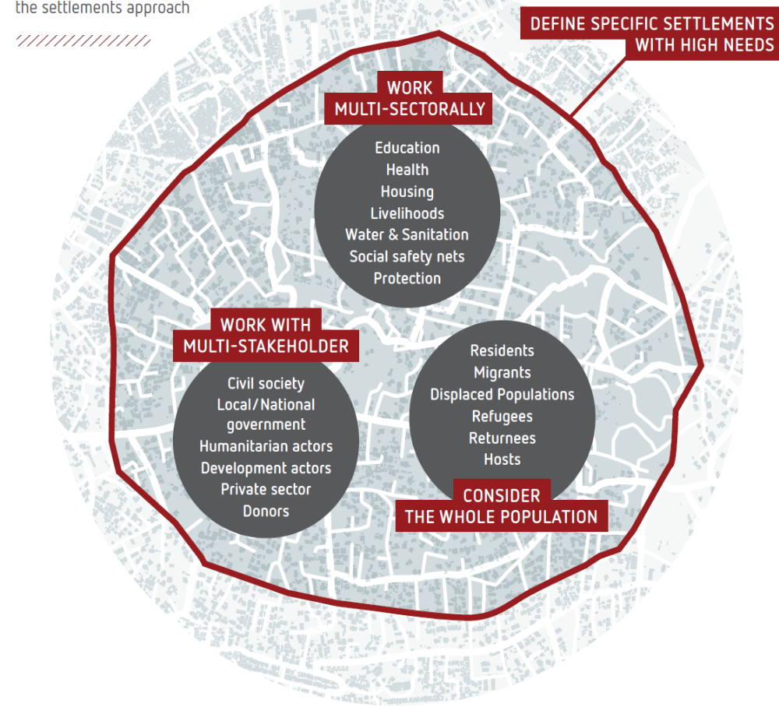
Afarta cabbir ee habka ku saleysan aagga
Notes:
Muuqaalka waxaa laga soo amaahday Qoraalka Hagista habka Dejinta, Dec. 2020. Halkaas oo laga heli karo: https://www.sheltercluster.org/settlements-approaches-urban-areas-working-group/documents/settlement-approach-guidance-note

Slide 6



Qeex
“Habka ku saleysan aagga waxaa loola jeedaa qaab qeexaya aagga, halkii laga ahaan lahaa waax ama koox bartilmaameed ah, meesha ugu weyn ee laga soo galo. Dhammaan daneeyayaasha, adeegyada iyo baahiyaha waa la dejinayaa oo la qiimeeyaa, isla markaana hawl wadeenada ay khusayso la abaabulaa oo lala shaqeeyaa ”. (ReDSS / IRC)
Daneeyayaal badan
Dadka oo dhan
Noocyo badan
Aag baahi badan leh

Slide 7

si sax ah u hadlaya
Qaxootiga Barakacayaasha ama xeryaha / dejinta dadka soo noqday
Barakacayaasha, qaxootiga soo noqday iyo qaxootiga iyo Bulshooyinka Martida loo yahay: Hal nidaam-deegaan
Bulshooyinka Martida loo yahay
Notes:
Boggan wuxuu muujinayaa isbeddelka u dhexeeya 'qaabkii hore ee loo shaqeyn jiray' oo ka kooban bixinta muddada gaaban ee gargaarka bani'aadamnimada ee dadka barakacayaasha ah (IDPs, qaxootiga iyo dadka soo laabtay) ee go'doominta, iyo 'habka cusub ee loo shaqeeyo' kaas oo tixgelinaya labadaba barakacayaasha iyo bulshada martida loo yahay ku noolaanshaha qaas u ah nidaam deegaan

Slide 8



Maxay tahay sababta loo qaadanayo habka noocaas ah?
Faa''iidooyinka dadka ay dhibaatadu saameysey?
"Waxqabadyada ku saleysan aagga ee ay hoggaaminayaan hay'adaha maxalliga ah ama bulshada waxay yeelan karaan faa'iidooyin ballaaran, waana in lagu dhiirrigeliyaa" ” (IRC, 2015)
Faa''iidooyinka maamulka deegaanka iyo daneeyayaasha?
Faa''iidooyinka ururada gargaarka?
Notes:
Waxqabadka2:wada tashi /wada-hadal kooxeed oo ku saabsan faa’iidooyinka laga filayo hab-ku-saleysan saddexdas arrimood ee muhiimka ah
Akhriso xigashada oo weydii ka-qaybgalayaasha fadhiga ama waxqabad kooxeed (koox kasta waxay ka shaqeysaa hal jilaa oo gaar ah) maxay yihiin faa'iidooyinka kala duwan ee ballaaran ee laga filayo habka ku saleysan aagga sida ay qabaan. Si kale haddii loo dhigo, maxaa loo qaatay hab deegaan ku saleysan?.
Qor ama wax ku sawir, adoo adeegsanaya fududeynta qaabdhismeedka, jawaabahooda ku yaal shaxda is-rogidda ka hor intaadan tusin bogaan-ka soo socda sida dib-u-soo-koobidda

Slide 9
Faa'iidooyinka ku saleysan aagga oo kooban .
Yaree xurgufta iyo sinaan la'aanta dhabta ah ama loo maleeyo waxayna gacan ka gaysataa hagaajinta wadajirka bulshada
Abuur ‘madal’ isu keenta jilayaal kala duwan oo leh awood kala duwan
Lahawlgal oo xooji hoggaanka iyo kartida Maamulayaasha Maxalliga ah
Keenso xalal waara oo la waafajiyay isla markaana la macneeyay
Notes:
Kuwani waa afar doodood oo lagu taageerayo ansaxinta ABA, laakiin waxaa jira inbadan oo kale oo kaqeybgalayaashu ay ku nuuxnuuxsan doonaan inta lagu gudajiro dhaqdhaqaaqa maskaxda iyo in aad ku soo koobi doontid warqad jajab ah oo aad hadda ku dhejin karto darbiga.
Fariimaha muhiimka ah:
Hababka aagga ku saleysan waxay:)
- Abuur ‘madal’ kaas oo isu keenta jilayaal kala duwan oo leh awood kala duwan si looga wada hadlo wadajirka jawaabta iyada oo ay hogaaminayaan mas'uuliyiinta heer qaran ama degmo
- In la yareeyo xiisadaha iyo sinnaan la'aanta dhabta ah ama loo maleeyo in ay gacan ka geysato hagaajinta wada noolaanshaha bulshada
- Keen xalal waara oo lagu waafajiyo macnaha guud;
- In loo sahlo kaqeybgalka bulshada ee macnaha leh, wadatashiga iyo kaqeybgalka dhammaan heerarka meertada qorshaynta
Ka faa'iideyso helitaanka, ballanqaadka iyo xiisaha maamullada maxalliga ah si ay uga jawaabaan baahiyaha xallinta muddada dheer ee loo baahan yahay iyo in la xoojiyo wadajirka bulshada (dhinacyada toosan iyo kuwa toosanba

Slide 10
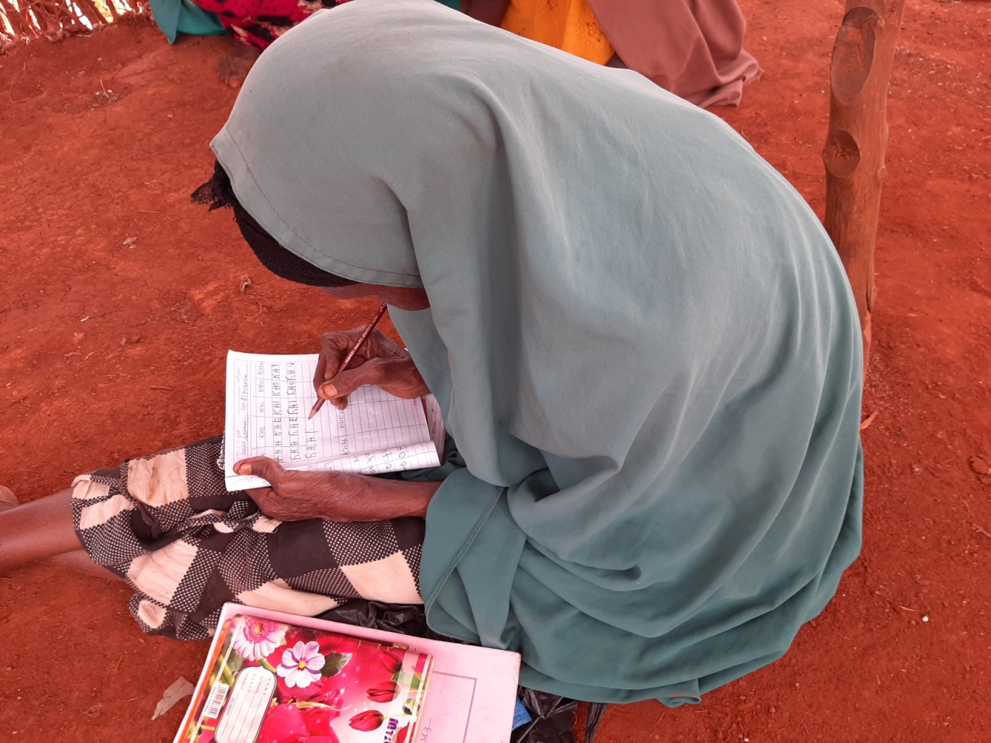
Waxqabadka
Sideen ugu qorsheynaa xalalka waara ee ku saleysan aagga?
Notes:
Diiradan ikhtiyaariga ahi waxay u baahan tahay 30 ilaa 45 daqiiqo.

Slide 11
Tobanka qodob ee habka ku saleysan aagga
Diirada saar goobta/deeganka
Qababka Hay'ado badan, habab badan
Waqtiyada dhabta ah
Falalka ku saleysan dadka iyo qorsheynta
Falalka ku saleysan dadka iyo qorsheynta
Wada shaqeynta qaybaha iyo barnaamijyada
Barnaamij debecsan
Nidaamyada gudaha ee Nimble
Qorshee kor u qaadista
Cabir wax ku biirinta aan loo aaneyn
Notes:
Kahor intaadan ka shaqeynin 10-ka qodob, waxaad xusi kartaa inaysan jirin wax caalami ah oo la isku raacay oo qeexaya habka ku saleysan aagga, sidoo kale ma jiro qaab hawleed la xiriira. Si kastaba ha noqotee, cilmi baaris lagu sameeyay qorshooyinka ku saleysan aagagga ee ku saleysan qaabeynta magaalooyinka ayaa waxay keentay in la sameeyo tiro ka kooban 10 qodob oo hagaya howlgelinta qaabkan. Maqnaanshaha hagitaan kale oo cad, ReDSS waxay qaadatay qodobadan waxtar leh ee u adeegaya mabaadi'da hagitaan ee qiimaha leh ee loogu talagalay isticmaalka hawlgalka. Tobanka mabda 'ee barnaamijyada soo-kabashada ee ku saleysan aagga waxaa laga soo qaatay cilmi-baaris la qaaday iyada oo qayb ka ah Xoogga
Mashruucyada Magaalooyinka (https://www.iied.org/stronger-cities-initiative) ee ku lug leh World Vision, Golaha Qaxootiga Norway, Guddiga Badbaadinta Caalamiga iyo Jaamacadda New South Wales (Sydney). Waad tixraaci kartaa qodobka soo socda si aad uhesho hagitaan dheeraad ah: https://odihpn.org/magazine/ten-principles-area-based-approaches-urban-post-disaster-recovery/
Fadhiga guud weydii ka-qaybgalayaasha waxa qayb kasta uga dhigan tahay iyaga. Tixraac oo u qaybi qoraal-gacmeedka “habka ku saleysan aagga”.
Activity 2. Playing cards (optional) : to be carried out only for workshops focusing on the area-based approach as running this activity will make the session 30 minutes longer.
Only show the title of the slide.
Before starting the activity, you can mention that there is no internationally agreed upon definition of area-based approach, nor is there a related operational framework. Nonetheless, research carried out on area-based planning initiatives in urban setting has resulted in the development of a set of 10 elements guiding the operationalization of this approach. In the absence of other clear guidance, ReDSS has adopted these useful elements that serve as valuable guiding principles for operational use. The ten principles for area-based recovery programmes are drawn from research undertaken as part of the Stronger
Cities Initiative (https://www.iied.org/stronger-cities-initiative ) involving World Vision, the Norwegian Refugee Council, the International Rescue Committee and the University of New South Wales (Sydney). You can refer to the following article for further guidance: https://odihpn.org/magazine/ten-principles-area-based-approaches-urban-post-disaster-recovery/
Playing cards.
Distribute playing cards. One game per group and ask participants to make the title of each element match its description.
Keep the word version of the card game with you to check their results. The first group coming up with the right matches wins. axqabad 2. Kaararka ciyaarta (ikhtiyaar): in lagu fuliyo oo keliya aqoon isweydaarsiyo diiradda saaraya habka ku saleysan aagga maadaama socodsiinta hawshani ay ka dhigeyso casharka 30 daqiiqo.
Kaliya muuji cinwaanka bogga.
Kahor intaadan bilaabin hawsha, waxaad sheegi kartaa inaysan jirin qeexitaan caalami ah oo la isku raacsan yahay oo ku saabsan habka ku saleysan aagga, sidoo kale ma jiro qaab hawleed la xiriira. Si kastaba ha noqotee, cilmi baaris lagu sameeyay qorshooyinka ku saleysan aagagga ee ku saleysan qaabeynta magaalooyinka ayaa waxay keentay in la sameeyo tiro ka kooban 10 cunsur oo hagaya howlgelinta qaabkan. Maqnaanshaha hagitaan kale oo cad, ReDSS waxay qaadatay qodobadan waxtar leh ee u adeegaya mabaadi'da hagitaan ee qiimaha leh ee loogu talagalay isticmaalka hawlgalka. Tobanka mabda 'ee barnaamijyada soo-kabashada ee ku saleysan aagga waxaa laga soo qaatay cilmi-baaris la sameeyay iyada oo qayb ka ah Xoogga
Mashruucyada Magaalooyinka (https://www.iied.org/stronger-cities-initiative) ee ku lug leh World Vision, Golaha Qaxootiga Norway, Guddiga Badbaadinta Caalamiga iyo Jaamacadda New South Wales (Sydney). Waxaad tixraaci kartaa qodobka soo socda si aad uhesho tilmaan dheeraad ah: https://odihpn.org/magazine/ten-principles-area-based-approaches-urban-post-disaster-recovery/
Kaararka lagu ciyaaro.
U qaybi kaararka ciyaarta. Hal ciyaar koox walba weydiiso kaqeybgalayaasha in cinwaanka cunsur kastaa u dhigmo sharraxaaddiisa.
Waad haysaa nooca ereyga kaarka si aad u hubiso natiijooyinkooda. Kooxda ugu horeysa ee la soo baxeysa kulamada saxda ah ayaa guuleysat

Slide 12
Diirada saar goobta: Xadaynta
Isku darka dadka
Heerka nuglaanta DACs
Displacement-specific vulnerabilities and risksDayacanka iyo halista u gaarka ah iyo qataraha
Jiritaanka, ama suuragalnimada qorshaynta deegaanka ku saleysan ee maxalliga ah
Meelaha maamulka dawladeed ee jira ama muuqaalada jireed ee reer magaalka environment
Aligning with the system : links to development planning and exit strategies
A specific area with specific needs
Xuduudaha jirka
Xuduudaha maamulka
Xuduudaha bulshada
Aag gaar ah oo baahiyo gaar ah leh
Xuduudaha Jirka
Xuduudaha maamulka
Xuduudaha bulshada
Adeegyada iyo qabashada suuqa
Notes:
Fariimaha muhiimka ah:
Qorshaynta aaggu waxay u isticmaashaa aag / goob juquraafi ahaan meesha ugu weyn ee laga soo galo. Aagga laga fulinayo habka ku saleysan aagga waxaa lagu go'aamin karaa iyadoo lagu saleynayo isku dhafka shuruudaha kala duwan:
Soohdimaha jira: jireed, maamul iyo bulsho (taas ayaa lagu qeexi doonaa daraasadda kiisaska Agora)
Dhowr arrimood:
-The mix of populations within this area: IDPs, refugees, returnees and host population; Isku darka dadka ku nool aaggan: Barakacayaasha, qaxootiga, dadka soo noqday iyo dadka ay martida u yihiin;
- Level of vulnerability within the displacement affected communities (DACs) as a whole- Heerka nuglaanta ka dhex jirta bulshooyinka barakacayaasha ay saameeyeen (DACs) guud ahaan
- Existence of displacement-specific vulnerabilities :Jiritaanka barakaca gaarka ah ee nugul
- Existence of, or potential for, locally owned area-based planning:- Jiritaanka, ama suurtagalnimada, qorshaynta deegaanka ku saleysan ee maxalliga ah
- jiritaanka maamul dowladeed oo jira ama muuqaalada jireed ee magaalada;
- Aag ay u aqoonsan yihiin dadka deegaanku inuu koobayo (1) unug dhaqan-dhaqaale oo isku xidhan iyo (2) isku xidhka xidhiidhada la saadaalin karo ee u dhexeeya daneeyayaasha
- La jaanqaadida nidaamka; xiriirinta istiraatiijiyadaha horumarinta iyo bixitaanka
Muhiimadda in lagu daro waa in qaab wax ku ool ah la qaataa, iyo in aaggu u baahan yahay inuu ka yara weynaado qorshaynta si looga fogaado abuurista jahwareer iyo waxyeelo!

Slide 13
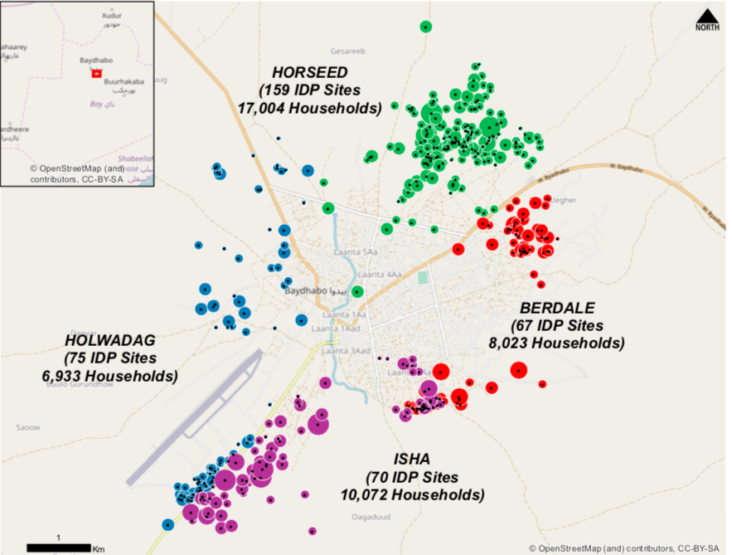

Promising practice in Bangui
Kokoro-Boeing and Plateau Recovery Planning
Notes:
Tani waa qayb ka mid ah falanqayn ku-meel-gaar ah oo ku saabsan baahida iyo bixinta adeegyada ee meelaha ay la saameyey , Bangui, CAR, Mai 2019
Daraasaddan waxay ku saabsan tahay falanqaynta habka ku saleysan aagga ee ay fulisay REACH, iyadoo la adeegsanaayo habka loo yaqaan 'AGORA', ee Bangui. Ujeeddada ugu weyn ee mashruucu waxay ahayd in la xusho aagagga ay dhibaatadu saameysey halka laga hirgelinayo qorshayaasha soo kabashada ee dhinacyada badan leh.

Slide 14
A two steps delimitation processHabka xadeynta laba talaabo ah
1
2
Waa kuwee aagaggan?
Maxaa Kokoro-Boeing iyo Buuraha?
Burbur muhiim ah inta lagu gudajiray iskahorimaadka
Si fiican ugama dhexayn dharka magaalada
Dhaqdhaqaaqyada barakaca muhiimka ah inta lagu jiro dhibaatada iyo soo noqoshada
5 Participatory mapping workshops to identify a “population or neighborhood basin”: Aqoon isweydaarsiyo ka qaybqaadasho ah oo lagu aqoonsanayo "dadka ama xaafadda webiga".
Midnimo dhaqan-dhaqaale oo isku xidhan
Shabakad xiriir la saadaalin karo ka dhexeysa daneeyayaasheeda
Notes:
Kani waa soo koobida tilaabooyinka ugu horeeya ee falanqaynta ay sameeyeen kooxda REACH iyo hawl wadeenada maxalliga ah ee khuseeya Bangui, oo ay ku jiraan maamulada maxalliga ah iyo daneeyayaasha ay khusayso (badhasaabyada, jilayaasha bulshada, hoggaamiyeyaasha xaafadaha, iwm.)
.
Waxaa jiray wareegii koowaad ee doodaha hareeraha xaafadaha halkaas oo qorshaha soo kabashada uu ka dhici karo. Laba waxaa lagu xushay shuruudaha ku jira qaybta 1aad.
Wejiga labaad waxaa diirada lagu saaray xadeynta : meelahee xaafadahaan ka mid ah: 5 aqoon isweydaarsi ka qaybqaadasho ayaa la abaabulay, oo ka qayb qaadanaya dhamaan hawl wadeenada maxalliga ah si loo go'aamiyo "tirada dadka ama deriska " halkaasoo qaab qorshayn aag ku dhisan lagu guuleysan karo. Shuruudaha ugu muhiimsan ee la adeegsaday halkas waxaa ka mid ah:
Jiritaanka midnimo dhaqan-dhaqaale oo isku xidhan;
Shabakad xiriir la saadaalin karo ka dhexeysa daneeyayaasheeda:
Xusuusnow in tixgalinta amniga aan lagu xisaabtamin in aan laga reebin oo aan la takoorin dadka ku nool meelaha ay adag tahay in la soo galo sababo nabadgelyo awgood. :
Warbixinta ku saabsan geedi socodka qorsheynta soo kabashada buuxda waxaa laga heli karaa halkaas (Faransiis):

Slide 15
“tirada dadka oo dhan ”: Sideen bartilmaameed u noqonaa?
Habka ku saleysan aagga waxaa lagu gartaa inuu diiradda saarayo baahiyaha, awoodaha iyo u nuglaanta gudaha aaga juqraafiyeed, halkii uu ka ahaan lahaa koox dad gaar ah.
Notes:
Habka ku saleysan aagga waxaa lagu gartaa inuu diiradda saarayo baahiyaha, awooda iyo u nuglaanta aagagga juqraafi ahaan, halkii uu ka ahaan lahaa koox dad gaar ah. Bartilmaameedku waa inuu ahaadaa mid inta badan ku saleysan nuglaanta, baahida iyo kartida
Sikastaba ha noqotee waajibaadka waxqabadka leh ee ka fogaanaya waxyeellada waa in la qaataa oo arrimaha qaar oo ay wadaagaan dadweynaha oo dhan la tixgeliyaa.

Slide 16
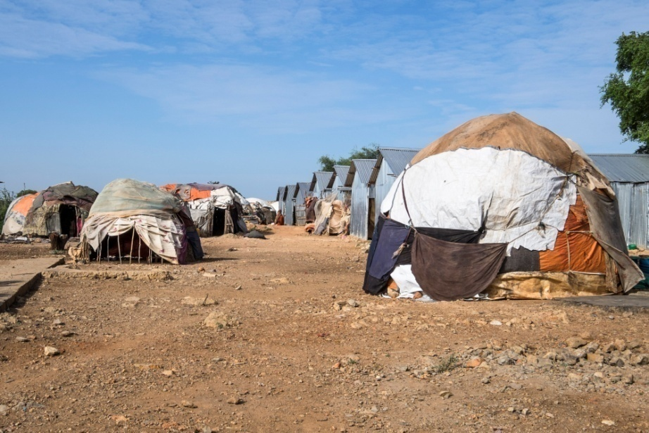

Beegsiga ficil ahaan: EIDAC Incubators waxay ku dhowdahay
Meelaha kicinta ”: khatarta barakaca ay saameeyeen bulshooyinka lagu soo xulay habka ka qaybqaadashada deegaanka
. Clusters of multiple IDP settlements and surrounding host community Qaybaha degsiimooyin badan oo barakacayaal ah iyo bulshada martida loo yahay ee ku hareeraysan
Tirada dadka la bartilmaameedsaday waxay ku lug leeyihiin dhammaan dadka halkaas ku nool: kuwa barakacay iyo kuwa aan barakac ahayn
Barnaamijku wuxuu mudnaanta siiyaa kooxaha ugu halista yar yar: dhadig iyo dhallinyar rag ah; haweenka nugul; gabdho iyo wiilal; waayeelka iyo dadka ka soo jeeda beelaha la hayb sooco.
Notes:
Hindisaha Tayeynta Isdhexgalka Bulshooyinka Barakacayaasha ah (EIDACS) wuxuu ahaa daladda Durable Solutions (DS) oo ay maalgeliso EU Emergency Trust for Africa. Hay'adda 'Concern Worldwide' waxay hoggaanka u haysay hay'adda Gargaar Relief and Development Organisation (GREDO), Norwegian Refugee Council (NRC), Danish Refugee Council (DRC) iyo Xoghaynta Xalinta Xalka ee Gobolka (ReDSS).

Slide 17
Dood ama daraasad kiis
Khibrad wadaaga ama wada hadalka ku saabsan barnaamijka jira ee ku saleysan goobta lagu qabtay aqoon isweydaarsiga.

Slide 18
Fariimaha muhiimka ah
Qaabka ku saleysan aaggu waa qaab awood u siinaya wax ka qabashada baahiyaha dhammaan bulshada ay saameeyeen barakaca ee ku sugan aag cayiman
Habka ku saleysan aagga wuxuu ka kooban yahay qeexidda aagga, ama degsiimada, halkii laga ahaan lahaa waax ama koox bartilmaameed ah, meesha ugu weyn ee laga soo galo. Dhammaan daneeyayaasha, adeegyada iyo baahiyaha waa la dejinayaa oo la qiimeeyaa, jilayaasha iyo qaybaha ku habboonna la abaabulaa oo la isku duwo
Xulashada aagga ama dejinta waa inay ku saleysnaataa shuruudo ay ka mid yihiin jiritaanka bulshooyinka barakacayaasha ay saameeyeen, arrimaha u gaarka ah barakaca iyo halista,
Xaddidaadda waa inay tixgelisaa jiritaanka jiritaanka xuduudaha maamul, bulsho-dhaqaale iyo / ama jireed.
Habka ku saleysan aaggu wuxuu bartilmaameedsanayaa dadka ugu nugul ee DAC oo dhan iyadoo la tixgelinayo barakaca khataraha gaarka ah iyo arrimaha ilaalinta.

