Slide 1





Adopting an area-based approach
Adopting a multisectoral and mutlistakholder approach
Develop or use existing coordination mechanisms
Assessing and measuring durable solutions
Involving DAC through Community-based planning
Durable Solutions. How do we do it?
Notes:
This slide is a recap of activity 3

Slide 2

1
Area-Based Approach to Durable Solutions

Slide 3
Objectives of Session
Define what an area-based approach is.
Examine the main elements and components of area-based approach to durable solutions
Examine delimitation and targeting methodologies .

Slide 4
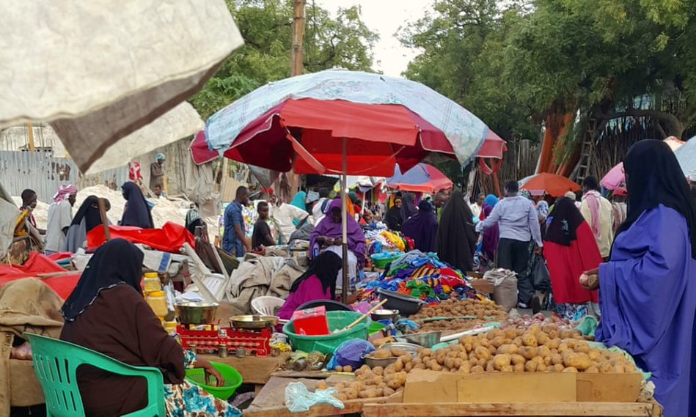

An area-based approach is an approach that responds to the whole population living in a specific geographic area
Notes:
- Area-based approach is an approach that responds to the whole population living in a specific geographic area
Activity 1: « cluster and name the components of the area-based definition”.
Show this slide and tell the participants that this is just a hint and that they will discover the full definition and all the dimensions of the ABA through an activity.
This activity is a group activity. Distribute the small papers in their envelop, without the title items in red and ask the participants to group them in a way that makes sense and find a title for each group.
Ask one group to tell their results and others to comment and/complete after.
Show the next two slides as a recap.

Slide 5
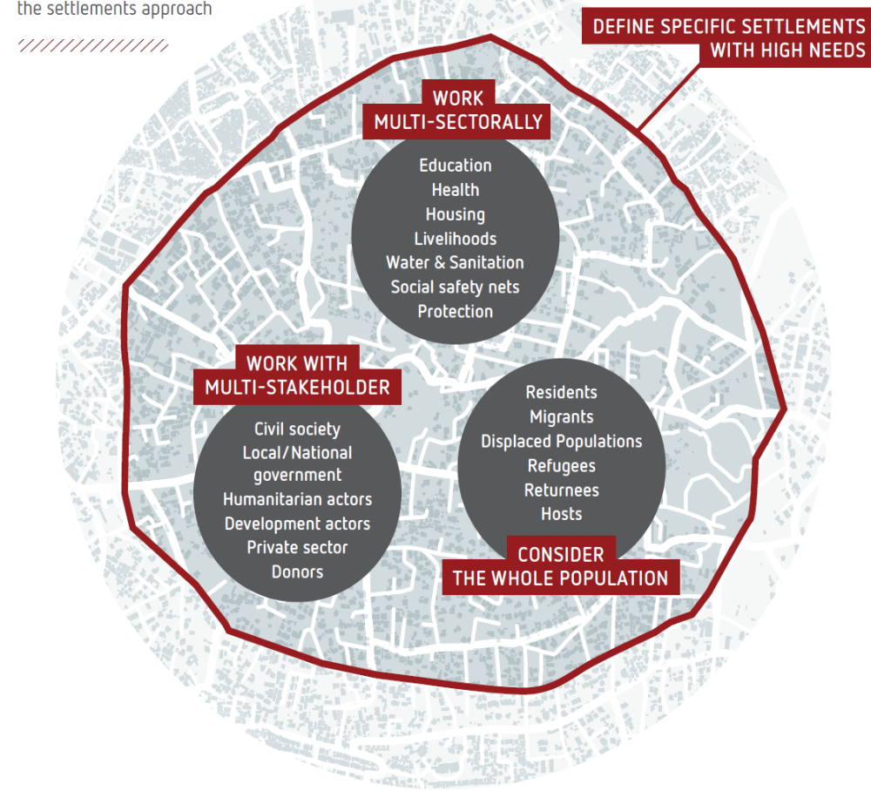
The four dimensions of the area-based approach
Notes:
The visual is borrowed from Reach Settlement Approach Guidance Note, Dec. 2020. Accessible there: https://www.sheltercluster.org/settlements-approaches-urban-areas-working-group/documents/settlement-approach-guidance-note

Slide 6



Definition
“Area based approaches refers to an approach that defines the area, rather than a sector or target group, as the main entry point. All stakeholders, services and needs are mapped and assessed, and relevant actors mobilized and coordinated with”. (ReDSS/IRC)
Multi-stakeholder
The whole population
Multi-sectoral
An area with high needs

Slide 7

Concretely speaking
Refugee IDP or returnees’ camps/settlements
IDPs, refugee returnees and refugees and Host Communities: One Eco-system
Host Communities
Notes:
This slide shows the shift between the former « way of working » consisting in providing short term dedicated humanitarian aid to displaced persons (IDPs, refugees and returnees) in isolation, and the « new way of workking » which considers both displaced persons and host communities living an a specific as an eco-system.

Slide 8



Why adopting such an approach ?
Benetits for affected populations?
“Area-based interventions led by local authorities or communities can have wide-ranging benefits, and should be encouraged” (IRC, 2015)
Benetits for local authorities and stakeholders?
Benetits for aid organisations?
Notes:
Activity 2: plenary or group discussion on the expected benefits of are-based approach for these three key actors. Read the quote and ask the participants in plenary or in a group activity (each group work on one specific actor) what are the wide ranging benefits expected from an area-based approach according to them. In other words, why adopting an area-based approach?.
Write or draw, using graphic facilitation, their answers on a flip chart before showing the following slide as the recap.

Slide 9
Area-based benefits in a nutshel
Reduce tensions and real or perceived inequalities and contribute to improving social cohesion
Create a ‘platform’ bringing together a diversity of actors with different capacities
Engage with and strengthen the leadership and capacities of Local Authorities
Bring targeted and contextualized durable solutions
Notes:
These are four arguments in favour of the adoption of an ABA, but there are many more that the participants will have highlighted during the brainstorming activity and that you will have summarized on a flip chart paper that you can now stick on the wall.
Key messages:
Area-based approaches can:
- Create a ‘platform’ which brings together a diversity of actors with different capacities to discuss the collective
response under the leadership of national or local authorities;
- Reduce tensions and real or perceived inequalities and contribute to improving social cohesion;
- Bring targeted and contextualized durable solutions;
- Enable community meaningful participation, consultation and involvement at all stage of the planning cycle;
- Capitalize on the availability, commitment and interest of local authorities to respond to long-term durable solutions needs and reinforce social cohesion (both horizontal and vertical dimensions)

Slide 10
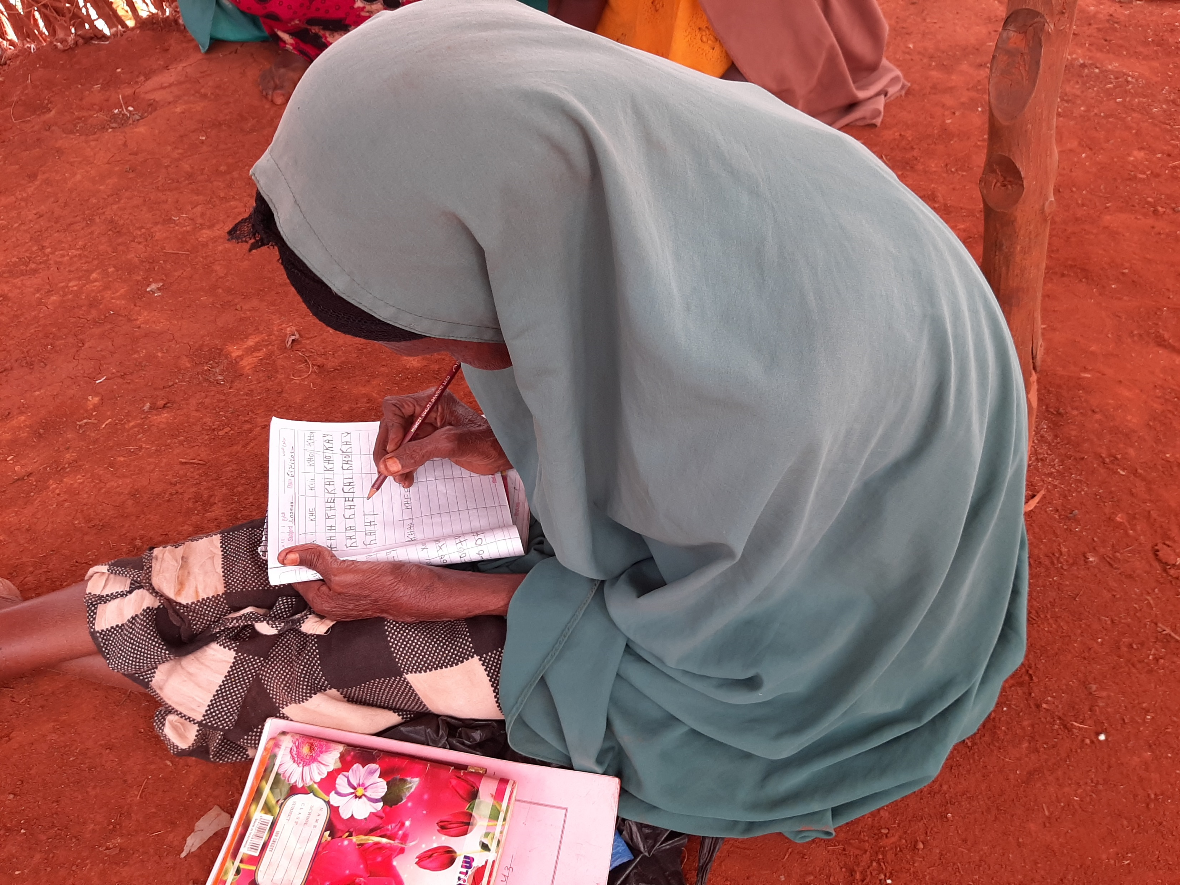
Activity
How do we plan for area-based durable solutions?
Notes:
This optional focus might require 30 to 45 minutes.

Slide 11
The ten elements of area-based approach
Focus on location
Multi-agency, multi-sectoral approach
Realistic timeframes
People-centered actions and planning
Work and invest in existing structures
Collaborating sectors and programmes
Flexible programming
Nimble internal systems
Plan for scaling-up
Measure contribution not attribution
Notes:
Before working on the 10 elements, you can mention that there is no internationally agreed upon definition of area-based approach, nor is there a related operational framework. Nonetheless, research carried out on area-based planning initiatives in urban setting has resulted in the development of a set of 10 elements guiding the operationalization of this approach. In the absence of other clear guidance, ReDSS has adopted these useful elements that serve as valuable guiding principles for operational use. The ten principles for area-based recovery programmes are drawn from research undertaken as part of the Stronger
Cities Initiative (https://www.iied.org/stronger-cities-initiative ) involving World Vision, the Norwegian Refugee Council, the International Rescue Committee and the University of New South Wales (Sydney). You can refer to the following article for further guidance: https://odihpn.org/magazine/ten-principles-area-based-approaches-urban-post-disaster-recovery/
In plenary ask the participants what each element means for them. Refer to and distribute the handout “area-based approach”.
Activity 2. Playing cards (optional) : to be carried out only for workshops focusing on the area-based approach as running this activity will make the session 30 minutes longer.
Only show the title of the slide.
Before starting the activity, you can mention that there is no internationally agreed upon definition of area-based approach, nor is there a related operational framework. Nonetheless, research carried out on area-based planning initiatives in urban setting has resulted in the development of a set of 10 elements guiding the operationalization of this approach. In the absence of other clear guidance, ReDSS has adopted these useful elements that serve as valuable guiding principles for operational use. The ten principles for area-based recovery programmes are drawn from research undertaken as part of the Stronger
Cities Initiative (https://www.iied.org/stronger-cities-initiative ) involving World Vision, the Norwegian Refugee Council, the International Rescue Committee and the University of New South Wales (Sydney). You can refer to the following article for further guidance: https://odihpn.org/magazine/ten-principles-area-based-approaches-urban-post-disaster-recovery/
Playing cards.
Distribute playing cards. One game per group and ask participants to make the title of each element match its description.
Keep the word version of the card game with you to check their results. The first group coming up with the right matches wins.

Slide 12

Focus on location: Delimitation
A specific area with specific needs
Physical boundaries
Administrative boundaries
Social boundaries
Services and market catchment
Mix of populations
Level of vulnerability of the DACs
Displacement-specific vulnerabilities and risks
Existence of, or potential for locally owned area-based planning
Existing government administrative area or physical features of the urban environment
Aligning with the system : links to development planning and exit strategies
Notes:
Key messages:
Area based planning uses an area/geographical location as the main entry point. The area in which an area-based approach is implemented can be determined based upon a mix of different criteria:
Existing boundaries: physical, administrative and social (that will be defined in the Agora case study)
A number of factors:
-The mix of populations within this area: IDPs, refugees, returnees and host population;
- Level of vulnerability within the displacement affected communities (DACs) as a whole
- Existence of displacement-specific vulnerabilities
- Existence of, or potential for, locally owned area-based planning
- Existing government administrative area or physical features of the urban environment;
- Area that is recognized by its inhabitants as encompassing (1) a coherent socio-economic unit and (2) a network of predictable relationships between its stakeholders.
- Aligning with the system; links to development and exit strategies
Important to add is that a pragmatic approach should be adopted, and that the area might need to be a bit larger than planned to avoid creating frustrations and doing harm!

Slide 13
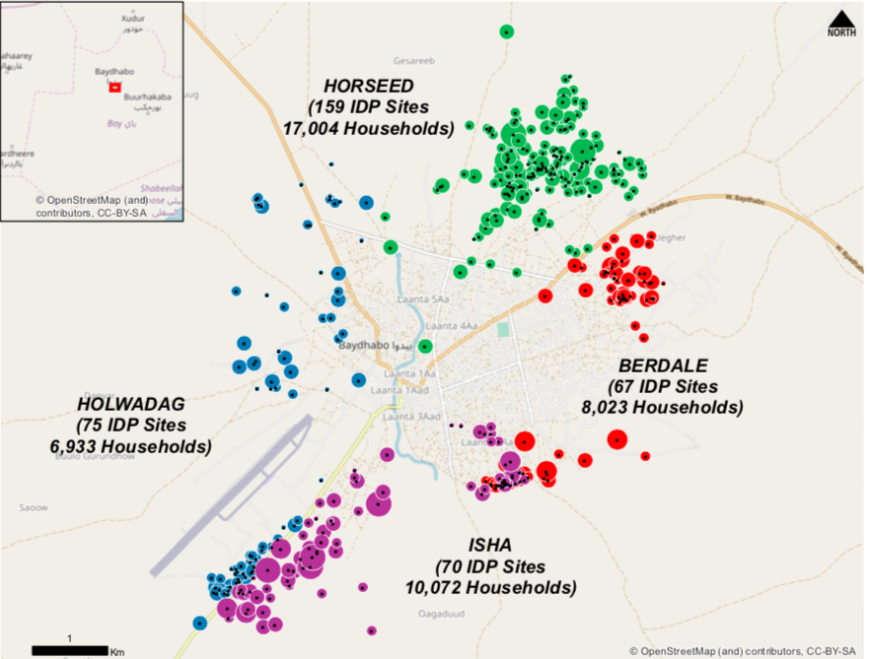

Promising practice in Bangui
Kokoro-Boeing and Plateau Recovery Planning
Notes:
This is an exerpt of a muti-sectoral and localized analysis of the demand and supply of services in cisis affected areas, Bangui ,CAR, Mai 2019.
This case study is about the area-based approach analysis carried out by REACH, using its AGORA methodology, in Bangui. The main aim of the project was to select crisis affected areas where to implement multi-sectoral recovery plans.

Slide 14
A two steps delimitation process
1
2
Why Kokoro-Boeing and Plateau?
Which areas in these locations?
Important destructions during the conflict
Not well integrated in the urban fabric
Important displacements movements during the crisis and returns
5 Participatory mapping workshops to identify a “population or neighborhood basin”:
A coherent socio-economic unity
A network of predictable relationships between its stakeholders
Notes:
This is a summary of the first steps of the analysis carried out by REACH team and relevant local actors in Bangui, including local authorities and relevant stakeholders (mayors, social actors, neighbourhood leaders, etc.)
There was a first round of discussions around the neighbourhoods where the recovery plan could take place. Two were selected based on the criteria in block 1.
The second phase was focused on the delimitation per se: which areas in these neighbourhoods: 5 participatory workshops were organised, involving all relevant local actors to determined “population or neighbourhood basin” where an area-based planning approach could be successful. The main criteria used where:
The existence of a coherent socio-economic unity;
A network of predictable relationships between its stakeholders
Note that security considerations were not taken into account not to exclude and discriminate against populations living in areas that are difficult to access due to security issues.
The report on the full recovery planning process can be found there (in French):

Slide 15
“whole population” : How do we target?
An area-based approach is characterized by its focus on needs, capacities and vulnerabilities within a geographic area, rather than among a specific population group.
Notes:
An area-based approach is characterized by its focus on needs, capacities and vulnerabilities within a geographic area, rather than among a specific population group. Targeting should therefore be based predominantly on vulnerability, needs and capacity.
However a pragmatic approach that avoids doing harm should be adopted and some of the issues shared by the whole population should be taken into account.

Slide 16
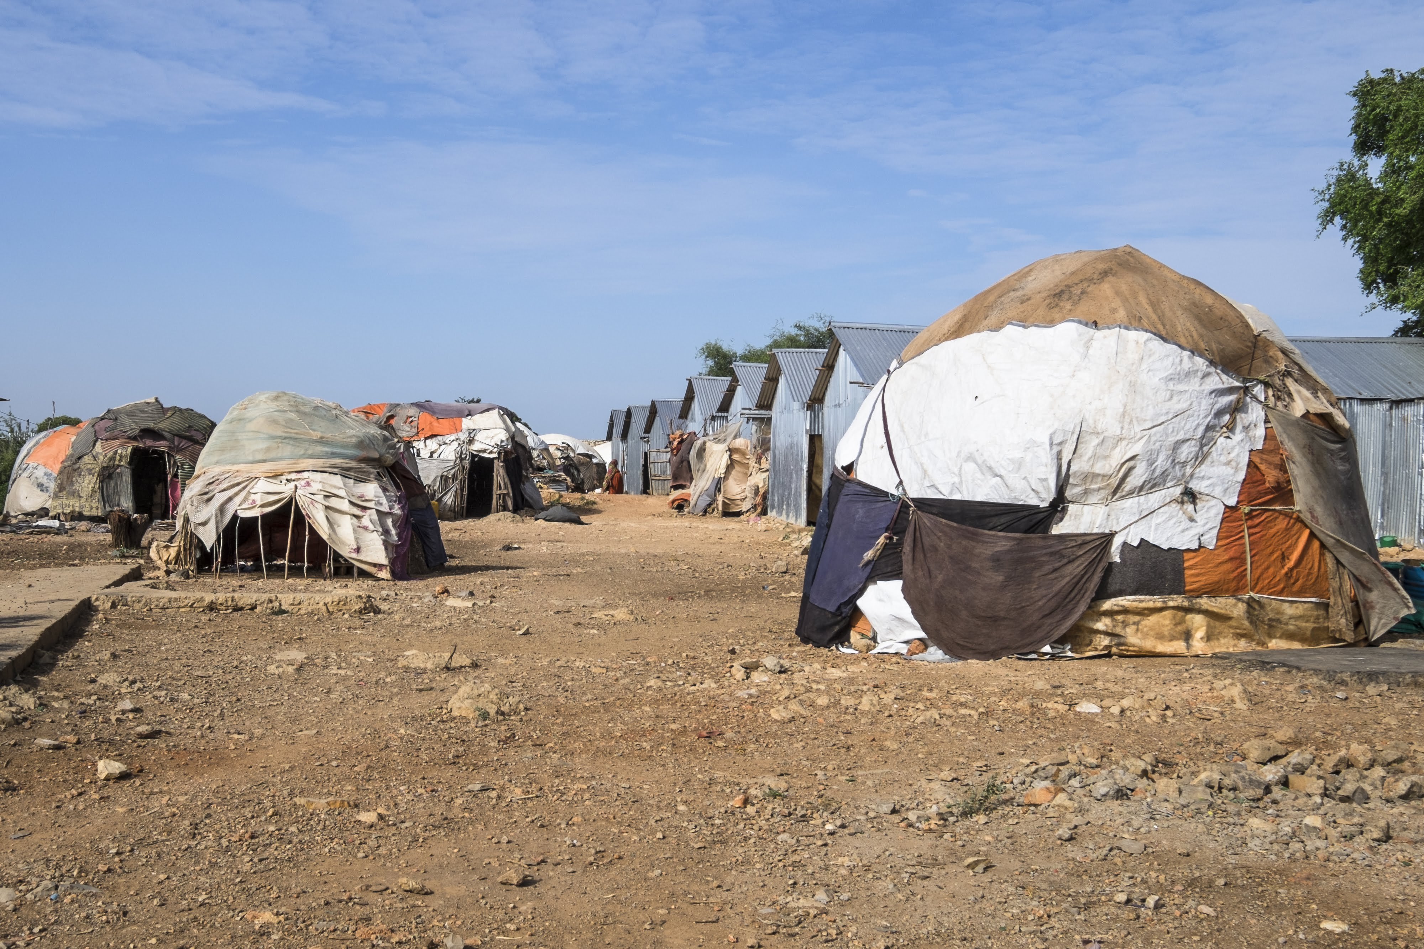

Targeting in practice: EIDAC Incubators approach
“Incubator Locations”: at risk displacement affected communities selected through a local participatory process
Clusters of multiple IDP settlements and surrounding host community.
Targeted population involve all who live there: both displaced and non-displaced.
The programme prioritizes the most at risk sub-groups: female and male youth; vulnerable women; girls and boys; elderly and people from marginalized clans.
Notes:
The Enhancing Integration of Displacement Affected Communities (EIDACS) initiative was a Durable Solutions (DS) consortium funded by the EU Emergency Trust for Africa. Concern Worldwide was the lead agency with Gargaar Relief and Development Organisation (GREDO), Norwegian Refugee Council (NRC), Danish Refugee Council (DRC) and the Regional Durable Solutions Secretariat (ReDSS) as partners.

Slide 17
Discussion or case study
Expérience sharing or discussion on existing area-based programme in the location where the workshop is held.

Slide 18
Key messages
The area-based approach is an approach that enables to address the needs of the whole Displacement Affected community in a given area.
The area-based approach consists in defining the area, or settlement, rather than a sector or target group, as the main entry point. All stakeholders, services and needs are mapped and assessed, and relevant actors and sectors are mobilized and coordinated.
The choice of the area or settlement should be based on criteria including the existence of displacement affected communities, displacement-specific issues and risks,
The delimitation of the are should take into account the existence of the existence of administrative, social-economic and/or physical boundaries.
The area-based approach targets the most vulnerable populations of the whole DAC while considering displacement specific risks and protection issues.

