Slide 1





Durable Solutions. How do we do it?
Adopting a multisectoral and mutlistakeholder approach
Developing or using existing coordination mechanisms
Assessing and measuring durable solutions
Involving DAC through Community-based planning
Adopting an area-based approach
Notes:
This slide is a recap of activity 3

Slide 2

2
A multi stakeholder and multisectoral approach and coordination

Slide 3
Objectives of Session
Explain the importance of involving a wide range of sectors and actors for DS planning, programming and implementation.
Map the actors that should be involved in durable solutions processes and determined their roles.
Examine coordination and coordination mechanisms to ensure coherent multisectoral and multi stakeholder durable solutions programmes in Somalia.

Slide 4
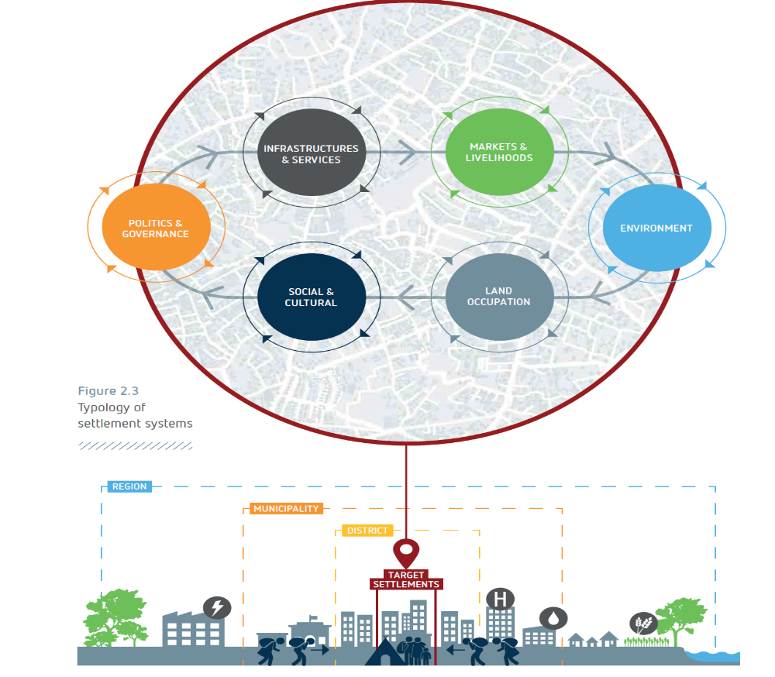
Multisectoral engagement
Notes:
Key messages:
Multi-stakeholder, multi-sectoral approach is needed to address a variety of needs, embracing a range of social, economic and physical, humanitarian and development objectives. You can refer to the 8 IASC criteria and highlight that they cover a wide range of protection, socio and economic dimensions that can only be addressed by a multi sectoral approach.
The multi-sectoral, multi-agency approach should focus on leveraging the expertise of various actors within an area and to work towards a common vision/collective outcome
A key aspect on this approach is how to build synergies based on the different expertise and to ensure that the various agencies involved in an area-based planning approach do not work in silos

Slide 5
Multi sectoral approach
Why?
How?
To address a variety of needs identified in a specific area.
Meet a wide range of protection, social, economic, humanitarian and development objectives
Leverage the expertise of various actors within an area to work towards a common goal and joint objectives.
Notes:
Key messages:
Multi-stakeholder, multi-sectoral approach is needed to address a variety of needs, embracing a range of social, economic and physical, humanitarian and development objectives. You can refer to the 8 IASC criteria and highlight that they cover a wide range of protection, socio and economic dimensions that can only be addressed by a multi sectoral approach.
The multi-sectoral, multi-agency approach should focus on leveraging the expertise of various actors within an area and to work towards a common vision/collective outcome
A key aspect on this approach is how to build synergies based on the different expertise and to ensure that the various agencies involved in an area-based planning approach do not work in silos

Slide 6
Multi stakeholder approach: key steps to success
Identify actors
1
Identify coordination mechanisms and potential gaps and opportunities
2
Strengthen collective understanding of the concepts and tools
3
Develop evidence and analysis
4
Develop long-term capacity development strategy
5
Notes:
Here are key steps to ensure a multi-sectoral approach.
Explain that:
The first two steps will be covered in this session.
Step 3 is covered by this workshop and other events and capacity building workshops targeting a wide range of key stakeholder with a view to ensure that all potential solutions actors have a shared understanding of what protection, solutions, area-based-approach and other displacement related concepts and policies mean. The ultimate goal is that all relevant actors speak the same language, use common tools to develop a common vision and joint outcome to support the progression of durable solutions for DAC in a selected area.
Step 4 will be covered in the next session and is key in ensuring that all actors share a common vision and joint outcome.
- Step 5 highlights the need to invest in longer term, sustainable and locally appropriate capacity building; not only on one-off trainings or periodic secondment, but also ongoing, peer-to-peer learning. For this to happen, you have to carefully identify strategic stakeholders, assess their learning/capacity development needs and develop a long-term strategy in accordance.
It is also a paramount to ensure complementarity of capacity building efforts between different actors, with better appreciation of already existing capacity and learning opportunities for humanitarian and development alike.

Slide 7
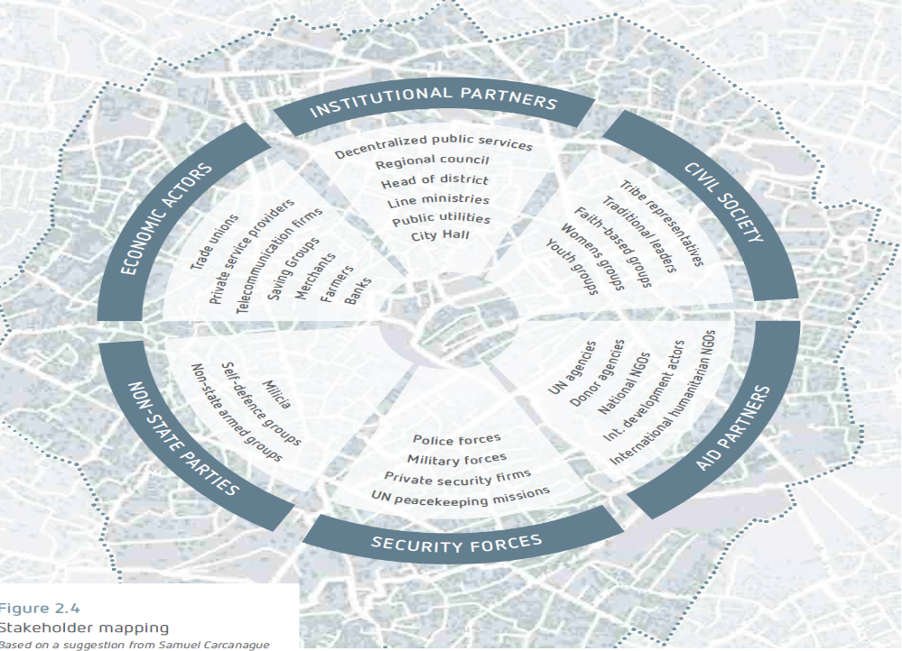
What actors should be involved to cover all the sectors and address the variety of needs of DAC?
Notes:
Source of the visual: Settlements Approach Guidance Note, where boundaries and action merge, Urban Settlements Working Group, Dec. 2020

Slide 8

Activity 1 : identify actors in your context
Actors
Actors
Actors
Actors
Actors
Actors
Actors mapping: who is in?
Comparative advantages?
Notes:
Key message:
Cross sector actors mapping and capacity assessment are key steps in the process of developing an area-based planning.
Activity 1:
Step 1: actors mapping:
Based on a definite selected area, ask the participants to map all the actors present in this area who should be part to the solutions planning process and its implementation.
1. Assign each group one or two category(ies) of actor and a color: : blue for humanitarian actors, green for development actors, pink for private sector (trade unions, banks, farmers etc.) , yellow for national or local authorities, orange for DAC, white for civil society and civil society organisations.
Ask them to list and write them down on the corresponding-coloured papers in about 15 minutes, one actor per paper. They will then propose their actors to the rest of the participants and stick them on the wall. Make sure that the papers form a circle with an empty centre.
- Step 2: Actors analysis
After the first debriefing make the question on comparative advantages appear on the screen (animation already inserted) and reiterate the fact that all the actors, from different sectors will be involved in the planning, implementation and monitoring based on comparative advantages.
What does it mean, and what does it mean in the context where the workshop is organised? See the following slide.

Slide 9
Comparative advantages: Actors' analysis
Actors | Category (humanitarian development, national, local authorities, CSOs, private sector, DAC, etc.) | Sector and experitise in the sector | Presence and experience in the area | Proximity with DAC | Capacities to scale up, ensure sustainability and flexibility to adapt to changes | Will and interest
Notes:
Comparative advantages: an actor analysis.
Elements of answer: the relevant actors will be involved to respond to the vulnerabilities and needs and to build on capacities identified based on their:
Expertise in the sectors where needs are identified
Presence and experience in the area
Experience and proximity with DAC
Capacities, capacities to scale up, capacity to ensure sustainability, hence the importance to ensure that national and local NGOs, CSOs are involved.
Flexibility to adapt to changes…
Activity 1 step 2 (optional) : Ask the participants to pick three actors from their initial list and start doing an actor's analysis to assess their comparative advantages.

Slide 10
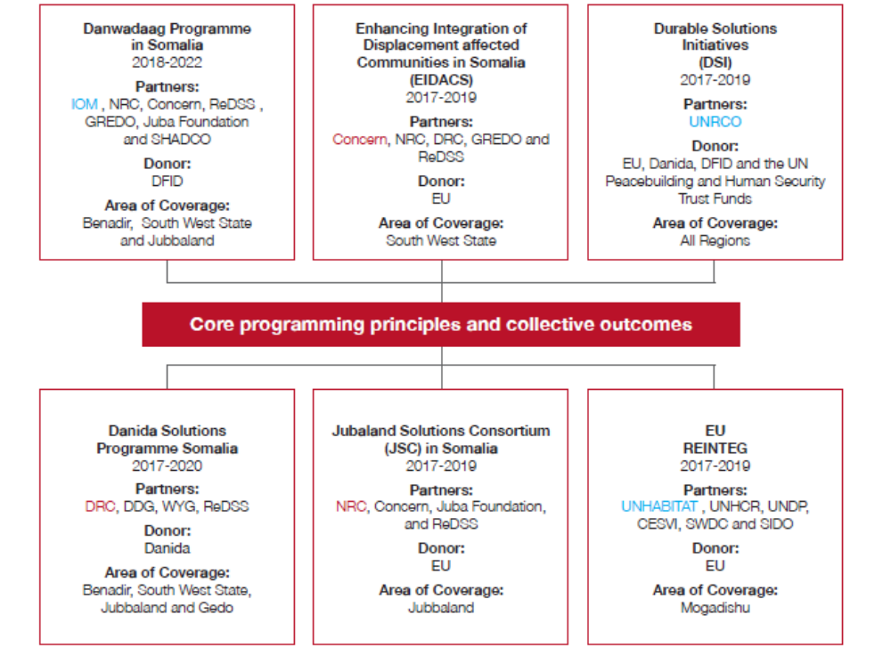
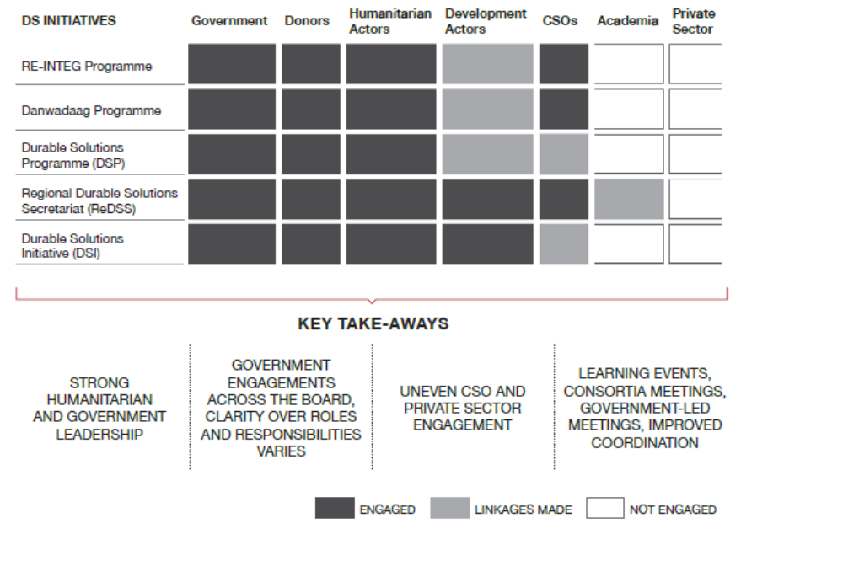
Durable solutions initiatives and actors in Somalia

Slide 11
What are the main challenges of a multistakeholder
Approach?
How to address them?

Slide 12

Coordination between the different actors and sectors
Why is coordination important?
Durable solutions programmes depend on many actors and sectors
It is key to develop mechanisms to coordinate the action of these stakeholders
More effective information flows
Ensure effective complementarity of the different sectors and actors in the area
Ensuring a more coherent and unified response to the needs and aspirations of DAC
To meet a common goal and joint objectives
Notes:
Key messages:
Area-based approach programming requires the creation or support of institutional mechanisms for more effective information flows and coordination between the many different actors and sectors
An effective area-based approach is dependent on ensuring complementarity with other actors and programs within the defined geographical area;
Collaboration between sectors is essential to deliver a more coherent and unified response and to contribute to a common vision on durable solutions.
Existing community structures, capacities and power dynamics should be mapped at the start of a solutions-focussed programme and new groups mechanisms should not be formed unless they fill gaps and bring significant added-value
A key learning from various area-based programs has been the need to develop, implement and support institutional mechanisms for more effective information flows and coordination between the many different actors and sectors.

Slide 13

Durable solutions National and local coordination
Durable Solutions Secretariat (DSS): Inter-ministerial mechanism to lead, coordinate and provide sustainable long-term solutions for displacement in Somalia.
Includes all relevant ministries and federal institutions
National Durable Solutions Secretariat
Regional durable solutions platforms
Government led coordination platforms
Notes:
Key messages:
National authorities have the primary responsibility to find durable solutions to displacement situations on their territory;
A wide range of actors across sectors are involved in area-based planning under the leadership of national and local authorities;
Show the visuals first (the animation is already inserted) and ask the participant what or who should be at the center of the circle, in a leadership role, and why.
Interactivity: You can continue the discussions about the national and local context:
Who leads durable solutions planning at the national and local level?
Who are the key national actors in a leading and coordinating position at the local level?
Who are or could be our solutions champions ie. Supporter and key allies for area-based planning: from previous experiences, district mayors have been key supporters/champion or area-bases solutions initiatives.

Slide 14
INTER MINISTERIAL TASFKFORCE on
DURABLE SOLUTIONS
Chaired by DPM co-chaired by DSRSG/RC/HC
Humanitarian Country Team/ Clusters
UN development
SDRF Migration, Displacement and Durable Solutions
SUB WORKING GROUP (MDDS SWG)
Chaired by NCRI and UNHCR
Designated representatives of: MOIFA, MOPIED, relevant line ministries, FMS, UN, NGOs, World Bank, Resilience consortia, Donors
NGO Consortiums
Donors
Jubbaland Kismayo
OPERATIONAL DURABLE SOLUTIONS PLATFORM
Chaired representative of by Jubbaland inter-ministerial committee and co-led by UN representative
Members: FGS; regional ICCG, WB, UN AFPs, NGO consortium, DS consortia, NGOs, Donors
South West State Baidoa
OPERATIONAL DURABLE SOLUTIONS PLATFORM
Chaired by representative of South West State inter-ministerial committee and co-led by UN representative
Members: FGS; regional ICCG, WB, UN AFPs, NGO consortium, DS consortia, NGOs, Donors
Benadir Mogadishu
OPERATIONAL DURABLE SOLUTIONS PLATFORM
Chaired by representative of Benadir inter-ministerial committee and co-led by UN representative
Members: FGS, regional ICCG, WB, UN AFPs, NGO consortium, DS consortia, NGOs, Donors
Municipality/District platform
DAC plans, area based multi-sector multi actor’s plans
Municipality/District platform
DAC plans, area based multi-sector multi actor’s plans
Municipality/District platform
DAC plans, area based multi-sector multi actor’s plans
Municipality/District platform
DAC plans, area based multi-sector multi actor’s plans
Municipality/District platform
DAC plans, area based multi-sector multi actor’s plans
Municipality/District platform
DAC plans, area based multi-sector multi actor’s plans

Slide 15
Creating a coordination mechanism
1. Aim for national and/or local ownership
3. Develop a coordination mechanism with a dedicated institution with a clear coordination mandate
4. Prepare partnership related documents: coordination framework, joint vision, principles, SoPs etc.
2. Map functions of actors, agencies and service providers

Slide 16
Activity 2: Coordination mechanisms
Complementarity between actors and programmes
Existing
Gaps
Opportunities
Support coordination capacities
Notes:
Activity 2 (optional, depending on the objectives of the workshop and on the target audience): What are the existing coordination mechanisms or programmes involving the actors previously listed in the defined geographical area?
First step: mapping: Ask each group to list the relevant and existing coordination mechanisms or programmes involving the actors previously listed and to write their names and their chairs and co-chairs on white papers, one programme/mechanism per paper. Then, ask them to list their members on coloured papers using the colour code of the previous exercise.
Debriefing: ask a group to present their results and to stick the coordination systems/programmes names and their members in columns on the wall. Ask the other groups to complete, amend the table.
Second step: analysis:
- Ask the participants what color is missing and what color is overrepresented in the table. This can be the first gap identified.
- Ask the participants if they see other potential gaps. For instance, none of the coordination mechanisms include all the actors previously listed or if they do, they are not really functioning, the leadership is not effective or some of its members are not active, involved or effectively participating.
Third step: what are the opportunities?
1. What are the existing coordination mechanisms or programmes that could be used/strengthened/tapped into to support the development of our area-based solutions plan?
2. What could be their role? What opportunities do this group offer?
3. Do we need to create a new platform/group?
4. What actors are absent from these groups and should be brought to our area-based solutions coordination platform/group?

Slide 17

A nationally owned process
?
Actors
Actors
Actors
Actors
Actors
Actors
Notes:
This is one of the principles for Durable Solutions programming as presented in module 1: Government-led: interventions support all tiers of government to play their key leadership and
coordination role based on the National Development Plan and other relevant government frameworks.
Key messages:
National authorities have the primary responsibility to find durable solutions to displacement situations on their territory;
A wide range of actors across sectors are involved in area-based planning under the leadership of national and local authorities;
Show the visuals first (the animation is already inserted) and ask the participant what or who should be at the center of the circle, in a leadership role, and why.
Interactivity: You can continue the discussions about the national and local context:
Who leads durable solutions planning at the national and local level?
Who are the key national actors in a leading and coordinating position at the local level?
Who are or could be our solutions champions ie. Supporter and key allies for area-based planning: from previous experiences, district mayors have been key supporters/champion or area-bases solutions initiatives.

Slide 18




Activity 3: Who does what in the end ?
Leading
Coordinating
Supporting
Participating and informing
Notes:
Activity 3 : Who does what in the end? Prepare a four-column table with the four headings (leading; coordinating; supporting; participating and informing) on the wall. In plenary, ask participants what is or would be the roles of the actors previously listed (activity 1) in the area-based planning process and place them accordingly.

Slide 19
Key messages
Multiple actors from different sectors are needed to address the multiple needs of Displacement Affected Communities in the selected and delimitated areas.
These actors should reflect the humanitarian, development and peace building nature of durable solutions. Displacement Affected Communities should also be considered as key actors of their progression towards durable solutions.
Coordination mechanisms need to be put in place to ensure an efficient flow of information, coherent planning and response based on joint analysis and common objectives.
The national and local authorities in Somalia have created coordination mechanisms at the national and local levels to ensure fluidity and coherence of the durable solutions planning.

