Slide 1





Raacida qaab ay ku bahoobaan waaxyo badan iyo hawleedeeno bada
Ku lug lahaanshaha DAC iyada oo loo marayo qorsheynta ku saleysan Bulshada
Qiimaynta iyo cabirka xalalka waara
Horumari ama isticmaal farsamooyinka isuduwidda jirta
Raacida qaab ay ku bahoobeen waaxyo badan iyo hawleedeeno badan
Raacida qaab deegaan ku saleysan
Xal waara. Sideen u qabanaa?
Notes:
This slide is a recap of activity 3

Slide 2


3
Qiimaynta Iyo Cabirka Xalalka Waara

Slide 3
Ujeedooyinka Kulanka
Sharax sababta iyo nooca qiimeynta muhiimka u ah in la sameeyo qorshe xal waara iyo in la cabbiro horumarka loo qaadayo dhinaca xalka waara
Sahmi nooca xogta iyo falanqaynta aan u baahanahay inaan ku sameyno falanqeynta xalal waara si habka ugu wanaagsan loogu fuliyo mashaariicda loogu talagalay xalalka waara ee Soomaaliya.
Baaritaan ku samee agabka iyo qaababka kala duwan ee loo sameeyay in lagu qiimeeyo laguna cabbiro horumarka loo qaadayo dhinaca xalka waara ee Soomaaliya

Slide 4
Waa maxay sababta aan ugu baahanahay xog iyo falanqeyn?
Si loo fahmo dayacanka/nugeelka, baahiyaha iyo awoodahaha aqooneed ee DAC
In si fiican loo fahmo dhaqdhaqaaqyada isku dhaca si loo yareeyo.
Tirakoobka jiritaanka, helitaanka iyo shaqeynta adeegyada
Si loo dejiyo heerar iyo tilmaamayaal gaar ah, la cabiri karo, lagu guuleysan karo, Macquul ah oo ku dhaco wakhti cayiman si loola socdo horumarka loo qadayo xagga xalka
Notes:
Make this section participatory by showing and the title + the question mark icon (animation already inserted) of the slide first and asking the question to the participants. Only show the bullet points after you managed to get sufficient good/relevant arguments/answers.

Slide 5
Xog noocee ah ayaan u baahan nahay? Howlaha
Howl ka kooban saddex tallaabo:
Si shaqsi ah u fikir 5 daqiiqo oo qor xogta iyo macluumaadka aad isleedahay waa loo baahan yahay
Laba labo usoo gudbiya fikradahiina shan daqiiqo oo kale gudohood.
Isukeena fikradaha kooxdiina (Shaxgelin) 10 daqiiqo gudaheed idinkoo iskudayaya inaad fikradaha koox koox isugu aadisaan si macaquul ah
Xog iyo macluumaad noocee ayaan u baahan nahay si aan u fulino falanqeyn xalal waara oo aan qorsheynaa xalalka waara ee aagga xaddidan?

Slide 6








Falanqaynta xalalka ee ku saleysan aagga
Falanqaynta aagga ku saleysan waxay u adeegsataa aag ballaadhan oo qeexan oo ah barta laga soo galo ee fahamka:
Astaamaha iyo xaaladaha dadyowga la beegsanaya
Sifooyinka gaarka ah ee meelaha martigeliyey, sida adeegyada iyo awooda kaabayaasha
Notes:
This slide is animated slide : each sentence on the left is illustrated by icons on the right appearing simultaneously.
The main messages here is that:
- The selected area will be the entry point for data collection and analysis on:
The different categories of populations (refugees, IDPs, host communities) to be able to compare the common and different needs of the different segment of populations;
Characteristics of the location’s structures and services.
A detailed list of the types of data for each side (population and location) is provided in the following slide.

Slide 7


Waa maxay xogta iyo falanqaynta?
Xog ku saabsan Meelaha / dhinaca saadka
Tiro koobka kaabayaasha / qiimeynta waxyeelada
Helitaanka adeegga & bixintiisa
Habnololeedka / suuqa shaqada
Nidaamka dhulka guryeynta iyo hantida
Qaab dhismeedka maamulka / dhaqdhaqaaqa howlwadeenada
Xogta ku saabsan dadweynaha / dhinaca baahida
Tirada dadka ee la kala soocay
Qaababka barakaca
Helitaan Adeegyada
Badbaadada iyo amniga
Helitaanka habnololeed
Helitaanka HLP
Wadajirka bulshada
Notes:
Here is a comprehensive approach to bring data on people and data on locations together.
This entails collecting macro data on the places and micro data on the population.
It is also a combination of quantitative and qualitative data.
Secondary data: We don’t automatically need to collect all the data. Part of it maybe available with partners.
We don’t need to collect and search for all the data, only the data and information that we need!
Activity 2: scattered data.
Source: Based on Jips presentation on area-based solutions analysis.

Slide 8
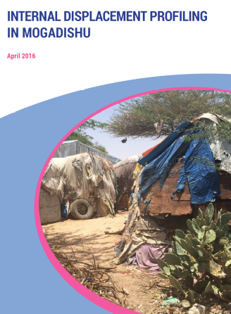
Zoom:Maktabka Tilmaamayaasha ee kulmiya hay’addaha: Cabirka horumarka laga gaarayo dhinaca xalalka ku aadan barakacayaasha
Koorsada A: Tilmaamayaasha cabirka dadweynaha ee furaha ah
Koorsada B: doorbidka mustaqbalka iyo qorshooyinka
Xog dejisan oo lagu heshiiyey
Ee loogu talagalay xog aruurinta si toos ah looga soo uruuriyo dadka uu saameyey barakaca iyadoo la adeegsanayo habab tirada
Oo ay kabi doonto falanqeyn xogta heer guud iyo xogta tayada
Koorsada C: 8da Shuruud ee xalalka waara ee IASC
Notes:
The interagency indicators library that was recently developed by many UN agencies and international NGOs based on the 8 IASC criteria + basic demographics and intention survey.
The Durable Solutions Indicator Library presents agreed-upon indicators that can be used to measure durable solutions outcomes. It can inform solutions-related policy, strategy processes, as well as programming and advocacy efforts.

Slide 9
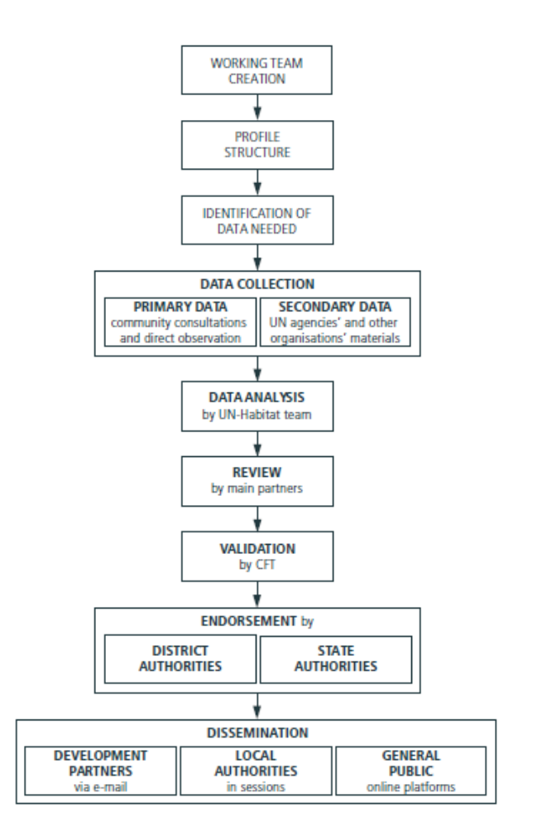
Zoom: Astaamaha Magaaloyinka ee Midnimo
Ujeeddada ugu weyn: soo bandhigid caddeyn aqoon amaahisa xalalka waara ee degsiimaynta magaaloyinka laguna hubiyo helitaanka xuquuqda iyo adeegyada DACs
Xaaladaha guud ee deegaanka iyo gobolka, oo ay ku jiraan xukunka, maamulka iyo aaladdaha qorsheynta sida NDP
Kobaca magaalooyinka, tirada dadka iyo awoodaha maxalliga ah
Qaababka isticmaalka dhulka, caqabadaha deegaanka iyo dhaqaalaha maxalliga ah
Adeegyada aasaasiga ah ee magaalooyinka
Cabirka barakaca, baahida iyo farqiga maqan ee adeega
Qorshaynta waxqabadka bulshada
development scenarios for town planning
Qorshaynta magaalada ayadoo la eegayo xaaladaha kala duwan ee horumarineed
Notes:
Source: Facilitating Durable Solutions in Somalia Experiences from Midnimo-I and the Application of Human Security, United Nations Trust Fund for Human Security

Slide 10
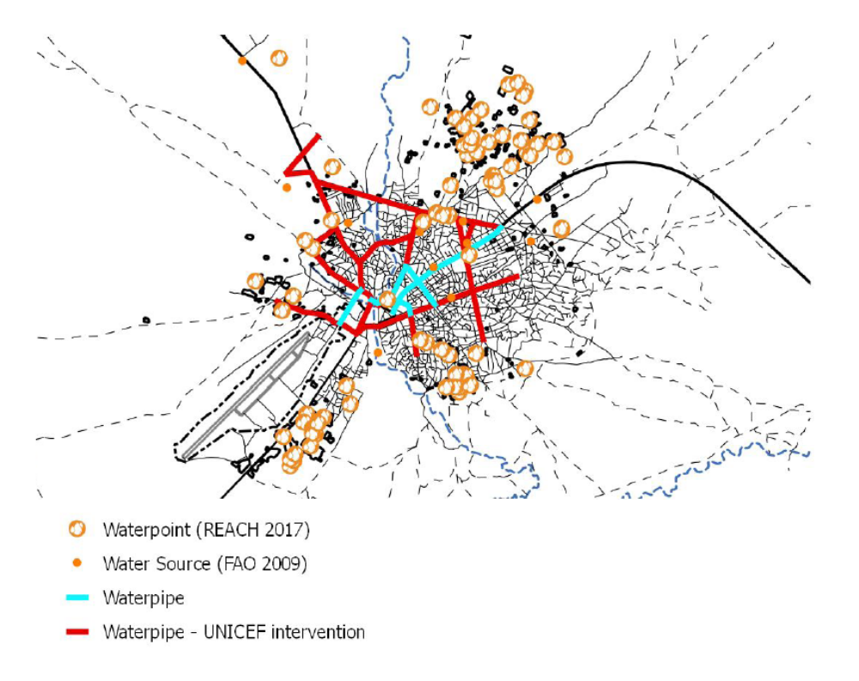
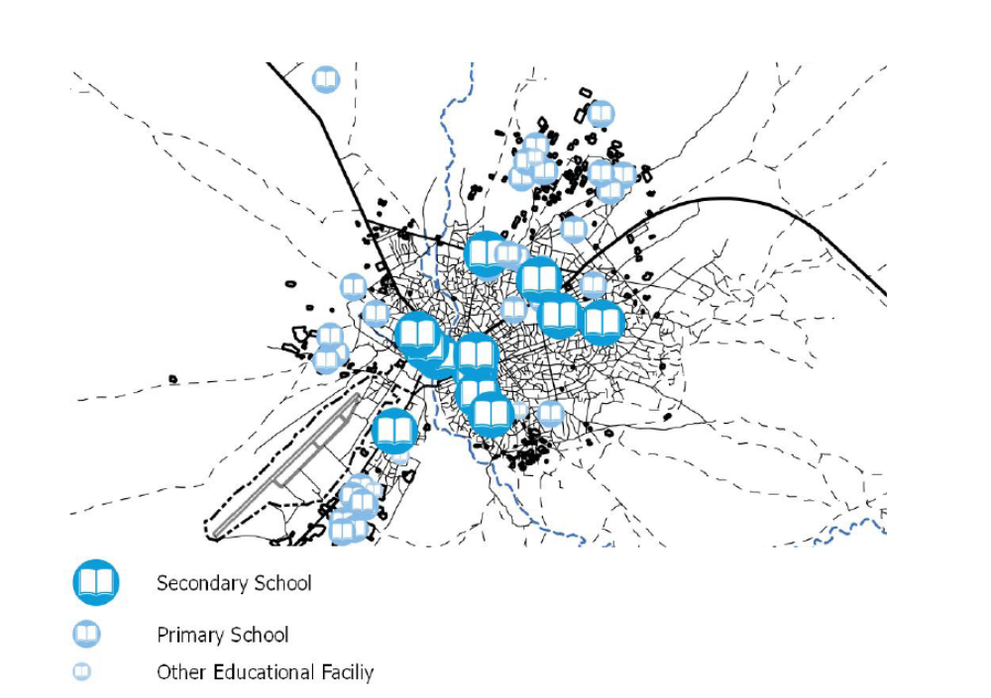
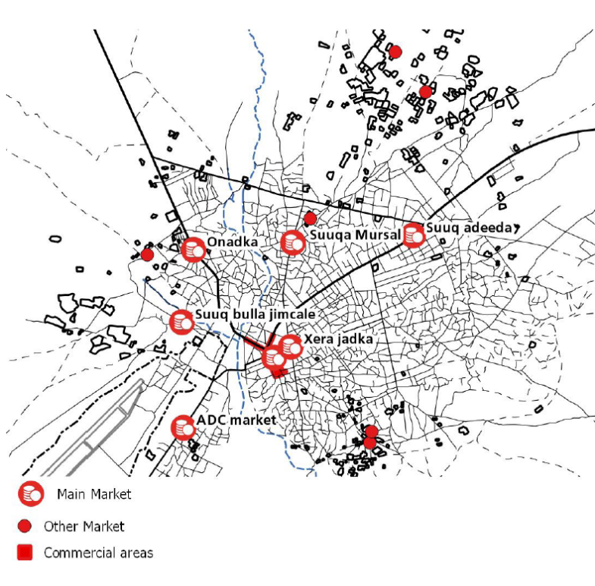
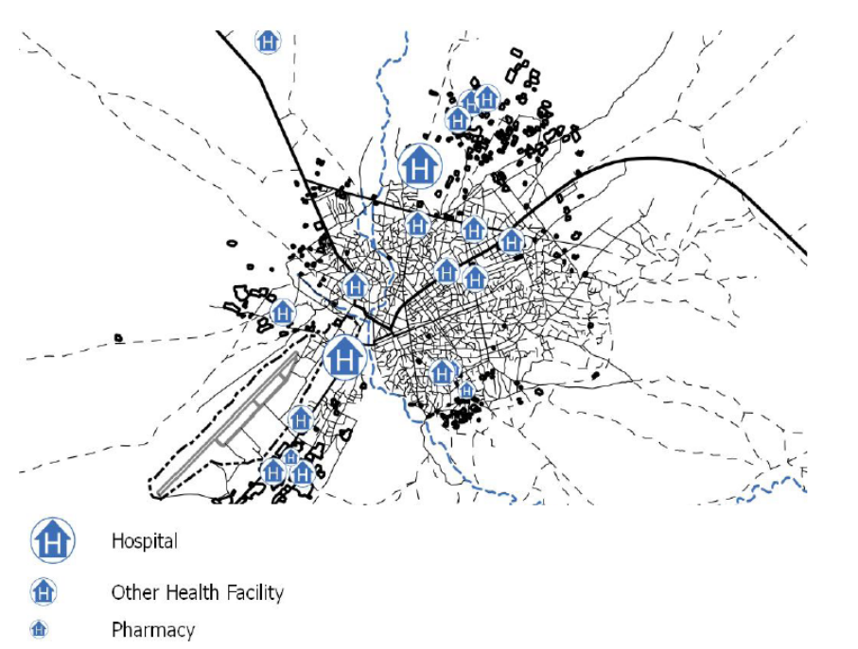
Dhanka saadka: Tirokoobka suuqyada iyo adeegyada aasaasiga ah ee magaalooyinka ee Baydhabo. Mashruuca Midnimo
Notes:
Source: Facilitating Durable Solutions in Somalia Experiences from Midnimo-I and the Application of Human Security, United Nations Trust Fund for Human Security

Slide 11
Ku celis iyo habsocodka
1
Dib-u-eegista iyo wadaagista xogta jirta iyo falanqaynta ay qabteen howlwadeenada maxalliga ah, kuwa qaran iyo kuwa caalamiga ahba.
Falanqaynta farqiga maqan ayaa la sameeyaa oo macluumaadka lagama maarmaanka ah kaliya ayay soo uruuriyaan howlwadeenada ku habboon, ayadoo lagu saleynayo faa'iidooyinka isbarbardhiga.
Qaababka kala duwan ee xog ururinta: xog uruurinta, warqadaha su'aalaha iyo sahaminta, tirokoobka, wadahadal kooxeedyada, Wareysiyada dadka xog ogaalka ah
Macluumaadka iyo gorfaynta labada dhinac ee saadka iyo baahida (dadka iyo adeegyada) waxay aqoon amaahiyaan falanqaynta iyo qorshaynta wadajirka ah
2
3
4

Slide 12



Qaab-dhismeedka ReDSS
Shuruudaha | Shuruudaha Hoose ee (IASC) | Tilmaamayaal
 | 1. BADBAADADA & AMNIGA / DIFAACA / WADAJIRKA BULSHADA | ?
 | 2. HELITAANKA ADEEGYADA AASAASIGA AH | ?
 | 3. HELITAANKA SHAQO ABUUR / FURSADO DHAQAALE | ?
 | 4. SOO CELINTA GURYEYNTA, DHULKA & HANTIDA | ?
 | 5. HELITAANKA DIIWAANGELIN | ?
 | 6. MIDEYNTA QOYSKA | ?
 | 7. KA QAYB QAADASHADA ARRIMAHA BULSHADA | ?
 | 8. HELITAANKA KAALMO WAX KU OOL AH IYO CADDAALAD | ?
Notes:
We have already examined the three safeties and corresponding criteria, the ReDSS framework developed a series of corresponding indicators to support the development of joint DS analysis.
- ReDSS framework is a tool that contributes to increasing the availability of data on displacement-affected communities, thereby supporting the development of more solutions-oriented responses; It was designed to support the development of solutions strategies and plans.
- The ReDSS Solutions Framework indicators measure the extent to which the 8 IASC criteria have been satisfied.
- The indicators are intended to be adaptable and contextualized- the analysis team may decide that certain indicators need to be tailored to the context to fit the theory of change of the solutions programme;
In most of the context it is relevant to draw linkages between the ReDSS/IASC indicators and SDGs or other national indicators to facilitate their inclusion in local and national plans.
Activity 2 (optional) : assign one or two criteria to each group and ask them to develop two indicators that could measure the progression of durable solutions for these criteria. Write the SMART indicators requirements on a flipchart to help them develop relevant indicators.
Specific:
Measurable
Relevant
Time bound

Slide 13
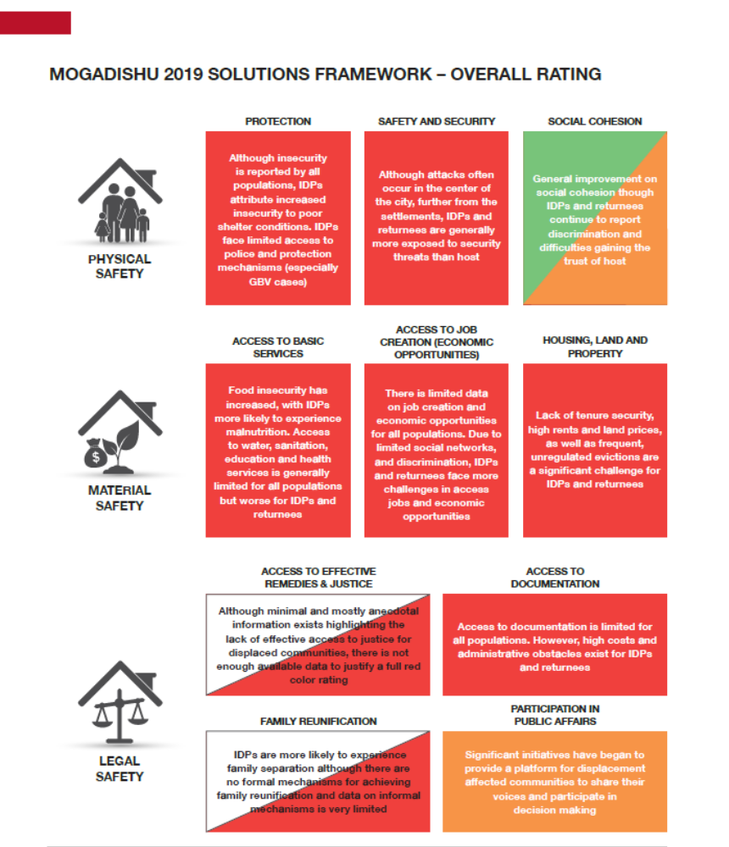
Buundeynta iyo Qiimeynta
Xaaladda dadka soo barakacay / kuwa dalka ku soo laabtay ayaa si aad ah uga xun tan dadka martida loo yahay, iyadoo ay jiraan nuglaansho ba’an oo barokaca u gaar ah iyo / ama takoor jira.
Xaalada dadka soo barakacay / kuwa dalka ku soo laabtay ayaa ka xun xaalada dadka martida loo yahay
Xaaladda dadka soo barakacay / kuwa dalka ku soo laabtay ayaa la mid ah ama ka fiican tan dadka martida loo yahay
Xog aan ku filnayn ayaa la heli karaa si loo buundeeyo shuruudahaan

Slide 14
Sideen u isticmaali karnaa qaab-dhismeedkan?
Qaab dhismeedka 'ReDSS' waa aalad gacan ka geysata kordhinta helitaanka xogta ee bulshada uu saameeyey barakaca;
Waxaa loogu talagalay in lagu taageero horumarinta istiraatiijiyadaha xalka iyo qorshooyinka.
Tilmaamayaasha Qaabdhismeedka xalalka ReDSS waxay cabiraan ilaa heerka 8da shuruud ee IASC la buuxiyey.
Tilmaamayaasha waxaa loogu talagalay inay noqdaan kuwo la jaanqaadi kara howlaha isla markaana lagu dabaqi karo xaalada guud - kooxda falanqeynta ayaa go'aansan karta in tilmaamayaasha qaarkood ay u baahan yihiin in la waafajiyo xaalada guud si ay ula jaan qaadaan aragtida isbeddelka ee barnaamijka xalka.;
Inta badan xaaladaha guud ee goobaha mashaariicda waxa habboon in la sawiro isku xirnaanta u dhexeeysa tilmaamayaasha ReDSS / IASC iyo SDGs ama tilmaamayaasha kale ee qaran si loo fududeeyo ka mid noqoshadooda qorshayaasha maxalliga ah iyo kuwa qarankaba.

Slide 15
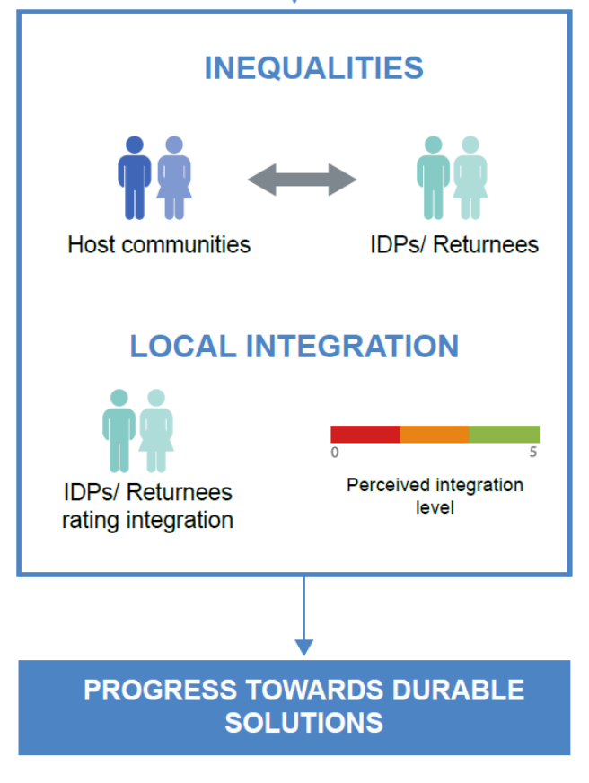
Dhaqan gelinta maxalliga ah ee qaabdhismeedka ReDSS ee Soomaaliya: LORA
Qiimeynta Isdhexgalka Deegaanka (Re) (LORA) waxay isku dartaa qaabdhismeedka IASC / ReDSS oo ay waheliyaan fikradaha maxalliga ah ee isdhexgalka.
Habka ayaa qiimeeyaa:
sinaan la'aanta udhaxeysa barakacayaasha iyo bulshada martida loo yahay dhamaan shuruudaha IASC (muuq ahaan, walxo ahaan iyo badbaado sharci).
Heerka ay gaarsiisan tahay inay barakacayaasha iyo dadka dalka ku soo laabtay inay dareemayaan isdhexgal, iyagoo iswaafajinaya qiyaasta barakacayaasha ee heerkooda is dhex galka oo ay waheliyaan jawaabaha su'aalaha shuruudaha IASC;
Notes:
https://regionaldss.org/wp-content/uploads/2020/12/Danwadaag_Measuring-the-End-of-Displacement-Emerging-Learning-from-Somalia.pdf

Slide 16
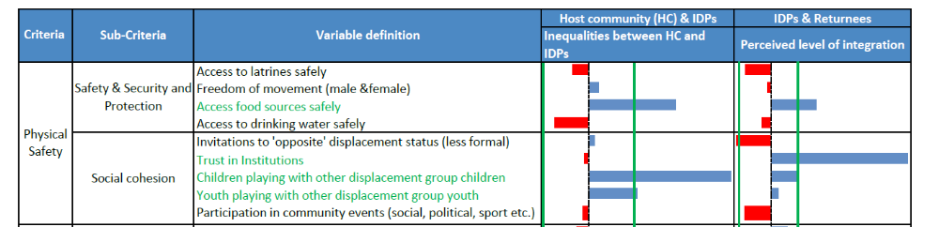
LORA-DU
LORA waa Agab barnaamij ku saleysan oo loo habeeyay duruufaha Soomaaliyeed ee kormeera horumarka dhinaca isdhexgalka oo soo saarta falanqeyn la jaanqaadaysa barnaamijyada iyo mudnaanta koowaad la siinayo oo mudnaanta siiya ilo oo waliba mudnaanta siiya ilo loogu talagalay Xalalka Waara. Waxay bixisaa 'khariidad waddo' oo loogu talagalay in lagu dhaqaajiyo qoysaska uu saameyey barakaca iyo bulshooyinka xagga isdhexgalka weyn

Slide 17
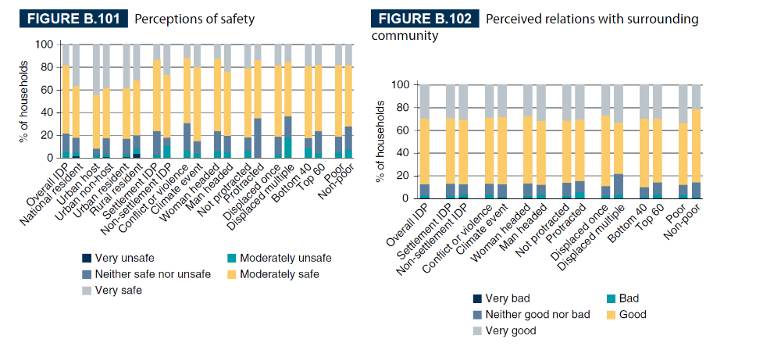
Ka mid noqoshada Xog uruurinta Qaranka / qiimeynta Saboolnimada
Barakacayaasha waa in lagu daraa nidaamyada aruurinta xogta qaranka
Falanqaynta xogta yar ee Bangiga Adduunka ee Soomaaliya (tilmaamayaasha barakaca ee qiimeynta saboolnimada)
Falanqaynta xogta yar ee dhaqan-dhaqaale ee ku saleysan qaab dhismeedka IASC
Muuqaalka astaamaha guud ee barokacayaasha oo ku xiraya sababihii ay usoo barakaceen oo ay waheliso baahidooda hada, hantidooda, iyo hamigooda hadda jira.
Xog shakhsiyeed iyo heer qoys labadaba
Waxaa ka mid ah bulshooyinka martida loo yahay iyo kuwa barokacay si laysugu barbardhigo.
Notes:
http://documents1.worldbank.org/curated/en/968141557465726421/pdf/Volume-B-Country-Case-Studies.pdf

Slide 18
Fariimaha Muhimka ah
Falanqeyn xalalka waara oo ku saleysan xog adag, ugu dambeyey oo ah xog lasoo gudbiyey ayaa fure u ah in lagu kabo horumarinta qorshaha la beegsaday ee xalka waara
Falanqeyn xalal waara oo xeel dheer waa inay ku jirtaa xog kala duwan oo ku saabsan dadweynaha (DAC), dhinaca baahida, iyo goobta, dhinaca saadka.
Falanqaynta noocan oo kale ah waa inay awood u siisaa howlwadeenada ka qayb qaadanaya xalalka waara in la isbarbardhigo xaaladaha barakacayaasha iyo martigaliyayaasha, si loo aqoonsado kuwa ugu nugul iyo in wax looga qabto arrimaha ay wadaagaan ee gaarka u ah dhibaatooyinka barakaca si wax looga qabto ayadoo la raacayo qaab istiraatiiji ah.
Qaab-dhismeedka ReDSS oo ku saleysan shuruudaha IASC waxaa loo sameeyay in lagu taageero falanqaynta iyo qorshaha noocaas ah. Waxaa loo isticmaali karaa inay noqoto bar bilow ah, la jaangooyay oo laga dhaqan geliyey xaaladaha maxalliga ah iyo waaqica jira.
Ku darista xog uruurinta la xariirta barakaca iyo xog uruurinta qaranka iyo qiimeynta saboolnimada ayaa fure u ah in lagu kabo siyaasada iyo qorshooyinka heer qaran iyo heer deegaan
.

