Slide 1





Adopting a multisectoral and mutlistakholder approach
Develop or use existing coordination mechanisms
Assessing and measuring durable solutions
Involving DAC through Community-based planning
Adopting an area-based approach
Durable Solutions. How do we do it?
Notes:
This slide is a recap of activity 3

Slide 2

3
Assessing and measuring Durable Solutions

Slide 3
Objectives of Session
Explain why and what assessments are key to develop a durable solutions plan and measure the progression toward durable solutions
Explore what type of data and analysis we need to carry out a durable solutions analysis to better programme for DS in Somalia.
Examine the different tools and frameworks developed to assess and measure the progression towards durable solutions in Somalia.

Slide 4
Why do we need data and analysis?
To understand the vulnerabilities, needs and capacities of the DAC
To better understand potential conflict dynamics to mitigate them
To map the availability, accessibility and functioning of services
To set SMART benchmarks and indicators to monitor progress towards solutions
Notes:
Make this section participatory by showing and the title + the question mark icon (animation already inserted) of the slide first and asking the question to the participants. Only show the bullet points after you managed to get sufficient good/relevant arguments/answers.

Slide 5
What data do we need? Activity
Three step activity:
Think individually for 5 minutes and list the data and information that you think would be needed
Share your ideas in pairs for another five minutes
Consolidate your ideas in your groups (tables) in 10 minutes trying to group them in a logical way.
What data and information do we need to carry out a durable solutions analysis and plan for durable solutions in the delimitated area?

Slide 6








Area-based solutions analysis
An area-based analysis utilizes a defined spatial area as the entry point for understanding:
the characteristics and conditions
of target populations
the specific characteristics of the areas hosting them, such as services and infrastructures capacity
Notes:
This slide is animated slide : each sentence on the left is illustrated by icons on the right appearing simultaneously.
The main messages here is that:
- The selected area will be the entry point for data collection and analysis on:
The different categories of populations (refugees, IDPs, host communities) to be able to compare the common and different needs of the different segment of populations;
Characteristics of the location’s structures and services.
A detailed list of the types of data for each side (population and location) is provided in the following slide.

Slide 7

What data and analysis ?
Data on Places/ the supply side
Infrastructure mapping/damage assessment
Service availability & provision
Livelihood / labour market
Housing Land and Property regime
Governance structures/ actors dynamics
Data on Populations/demand side
Disaggregated demographics
Displacement patterns
Access to services
Safety and security
Access to livelihoods
Access to HLP
Community cohesion…
Notes:
Here is a comprehensive approach to bring data on people and data on locations together.
This entails collecting macro data on the places and micro data on the population.
It is also a combination of quantitative and qualitative data.
Secondary data: We don’t automatically need to collect all the data. Part of it maybe available with partners.
We don’t need to collect and search for all the data, only the data and information that we need!
Activity 2: scattered data.
Source: Based on Jips presentation on area-based solutions analysis.

Slide 8
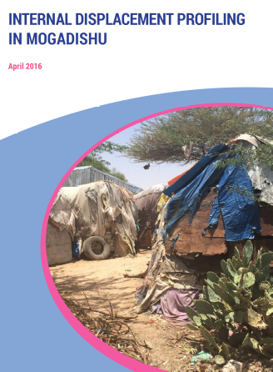
Zoom: Interagency Indicators library: Measuring progress towards solutions for IDPs
Module A: Core demographic indicators
Module B: future preference and plans
Agreed upon set of data
Meant for collecting data directly from displacement-affected populations using quantitative methods
To be complemented by macro level data and analysis and qualitative data
Module C: 8 IASC durable solutions criteria
Notes:
The interagency indicators library that was recently developed by many UN agencies and international NGOs based on the 8 IASC criteria + basic demographics and intention survey.
The Durable Solutions Indicator Library presents agreed-upon indicators that can be used to measure durable solutions outcomes. It can inform solutions-related policy, strategy processes, as well as programming and advocacy efforts.

Slide 9
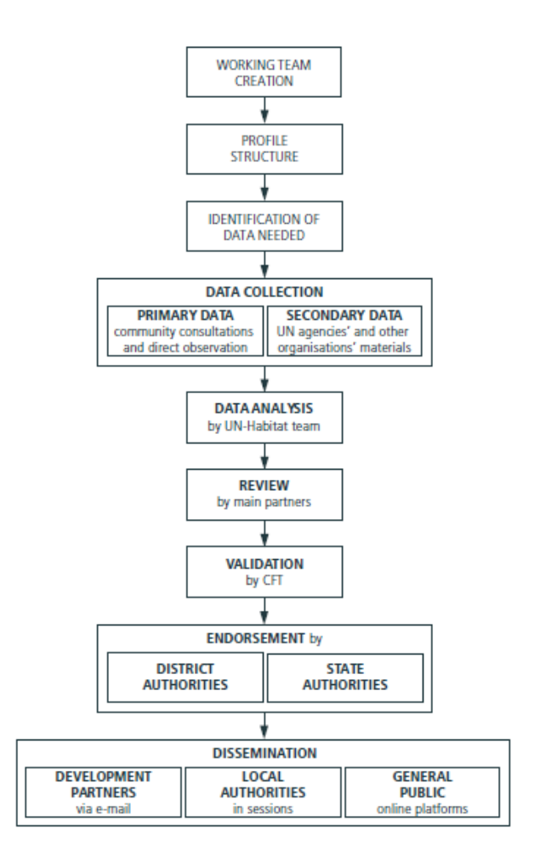
Zoom: Midnimo urban profiles
Main goal: provide evidence to inform durable solutions in urban settlement and ensure access to rights and services to DACs
local and regional context, including governance, administration and planning instruments such as the NDP
urban growth, demographics and local capacities
land use patterns, environmental constraints and local economy
basic urban services
dimensions of displacement, needs and service gap
community action planning
development scenarios for town planning
Notes:
Source: Facilitating Durable Solutions in Somalia Experiences from Midnimo-I and the Application of Human Security, United Nations Trust Fund for Human Security

Slide 10
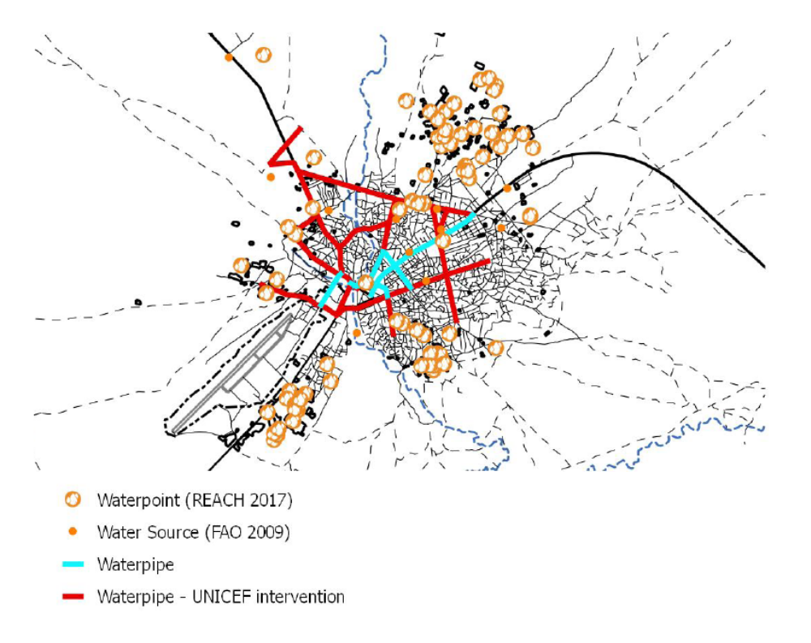
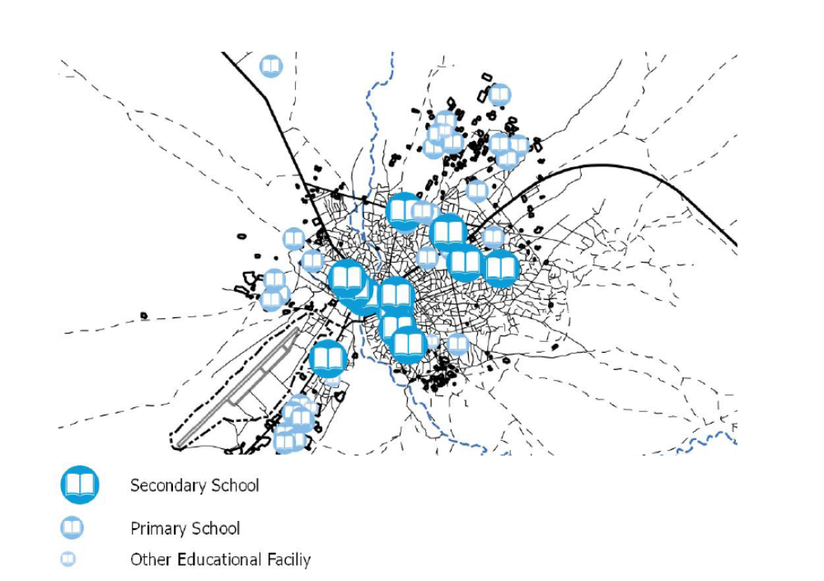
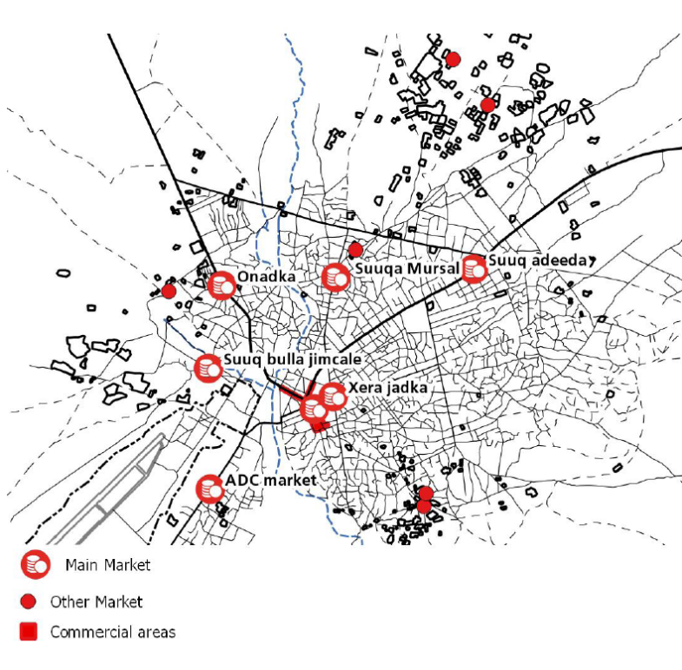
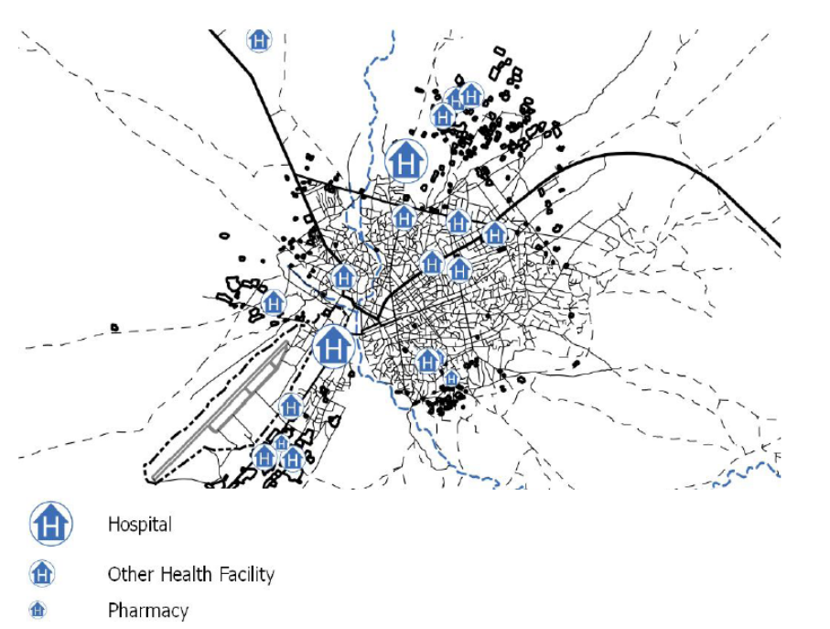
The supply side: Mapping of markets and basic urban services in Baidoa.
Midnimo Project
Notes:
Source: Facilitating Durable Solutions in Somalia Experiences from Midnimo-I and the Application of Human Security, United Nations Trust Fund for Human Security

Slide 11
Recap and process
1
Review and sharing of existing data and analysis held by local, national and international actors.
A gap analysis is carried out and only necessary data is collected by relevant actors, based on comparative advantages.
A variety of data collection methodology: statistics, questionnaires and surveys, mapping, focus group discussions, Key Informant Interviews
Data and analysis on both supply and demand side (persons and services) inform joint analysis and planning
2
3
4

Slide 12



ReDSS framework
Criteria | Sub criteria (IASC) | INDICATORS
 | 1. SAFETY & SECURITY/ PROTECTION/ SOCIAL COHESION | ?
 | 2. ACCESS TO BASIC SERVICES | ?
 | 3. ACCESS TO JOB CREATION/ ECONOMIC OPPORTUNITIES | ?
 | 4. RESTORATION OF HOUSING, LAND & PROPERTY | ?
 | 5. ACCESS TO DOCUMENTATION | ?
 | 6. FAMILY REUNIFICATION | ?
 | 7. PARTICIPATION IN PUBLIC AFFAIRS | ?
 | 8. ACCESS TO EFFECTIVE REMEDIES AND JUSTICE | ?
Notes:
We have already examined the three safeties and corresponding criteria, the ReDSS framework developed a series of corresponding indicators to support the development of joint DS analysis.
- ReDSS framework is a tool that contributes to increasing the availability of data on displacement-affected communities, thereby supporting the development of more solutions-oriented responses; It was designed to support the development of solutions strategies and plans.
- The ReDSS Solutions Framework indicators measure the extent to which the 8 IASC criteria have been satisfied.
- The indicators are intended to be adaptable and contextualized- the analysis team may decide that certain indicators need to be tailored to the context to fit the theory of change of the solutions programme;
In most of the context it is relevant to draw linkages between the ReDSS/IASC indicators and SDGs or other national indicators to facilitate their inclusion in local and national plans.
Activity 2 (optional) : assign one or two criteria to each group and ask them to develop two indicators that could measure the progression of durable solutions for these criteria. Write the SMART indicators requirements on a flipchart to help them develop relevant indicators.
Specific:
Measurable
Relevant
Time bound

Slide 13
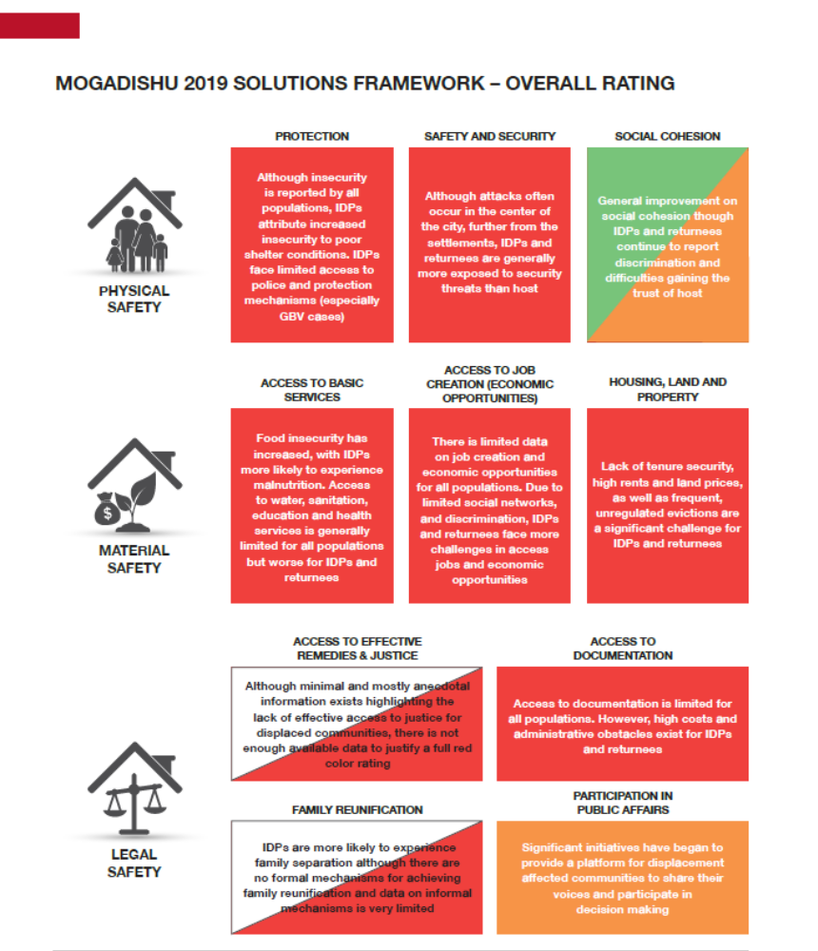
Rating and assessment
The situation of IDPs/ returnees is significantly worse than that of the host population, with significant displacement-specific vulnerabilities and/or discrimination existing
The situation of IDPs/ returnees is worse than that of the host population
The situation of IDPs/ returnees is similar or better than that of the host population
Inadequate data is available to rate this criteria

Slide 14
How can we use this framework?
ReDSS framework is a tool that contributes to increasing the availability of data on displacement-affected communities;
It was designed to support the development of solutions strategies and plans.
The ReDSS Solutions Framework indicators measure the extent to which the 8 IASC criteria have been satisfied.
The indicators are intended to be adaptable and contextualized- the analysis team may decide that certain indicators need to be tailored to the context to fit the theory of change of the solutions programme;
In most of the context it is relevant to draw linkages between the ReDSS/IASC indicators and SDGs or other national indicators to facilitate their inclusion in local and national plans.

Slide 15
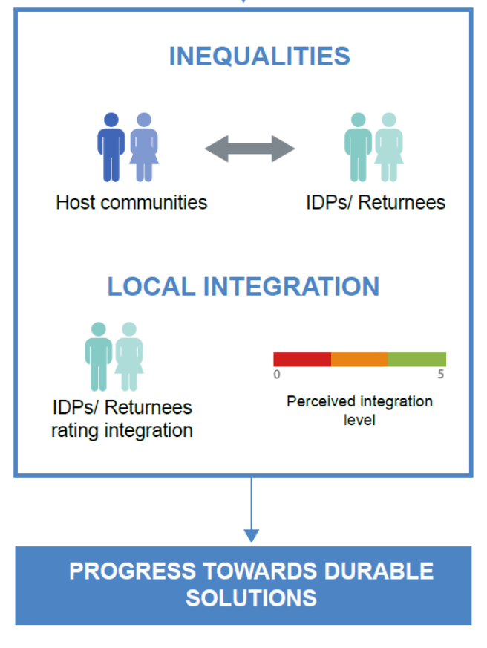
Local adaptation of the ReDSS framework in Somalia : the LORA
The Local (Re)Integration Assessment (LORA) combines the IASC/ReDSS frameworks with localized concepts of integration.
The method evaluates:
the inequality between IDPs and host community across the IASC criteria (physical, material and legal safety).
the extent to which IDPs and returnees feel integrated, by correlating IDPs’ rating of their level of integration with answers to IASC criteria questions;
Notes:
https://regionaldss.org/wp-content/uploads/2020/12/Danwadaag_Measuring-the-End-of-Displacement-Emerging-Learning-from-Somalia.pdf

Slide 16
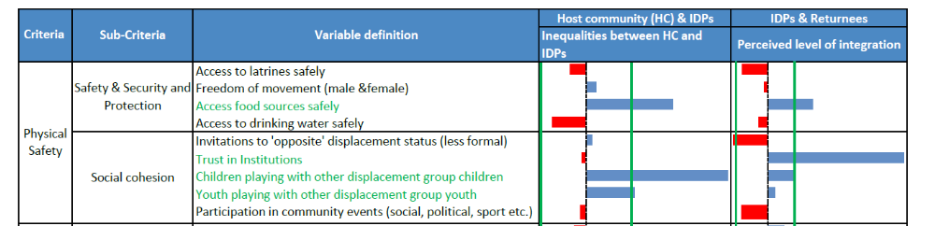
The LORA
The LORA is a programme-based tool adapted to the Somali context that monitors progress towards integration and generates analysis to adapt programming and prioritise resources and prioritise resources for Durable Solutions. It provides a ‘road map’ for moving displacement-affected households and communities towards greater integration.

Slide 17
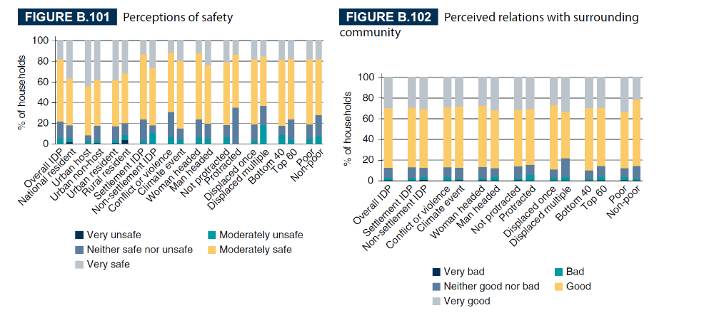
Inclusion in National Statistics / Poverty assessments
Displaced persons should be included into national data collection systems.
World Bank micro data analysis for Somalia (displacement indicators in poverty assessments)
Socio-economic micro-data analysis based on IASC framework
A holistic profile of IDPs linking the causes of their displacement with their current needs, assets, and aspirations.
Both individual and household-level data
It includes host communities and displaced for comparison.
Notes:
http://documents1.worldbank.org/curated/en/968141557465726421/pdf/Volume-B-Country-Case-Studies.pdf

Slide 18
Key messages
A durable solutions analysis based on solid, up to date and shared data is key to inform the development of a targeted durable solution plan.
A comprehensive durable solutions analysis should include a variety of data on the populations (DAC), the demand side, and on the place, the supply side.
Such an analysis should enable the actors involved in the durable solutions to compare the situations of displaced and hosts, to identify the most vulnerable ones and to address common and displacement specific issues to address them in a strategic manner.
The ReDSS framework which is based on the IASC criteria was developed to support such analysis and plan. It can be used as a starting point, tweaked and adapted to the local situations and realities.
The inclusion of displacement statistics into national statistics and poverty assessments is key to inform national and local policy and plans.

