Slide 1





Raacida qaab ay ku bahoobeen waaxyo badan iyo hawleedeeno badan
Horumari ama isticmaal farsamooyinka isuduwidda jirta
Qiimaynta iyo cabirka xalalka waara
Ku lug lahaanshaha DAC iyada oo loo marayo qorsheynta ku saleysan Bulshada
Raacida qaab deegaan ku saleysan
Xal waara. Sideen u qabanaa?
Notes:
This slide is a recap of activity 3

Slide 2


4
DAC lug lahaansho haku yeelato iyadoo loo marayo qorsheynta ku saleysan Bulshada

Slide 3
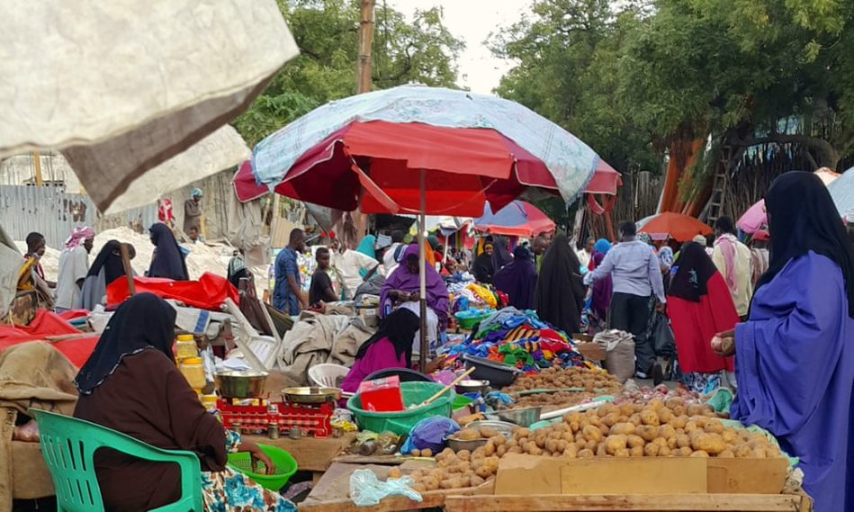
Abaabulka DAC
Ogeysii
La tasho
Awood sii
Ka qaybgeli
Iskaashi samee
Notes:
Here is a short energizer to start with (optional) :
Only shows the title of the slide at the end of the energizer. The animation is inserted.
Graphic facilitation: ask 5 groups to find a good way to draw/find a visual for the following terms, each group is assigned a term:
Inform
Consult
Empower
Involve
Collaborate
Give them 5 to 10 minutes, show the different drawings and ask the participants why, in their opinion, they were asked to work on these specific words?
Explain that informing, consulting, empowering, involving and collaborating with DAC are the main ways to ensure their participation to the planning, implementation and monitoring of an Area-based plan.
Key message: Throughout this session, we will try and find ways to inform, consult, empower, involve and collaborate with DAC to develop area-based plan reflecting their needs, vulnerabilities, capacities and concerns.

Slide 4
Ujeedooyinka Kulanka
Adeegso hab ku saleysan bulshada iyo habka ka qaybqaadashada.
Sharax waxa ay tahay Qorshaynta ku saleysan Bulshada
Sharax geeddi-socodka qorshe hawleedka bulshada illaa ku daristiisa qorshaynta maxalliga ah ama heer qaran.
Baaritaan ku same mashaariicda qorshaynta bulshada ku saleysan ee laga fuliyo Soomaaliya iyo saameynta ay ku leeyihiin DAC

Slide 5

Zoom: Barnaamijka Isla-xisaabtanka Bulshada ee la wadaago (CSAP)
Raadiye lagu dhisayo wadahadalo laguna ururiyo ra'yiga dadweynaha ee ku saabsan arrimaha la xiriira xalalka waara
Waxaa soo diyaariyay asaaska Codadka Afrika
Waxaa la daah furay ayadoo lakaashanayo ReDSS iyo Maamulka Gobolka Banaadir
"Haa, waxaan dareemayaa inaan qayb ka ahay maxaa yeelay latashiga bulshada had iyo jeer waa waxa ugu fiican ee laqaban karo shaqsiyanna aniga waxaan aaminsanahay inaan kamid ahay go'aamada bulshada dhexdeeda waana uga mahadcelineynaa in badan kuwa ka dhigay goobahan nabdoon kuwo hadla sida soo jeediyaasha ka hadla raadiyaasha, hogaamiyaasha ku lugta leh iyo ururada gargaarka ee ku lugta leh sidoo kale. "
Kaqeybgale dumar, Muqdisho, Soomaaliya
Notes:
This slide is optional.

Slide 6
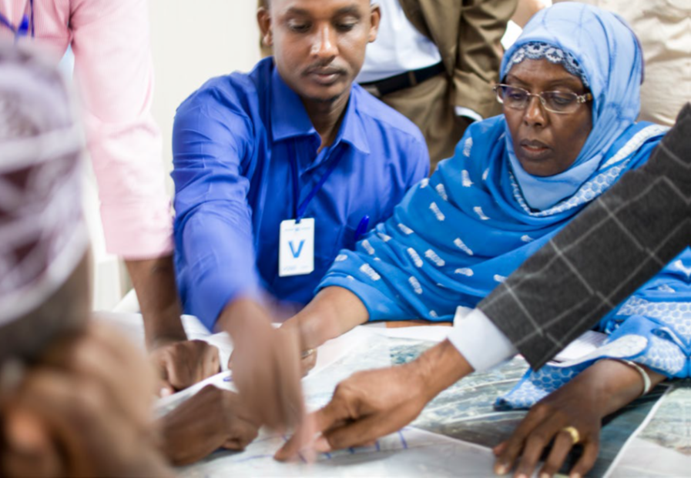
Isla xisabtan loo sameynayo dadka saameyntu gaartay
Kaqeybgalka iyo ka mid noqoshada: kaqeybgalka dhamaan xubnaha DAC ee wax ku ool ah oo macnahana leh ee dhamaan heerarka qorshooyinka xalalka waara
Isgaarsiinta iyo hufnaanta: macluumaad cad oo ku saabsan xuquuqdooda, waxyaabaha ay mulki u leeyihiin iyo barnaamijka iyadoo loo marayo marinnada isgaarsiinta ee la heli karo oo ku qoran luuqad ay fahmayaan
Nidaamka jawaab celinta iyo ka falcelinta
Wadatashiga Qorsheynta Magaalada,
Baydhabo / UN-HabitatMidnimo
Notes:
Accountability to affected population is not more than ensuring that people are at the centre of the area-based approach and that partner organisations are not only accountable to donors but first and foremost to the population that they are working with.
Accountability refers to the responsible use of power (resources, decision making) by humanitarian and development actors, combined with effective and quality programming that recognizes a community’s dignity, capacity, and ability to be independent. Area-based project partners commit to ‘putting people first' and drawing on the rich range of experiences, capacities, and aspirations of refugee, displaced and hosts women, men, girls and boys. In addition, they are committed to being accountable to the people they serve by listening and responding to their needs, perspectives, and priorities.
These can be done through three types of enablers listed on the slide.
UNHCR's AAP framework and these values are outlined in UNHCR's Policy on Age, Gender and Diversity (AGD, 2018), specifically core actions 2-5:

Slide 7
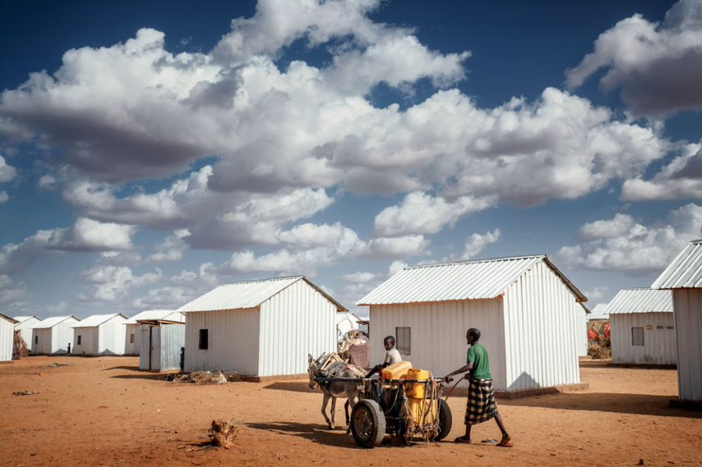
Habka ku saleysan bulshada. Waa maxay?
Habka ay bulshooyinka door firfircoon ku leeyihiin kana qaybgalaan muujinta iyo wax ka qabashada arrimaha iyaga quseeya
Notes:
Adopting a community-based approach throughout the area-based planning process is the best way to ensure DAC effective involvement and participation and real Accountability to Affected Populations.

Slide 8



Cabbir labalaabma
1
2
Awood siinta bulshooyinka si ay uga qeyb qaataan geedi socodka qorshaynta ka qaybqaadashada ee ku saleysan aaga oo si toos ah noloshooda u saamaynaya
Xoojinta awoodaha mas'uuliyiinta heer qaran iyo heer degmo iyo la-hawlgalayaasha si ay u hoggaamiyaan, u qorsheeyaan iskuna duwaan waxqabadyada ku saleysan bulshada
Notes:
Key message:
Community-based approach entails communities to take part to area-based participatory planning processes directly affecting their life and strengthening the capacities of local actors to lead such participatory process to ensure that interventions will respond to the needs of the DAC. To this end, community-based interventions should also strengthen local coordination and planning capacities. This is a great way for national ad local authorities to strengthen social cohesion between different groups, reinforce their legitimacy and improve their relationship with DAC.
Plenary discussion: Ask about relevant/successful examples of initiatives at local level involving a community-based approach.

Slide 9
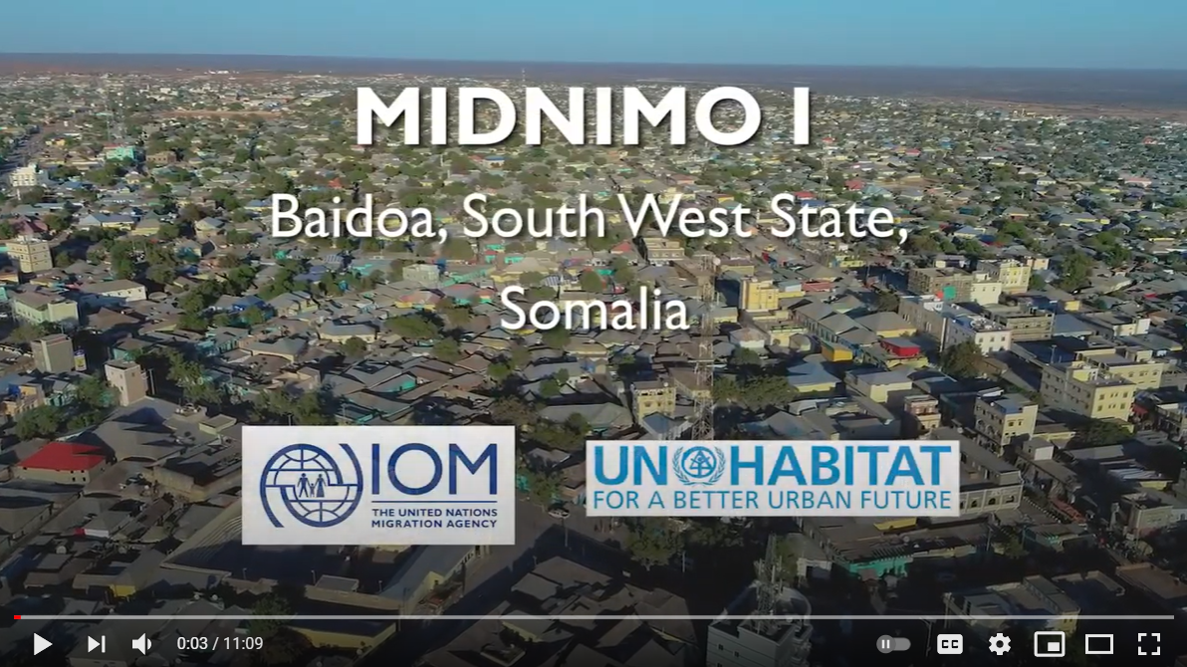
Filin iyo Wadahadalo
Maxay yihiin, sida aad adigu isleedahay faa'iidooyinka ugu waaweyn ee habka qorshaynta bulshada ku saleysan?
Maxay yihiin caqabadaha ama dhibaatooyinka ugu waaweyn ee aad isleedahay waxay caqabad ku noqon karaan hirgelinta geeddi-socodka noocan ah?
Sidee xal ugu raadin kartaa arimahan?
Notes:
You can show this video if you have time.
https://www.youtube.com/watch?v=xajkcqqzurs

Slide 10
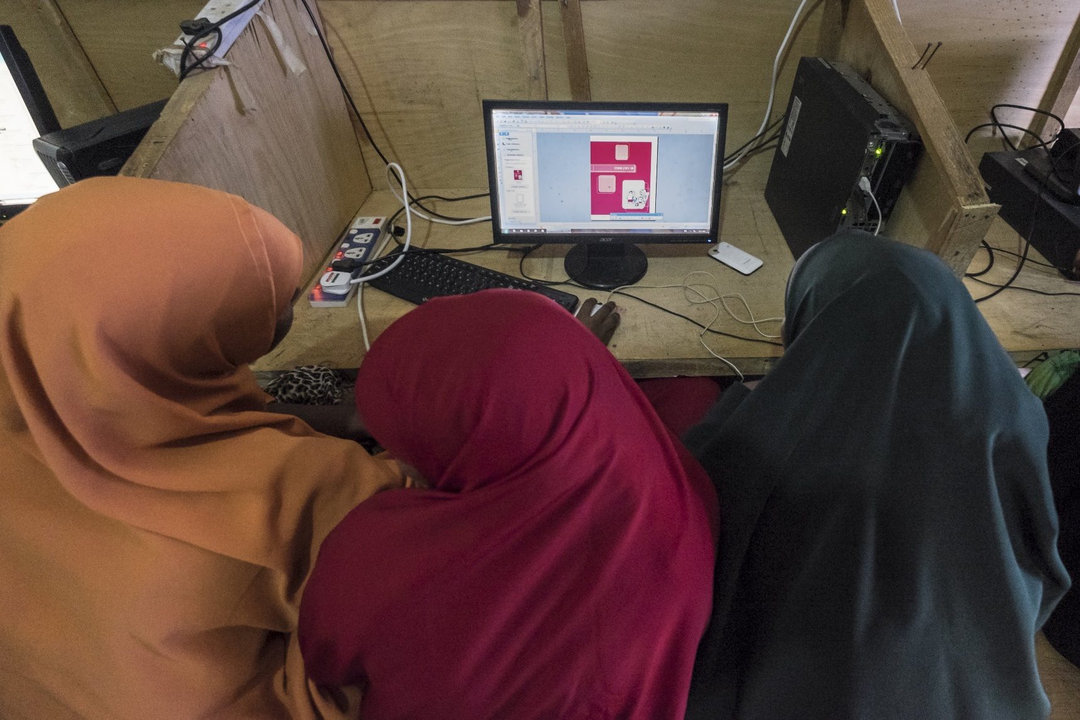

Qorshe Howleedka Bulshada ee ah Xalka waara
Notes:
Key messages:
- In the Community Action Planning process DAC are the primary resource rather than the objects of solutions planning. This approach motivates them to take the lead in the planning and implementation of solutions activities.
- Community Action Planning develops the capacity of the communities to take appropriate actions for their own solutions
- It is important that the DAC itself prepares the Community Action Plan as it helps to internalize the plans and to take responsibility for implementation and maintenance.
- The planning process is carried out in the form of workshops under the lead of the local Government, in which the DAC members and other partner organizations participate.

Slide 11
Maxay yihiin Qorshe Howleedka Bulshada (CAPs)
DAC waxay kaqeyb qaadataa qorshaynta aaga ku saleysan, iyadoo loo marayo:
Aqoonsiga nuglaantooda, baahidooda, kartidooda, mudnaantooda iyo himilooyinkooda mustaqbalka
Aqoonsiga xalalka suurtagalka ah
Diyaarinta, isugeynta iyo ansaxinta qorshaha waxqabadka bulshada ee ku saleysan mudnaan siinta
Ka qaybqaadashada fulinta
Kaqeybgal firfircoon ee kormeerka iyo qiimeynta
Nidaam awood u siinaya bulshooyinka, oo ay ku jiraan kooxaha dhaqan-dhaqaale ee nugul iyo hoggaamiyeyaashooda inay dalbadaan oo ay si firfircoon uga qaybgalaan waxqabadyada horumarineed ee ku haboon danahooda

Slide 12
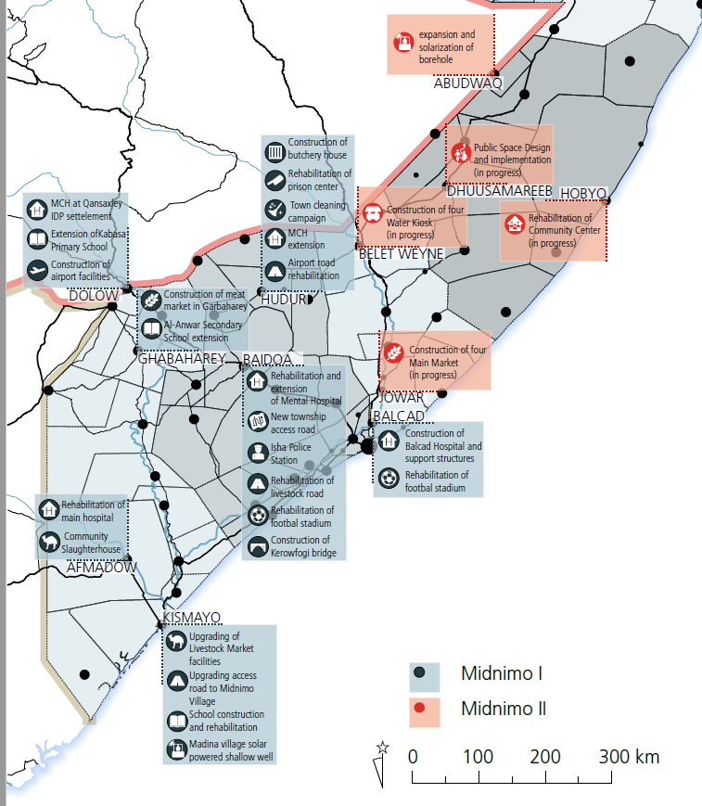
Qorshe Howleedka Bulshada Midnimo
Qorshayaal ku saleysan bulshada ayaa udub dhexaad u ahaa mashaariicda Midnimo
7 Qorshe Howleedka Bulsho oo ay leedahay Midnimo I iyo 6 ay leedahay Midnimo II
Iyadoo la waafajinayo geedi socodka Is-afgaradka Nidaamka Qorsheynta ee Qaab-dhismeedka Wadajir oo ay dowladda hoose u adeegsato inay ku dhiirrigeliso mashaariicda ay wadaan bulshada

Slide 13
Mabaadi'da geedi socodka Qorshe Howleedyada Bulshada
Kaqeybgalka loo dhanyahay oo leh aragti lagu hagaajinayo wadajirka bulshada iyo xiriirada lala yeesho kooxaha laga yaabo inay leeyihiin dano is khilaafsan. Kaqeybgalka haweenka, dhalinyarada, barakacayaasha, dadka dalka ku soo laabtay iyo kooxaha kale ee la xaqiro iyo kuwa aan muuqan waa in la damaanad qaadaa
Natiijooyinka iyo geeddi-socodka inay lahaato Somaalida: hoggaaminta maxalliga ah iyo lahaanshaha bulshooyinka. Sharcinimada maamulka deegaanka oo la xoojiyay
Geedi socodka qorshaynta is afgaradka: kobcinta iskaashi wada shaqey oo waara oo ku saleysan aaminaad
DAC ay hesho Daahfurnaan iyo islaxisaabtan
Notes:
Optional slide
Based on Midnimo process. Source: IOM Community-Based Planning Approach Facilitation Guideline

Slide 14






Yaa ka mid ah Qorshe Howleedka Bulshada?
Wakiillada dhammaan kooxaha dhaqan-dhaqaale ee bulshada la soo xulay. Dhammaan codadka waa in la dhageystaa!
Bulshada ama hoggaamiyeyaasha maxalliga ah si ay u abaabulaan xubnaha bulshada ayna u abuuraan jawi awood siiya
Fududeeyeyaasha loo tababaray fududeynta wadatashiga iyo doodaha
Mas’uuliyiinta maxalliga ah inay hubiyaan isku xirnaanta qorshayaasha waxqabadka bulshada iyo qorshooyinka degmada
Bixiyeyaasha taageerada farsamada: Xukumada, maamulada maxalliga ah, UN, NGOs, Qaybaha gaarka loo leeyahay ee dhagaysta kuna daraya barnaamijyadooda mudnaanta DAC
Kuwa doorka cayaara ee aan muuqan/Dadka saameynta leh

Slide 15

Weynee Guddiga fududeeyayaasha
Maxay yihiin?
Ragga iyo haweenka ay magacaawday Dawlada Hoose.
Shaqaalaha waaxda dowladda ee ay khuseeya
Lataliyaha deegaan waaxeed
Madaxa Tuulada
Ward/village Secretary
Xoghayaha waaxda / tuulada
Maxay qabtaan?
Waa ay wada shaqeeyaan si ay uga caawiyaan bulshada inay muujiyaan waxa ay jeclaan lahaayeen inay ka dhacaan bulshadooda dhexdeeda
Waxay hubiyaan inaysan bulshada ku soo rogin aragtidooda ama mid dibadda kaga timid.
Notes:
Optional slide.
Taking lessons from one district to inform activities in the other locations, the selection process for CFT members was updated over the course of the project. While the first CFT in Kismayo consisted of four men from the local government, the last CFT that was established in Balcad comprised two women and two men, equally representing the community and the government - Midnimo handbook, 2020.

Slide 16
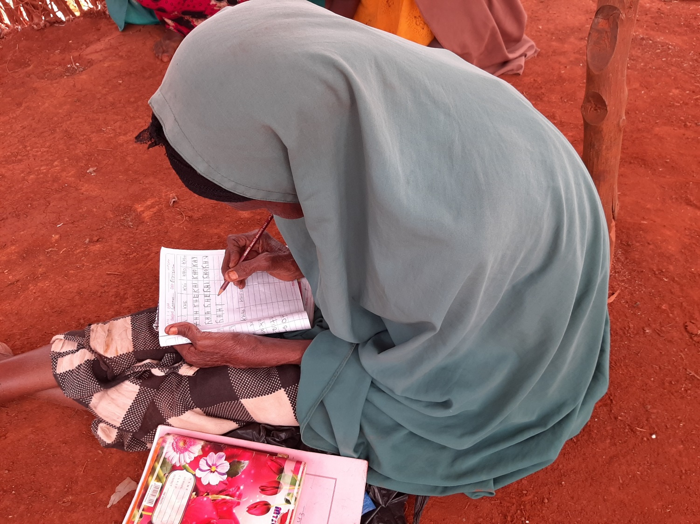
Howl: Yaa ka mid ah Qorshe Howleedka Bulshada
Notes:
Activity 1: Who is in the CAP? Group activity aiming at listing potential CAP in the context where the workshop takes place.
Assign each group a category of actors (depending on the context: IDPs, Returnees, Women, Youth, local authorities, local and religious leaders, local CSOs, Private Sector, Representatives of professionals – market merchants, teachers etc.- marginalized clans/persons, disabled persons) and ask them to list from 5 to 7 existing structures (community group, organisation, agency) that should take part to an area-based Community Action Plan. Note that the total number of participants should not exceed 45.
Here are the main criteria that will guide the selection: You can write them down on a flip chart paper.
Representativity
Popularity
Proximity with the community they represent
Gender and age balance
Potential capacity to take part to a simple planning development process
- The list should ensure that excluded, vulnerable and “invisible” persons are represented!
If there is no existing community structure or organisation meeting this requirement, ask the participants to think about ways to include relevant participants into the CAP.
Here are examples of categories of populations to be represented:
IDPs
Refugees
Host community
Persons with disabilities
Inhabitant of a specific zone in the delimitated area: informal settlement, persons at risk of evictions, etc.
Local NGOs and CSOs
Partner organisations
Local authorities

Slide 17








Qorshe Howleedka Bulho Ka dhig mid u shaqeeysa talaabo talaabo
1. Wacyigelinta heer qaran iyo heer degmo
2. Xulista iyo Tababbarka fududeeyayaasha
3. Aqoonsiga iyo xulashada howl hay’addaha howlgala. Tirokoobka bulshada iyo aagga
4. Kulamada latashiga bulshada (diyaarinta)
5. Kulamada la tashiga bulshada
6. Qorshaha fulinta iyo kormeerka
7. Isugeynta iyo faafinta qorshaha
8. ISKU XIRKA QORSHAHA IYO QORSHAYAASHA HORUMARINTA MAXALLIGA AH IYO KUWA QARANKABA
Notes:
You can distribute the handout entitled “CBS detailed steps” for a more detailed description of the process (in 15 steps) as it was developed for the MIDNIMO project.
Interactivity: It is possible here to start a discussion with participants on whether they have previously taken part to an inclusive CAP and included/linked this CAP with their development planning, and if so, how?

Slide 18
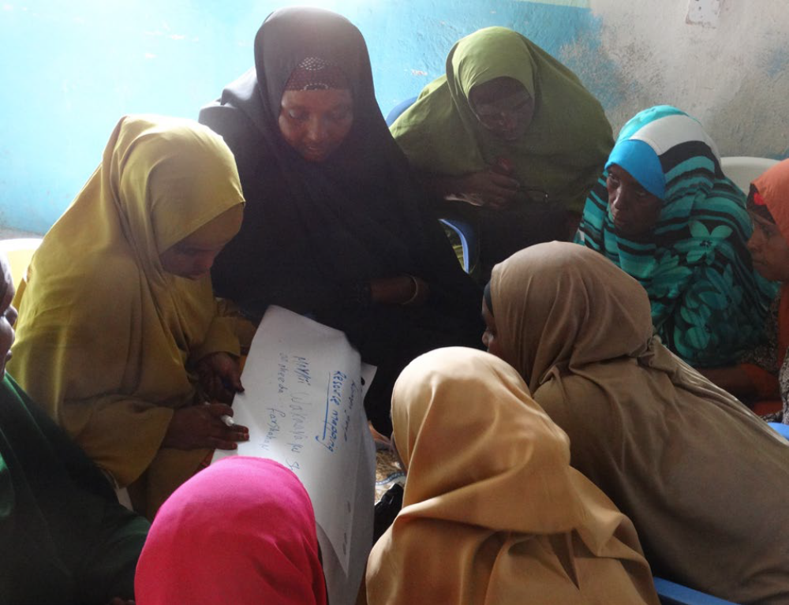
Weynee Latashiga Bulshada Midnimo
Kulan 5 maalmood ah
125 xubnood oo bulshada ah oo ka kala socda dhamaan kooxaha dhaqan-dhaqaale: haweenka, kooxaha culumada diinta, barakacayaasha, Dadka dalka ku soo laabtay, bulshada martida loo yahay, dhalinyarada, gudiyada tuulooyinka magaalooyinka, hogaamiyaasha, ganacsatada, bulshada rayidka ah iyo kuwa kaloo badan oo ka kala yimid daafaha degmada.
Dhammaan kooxaha, oo ay ku jiraan kuwa aan sida caadiga ah marin u helin dowladda oo aan codadkooda badanaa la maqlin ayaa awoodaan inay wadaagaan fikradahooda isla markaana ay gacan ka geystaan xallin ay dadku xudunta u yihiin.
Haweeney joogta qorshaynta bulshada, Xudur / UN-Habitat
Notes:
Optional slide

Slide 19
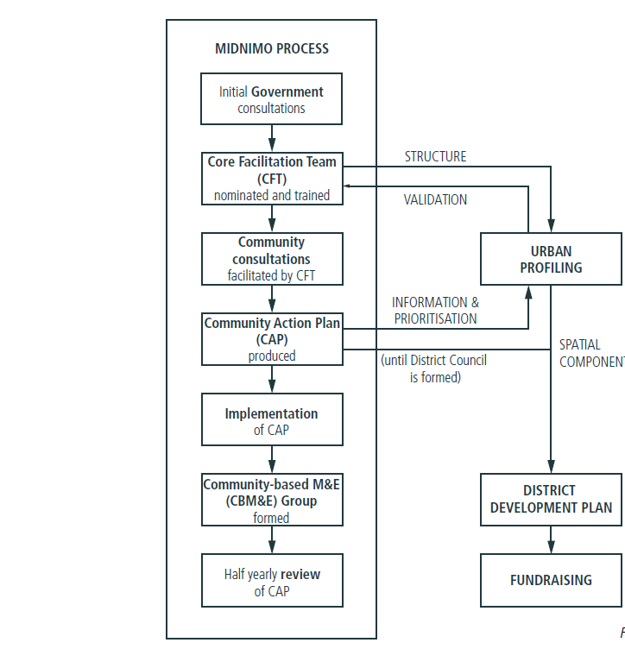

Geed-socodka Midnimo
Tilmaamaha Fududeynta Habka Qorshaynta ku saleysan Bulshada ee IOM

Slide 20
Tusaalaha jadwalka Qorshe Howleedka Bulshada
Arrimaha | Sababaha dhibaatada | Xalka la soo jeediyey | Tallaabooyinka la qaadayo | Kala mudnaan siinta
Shuruuda 1aad ee IASC
Shuruuda 2aad ee IASC
Shuruuda 3aad ee IASC
“Maxaan ubaahanahay si aan uga gudubno arimaheena la xiriira barakaca”
Notes:
Here is an example/sample of the matrix that can be used to guide and list the participants discussions. The guiding question on the right is to be adapted to the context of t he workshop.

Slide 21
Tusaalaha Jadwalka Mideynta
Ujeedka ama Shuruuda IASC | Howlaha | Qaybaha/ saktarka | Mudada | Tilmaamaha
Ururuda | Hogaanka
Qaab-dhismeedka Qorsheynta Tixraaca ee ururada iyo deeq-bixiyeyaasha
In la abuuro ama lagu xiro qorshooyin waaxeedyada ama horumarineed ee maxalliga ah
Notes:
Here is an example of a consolidation matrix to be developed based on shared and concerted data and the results of the CAP.
This will need to be disseminated at community level and put in a format that can be used by local authorities to link it to existing local plan or as a district/local plan.

Slide 22
Xog ururin iyo falanqeyn Qorsheesan
Qorshaha Waxqabadka Bulshada
Qorsheynta Horumarka Maxaliga
Xogta, falanqeynta, qorshe Howleedka bulshada iyo qorshaha maxaliga
Hogaanka Dawladdeed oo ay waheliso daneeyayaal badan iyo taageero dhinacyo badan leh
Notes:
This slide summarizes how one or several well consolidated area-based plan(s) grounded in sound concerted data and analysis and community planning processes can be linked to or inform government led local development planning.

Slide 23

Isku Darka Qorshe Howleedyada Bulshada ee Degmooyinka Soomaaliya ee Baydhabo iyo Kismaayo
Qorshaha Waxqabadka bulshada
Waxqabadka bulshada ee Midnimo ee magaalooyinka Baydhabo iyo Kismaayo ee IOM / UN Habitat
Isugeynta/Mideynta
Magaalooyinka ay Danwadaag taageertay inay mideeyaan kuwan iyo kuwa kale oo ah qorshaha waxqabadka bulshada iyo qorshayaalka heerka degmo oo isku dhafan.
Qorsheynta Maxaliga ah
Agab loogu talagalay mas'uuliyiinta maxalliga ah inay isku dubaridaan waxqabadyada hay'adaha kala duwan ee bani'aadamnimada iyo horumarinta isla markaana ka fogaadaan ku celcelinta.
Bareesada geli
Bangiga Adduunka, Hay’adda GIZ iyo UN-Habitat waxay adeegsadaan Qorshaha Waxqabadka Bulshada markii la naqshadeynayo lana qorsheynayo kaabayaasha iyo barnaamijyada adkeysiga
Notes:
Case study : Integrated Community Action Plans (CAPs): have been adopted by many aid actors in Somalia, albeit with different community engagement models and structures. While they have proven an important tool to ensure more participatory and inclusive prioritisation and planning processes, they have often been uncoordinated and disjointed, with many parallel processes in the same locations. Building on learning from this, several durable solutions actors have adopted a more coordinated approach together with the municipalities, on which it is possible to build. For example, the IOM/UN Habitat Midnimo project has developed community action plans for Baidoa and Kismayo. The Danwadaag consortium then supported the municipalities in Baidoa and Kismayo to consolidate these and other existing CAPs into integrated district-level plans. These have become an important tool for the local authorities to coordinate activities of various humanitarian and development partners in their area and ensure avoidance of duplication. While not all actors base their engagement on these plans yet, and many aid actors continue to have different community engagement modalities, several development partners such as the World Bank, Deutsche Gesellschaft fuer Internationale Zusammenarbeit (GIZ) and UN-HABITAT have now started using the CAPs when designing and planning their urban infrastructure and resilience programmes.
Source: Advancing multi stakeholder engagement to sustain solutions, ReDSS briefing paper, Dec. 2019, accessible there: https://regionaldss.org/index.php/research-and-knowledge-management/redss-publications/
Activity 2: Activity in plenary: map local development and sectoral planning agenda and opportunities for a CAP or several CAPs to be linked to local planning processes.
First step:
Are there local development and sectoral planning processes and agenda in the area where the ABA will be applied? Who leads and coordinates them?
Are there other CAPs processes or CAPs already developed/implemented?
Second step.
What would be the opportunities to link the area-based solutions CAP to local development or sectoral planning processes or to consolidate this CAP and potential others into an integrated local plan?
Would this CAP be compiled with others?
What are the existing programmes that could be linked to the consolidated plan? Potential actors who could engage in such a plan?

Slide 24
Fariimaha Muhimka ah
Isla xisaabtan inay helaan dadka ay dhibaatadu saameysey ayaa ah xaqiijinta in dadku yihiin udub dhaxaad iyo inay ururada howl gala ogolaadaan inay bulshada la xisaabtanto.
Habka ku saleysan bulshada waa qaab ay bulshooyinka uga qeyb qaataan muujinta iyo wax ka qabashada arrimaha iyaga quseeya.
Habka ku saleysan bulshada wuxuu ka kooban yahay awood siinta ururada maxalliga ah si ay u go'aamiyaan waxqabadyada ugu waxtarka badan una taageeraan si loo hirgeliyo loona qiimeeyo waxqabadyada
Marka lagu gudo jiro Hawsha Qorshaynta Howleedka Bulshada, DAC waa ilaha aasaasiga ah. Habkani wuxuu ku dhiirrigelinayaa ayaga inay qayb firfircoon ka qaataan qorshaynta, fulinta iyo kormeerka hawlaha xallinta
Soosaarida Qorshe Hawleed Bulsho oo loo wada dhan yahay oo isku dhafan waxay u baahan tahay geeddi-socod tallaabo tallaabo ah oo ka dhasha qorshe mideeysan oo lala xiriirinayo horumarinta maxalliga ah iyo qorshayaasha sakatarad iyo ajendaha qorsheynta.
Geedi socodka qorshaynta Qorshe Howleedka Bulsho waa in ay hogaamiyaan iskuna dubbaridaan maamulada maxalliga ah si loo hubiyo in ay la jaanqaadaan qorshooyinka deegaanka ku saleysan aaggaga ee jira.
.

