Slide 1





Adopting a multisectoral and mutlistakholder approach
Developing or using existing coordination mechanisms
Assessing and measuring durable solutions
Involve DAC through Community-based planning
Adopting an area-based approach
Durable Solutions. How do we do it?
Notes:
This slide is a recap of activity 3

Slide 2


4
Involve DAC through Community-based planning

Slide 3
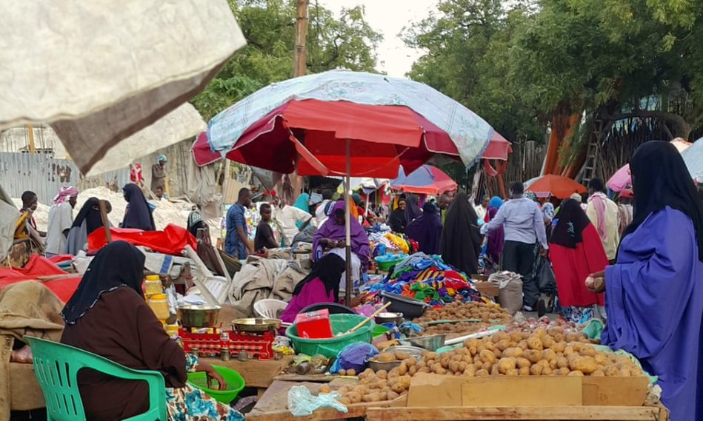
DAC mobilization
Inform
Consult
Empower
Involve
Collaborate
Notes:
Here is a short energizer to start with (optional) :
Only shows the title of the slide at the end of the energizer. The animation is inserted.
Graphic facilitation: ask 5 groups to find a good way to draw/find a visual for the following terms, each group is assigned a term:
Inform
Consult
Empower
Involve
Collaborate
Give them 5 to 10 minutes, show the different drawings and ask the participants why, in their opinion, they were asked to work on these specific words?
Explain that informing, consulting, empowering, involving and collaborating with DAC are the main ways to ensure their participation to the planning, implementation and monitoring of an Area-based plan.
Key message: Throughout this session, we will try and find ways to inform, consult, empower, involve and collaborate with DAC to develop area-based plan reflecting their needs, vulnerabilities, capacities and concerns.

Slide 4
Objective of Session
Apply a community-based approach and a participatory methodology.
Explain what a Community-Based Planning is.
Describe a community action plan process up to its incorporation into local or national planning.
Examine community-based planning projects carried out in Somalia and their impacts on DAC.

Slide 5

Zoom: Common Social Accountability Platform (CSAP)
Radio to build dialogue and gather public opinion on issues related to durable solutions
Developed by Africa’s Voices Foundation
Launched in partnership with ReDSS and the Banadir Regional Administration
"Yes, I feel involved because community consultation is always the best thing to do and I personally believe that I am part of the decisions in the community and we appreciate a lot those who made these safe spaces to talk like the radio presenters, the leaders involved and those aid organisations who are involved as well."
Female participant, Mogadishu, Somalia
Notes:
This slide is optional.

Slide 6
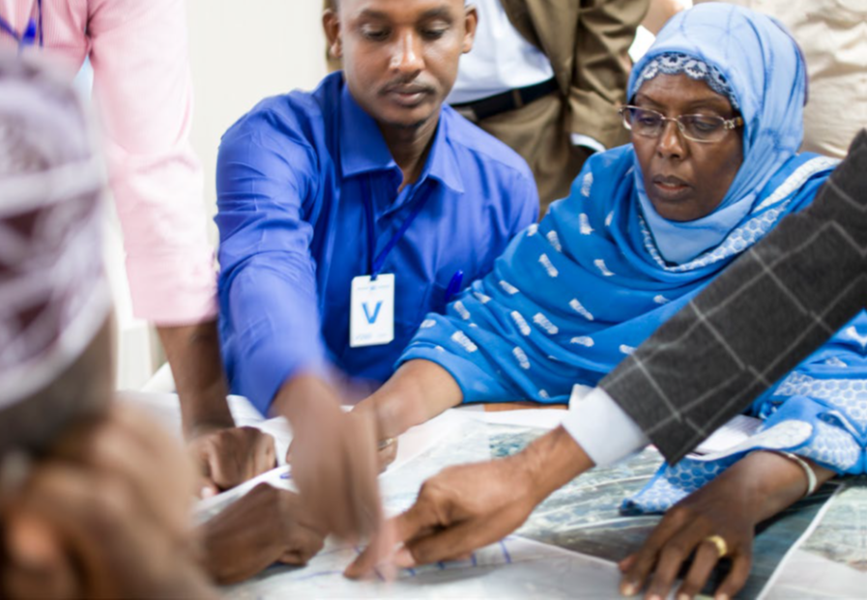
Accountability to affected population
Participation and inclusion: effective and meaningful engagement of all DAC members in all stages of durable solutions planning
Communication and transparency: clear information on their rights, entitlements and on the programme through accessible communication channels in a language they understand
Feedback and response system
City Planning Consultation, Baidoa / UN-Habitat
Midnimo
Notes:
Accountability to affected population is not more than ensuring that people are at the centre of the area-based approach and that partner organisations are not only accountable to donors but first and foremost to the population that they are working with.
Accountability refers to the responsible use of power (resources, decision making) by humanitarian and development actors, combined with effective and quality programming that recognizes a community’s dignity, capacity, and ability to be independent. Area-based project partners commit to ‘putting people first' and drawing on the rich range of experiences, capacities, and aspirations of refugee, displaced and hosts women, men, girls and boys. In addition, they are committed to being accountable to the people they serve by listening and responding to their needs, perspectives, and priorities.
These can be done through three types of enablers listed on the slide.
UNHCR's AAP framework and these values are outlined in UNHCR's Policy on Age, Gender and Diversity (AGD, 2018), specifically core actions 2-5:

Slide 7
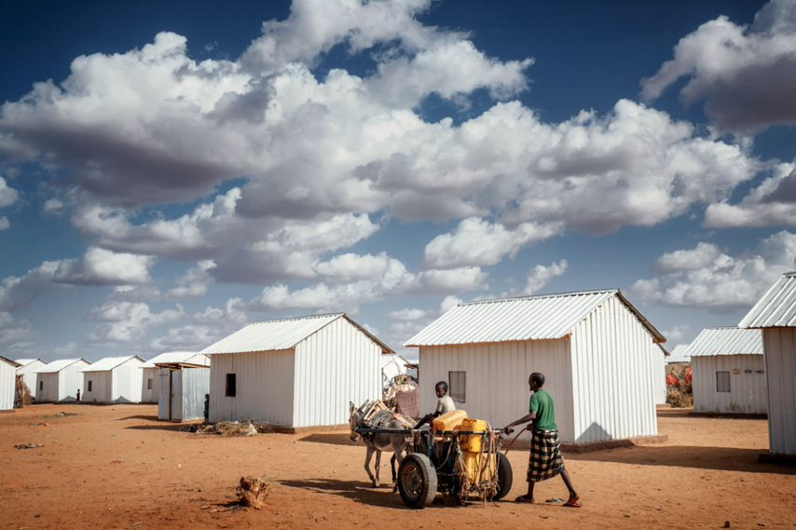
Community-based approach. What is it?
An approach in which communities have an active role and participate in highlighting and addressing the issues that matter to them
Notes:
Adopting a community-based approach throughout the area-based planning process is the best way to ensure DAC effective involvement and participation and real Accountability to Affected Populations.

Slide 8


A twofold dimension
1
2
Empowering communities to take part to area-based participatory planning processes directly affecting their life
Strengthening the capacities of national and local authorities and partners to lead, plan and coordinate for community-based interventions
Notes:
Key message:
Community-based approach entails communities to take part to area-based participatory planning processes directly affecting their life and strengthening the capacities of local actors to lead such participatory process to ensure that interventions will respond to the needs of the DAC. To this end, community-based interventions should also strengthen local coordination and planning capacities. This is a great way for national ad local authorities to strengthen social cohesion between different groups, reinforce their legitimacy and improve their relationship with DAC.
Plenary discussion: Ask about relevant/successful examples of initiatives at local level involving a community-based approach.

Slide 9
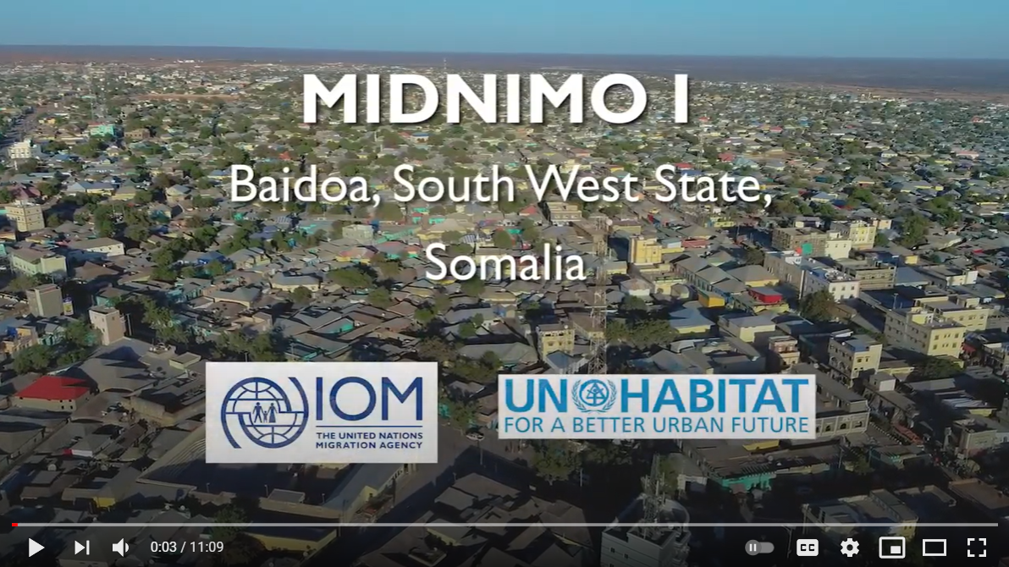
Video and discussion
What are, according to you the main benefits of such a community-based planning process?
What are the main obstacles or difficulties that you think could hamper the implementation of such a process?
How could you find solutions to these issues?
Notes:
You can show this video if you have time.
https://www.youtube.com/watch?v=xajkcqqzurs

Slide 10
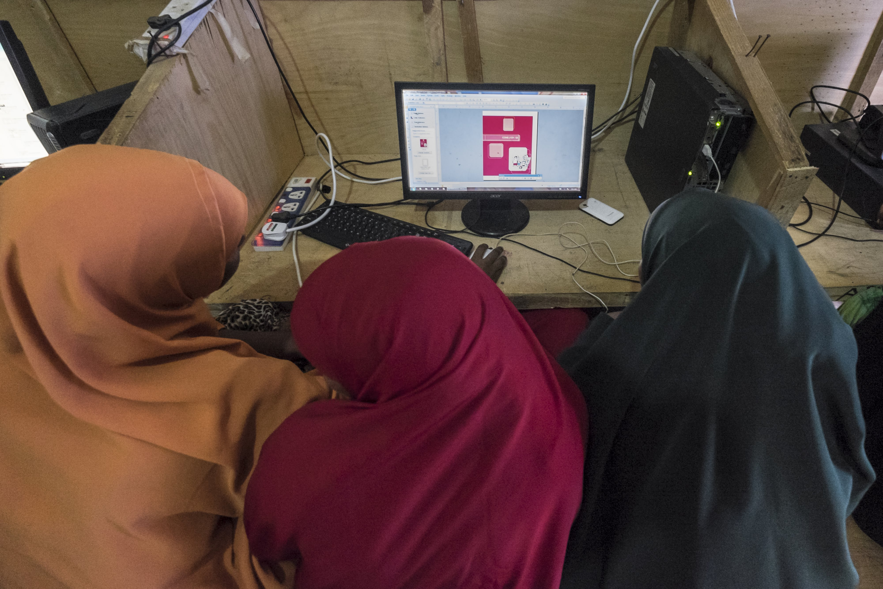

Durable Solutions Community Actions (CAPs)
Notes:
Key messages:
- In the Community Action Planning process DAC are the primary resource rather than the objects of solutions planning. This approach motivates them to take the lead in the planning and implementation of solutions activities.
- Community Action Planning develops the capacity of the communities to take appropriate actions for their own solutions
- It is important that the DAC itself prepares the Community Action Plan as it helps to internalize the plans and to take responsibility for implementation and maintenance.
- The planning process is carried out in the form of workshops under the lead of the local Government, in which the DAC members and other partner organizations participate.

Slide 11
What is a CAP?
DAC participate in the area-based planning, through:
Identification of their vulnerabilities, needs, capacities, priorities and visions for the future
Identification of potential solutions
Preparation, consolidation and validation of a community action plan based on priorititization
Participation in the implementation
Active participation in the monitoring and evaluation
A process that empowers communities, including vulnerable socio-enomic groups and their leaders to demand and actively participate in development interventions that are relevant to them.

Slide 12
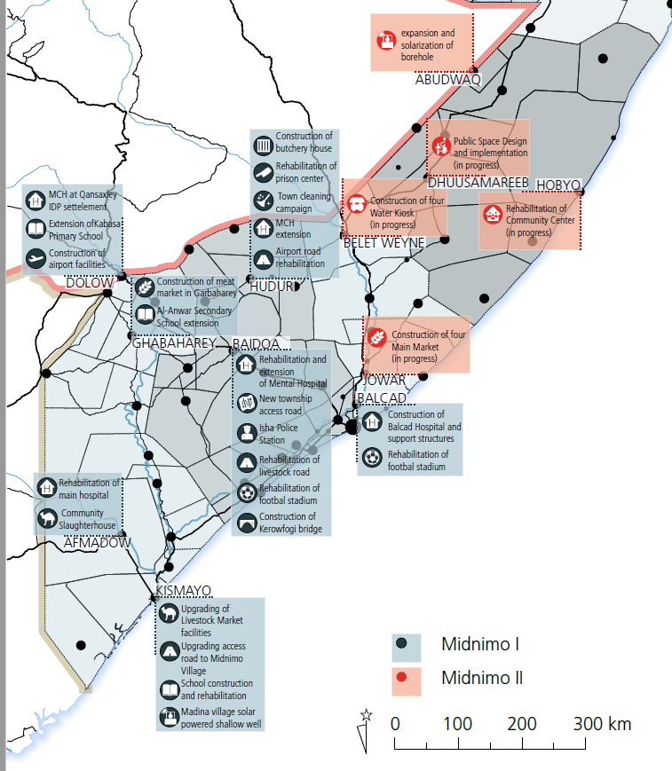
Midnimo’s CAPs
Community-based plans were at the heart of Midnimo projects
7 Caps for Midnimo I and 6 for Midnimo II
In line with the Wadajir Framework Consensus Planning Process used by local governement to promote community driven projects

Slide 13
Principles of the CAPs process
Inclusive participation with a view to improve social cohesion and relationships with groups who might have conflicting interest. Participation of women, youths, IDPs, returnees and other marginalized and invisible groups should be guaranteed
Somali ownership of process and outcomes : local leadership and ownership of communities. Enhanced legitimacy of local governance
Consensus planning process: foster collaborative and sustainable partnership based on trust.
Transparency and accountability to DAC
Notes:
Optional slide
Based on Midnimo process. Source: IOM Community-Based Planning Approach Facilitation Guideline

Slide 14






Who is in the CAP?
Representatives of all socio-economic groups of the selected community. All voices must be heard !
Community or local leaders to mobilize community members and create an enabling enviroment
Facilitators who are trained to facilitate consultations and debates
Local authorities to ensure linkage between CAP and district plans
Technical support providers: Governement, local authorities, UN, NGOs, Private sectors who listen and include DAC’s priorities into their programmes
Invisible players / influencial people

Slide 15

Zoom on the Committee of facilitators
Who are they?
Men and women appointed by local Governement.
Relevent Government department personnel
Ward counsillor
Village Head
Ward/village Secretary
What are they doing?
They work together to assist the communities to express what they would like to happen in their community
They ensure not to impose external or their view.
Notes:
Optional slide.
Taking lessons from one district to inform activities in the other locations, the selection process for CFT members was updated over the course of the project. While the first CFT in Kismayo consisted of four men from the local government, the last CFT that was established in Balcad comprised two women and two men, equally representing the community and the government - Midnimo handbook, 2020.

Slide 16
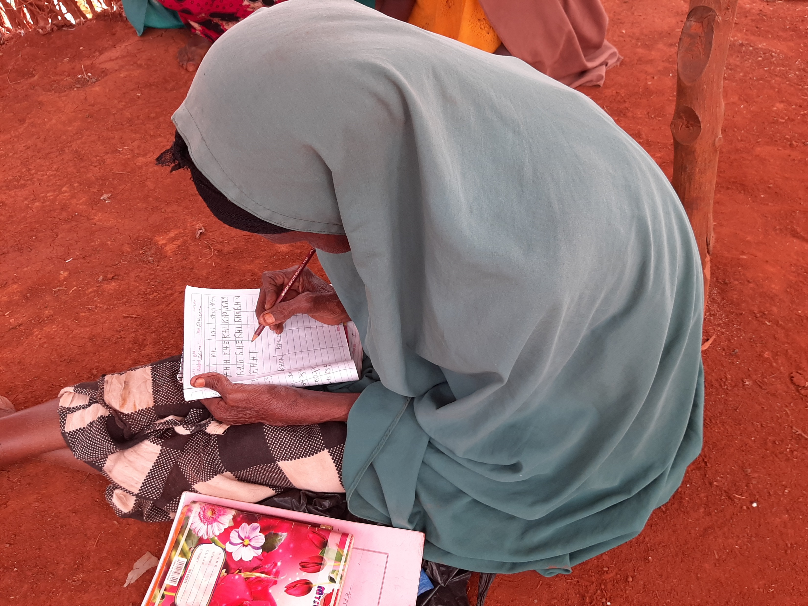
Activity: Who is in the CAP?
Notes:
Activity 1: Who is in the CAP? Group activity aiming at listing potential CAP in the context where the workshop takes place.
Assign each group a category of actors (depending on the context: IDPs, Returnees, Women, Youth, local authorities, local and religious leaders, local CSOs, Private Sector, Representatives of professionals – market merchants, teachers etc.- marginalized clans/persons, disabled persons) and ask them to list from 5 to 7 existing structures (community group, organisation, agency) that should take part to an area-based Community Action Plan. Note that the total number of participants should not exceed 45.
Here are the main criteria that will guide the selection: You can write them down on a flip chart paper.
Representativity
Popularity
Proximity with the community they represent
Gender and age balance
Potential capacity to take part to a simple planning development process
- The list should ensure that excluded, vulnerable and “invisible” persons are represented!
If there is no existing community structure or organisation meeting this requirement, ask the participants to think about ways to include relevant participants into the CAP.
Here are examples of categories of populations to be represented:
IDPs
Refugees
Host community
Persons with disabilities
Inhabitant of a specific zone in the delimitated area: informal settlement, persons at risk of evictions, etc.
Local NGOs and CSOs
Partner organisations
Local authorities

Slide 17







CAP
Make it work step by step
1. Awareness raising at national and local levels
2. Selection and Training of facilitators
3. Actors identification and selection. Social and area mapping
4. Community consultation workshop(s) preparation
5. Community consultation workshop(s)
6. Implementation and monitoring plan
7. Consolidation and dissemination of the Plan
8. Linking the Plan to local and national development plans
Notes:
You can distribute the handout entitled “CBS detailed steps” for a more detailed description of the process (in 15 steps) as it was developed for the MIDNIMO project.
Interactivity: It is possible here to start a discussion with participants on whether they have previously taken part to an inclusive CAP and included/linked this CAP with their development planning, and if so, how?

Slide 18
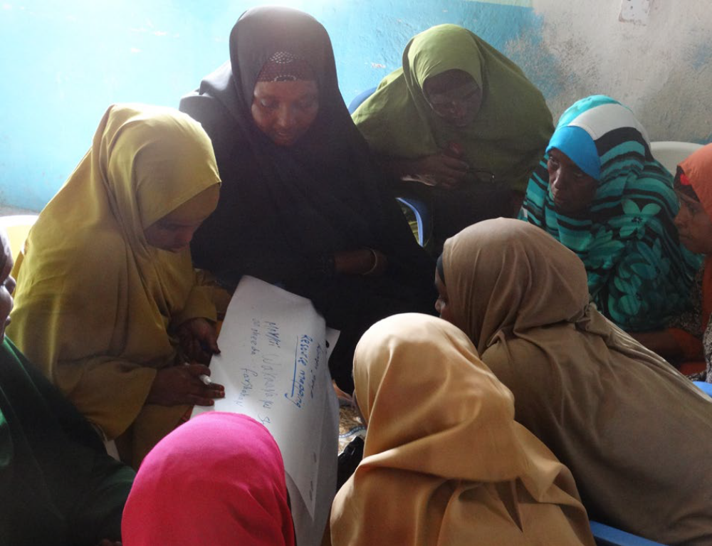
Zoom on Midnimo Community Consultations
5 days workshop
125 community members from all socioeconomic groups: women, religious groups, IDPs, returnees, host communities, youth, urban village committees, leaders, businesses, civil society and many more from across the district.
All groups, including those who do not typically have access to the government and whose voices are not often heard are able to share their insights and contribute to people-centred solutions.
Women at Community Planning, Hudur / UN-Habitat
Notes:
Optional slide

Slide 19
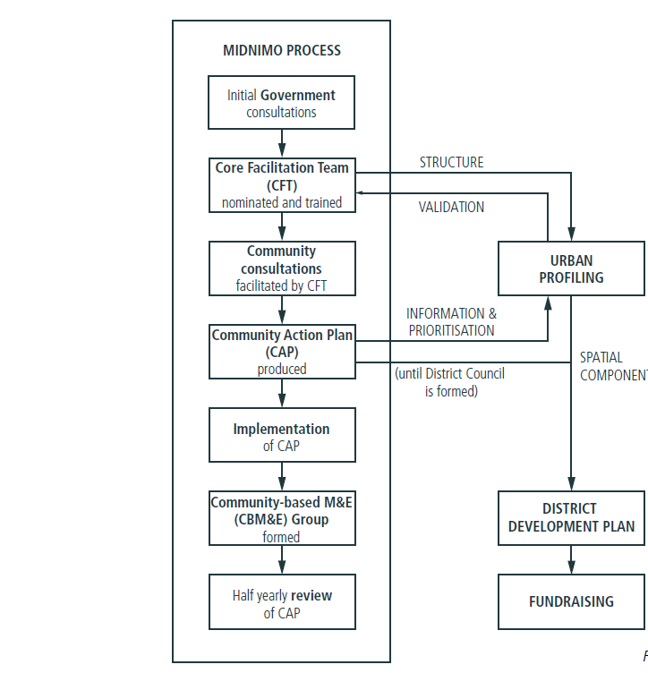

Midnimo process
IOM Community-Based Planning Approach Facilitation Guideline

Slide 20
Example of CAP Matrix
Issues | Causes of the problem | Proposed solutions | Actions to be taken | Prioritization
IASC Criteria 1
IASC criteria 2
IASC criteria 3 …
“What do we need to overcome our displacement related issues”
Notes:
Here is an example/sample of the matrix that can be used to guide and list the participants discussions. The guiding question on the right is to be adapted to the context of t he workshop.

Slide 21
Example of consolidation matrix
Objective or IASC criteria | Activities | Sectors | Timeline | Indicators
Actors | Lead
Reference planning framework for actors and donors
To form or be linked to local sectoral or development plans
Notes:
Here is an example of a consolidation matrix to be developed based on shared and concerted data and the results of the CAP.
This will need to be disseminated at community level and put in a format that can be used by local authorities to link it to existing local plan or as a district/local plan.

Slide 22
Concerted data and analysis
Community Action Plan
Local development planning
Data, analysis, CAP and local plan
Government led with multi stakeholder and multi sectoral support
Notes:
This slide summarizes how one or several well consolidated area-based plan(s) grounded in sound concerted data and analysis and community planning processes can be linked to or inform government led local development planning.

Slide 23

Integrated District Community Action Plans in Somalia
Baidoa and Kismayo
CAP
IOM/UN Habitat Midnimo community action in Baidoa and Kismayo
Consolidation
Danwadaag supported the municipalities to consolidate these and other CAPs into integrated district-level plans.
Local Planning
Tool for local authorities to coordinate activities of various humanitarian and development partners and avoid duplication.
Plug in
World Bank, GIZ and UN Habitat use the CAPs when designing and planning infrastructures and resilience programmes
Notes:
Case study : Integrated Community Action Plans (CAPs): have been adopted by many aid actors in Somalia, albeit with different community engagement models and structures. While they have proven an important tool to ensure more participatory and inclusive prioritisation and planning processes, they have often been uncoordinated and disjointed, with many parallel processes in the same locations. Building on learning from this, several durable solutions actors have adopted a more coordinated approach together with the municipalities, on which it is possible to build. For example, the IOM/UN Habitat Midnimo project has developed community action plans for Baidoa and Kismayo. The Danwadaag consortium then supported the municipalities in Baidoa and Kismayo to consolidate these and other existing CAPs into integrated district-level plans. These have become an important tool for the local authorities to coordinate activities of various humanitarian and development partners in their area and ensure avoidance of duplication. While not all actors base their engagement on these plans yet, and many aid actors continue to have different community engagement modalities, several development partners such as the World Bank, Deutsche Gesellschaft fuer Internationale Zusammenarbeit (GIZ) and UN-HABITAT have now started using the CAPs when designing and planning their urban infrastructure and resilience programmes.
Source: Advancing multi stakeholder engagement to sustain solutions, ReDSS briefing paper, Dec. 2019, accessible there: https://regionaldss.org/index.php/research-and-knowledge-management/redss-publications/
Activity 2: Activity in plenary: map local development and sectoral planning agenda and opportunities for a CAP or several CAPs to be linked to local planning processes.
First step:
Are there local development and sectoral planning processes and agenda in the area where the ABA will be applied? Who leads and coordinates them?
Are there other CAPs processes or CAPs already developed/implemented?
Second step.
What would be the opportunities to link the area-based solutions CAP to local development or sectoral planning processes or to consolidate this CAP and potential others into an integrated local plan?
Would this CAP be compiled with others?
What are the existing programmes that could be linked to the consolidated plan? Potential actors who could engage in such a plan?

Slide 24
Key messages
Accountability to affected population is ensuring that people are at the centre and that partner organisations are accountable to the population that they are working with.
Community-based approach is an approach in which communities participate in highlighting and addressing the issues that matter to them.
Community-based approach entails empowering local actors to determine what interventions would be most effective and supporting them to implement and evaluate the interventions.
In the Community Action Planning process DAC are the primary resource. This approach motivates them to take an active part in the planning, implementation and monitoring of solutions activities.
Developing an inclusive and integrated Community Action Planning requires a step-by-step process that results in a consolidated plan to be linked to local development and sectoral plans and planning agenda.
The CAP planning process should be led and coordinated by local authorities to ensure that there is alignment with existing locally owned area-based plans.

