Slide 1
Koorsada 3aad: Guriyeyn, Dhul iyo Hanti ayaa xuddun u ah Xalalka waara
1. Waa maxay guriyeyn, Dhul iyo hanti maxayna u yihiin xudunta geeddi-socodka xalalka waara?
2. Kobcinta Xasilinta mudada la deganaan karo guryahay iyo xuquuqda guriyen, dhul iyo hanti ee Soomaaliya
Notes:
This slide is a recap of activity 3

Slide 2

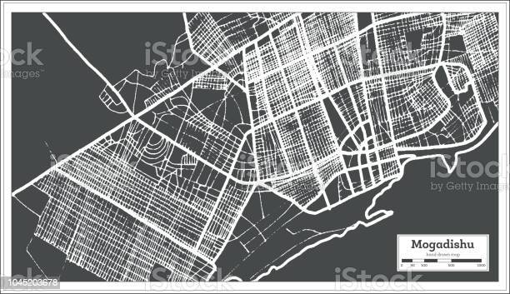
1
Waa maxay Guriyen, Dhul iyo Hanti maxaase sababay inay udub dhexaad u noqdaan Xalalka waara?

Slide 3
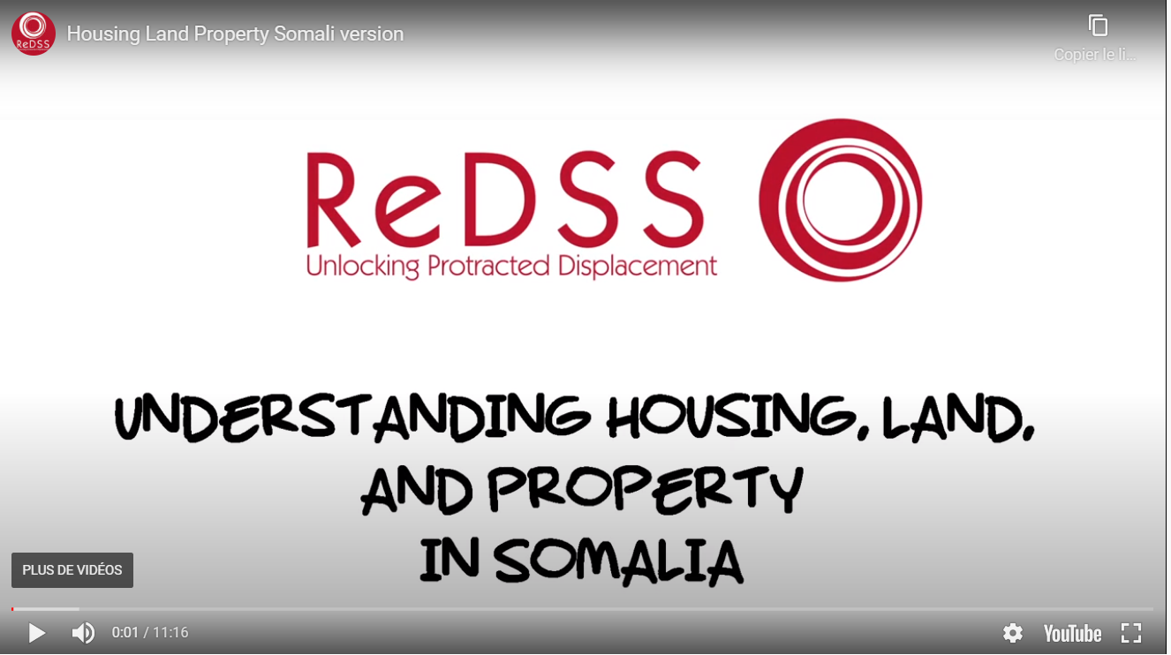
Notes:
In Somali language: https://regionaldss.org/index.php/capacity-development/housing-land-property-somalia/#1587408796347-5cdc1aac-133d
In English: https://regionaldss.org/index.php/capacity-development/housing-land-property-somalia/#1587408796347-5cdc1aac-133d

Slide 4
Ujeedooyinka
Dhamaadka kulankan, waxaad awoodi doontaa inaad:
Sharaxdo fikradda Guriyeynta, Dhul iyo Hanti iyo sida ay ugu habboon tahay horumarka xalalka waara
Aqoonsato oo kala saarto arrimaha waaweyn ee la xiriira guriyeyn, dhul iyo hanti ee ka hortaagan bulshooyinka uu saameyey barakaca inay u horumaraan xagga xalalka waara;
Aqoonsato arrimaha gaarka ah ee ay haweenku kala kulmaan helitaanka xuquuqdooda guriyeyn, dhul iyo Hanti
Baaritaan ku sameyso arrimaha la xiriira xasilinta muddada deganaanta guryaha Soomaaliya, iyadoo si gaar ah diiradda loo saarayo guryo ka saarista xoog ah.

Slide 5
guriyeyn, dhul iyo Hanti iyo xalalka waara: Howl
Iyadoo lagu saleynayo dhacdooyinka kiiska, aqoonso arrimaha la xiriira guriyeyn, dhul iyo Hanti ee ay wajahayaan shaqsiyaadka
Deegaanada magan galyada loo degan yahay.
Deegaanada ay ka kala soo jeedaan
2. Aqoonso arrimaha ugu caansan ee la xiriira guriyeyn, dhul iyo Hanti ee ay la kulmaan dadka ku barokacay Soomaaliya
Notes:
Activity 1. HLP-related issues or obstacles faced by DAC.
Group activity.
1. Based on the case scenarios, identify the HLP-related issues faced by the characters:
In the place of refuge
In their place of origin
2. Identify the most common HLP-related issues faced by displaced persons in Somalia

Slide 6

Waa Maxay Guriyeyn, Dhul iyo Hant?
Guriyeyn: Xuquuqda guriyeynta waa xaqa aad u leedahay inaad hesho oo aad degto guri badbaada leh oo amni ah kaas oo loogu noolaado nabad iyo sharaf
Dhul: Xaqa aad u leedahay dhul waxaa loola jeedaa xaqa aad u leedahay lahaansha dhul oo la aqoonsan yahay bulsho ahaan ama sharci ahaan
Xuquuqda lahaanshaha hanti waxaa loola jeedaa xuquuqda aad u leedahay inaad yeelato hanti oo aad go'aamiso sida loo isticmaalo

Slide 7
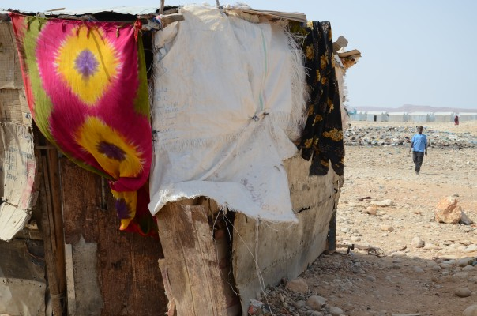
Maxay tahay sababta guriyeynta, Dhul iyo Hanti
?
Hoy
Meel sharaf loogu noolaado
Ka difaaca xadgudubyada jirka (oo ay ku jiraan Xadgudubyada ku saleysan jinsiga, iwm.);
Dhul loogu talagalay hawlo dhaqaale oo beero ka baxo, habnololeed iwm
Hoy waa barta bilowga u ah xasillooni badan oo xaalado dhaqan-dhaqaale ah
Tallaabo muhiim ah oo loogu talagalay soo kabashada degdega ah ee barakacayaasha iyo bulshada martida loo yahay labadaba
Fure u ah wadajirka bulshada, dhismaha nabadda iyo dib u heshiisiinta…
Notes:
Activity 1: braistorming in plenary.
Why are HLP rights at the heart of durable solutions, according to you?

Slide 8

Guriyeyn, Dhul iyo Hanti waa xaq!
Wax ka badan saqaf ka sarreeya madaxyadeena
Xaq u yeelashada guri
Xaq u leedahay inaad xor ka tahay gurya ka saarista xooga ah
Xaqa u leeadahay hoy ammaan ah
Awood u leedahay inaad sugto habnololeed
Dhamaan laxiriira xaquuqda helitaanka heer nololeed oo kufilan iyo in lagu noolaado amaan iyo sharaf

Slide 9

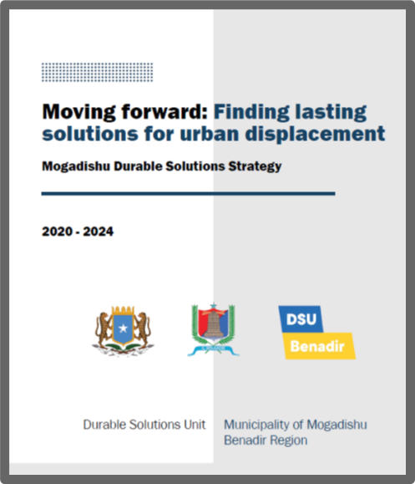
Qaab-dhismeedka Sharci Iyo Siyaasadeed Ee Qaran
Dastuurka KMG ah ee Jamhuuriyadda Federaalka Soomaaliya, 1 Ogosto 2012:
Xaqa u lahaanshaha yeelashada Hanti, Qod. 26,
Xaqa u lahaanshaha badbaadada (Qod.15)
Xaqa lama taabtaannimada ee hoygaaga, Qod19, Xaqa aad u leedahay inaad raadsato wax ka qabashada sharci ee ku tumashada xuquuqda aadanaha,
Xaq u lahaanshaha helitaanka cadaalad iwm

Slide 10
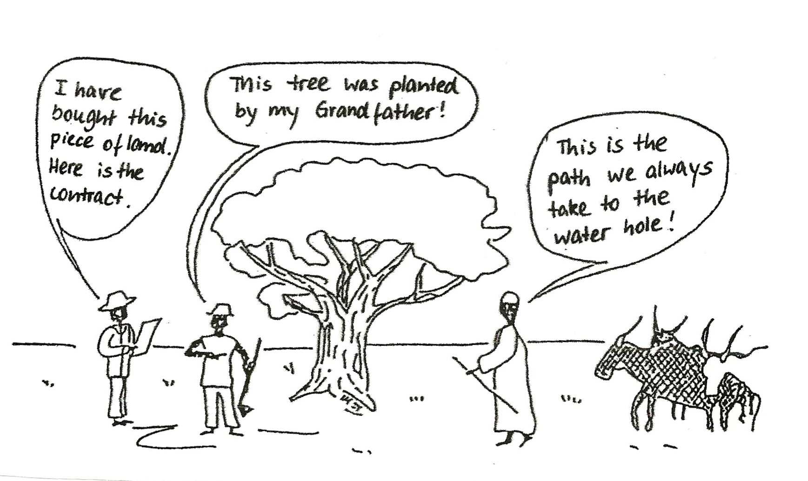
Noocyada Nidaamyada qaabeynta muddada lahaanshaha
Xuquuqda dhaqanka
Lahaanshaha shaqsiyeed (sharci ah)
Xuquuqda isticmaalaha
Notes:
Formal individual or joint ownership rights (e.g. with formal documents) - these are rare, less than 30% globally and much less in fragile contexts.
Customary rights (for individuals or more often groups) - these are administered by customary institutions, such as chiefs, traditional leaders, etc.; HLP rights are protected for the majority of people in developing countries by such systems that needs to be recognized and strengthened.
User rights – this category includes a wide range of HLP options such as rental agreements, rights of use / inhabit, rights to plant and harvest, rights to access water sources, rights of passing through, etc. User rights can be individual or collective and are a good avenue to provide durable solutions at scale in a limited time span while working on longer term HLP options.

Slide 11
Diirada saar: Xuquuqda in dadku ugu noolaadaan karaan guryahooda cabsi la’aan
“Nabadgelyada joogitaanku guryaha waxay ka dhigan tahay in dadku ay ku noolaan karaan guryahooda iyagoo aan ka baqaynin in qasab looga saaro, ha noqoto degsiimo wadaag, degsiimo aan rasmi ahayn, bulshooyinka martida loo yahay ama ka dib soo noqoshada. Waa aasaaska xaq u yeelashada guriyeyn ku filan iyo xuquuq badan oo kale oo aadaminimo ah ”.
Global shelter cluster

Slide 12
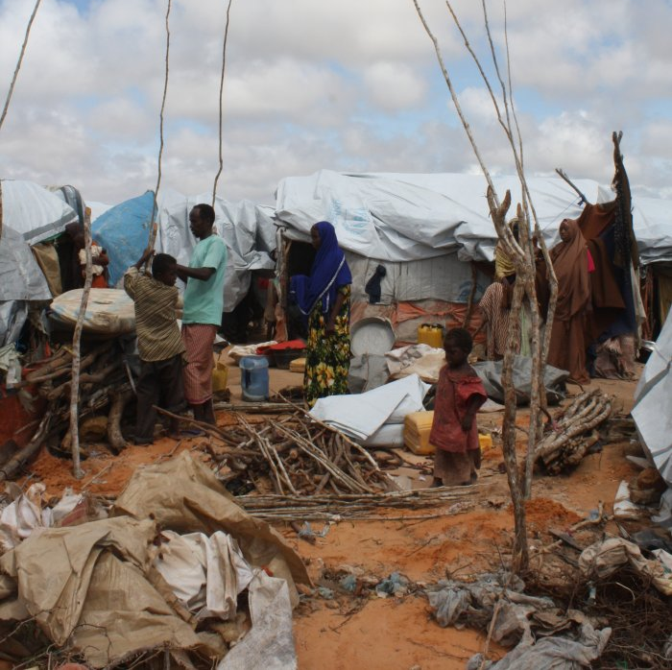
Xuquuqda helitaanka guri ku filan dhammaan
Dadka oo dhan waa inay helaan xuquuqda inay heli karaan guriyeyn, dhul iyo hanti iyadoon loo eegin habka lahaanshaha dhulka
Barakacayaasha ku nool degsiimooyinka aan rasmiga ahayn waxaa laga yaabaa inaysan lahaan karin heshiisyo sharci ah si ay halkaas ku sii noolaadaan laakiin ay weli leeyihiin xuquuqooda ay u leeyihiin inay helaan guryo ku filan iyo in laga difaaco guryo ka saarista qasabka ah
Waxaan xaq u leenahay guriyeyn inagu filan

Slide 13
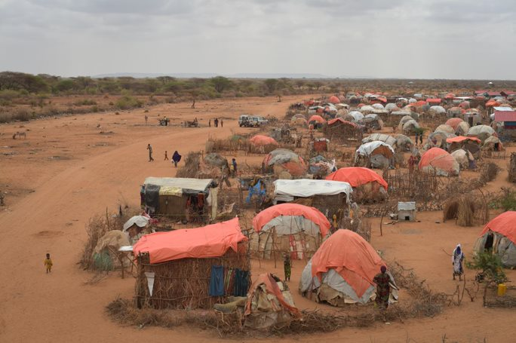
Waa maxay guri ku filan? 7 shuruud
Faallada Guud ee CESCR 4: guryeyn ku filan:
Nabadgeliya ugu noolaansha guryaha oo sharciga ah
Helitaanka adeegyada, agabka, tas-hiilaadka, iyo kaabayaasha dhaqaalaha
La awoodi karo qiima ahaan
Lagu noolaan karo degganaan
La gaari karo/ aan ciriiri ahayn
Goobta
Ku filnaanshaha dhanka dhaqanka

Slide 14
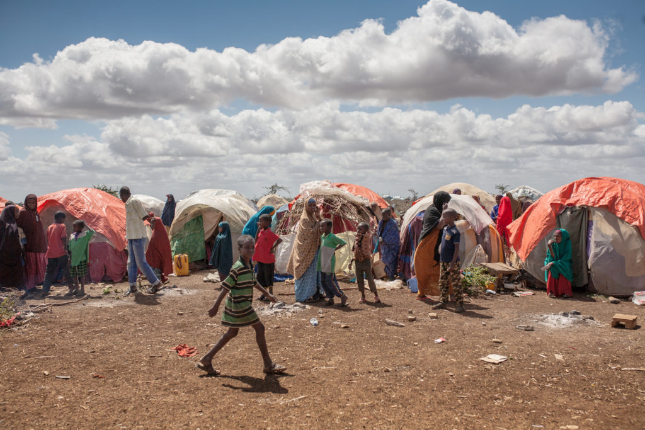
Guriyeynta, Dhulka iyo Hantida oo caqabad ku ah xalalka waara ee goobta magan-galyada
Hoyga aan ku filnayn: khataraha ilaalinta oo kordhay – xadgudubyada jinsiga iyo caafimaadka - iyo meelaha u nugul masiibooyinka
Khatarta in xoog lagu raro iyo barakac labaad
La'aanta / helitaanka xaddidan ee dhul si loo helo nolol iyo habnololeed
Xiisada ka dhex aloosan bulshada martida loo yahay ee ku aadan kheyraadka taasoo horseedeysa isku dhacyo iyo xasilooni daro hor leh
Helitaanka adeegyada, waxbarashada iyo xarumaha caafimaadka oo xadidan

Slide 15
Caqabadaha hortaagan xalalka waara ee goobaha asalka laga soo jeedo
  Rabshad jireed oo ku saabsan gacan ku haynta dhulka, guryeynta iyo hantida;
  Deganaan sharci darro ah, isticmaal sharci darro ah iyo meelo iska-deg ah
  Burbur iyo dhac;
  La wareegidda iyo dib-u-qoondaynta (tusaale ahaan ku saleysan xiriirka siyaasadeed ama midka jinsi);
  Khasaaraha lumitaanka diiwaanka guryaha, dhulka iyo hantida;
  Xuquuqda dhaqanka iyo isticmaalaha
  Nidaamyada maaraynta dhulka oo daciif ah;
  Qaab-dhismeedka sharci iyo siyaasadeed oo liita
Hoos u dhaca kaabayaasha / Burburinta calaamadaha xuduudaha;
Fulin la'aanta ballanqaadyada soo celinta;
Ka reebista haweenka, carruurta iyo dadka laga tirada badan yahay;
Dhul la caddeeyay in aanu ku habboonayn deggenaansho (aagga halista);
Miinooyinka dhulka lagu aaso / Qarax aan weli qarxin (UXO).

Slide 16
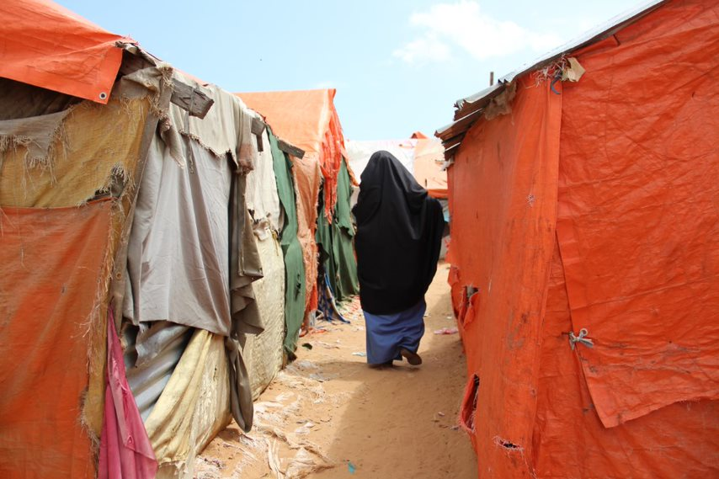
Diirada saar: Haweenka iyo Xaquuqda Guriyeynta, Dhul iyo hanti oo lagu Xadgudbo
Diidmada xuquuqda lahaanshaha hantida guurka sababay
Dhaxalka oo laga reebo
Ka masaxida magacyadooda warqadaha lahaanshaha dhulka ee heshiisyada kirada dhulka
Nidaamyada ragga u badan ee qaybta maamulka dhulka
La'aanta helitaan caddaalad, oo ay ku jiraan caddaaladda aan rasmiga ahayn / cadaalad diineed, ee ku tumashada xuquuqda guryeyn, la haansho dhul iyo hanti.
Notes:
Women are disproportionately affected by HLP violations and therefore particular attention should be put on them.
Women HLP rights are often violated by: denial of marital property rights, exclusion from inheritance, ‘head of household approach’ leading to the omission from title deeds and lease agreements, male dominated practices and processes in the land administration sector, etc.
Lack of access to justice for violation of HLP rights (including formal, community, religious processes)

Slide 17
Shuruudaha Guriyeynta, lahaanshaha dhul iyo hanti iyo xalalka kale waara
Badbaadada iyo amniga
Diiwaangelin
Habnololeed iyo Shaqo
Heer nololeed ku filan
Wadajirka bulshada
Notes:
Activity 3 (optional) For HLP focused workshops only):
Form five groups and assign one criteria to each group.
Ask them to show the link between Housing land and Property and the assigned criteria and to give examples in the Somalia context.

Slide 18
Caqabadaha ugu waaweyn
Diiwaanka dhulka iyo hantida liita ee diiwaangelinta lahaanshaha ama dhulka iyo hantida
La'aanta awoodo aqooneed ee dhanka hay'adaha maamulka iyo garsoorka oo ay ku ilaaliyaan/difaacaan heshiisyada kala duwan ee dhulka
Hababka xallinta khilaafaadka dhaqanka iyo diinta oo takooro Barakacayaasha iyo haweenka
Degitaan ciriiri ah oo ku yimaada dhulka hantida dadweynaha ama kuwa gaarka loo leeyahay oo ay ku socoto hanjabaado isdaba joog ah in xoog looga saarayo
Notes:
Why are HLP rights at the heart of durable solutions, according to you?

Slide 19
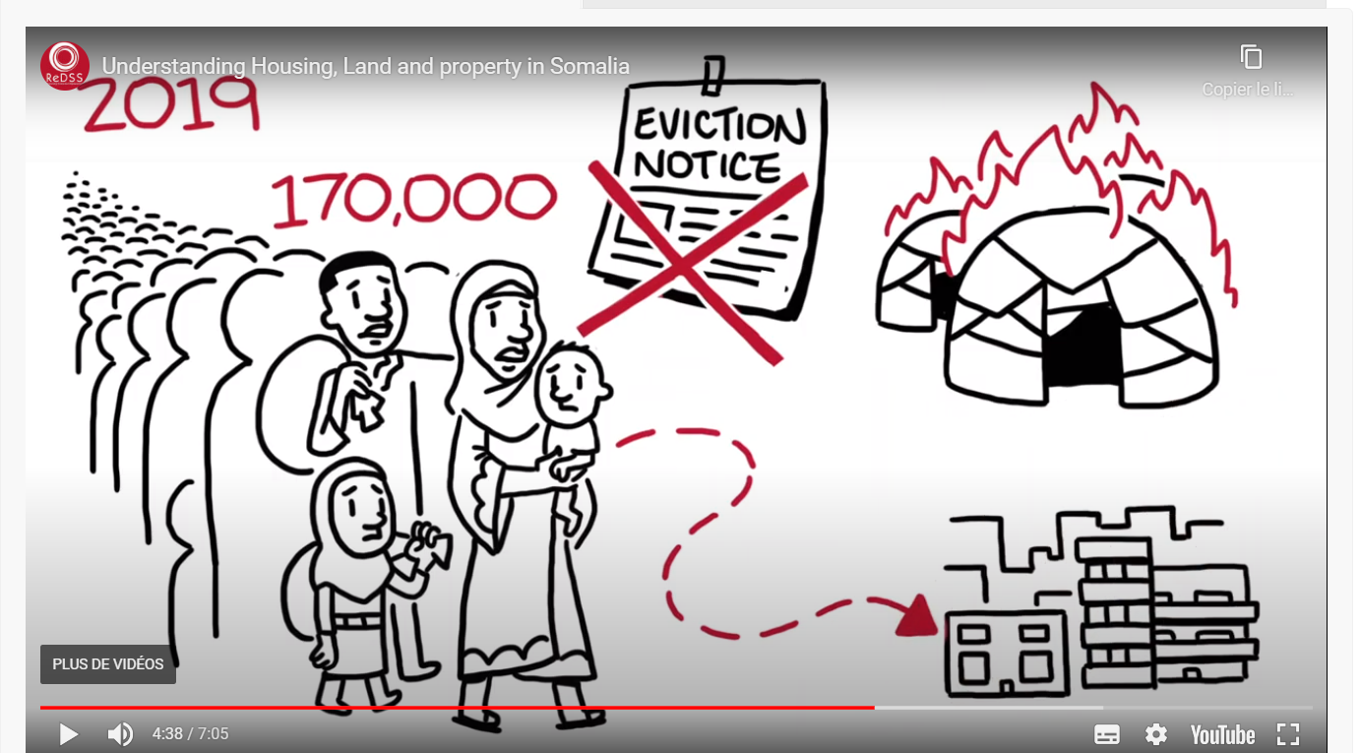
Guryo ka saarista xooga ah
Notes:
Show this image that summarizes well both the definition of forced migration and its magnitide in Somalia. Ask the participant to explain what they see and what they understand.

Slide 20
Guryo ka saarista xooga ah. Maxay tahay?
‘Ka saarista abid ama kumeelgaarka ah ee ka soo horjeedda rabitaanka shakhsiyaadka, qoysaska iyo / ama bulshooyinka ee laga saaro guryaha iyo / ama dhulka ay degan yihiin, iyada oo aan la siinin, ama aan loo ogaalan inay helaan, qaababka ku habboon ee sharci ama difaac kale.’
Xitaa guri ka saarid ku saleysan sabab sharciyeed sida kireystaha / degganaha oo jebiyey heshiiska waxay noqon kartaa ka saarid xoog ah haddii:
Aynan raacin nidaamka cadaaladda (la isticmaalo hanjabaadyo guri ka saarid aan rasmi ahayn)
iyo / ama aynan awood u siinin kireystaha/degganaha inuu helo matalaad sharci

Slide 21
Fariimaha muhimka ah
  Xuquuqda guriyeyn, lahaansho dhul iyo hanti ayaa loo aqoonsan yahay xaquuqul insaan caalami ah iyo qaybo ka mid ah xuquuqda helitaanka heer nololeed ku filan
  In aad uga badan kaliya darbiyada iyo saqafka ka sareeya madaxa qofka, xuquuqda guri, lahaansho dhul iyo hant ayaa fure u ah xaqiijinta badbaadada, amniga iyo sharafta, helitaanka hab-nololeed iyo heer nololeed ku filan. Sidaa darteed waxay udub dhexaad u yihiin geeddi-socodka xalalka waara
  Iyadoo aan loo eegin habeyntooda nabadgelyo ugu noolaanshaha guryaha, Bulshooyinka uu saameyey Barakaca waa inay helaan xuquuqdooda guri, lahaansha dhul iyo hanti, oo ay ku jiraan nabadgelyo ugu noolaanshaha guryaha oo ka ilaalinaya guryo ka saarista qasabka ah

