Slide 1
Module 3
Housing, Land and Property at the heart of durable Solutions
1. What is HLP and why it is at the heart of durable solutions processes?
2. Enhancing security of tenure and durable solutions in Somalia
Notes:
This slide is a recap of activity 3

Slide 2

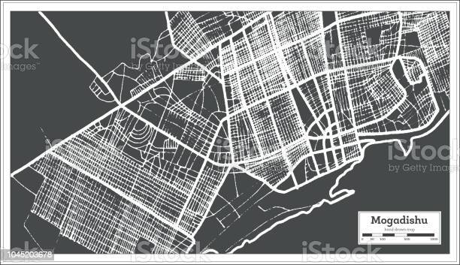
1
What is HLP and why is it at the heart of durable Solutions?

Slide 3
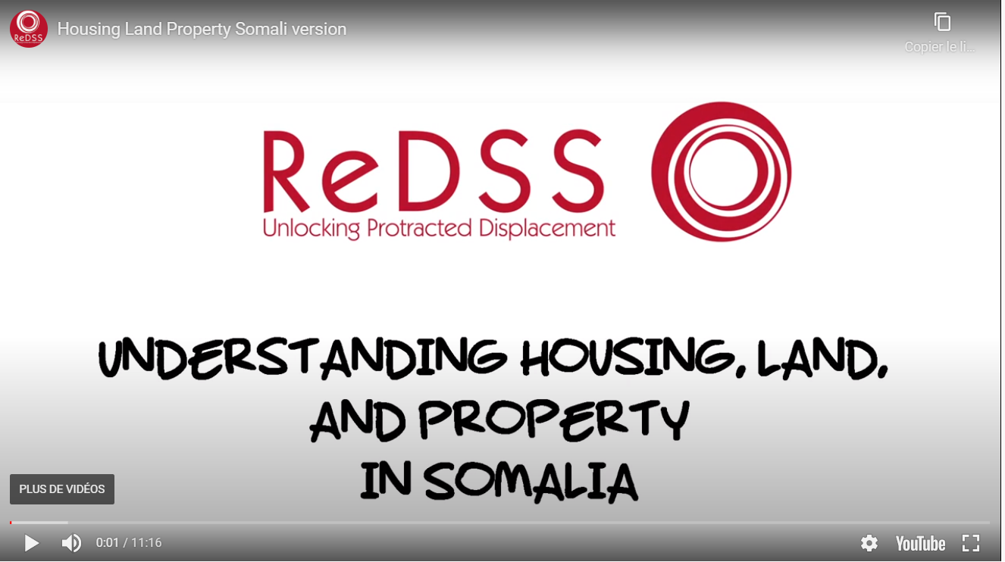
Notes:
In Somali language: https://regionaldss.org/index.php/capacity-development/housing-land-property-somalia/#1587408796347-5cdc1aac-133d
In English: https://regionaldss.org/index.php/capacity-development/housing-land-property-somalia/#1587408796347-5cdc1aac-133d

Slide 4
Objectives of Session
Explain the concept of Housing, Land and Property and its relevance for the progression durable solutions
Identify and categorize the main HLP-related issues preventing DAC from progressing toward durable solutions;
Identify the specific issues faced by women in accessing their HLP rights
Examine the issues related to tenure security in Somalia, with a specific focus on forced evictions.

Slide 5
HLP and durable solutions: Activity
1. Based on the case scenarios, identify the HLP-related issues faced by the characters:
In the place of refuge
In their place of origin
2. Identify the most common HLP-related issues faced by displaced persons in Somalia
Notes:
Activity 1. HLP-related issues or obstacles faced by DAC.
Group activity.
1. Based on the case scenarios, identify the HLP-related issues faced by the characters:
In the place of refuge
In their place of origin
2. Identify the most common HLP-related issues faced by displaced persons in Somalia

Slide 6

What is HLP?
Housing: The right to housing is the right to obtain and occupy a safe and secure home in which to live in peace and dignity.
Land: The right to land refers to entitlements to land that are recognized socially or legally.
Property rights refer to the right to own property and decide how it is used.

Slide 7
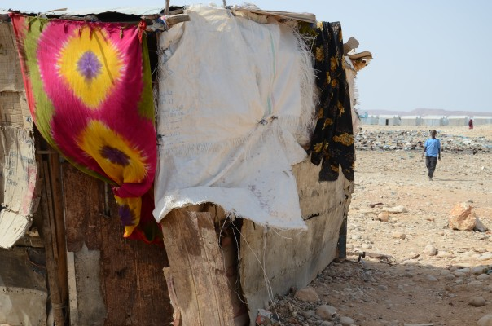
Why housing, Land and Property?
A shelter
A place to live with dignity
Protection from physical violence (including GBV, etc.);
Land for agriculture economic activities, livelihoods etc
A home is a starting point for a more stable socio-economic situation
A key step for early recovery for both displaced and host community
Key for social cohesion, peace building and reconciliation…
Notes:
Activity 1: braistorming in plenary.
Why are HLP rights at the heart of durable solutions, according to you?

Slide 8

HLP are rights!
More than a roof over our head
Right to have a home
Right to be free from forced evictions
Right to a safe shelter
Ability to secure a livelihood
All related to the right to adequate standard of living and to live in safety and dignity

Slide 9

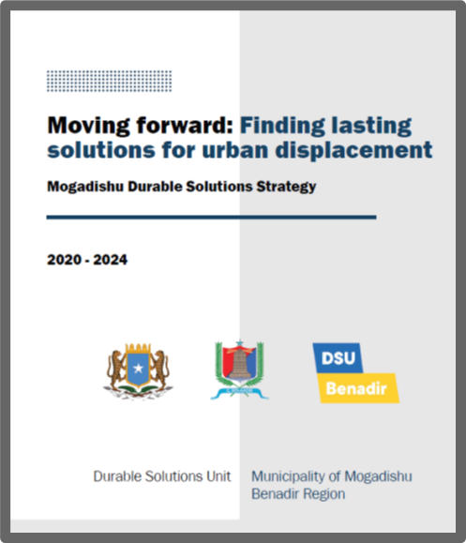
National legal and policy frameworks
Provisional Constitution of the Federal Republic of Somalia, 1 August 2012:
Right to property art. 26,
Right to safety (art.15)
Right to inviolability of home, art 19,
Right to seek redress for violation of human rights,
Right to access to justice etc.

Slide 10
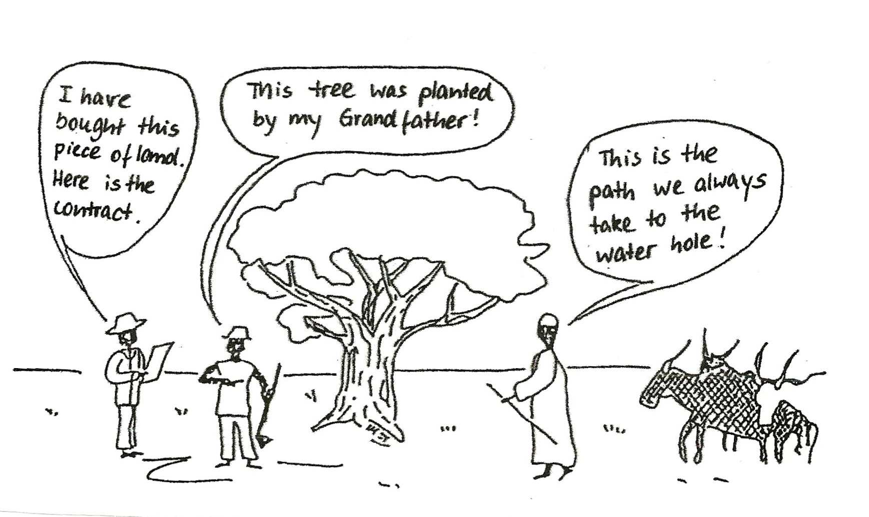
Forms of tenure arrangements
Customary rights
Individual ownership (statutory)
User rights
Notes:
Formal individual or joint ownership rights (e.g. with formal documents) - these are rare, less than 30% globally and much less in fragile contexts.
Customary rights (for individuals or more often groups) - these are administered by customary institutions, such as chiefs, traditional leaders, etc.; HLP rights are protected for the majority of people in developing countries by such systems that needs to be recognized and strengthened.
User rights – this category includes a wide range of HLP options such as rental agreements, rights of use / inhabit, rights to plant and harvest, rights to access water sources, rights of passing through, etc. User rights can be individual or collective and are a good avenue to provide durable solutions at scale in a limited time span while working on longer term HLP options.

Slide 11
Focus: Right to security of tenure
“Security of tenure means that people can live in their homes without fear of forced eviction, whether in communal settlement, informal settlements, host communities or after return. It is the foundation of the right to adequate housing and many other human rights”.
Global shelter cluster

Slide 12
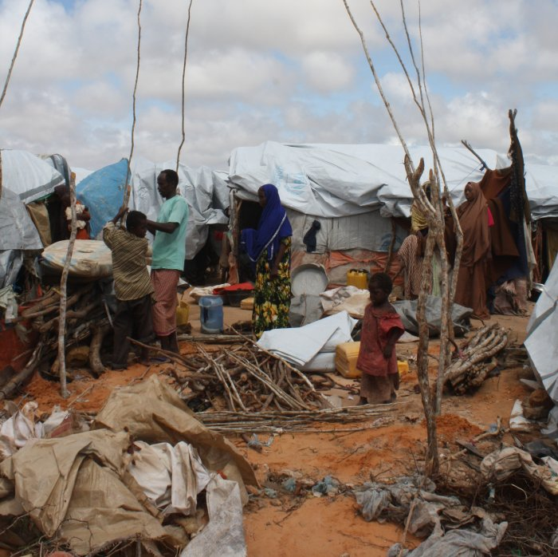
Right to adequate housing for all
All persons should have access to HLP rights regardless of the land tenure arrangement.
IDPs living in informal settlements may not possess legal agreements to live there but still possess their right to adequate housing and protection against forced eviction
We have the right to adequate housing

Slide 13
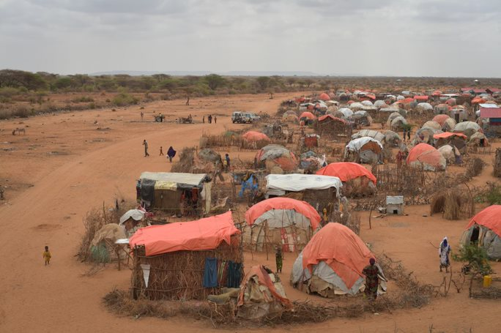
What is adequate housing? 7 criteria
ICESCR General Comment 4: adequate housing:
  Legal security of tenure
  Availability of services, materials, facilities and infrastructure
  Affordability
  Habitability
  Accessibility
  Location
  Cultural adequacy

Slide 14
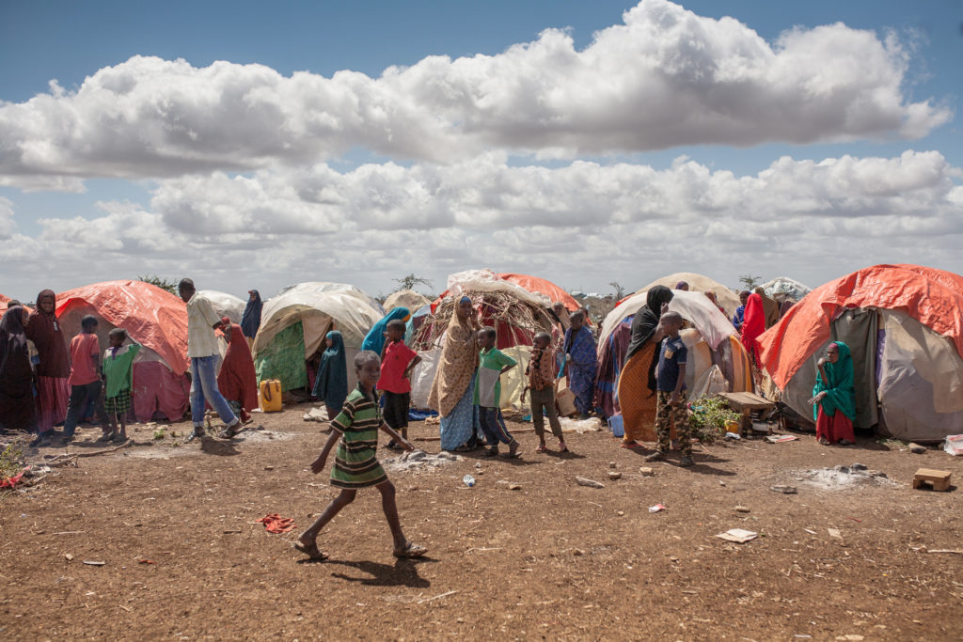
HLP as obstacles to durable solutions in the place of refuge
Inadequate shelter: increased protection risks – GBV and health – and areas prone to disasters
Risk of forced eviction and secondary displacement
Lack / Limited access to land for subsistence and livelihood
Tension with hosts over resources leading to further conflicts and instability
Limited access to services, education and health facilities

Slide 15
Obstacles to durable solutions in the place of origin
  Physical violence over the control of land, housing and property;
  Illegal occupation, illegal use and squatting
  Destruction and looting;
  Confiscation and re-allocation (e.g. based on political or ethnic affiliation);
  Loss of HLP records;
  Customary and user rights
  Weak land management systems;
  Poor legal and policy frameworks
Degradation of infrastructure /Destruction of boundary markers;
Non-implementation of restitution commitments;
Exclusion of women, children and minorities;
Land declared unsuitable for residence (risk area);
Landmines/unexploded ordnance (UXO).

Slide 16
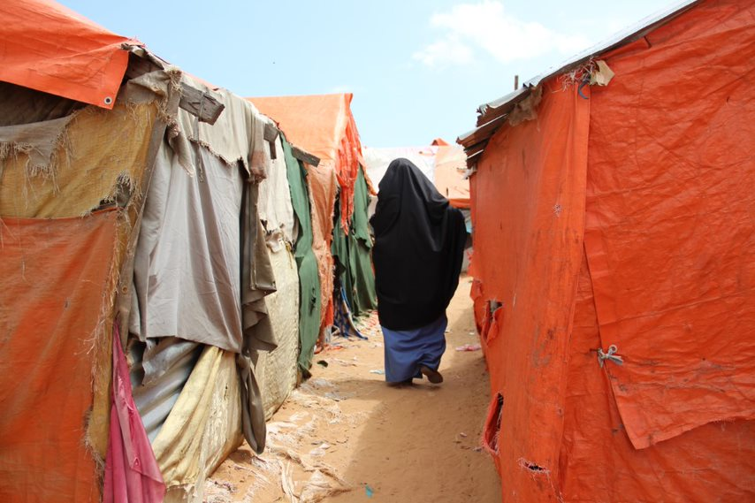
Focus: Women and HLP right violations
Denial of marital property rights
Exclusion of inheritance
Omission of their names on title deeds of lease agreements
Male dominated processes in land administration sector
Lack of access to justice, including informal/religious justice, for violation of HLP rights.
Notes:
Women are disproportionately affected by HLP violations and therefore particular attention should be put on them.
Women HLP rights are often violated by: denial of marital property rights, exclusion from inheritance, ‘head of household approach’ leading to the omission from title deeds and lease agreements, male dominated practices and processes in the land administration sector, etc.
Lack of access to justice for violation of HLP rights (including formal, community, religious processes)

Slide 17
HLP and other durable solutions criteria
Safety and security
Documentation
Livelihood and employment
Adequate standard of living
Social cohesion
Notes:
Activity 3 (optional) For HLP focused workshops only):
Form five groups and assign one criteria to each group.
Ask them to show the link between Housing land and Property and the assigned criteria and to give examples in the Somalia context.

Slide 18
Main obstacles
Poor land and property registry documenting ownership or land and property
Lack of capacities of administrative and judicial institutions to protect various agreements over land
Customary and religious dispute resolution mechanisms that discriminates IDPs and women
Cramped settlement on public or private land with continuous threats of forced evictions
Notes:
Why are HLP rights at the heart of durable solutions, according to you?

Slide 19
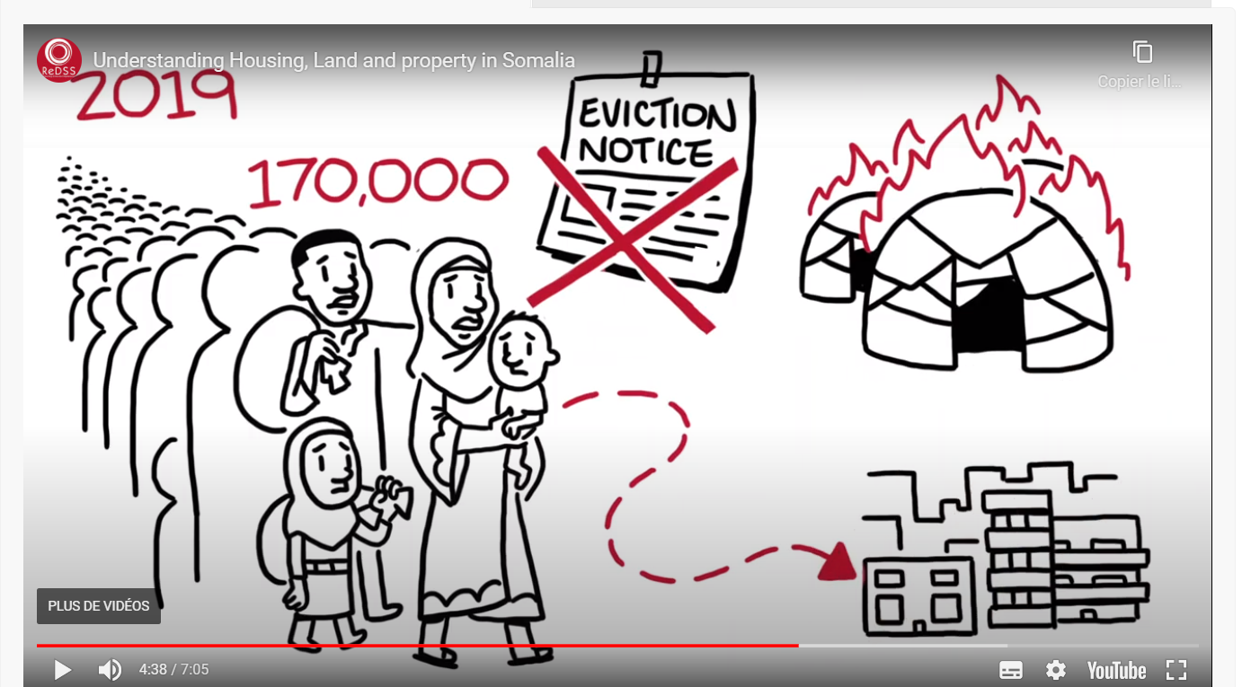
Forced evictions
Notes:
Show this image that summarizes well both the definition of forced migration and its magnitide in Somalia. Ask the participant to explain what they see and what they understand.

Slide 20
Forced evictions. What is it?
‘The permanent or temporary removal against their will of individuals, families and/or communities from the homes and/or land which they occupy, without the provision of, and access to, appropriate forms of legal or other protection.’
Even an eviction that is founded on a legal reason such as a breach of an agreement by the tenant/occupant may be a forced eviction if:
it does not follow due process (uses informal eviction threats)
and/or does not afford the occupant access to legal representation.

Slide 21
Key messages
  HLP rights are universally recognised human rights and components of the right to an adequate standard of living
  Much more than just walls and a roof over one’s head, HLP rights are key to ensure safety, security and dignity, access to livelihood and an adequate standard of living. They are therefore at the heart of durable solutions processes.
  Regardless of their tenure arrangements, Displacement Affected Communities should have access to their HLP rights, including the security of tenure that protect them against forced evictions.

