Slide 1
Koorsada 3aad: Guriyeyn, Dhul iyo Hanti ayaa xuddun u ah Xalalka waara
1. Waa maxay guriyeyn, Dhul iyo hanti maxayna u yihiin xudunta geeddi-socodka xalalka waara?
2. Kobcinta Xasilinta mudada la deganaan karo guryahay iyo xuquuqda guriyen, dhul iyo hanti ee Soomaaliya
Notes:
This slide is a recap of activity 3

Slide 2

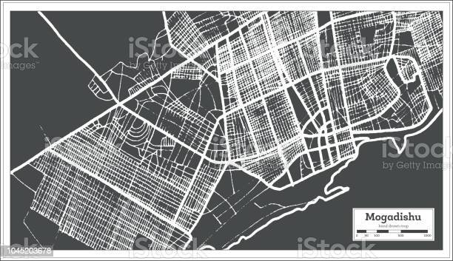
2
Kobcinta Xasilinta mudada la deganaan karo guryahay iyo xuquuqda guriyen, dhul iyo hanti ee Soomaaliya

Slide 3
Ujeedooyinka
Dhamaadka kulankan, waxaad awoodi doontaa inaad::
Sharaxaad ka bixiso nidaamka guri ka saarida sharciga ah iyadoo la waafajinayo habraaca guri ka saarista qaranka
Sahmiso/doondoonto talaabooyin kor loogu qaadayo xasilinta Mudada guryahay la deganaan karo iyo xuquuqda guriyeyn, Dhul iyo hanti ee Soomaaliya, oo ay ku jiraan dhaqamada wanaagsan
Baaritaan ku sameyso daraasadaha kiisas gaar ah iyo casharrada laga bartay dib u dejinta iyo ka mid noqoshada dejinta mashaariicda qorshaynta magaalooyinka

Slide 4

Caqabadaha hortaagan mudada Guryaha lagu jirayo
Maxaa la qaban karaa si kor loogu qaado Xasilinta Mudada la deganaan karo iyo xuquuqda guriyeyn, dhul iyo hanti ee somalia?
“Xasilinta Mudada guryahay la deganaan karo waxay ka dhigan tahay in dadku ay ku noolaan karaan guryahooda iyagoo aan ka baqaynin in qasab looga saarayo, ha ahaato dejinta wadaagga, degsiimooyinka aan rasmiga ahayn, bulshooyinka martida loo yahay, ama ka dib soo noqoshada. Waa aasaaska xaq u yeelashada xaquuq guriyeyn ku filan iyo xuquuqooyin kale oo badan oo bini’aadamnimo”.
Notes:
Activity 4 (optional. For HLP focused workshops only) : Fishbowl :
• Change to room set up: A Fishbowl discussion requires a circle of chairs (“the fishbowl”) and enough room around the circle for the remaining participants to observe what is happening in the “fishbowl.”
• Participants are separated into an inner and outer circle. Ask 4 to 6 participants to sit in the inner circle, or fishbowl, and let them start answering the main question and discuss for 5 minutes; Participants in the outer circle listen to the discussion and take notes. After 5 minutes ask three to four participants of the inner circle to leave and ask participants around who wants to join the inner circle. You can do two more rounds if you feel that other participants want to join the inner circle and bring relevant issues.
• Debriefing: Write the main issues coming up during the discussion on a flip chart paper and ask the participants to correct or complete the list of obstacles. The following slides are there to summary the main obstacles to security of tenure in Somalia.

Slide 5


Xalalka: Qaabdhismeedka Siyaasadeed Ee Cusub
Habraaca Guri ka saarista:
Xaq uhelida guriyeyn ku filan
Mamnuucida guri ka saarista sabab la’aanta
Barakaca ka dhasha dadka oo si qasabka ah looga rarayo guryahooda waa nooc ka mid ah barakaca aan sababta lahayn
Waxay dejisaa xaaladda iyo hababka looga saarayo si sharci ah
Iyadoo waafaqsan heshiiskii Kampala
Notes:
The National Eviction Guidelines, 2019 set out the conditions for lawful evictions and the procedures to be followed before, during and after evictions. The guidelines confirm the ‘right of everyone to adequate housing as guaranteed by Article 25 of the Universal Declaration of Human Rights’ and ‘prohibit arbitrary displacement of internally displaced persons’. Related to internal displacement more specifically, the guidelines ‘prohibit arbitrary displacement of internally displaced persons’ and follow Article 11(4) of the African Union Convention for the Protection and Assistance of IDPs in Africa (Kampala Convention), which sets out obligations of state parties to ‘establish appropriate mechanisms providing for simplified procedures where necessary for resolving disputes relating to the property of internally displaced persons’.

Slide 6

Gurya ka saarista: habsocodka sharciga ah
Shuruudaha iyo nidaamka loo marayo gurya ka saarista sharciga ah:
Kaliya duruufaha lagama maarmaanka ah iyo kuwa gaarka ah:
Sabab sharci ah ama arrin qasabeyso dib u soo celinta dhulka danta guud
Loo baahan yahay in la ilaaliyo lana soo celiyo xuquuqda lahaanshaha hanti
Dan guud oo ka muhimsan wax kasta oo dhan
Badbaadooyinka
Dadka guryaha laga saarayo lama dhigi karo guri la'aan ama inay inay u nugulaadaan xadgudubka xuquuqda aadanaha
Beddel ku filan oo hoy ah

Slide 7
Habraaca oo ah tilaabo tilaabo
Waajibaadka ogeysiinta iyo sameynta ogeysiiska
Xuquuqda aad leedahay inaad hesho ficil maamul cadaalad ah, dib u eegis garsoor ama racfaan
Xuquuqda inaad hesho kaalmo Sharci iyo Macluumaadka
Aasaasida guddiga gurya ka saarista ee fulinta amarka guryo ka saarista
Aqoonso in la heli karo hoy kale oo kufilan iyadoo lala tashanayo Bulshooyinka Barakcayaasha
Badbaadada inta lagu gudo jiro gurya ka saarista
Saxitaanada sharciga iyo wax usixida gurya ka saarista kadib
Notes:
Activity 2: Print and cut the activity 2 document, mix the pieces of paper and and put them into envelops : one envelop per group. Ask each group to put the lawful eviction steps into the right order.

Slide 8
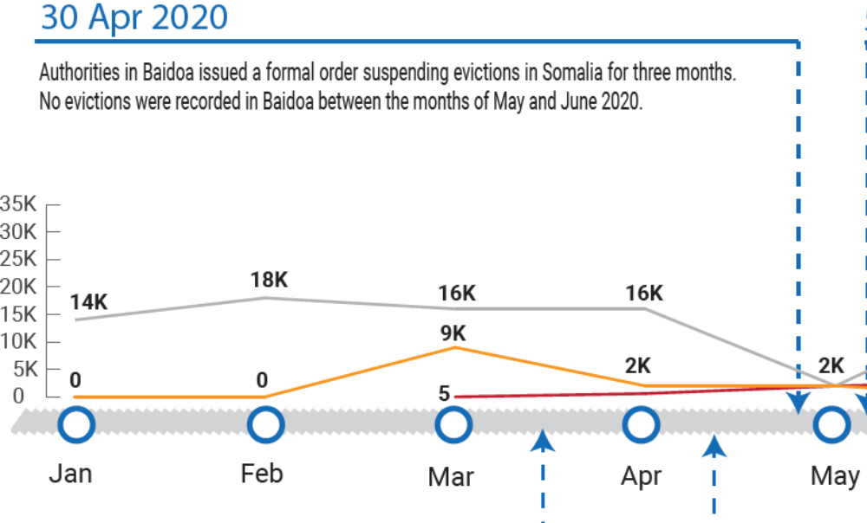
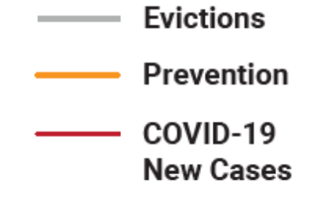
Ka Hortag: Joojinta Barakicinta Xooga ah ee Baydhabo
Tusaalaha tallaabooyinka ka hortagga:heshiisyada ijaarka guryaha ayaa loo kordhiyay 19 goobood oo barakacayaal ah (1,407 qoys)
Notes:
In Somalia, the Baidoa District Administration, has issued an official directive suspending evictions in Baidoa during “the Covid-19 period”. The mayor of Baidoa issued a warning of legal action for landowners who disobey the directive. While enforcement and monitoring will likely remain a challenge, the directive shows intent and a route that can be replicated across the region.
Moratorium was agreed by the Baidoa Mayor on 30 April 2020 and no evictions were reported in Baidoa during the months of May and June 2020, a significant drop from 6360 evictions reported in April 2020. In addition, as a result of the moratorium and coordinated prevention initiatives this year, lease agreements were extended for 19 IDP sites (1,407 households), and an aggregate 1,139 households were protected from forced evictions. Based on eviction vulnerability criteria, post-eviction assistance has been put in place for the eligible households if evicted.
Key message there is the engagement of local authorities!

Slide 9
Tallaabooyin kale oo lagu xoojinayo xuquuqda guryeynta, dhulka iyo hanti
Kaalmo Sharci
Helitaanka kaalmada sharciga iyo la-talinta
kaalmada sharciga ee qaraarada khilaafaadka.
Xooji nidaamka cadaalada ee aan rasmiga aheyn iyadoo loo eegayo dhinaca jinsiga rag iyo dumar isla markaana waafaqsan mabda’a xuquuqul insaanka iyo midabtakoor la’aanta
Mudada deganaashaha guryaha:
Soosaarista dukumiintiyada mudada deganaashaha sharciga ah: heshiiska kirada, qandaraaska kirada, shahaadooyinka deganaanshaha ku meel gaarka ah, heshiisyada dhulka la wadaago, warqadaha lahaanshaha….
Kaalmada dhimista kirada

Slide 10
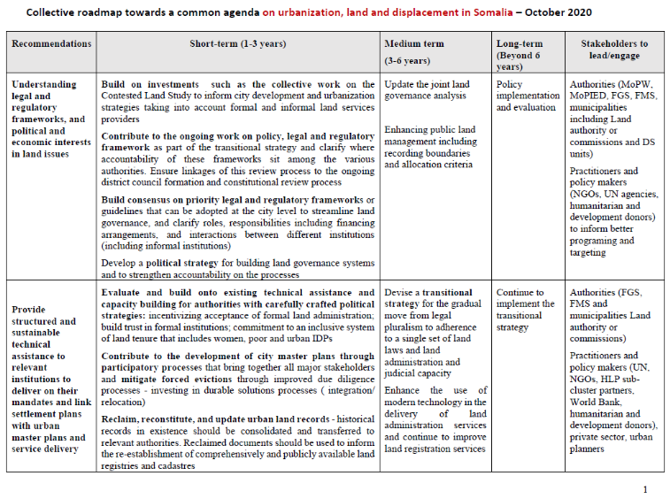
Jaheyn ku saabsan magaalaynta, dhulka iyo barakaca
La soo saaray WB, ayadoo lala waheshanaya Deeq-bixiyeyaasha, iyo xirfadleyaal
Saddex talooyin oo waaweyn:
Fahamka qaabdhismeedka sharci iyo xeer, iyo danaha siyaasadeed iyo dhaqaale ee arrimaha dhulka
Bixinta gargaar farsamo oo habeysan oo waara oo la siinayo hay'adaha ay khuseyso si ay uga soo baxaan waajibaadkooda kuna xiriiriyaan qorshooyinka dhul dejinta kuwa guud ee magaalooyinka iyo adeeg bixinta
Horumari maaraynta khilaafka dhulka iyadoo loo marayo geedi socod dib u heshiisiin qaran oo dhameystiran, iyo su'aalo balaaran oo ku saabsan xuquuqda muwaadinimada

Slide 11
Dhul qeybinta loogu talagalay guryaha
Qeybinta dhulka iyo guryeynta loogu talagalay barakacayaasha nugul iyo qaxootiga soo laabtay
Hab maamuuska ayaa dejinaya:
shuruudaha u-qalmitaanka ee qaybinta dhulka
Inuu jiro dhul la qeybiyo
Mudnaanta qoondaynta dhulka
go'aaminta dadka ka-faa'iideysanaya,
waajibaadka saaran ka-faa'iideystayaasha
Lahaanshaha dhulka: laga bilaabo mid ku meel gaadh ah ilaa lahaansho rasmi ah.

Slide 12
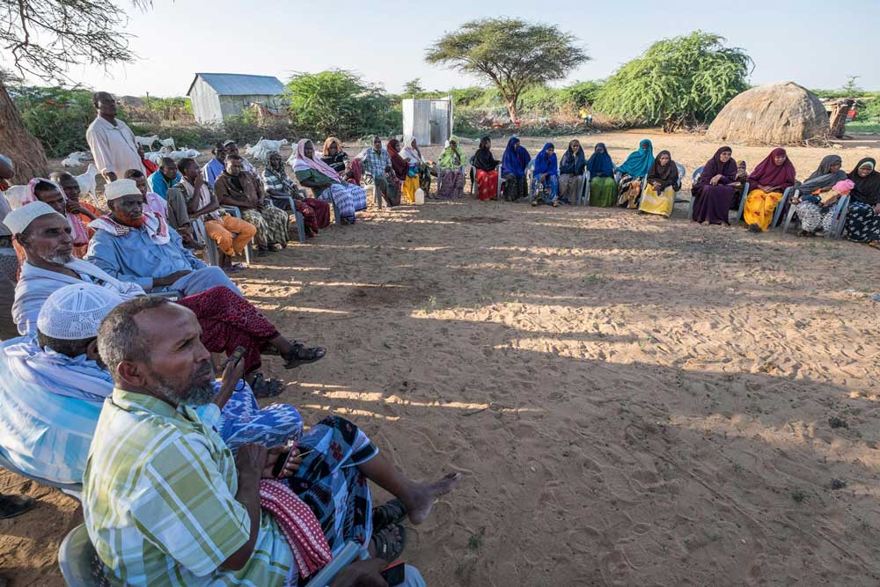
Dib u dejin: ma hilmaami doonno!
Macluumaadka bulshada, wadatashiga iyo kaqeybgalka nidaamka dib udajinta iyo qorshaha DS.
Ixtiraam heerarka xalalka waara
In aan la abuurin barakicin khasab ah!
Mabaadi'da guriyeynta ku filan:
Mudada deganaashaha sharciga ah
Helitaanka adeegyada, tas-hiilaadka, kaabayaasha dhaqaalaha
Qiimo jaban
Lagu noolaan karo
Meel la gaari karo and goobta uu ku yaalo
Dhaqanka ahaan ugu filan

Slide 13
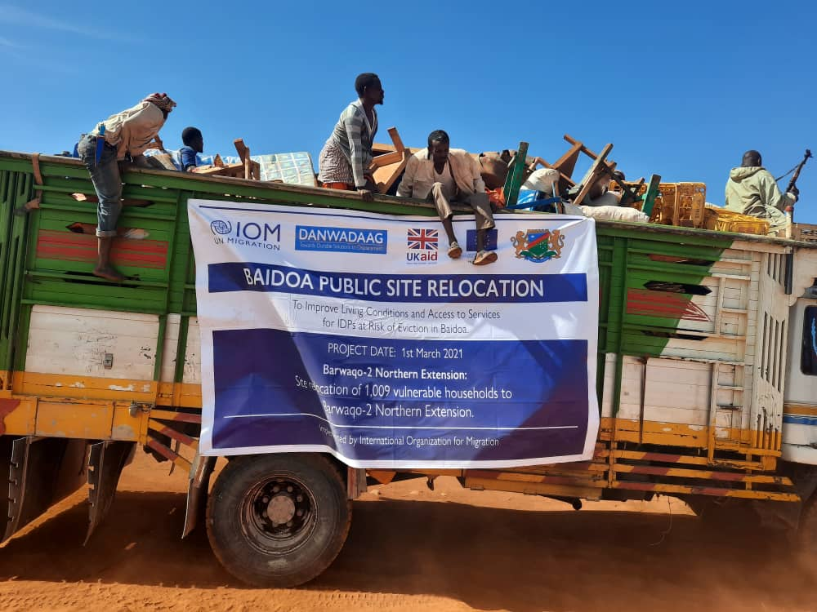
Kiis barasho
1,009 qoys oo qatar ugu jira in laga saaro magaalada Baydhabo ayaa loo wareejiyey Barwaaqo 2, oo ah goob dadweyne oo ay ku deeqday Dowlad Goboleedka Koonfur Galbeed. Waxay heli karaan joogitaan/deganaasho dhul oo waara.
Goob 200m2 ah oo leh beer yar.
Adeegyada ka baxa:
Wadooyin
Nalalka waddooyinka
Saldhigyada Booliska
Xaruumaha caafimaadka
Dugsiyada maadiga
Goobaha Bulshada

Slide 14

Qorshaynta dejinta iyo casriyeynta
SDG 11 waxay higsaneysaa inay ka dhigto magaalooyinka iyo degsiimooyinka aadanaha mid loo wada dhan yahay, oo ammaan ah, adkeysina leh oo waara
Ujeeddadeedu waa in la hubiyo in dadka oo dhami helaan guryo ku filan, ammaan ah oo la awoodi karo qiima ahaan iyo adeegyada aasaasiga ah iyo casriyeynta xaafadaha isku raranta ah, helitaanka gaadiid badbaado leh, qiimo jaban, marin loo heli karo oo waara dhammaan dadka, hagaajinta nabadgelyada waddooyinka
In kor loo qaado awooda kaqeybqaadashada, qorshaynta iyo maaraynta dhul dejinta dadka ee isku-dhafan, oo waarta

Slide 15
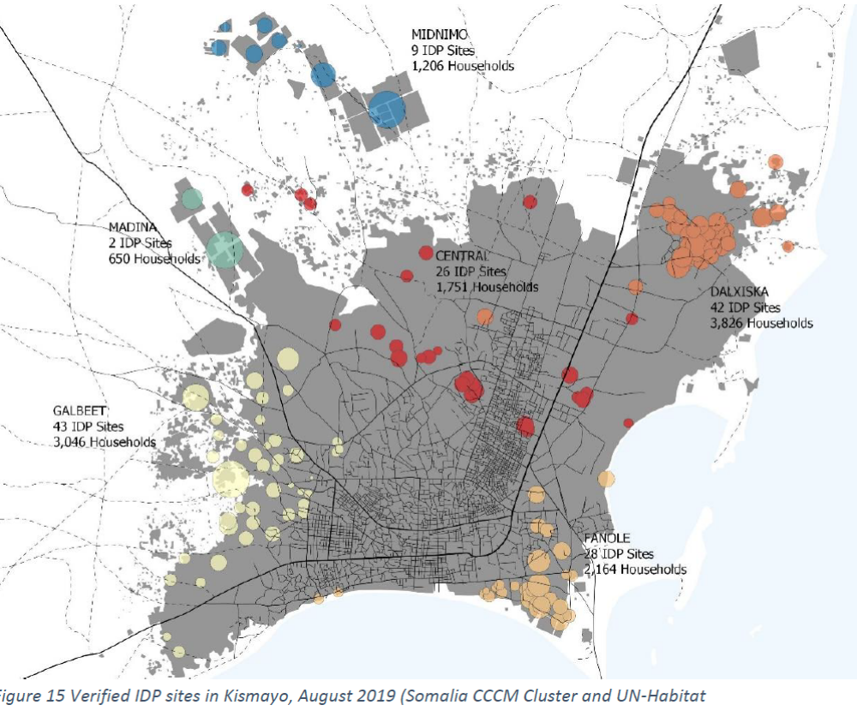
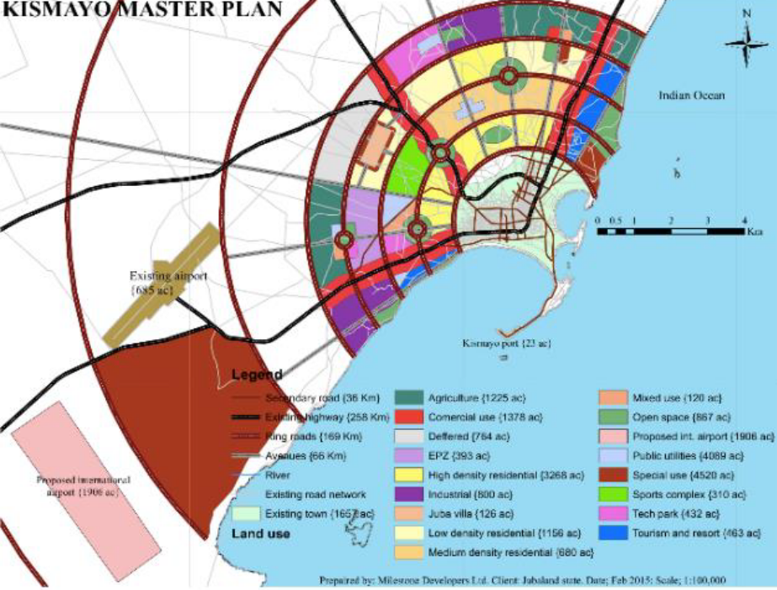
Qorshaynta dejinta iyo casriyeynta
Isku-darka degsiimooyinka barakacayaasha iyo bulshada marti-gelisay qorshooyinka horumarinta magaalooyinka
Abuuritaanka ama isku-darka guryaha ku yaal bey'ado ammaansan oo isku xiran oo leh adeegyo la xoojiyay: gaadiid, habnololeed, waxbarasho, tas-hiilaad caafimaad, iwm oo ay helaan dhamaan.
Ayadoo la adeegsanayo qaababka ku saleysan aagga iyo bulshada ee isku xiraya Qorshe Howleedka Bulshada iyo qorsheynta magaalooyinka iyo qorshooyinka horumarinta ee hoos imanaya hoggaanka deegaanka / heer qaran.
Hab cusub oo lagu taageerayo Barakacayaasha iyo martigaliyaasha ku nool magaalooyinka sida xowliga ah u koraya ee Soomaaliya
Notes:
Pictures taken from the Kismayo Urban Profile Working Paper and Spatial Analyses for Urban Planning, Oct. 2020.
The one on the top shows the localisation of verified IDP settlements in Kismayo in August 2019 (Somalia CCCM Cluster and UN-Habitat)
The second, at the bottom is the or City master plan for the development of the city of Kismayo. Ideally IDP and host community settlement should be integrated and aligned to it to ensure an inclusive development f the city.

Slide 16
Fariimaha Muhimka ah
Mudada la deganaan karo guryaha ayaa fure u ah xaqiijinta helitaanka xuquuqda guryeyn, dhul iyo hanti iyo xalalka waara
Soomaaliya gudaheeda, waxaa ka jira caqabado badan oo hortaagan mudada la deganaan karo guryaha ee dadka uu saameyey barakaca, oo ay ku jiraan kuwa xooga looga saaro dhulal gaar loo leeyahay oo la degan yahay.
Bixinta kaalmo sharci, xoojinta nidaamka cadaalada ee aan rasmiga aheyn, bixinta dukumiintiyada sharciga ah ayaa ah siyaabaha lagu xoojiyo inay dad barakacayaasha helaan mudo dheer oo ay deganaan karaan guryaha ee Soomaaliya.
La shaqeynta ururada howl wadeenada dowladda hoose ayaa cadeysay inay gacan ka geysato yareynta dhacdooyinka guryo ka saarista qasabka ah iyo ku tumashada xuquuqda guryeyn, dhul iyo hanti.
Mas’uuliyinta Soomaaliya ayaa dhawaanahan qaatay siyaasado lagu xoojinayo helitaanka mudo dheer oo guryaha lagu deganaado oo loogu talagalay bulshooyinka barakacayaasha. Fulintooda waxay muhiim u tahay horumarka dhanka xalalka waara
Habka isku dhafan ee deegaandejinta iyo ku-xirka qorshaynta magaalooyinka si loo hubiyo ka mid noqoshada bulshooyinka barakacayaasha ee horumarinta caasimada ayaa xudun u ah qorshaynta xalalka waara ee muddada dheer.

