Slide 1
Module 3
Housing, Land and Property at the heart of durable Solutions
1. What is HLP and why it is at the heart of durable solutions processes?
2. Enhancing security of tenure and HLP rights in Somalia
Notes:
This slide is a recap of activity 3

Slide 2

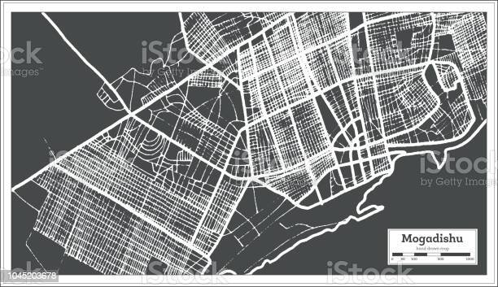
2
Enhancing security of tenure and HLP rights in Somalia

Slide 3
Objectives of Session
Describe the legal eviction process in line with the national eviction guidelines.
Explore measures to enhance security of tenure and HLP rights in Somalia, including good practices
Examine case studies and lessons learnt from relocation and inclusion of settlement in urban planning projects.

Slide 4

Obstacles to security of tenure
“Security of tenure means that people can live in their homes without fear of forced eviction, whether in communal settlement, informal settlements, host communities or after return. It is the foundation of the right to adequate housing and many other human rights”.
What can be done to enhance security of tenure and HLP rights in somalia?
Notes:
Activity 4 (optional. For HLP focused workshops only) : Fishbowl :
• Change to room set up: A Fishbowl discussion requires a circle of chairs (“the fishbowl”) and enough room around the circle for the remaining participants to observe what is happening in the “fishbowl.”
• Participants are separated into an inner and outer circle. Ask 4 to 6 participants to sit in the inner circle, or fishbowl, and let them start answering the main question and discuss for 5 minutes; Participants in the outer circle listen to the discussion and take notes. After 5 minutes ask three to four participants of the inner circle to leave and ask participants around who wants to join the inner circle. You can do two more rounds if you feel that other participants want to join the inner circle and bring relevant issues.
• Debriefing: Write the main issues coming up during the discussion on a flip chart paper and ask the participants to correct or complete the list of obstacles. The following slides are there to summary the main obstacles to security of tenure in Somalia.

Slide 5
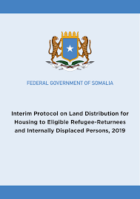

Solutions: new policy frameworks
National eviction guidelines:
Right to adequate housing
Prohibition of arbitrary displacement as forced eviction is a form of arbitrary displacement
Sets out the condition and procedures for lawful evictions
In line with the Kampala Convention
Notes:
The National Eviction Guidelines, 2019 set out the conditions for lawful evictions and the procedures to be followed before, during and after evictions. The guidelines confirm the ‘right of everyone to adequate housing as guaranteed by Article 25 of the Universal Declaration of Human Rights’ and ‘prohibit arbitrary displacement of internally displaced persons’. Related to internal displacement more specifically, the guidelines ‘prohibit arbitrary displacement of internally displaced persons’ and follow Article 11(4) of the African Union Convention for the Protection and Assistance of IDPs in Africa (Kampala Convention), which sets out obligations of state parties to ‘establish appropriate mechanisms providing for simplified procedures where necessary for resolving disputes relating to the property of internally displaced persons’.

Slide 6

Evictions: the due process
Conditions and procedure for lawful eviction:
Only in unavoidable and exceptional circumstances:
legitimate or compelling reason to reclaim public land
Necessary to uphold and restore property rights
Overriding public interest
Safeguards:
evictees can’t be rendered homeless or vulnerable to violation of human rights
Adequate shelter alternative

Slide 7
Step by step procedure
Duty to notify and form notice
Right to fair administrative action, judicial review or appeal
Right to legal Aid and Information
Establishment of the eviction committee for the implementation of the eviction order
Identify alternative adequate shelter in consultation with DAC
Safeguards during eviction
Legal remedy and reddress after éviction
Notes:
Activity 2: Print and cut the activity 2 document, mix the pieces of paper and and put them into envelops : one envelop per group. Ask each group to put the lawful eviction steps into the right order.

Slide 8
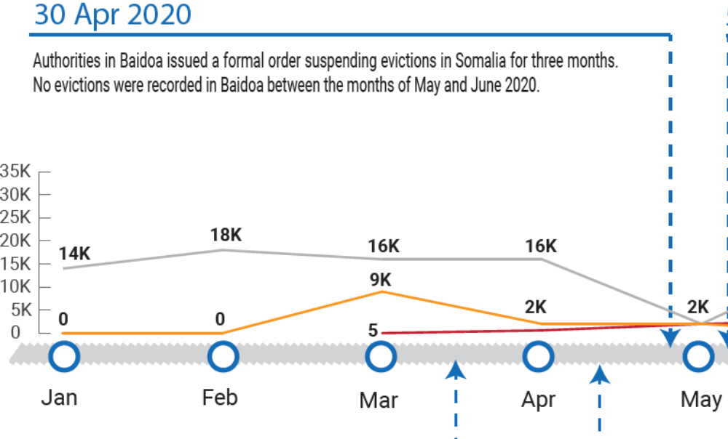
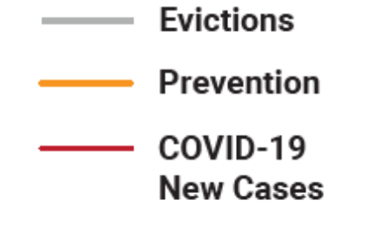
Prevention : Moratorium on foced evictions in Baidoa
Example of prevention measures:
lease agreements were extended for 19 IDP sites (1,407 households)
Notes:
In Somalia, the Baidoa District Administration, has issued an official directive suspending evictions in Baidoa during “the Covid-19 period”. The mayor of Baidoa issued a warning of legal action for landowners who disobey the directive. While enforcement and monitoring will likely remain a challenge, the directive shows intent and a route that can be replicated across the region.
Moratorium was agreed by the Baidoa Mayor on 30 April 2020 and no evictions were reported in Baidoa during the months of May and June 2020, a significant drop from 6360 evictions reported in April 2020. In addition, as a result of the moratorium and coordinated prevention initiatives this year, lease agreements were extended for 19 IDP sites (1,407 households), and an aggregate 1,139 households were protected from forced evictions. Based on eviction vulnerability criteria, post-eviction assistance has been put in place for the eligible households if evicted.
Key message there is the engagement of local authorities!

Slide 9
Other measures to enhance HLP rights
Legal aid
Access to legal aid and counselling
legal assistance for dispute resolutions.
Strenghten the informal justice system with a gender lens and in line with human rights and non discrimination principle
Tenure security:
Issuance of legal tenure security documents : rental agreement, lease contract, temporary occupancy certificates, communal land agreements, title deeds….
Rental subsidy

Slide 10
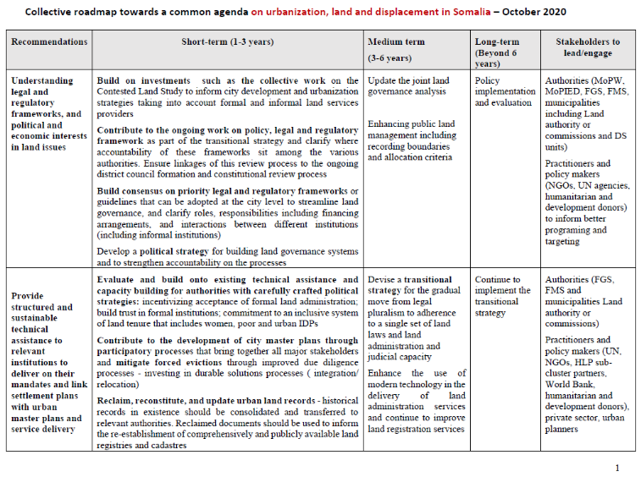
collective road map on urbanization, land and displacement
Developed together with WB, Donors, and practioners
Three main recommendations:
Understanding legal and regulatory frameworks, and political and economic interests in land issues
Provide structured and sustainable technical assistance to relevant institutions to deliver on their mandates and link settlement plans with urban master plans and service delivery
Advance the management of land conflict through a comprehensive national reconciliation process, and wider questions of citizenship rights

Slide 11
Land distribution for housing
Provisions for land and housing for vulnerable IDPs an refugee returnees
The Protocol establishes:
the eligibility criteria for land distribution
availability of land for distribution
priority in land allocation,
determination of beneficiaries,
the obligations of beneficiaries
land ownership: from temporary to permanent title.

Slide 12
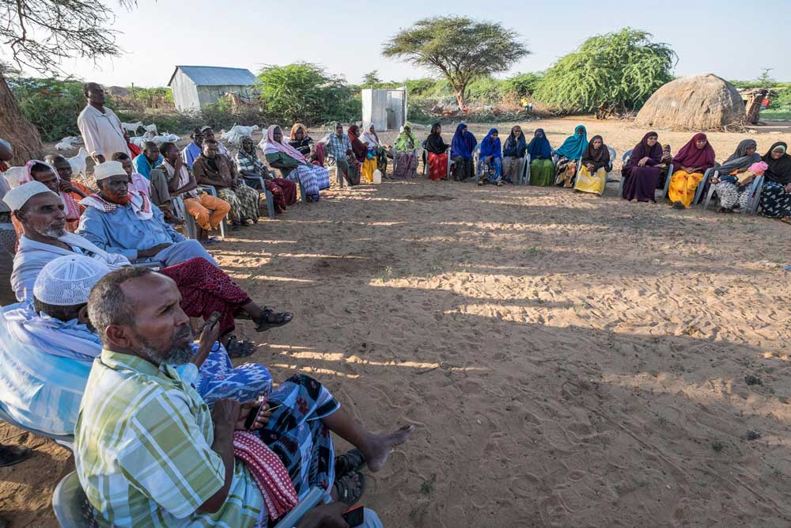
Relocation: we shall not forget!
Community information, consultation and participation to the relocation process and DS plan.
Respect Durable solutions standards
Not to create forced displacement!
Adequate housing principles:
Legal security of tenure
Availability of services, facilities, infrastructure
Affordability
Habitability
Accessibility and Location
Cultural adequacy

Slide 13
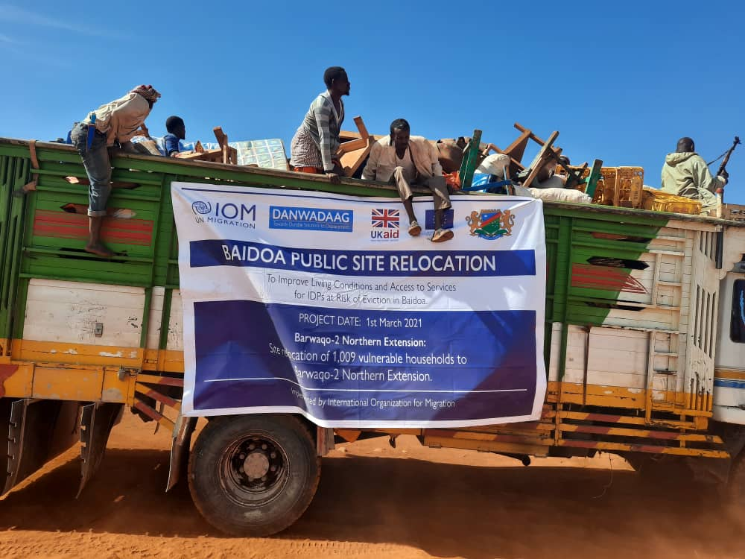
Case study
1,009 families at risk of eviction in Baidoa were transferred to Barwaqo 2, a public site donated by the South West State Government. They have access to sustainable land tenure.
A plot of 200m2 with a small garden.
Services provided:
Roads
Streetlights
Police Stations
Health clinics
School
Community Centre

Slide 14

Settlement planning and upgrading
SDG 11 aims to make cities and human settlements inclusive, safe, resilient and sustainable.
It aims to ensure access for all to adequate, safe and affordable housing and basic services and upgrade slums, provide access to safe, affordable, accessible and sustainable transport for all, improving road safety.
Enhance capacity for participatory, integrated and sustainable human settlement planning and management.

Slide 15
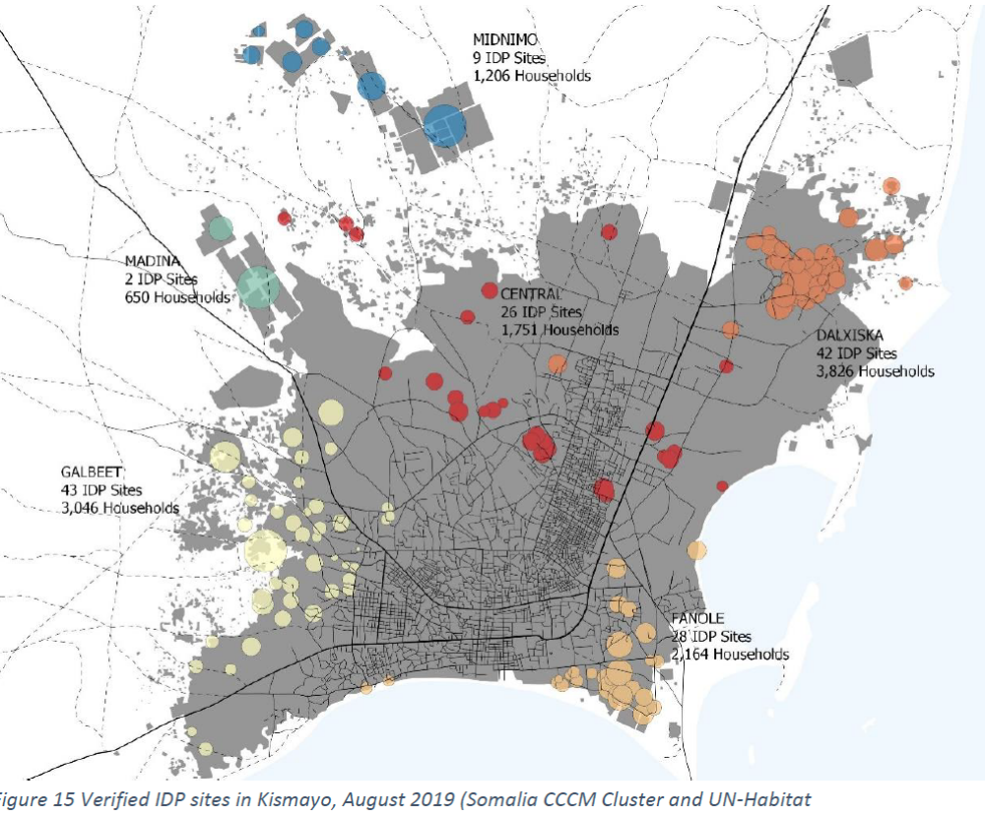
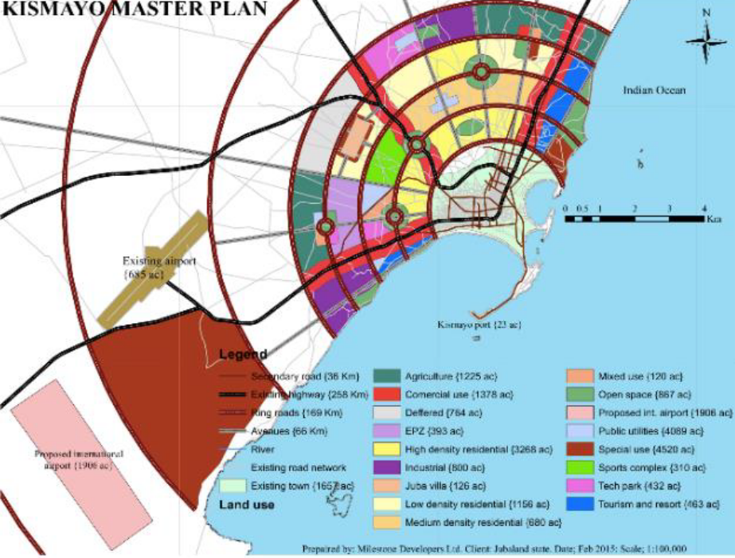
Settlement planning and upgrading
Integrating IDP settlements and host communities to urban development plans
Creation or consolidation of homes in safe and connected environments with enhanced access to services: transportation, livelihood, education, health facilities, etc. for all.
Using the area and community-based approaches linking CAPs to urban planning and development plans under local/national leadership.
A new way to support IDPs and host in the rapidly growing cities of Somalia
Notes:
Pictures taken from the Kismayo Urban Profile Working Paper and Spatial Analyses for Urban Planning, Oct. 2020.
The one on the top shows the localisation of verified IDP settlements in Kismayo in August 2019 (Somalia CCCM Cluster and UN-Habitat)
The second, at the bottom is the or City master plan for the development of the city of Kismayo. Ideally IDP and host community settlement should be integrated and aligned to it to ensure an inclusive development f the city.

Slide 16
Key messages
The security of tenure is key for ensuring access to HLP rights and durable solutions
In Somalia, there are many obstacles to security of tenure for DAC, including forced evictions from occupied private lands.
Providing legal aid, strengthening the informal justice system, issuing legal documents are ways to enhance access to security of tenure for DAC in Somalia.
Working with municipal actors proved to be instrumental in reducing the incidence of forced eviction and violation of HLP rights.
The Somali authorities have recently adopted policies to strengthen access to security of tenure for DAC. Their implementation is crucial in the progress towards durable solutions.
Settlement integrated approach and linkage with urban planning to ensure the inclusion of DAC in the city development is at the heart of long-term durable solutions planning.

