Slide 1
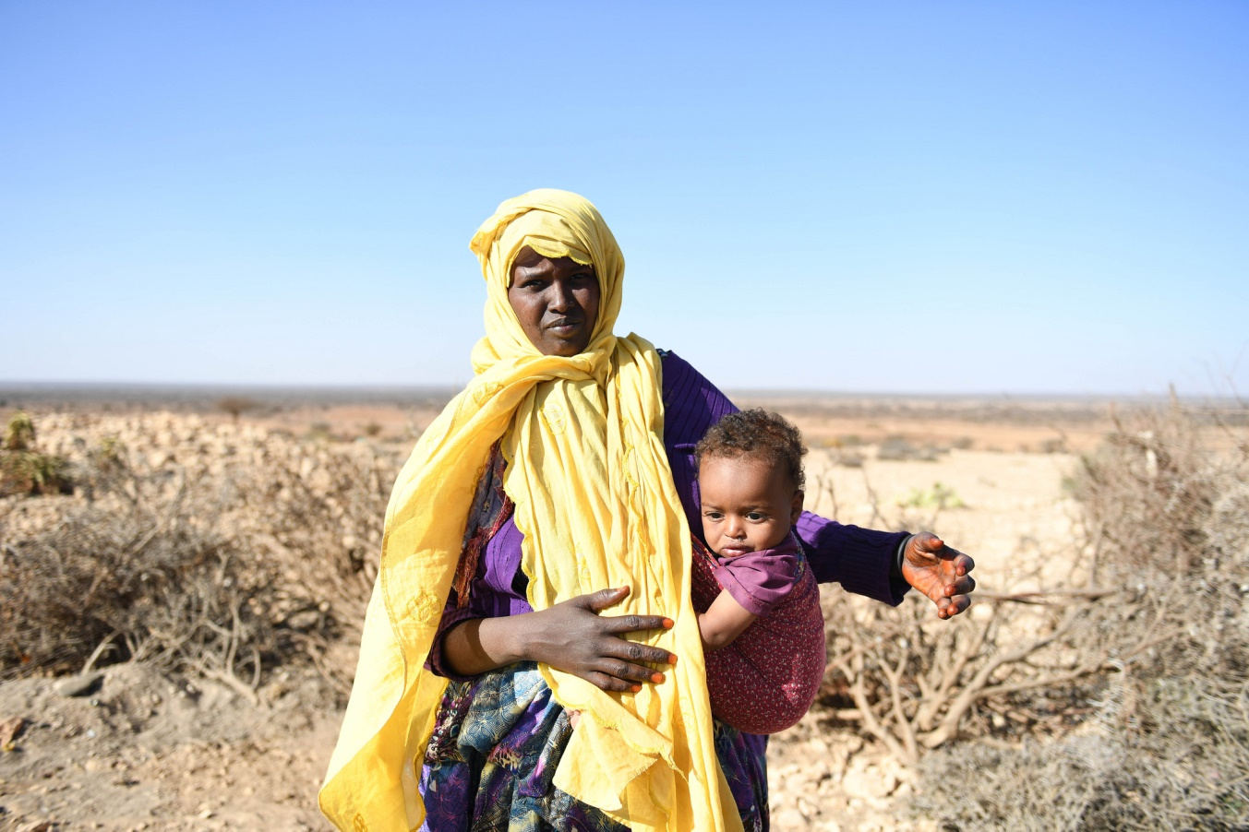
Xal waara uraadinta Bulshooyinka uu saameyey Barakacaee Soomaaliya

Slide 2

Xeeladaha Tababarka

Slide 3
Ujeedooyinka
Dhamaadka kulankan waxaad awoodi doontaa inaad:
Sharaxdo wareegga tababarka
Tixdo ficillada kala duwan ee la qaado iyo su'aalaha laga jawaabayo inta lagu jiro qeybta qiimeynta ee wejiga diyaarinta, ka hor inta aan la bilaabin nashqadeynta casharada tababarka.
Soo saarto ujeeddooyinka tababarka ee ku saleysan hadafka ugu weyn iyo dhagaystayaasha tababarka
Ku dabaqto mabaadi'da waxbarashada dadka waaweyn qaabeynta munaasabadaha tababarka
Khibrad u yeelato qaababka waxbarasho iyo tababar ee kala duwan
Adeegsato qaabeynta qalabka tababarka oo khibradeesan

Slide 4
The training cycle
Wareegga tababarka
Sahan Qiimayn
Naqshadayn iyo qorshayn
Fududeyn
Qiimeyn
Dawagal

Slide 5

1. Sadexda « Suaal »
Sabab?
Kuma?
waa maxay?

Slide 6
Maxaan u rabnaa inaan tababarno?
Maxaan dooneynaa inaan gaarno?
Tababar mas'uuliyiinta qaranka iyo la-hawlgalayaasha si loogu taageero inay si firfircoon uga qaybqaataan qorshayaasha xalalka waara ee loogu talagalay bulshooyinka ay saameeyeen barakacyada
1
Waa maxay aqoonta iyo kartida ka dhiman iyo baahiyaha tababarka ee la ogaaday inay jiraan?
Maxay yihiin nusqaamaha ugu daran ee jira iyo baahiyaha tababarka la ogaaday inay jiraan??
Waa maxay hadafka ugu weyn ee barnaamijka tababarka / siminaarka?
2

Slide 7

Kuma?
Xulka taxaddarka leh ee kaqeybgalayaasha
Go'aami astaamaha lagu xusho ka qaybgalayaasha
La wadaag qaybaha diiraada lagu saarayo, wada-hawlgalayaasha ujeeddada ugu weyn, ujeeddooyinka horudhaca ah iyo astaamaha lagu soo xushay kaqeybgalayaasha.
Weydii magacyada sida ugu dhaqsaha badan
La xiriir kaqeybgalayaasha kahor tababarka

Slide 8

Waa Maxay? Baahiyaha barasho Qiimeyn
Nooc
Wada hadal kooxeedyo
Waraysi shaqsi Khibradle ah
Wadahadal aan rasmi ahayn
La wadaag ka qaybgalayaasha natiijooyinka iyo saameynta ay ku leeyihiin ujeedooyinka iyo ajandaha

Slide 9
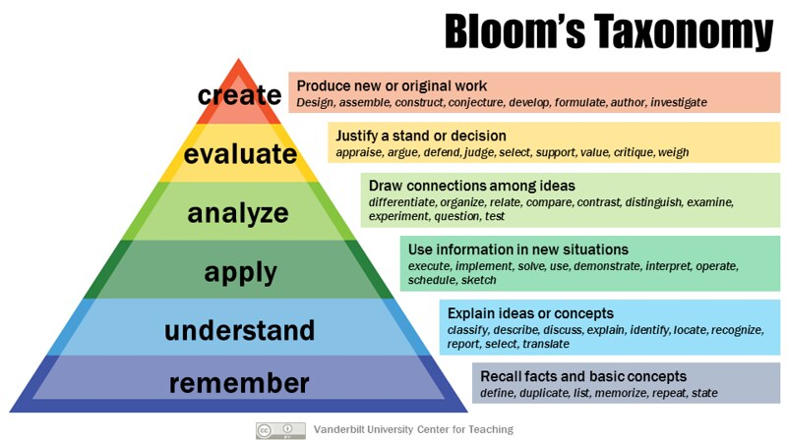
Dejinta Qabyo-qoraalka
Ujeeddooyinka
Notes:
Taxonomy, in a broad sense the science of classification.
A framework for categorizing educational/training goals: Taxonomy of Educational Objectives.

Slide 10
Iyo« H »: Sidee?
Habka u tababarka u dhacayo
Ilaa goorma?
Barashada Masaafada Fog?
Fool ka fool?
Qaab isku dhafan?
Tirada maalmaha: afar kalfadhi maalintii
Fududeeyeyaal/tababarayaal
Miisaaniyadda: qolka, cuntada, xaqa habeen-dhaxa ugu yaraan
U-doodis iyo Wacyigelin
Tababar
Awood dhisid

Slide 11
Liiska Hubinta ee Qiimaynta ka hor Tababarka
Sabab?
Waa Maxay?
Waa maxay baahiyaha tababarka?
Waa maxay ujeeddada ugu weyn ee tababarku?
Qiimeynta baahiyaha barasho iyo warbixinta
Ujeedooyinka
Kuma?
Sidee?
Waa kuma dhagaystayaasha loola jeedo tababarka?
Waa maxay astaamaha ka qaybqaataha?
Habka uu u dhacayo
Dhererka iyo waqtiga
Miisaaniyada

Slide 12
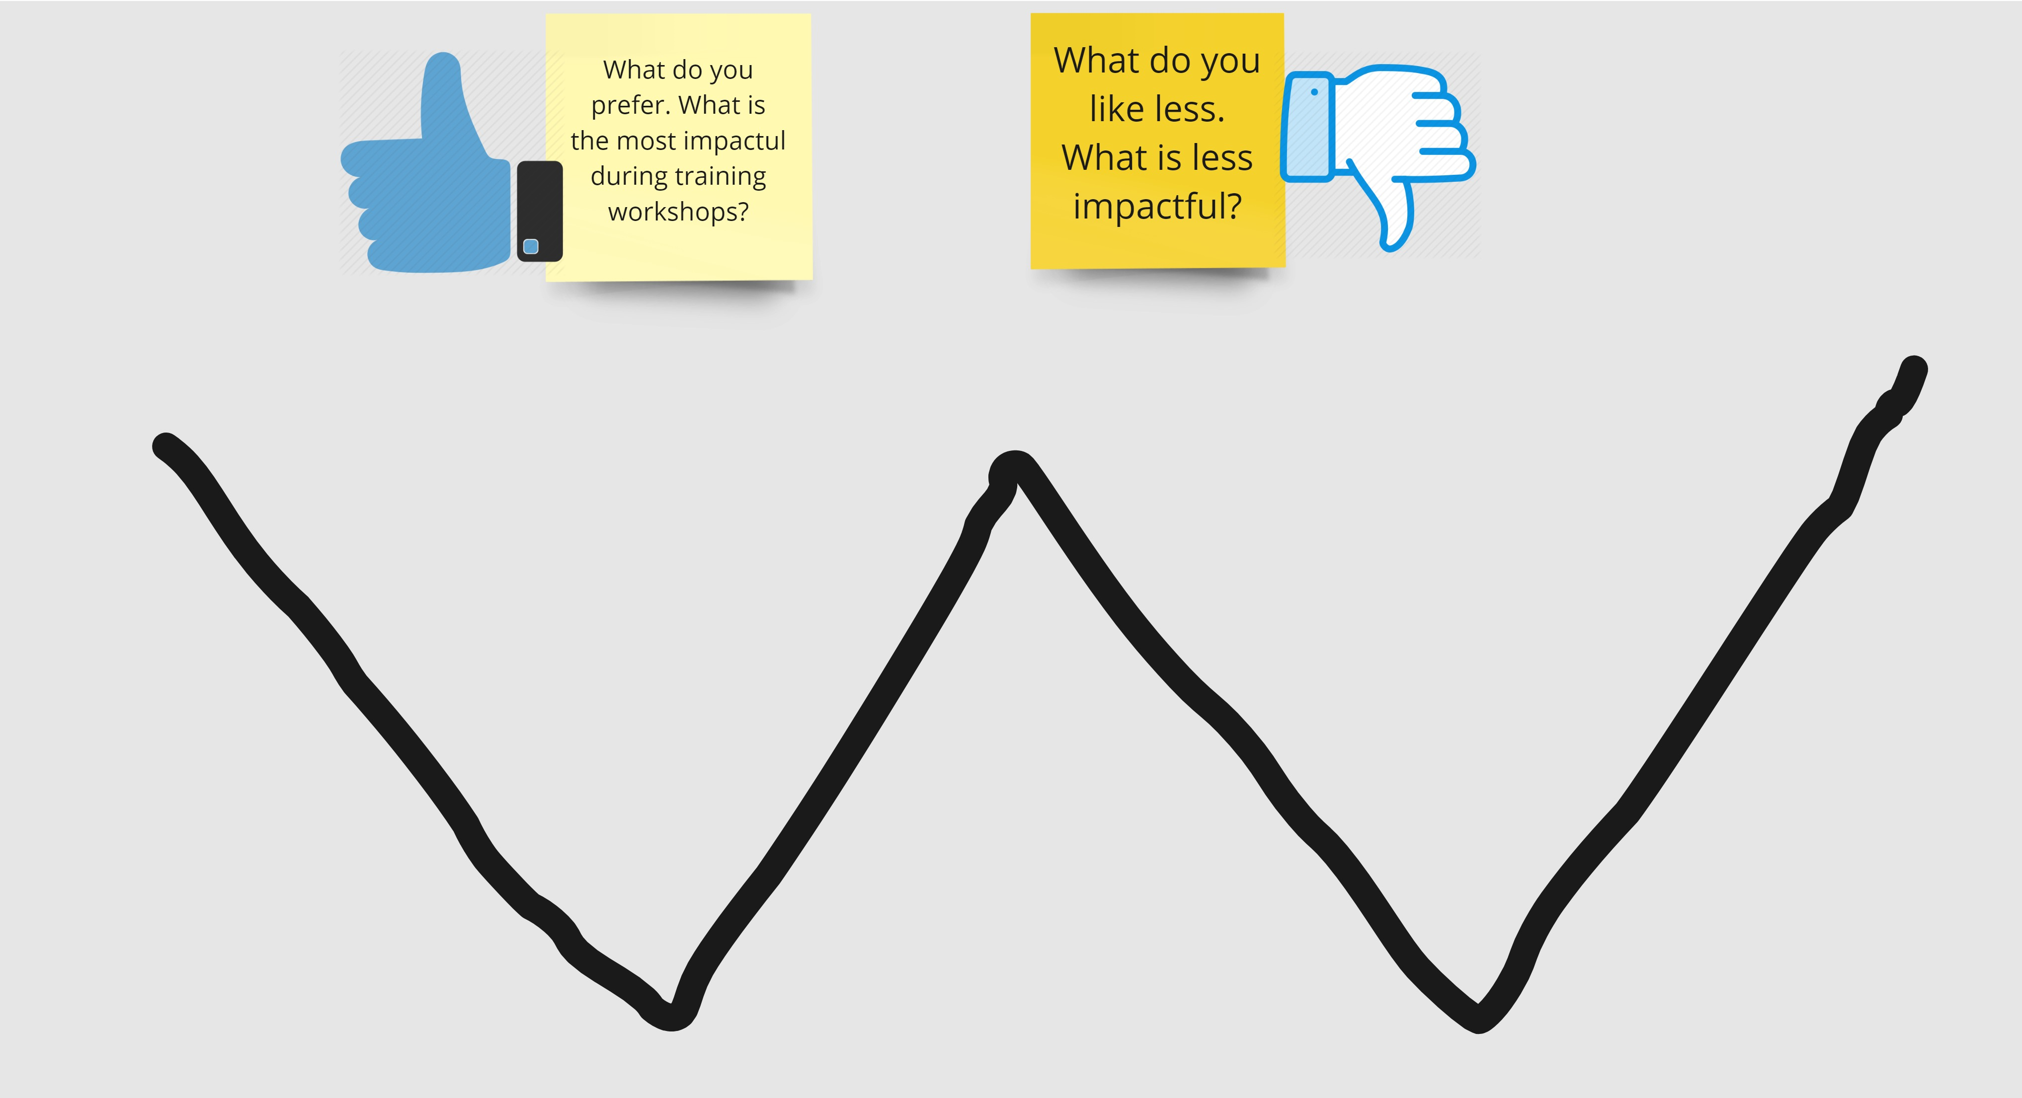
Kor iyo hoos u kaca W!
Maxaad doorbideysaa? maxaa ugu saameynta badan inta lagu jiro aqoon tababarka
Maxaad jeceshahay in ka yar. Maxaa ka saameyn yar
Notes:
Based on the W model used for the reintegration follow up at individual (economoc aspect of reintegration) in the handbook.

Slide 13
Mabaadi'da waxbarashada dadka waaweyn
Ku haboon
Ka Qayb Qaadashada culus leh
Ku saleysan khibrad
Xalinta dhibaatada
QiimO deg deg ah
Notes:
When we learn as adults, it is a different experience than when we were children. We are better able to make decisions, draw conclusions, and recognise patterns. We are less likely to do something just because, because we expect logical reasons and arguments to do it. Malcolm Knowles, an expert in adult learning, identified five principles that help us create an environment where adults learn best.
The subject matter and methodology have an immediate value
Adults need to be involved in the planning and evaluation of their training.
Experience, including mistakes, provides the best basis for learning activities.
Adults are most interested in learning subjects that have immediate relevance and impact on their job or personal life.
Adult learning is problem-centered rather than content-oriented.
These are key principles that should always be kept in mind when designing training sessions, so getting these clarified early in the training program gives a useful reference point.
And now let’s review how to proceed with a full day that is dedicated to the topic of Training Design.

Slide 14
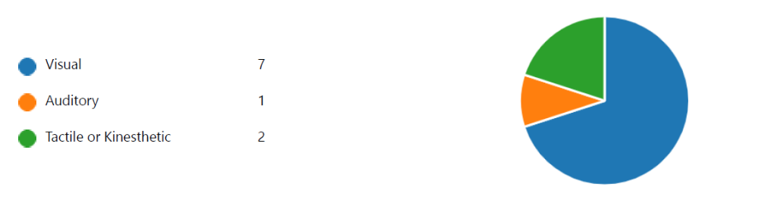
Iyo qaababka …

Slide 15
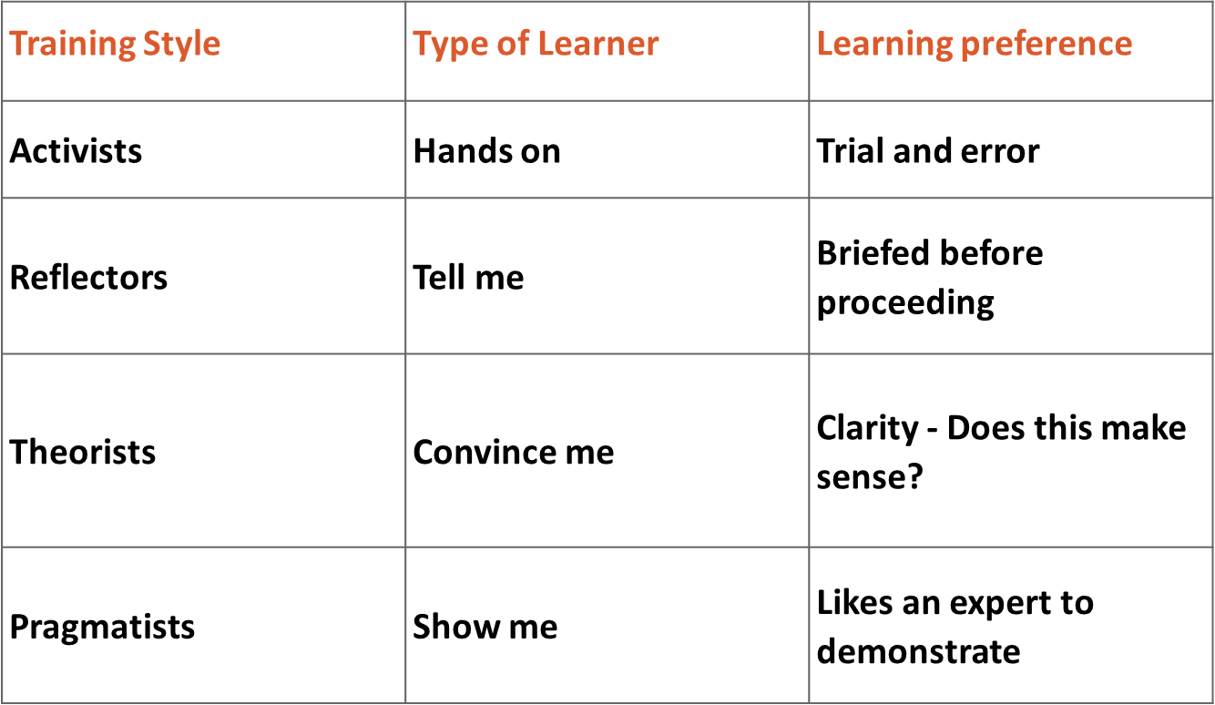
Qaabka Tababbarka / Doorbidyada

Slide 16

Barasho khibradeesan
“Geedi socodka cilmiga lagu unkay iyadoo loo marayo isbedelka khibrada. Cilmiga wuxuu ka dhashaa isku darka hanashada fahamka iyo isbadalka khibrada. ”

Slide 17
Wareegga Barashada
Khibrad la taaban karo
U fiirsashada Milicsiga
Abstract Fikrad aan la taaban karin
( Guud ahaan
Tijaabo ama Ku dabaqid
Isbedal doone
Pragmatists
Reflectors
Theorists

Slide 18

Hawl
Aynu faahfaahino kal-fadhiga 1aad! 1!
Notes:
In the next slides, we will explore the underlying concepts and definition of reintegration, and how reintegration processes can be supported.

