Slide 1
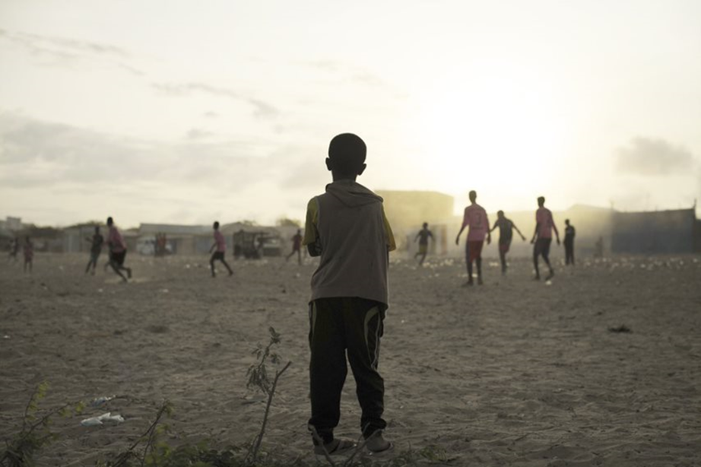
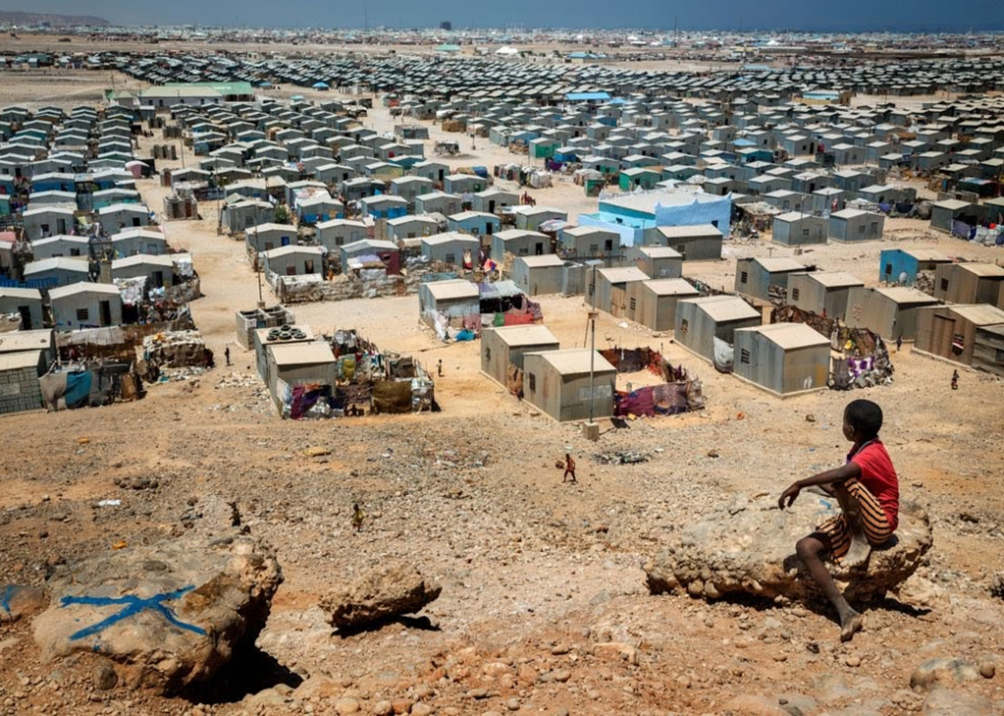
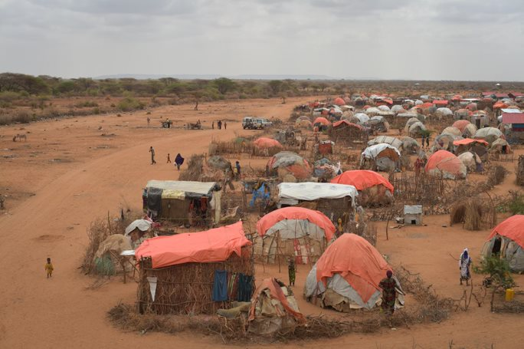
ReDSS durable solutions training of trainers workshop
Finding Durable Solutions for Displacement Affected Communities in Somalia

Slide 2

Training Techniques

Slide 3
Objectives of Session
Describe the training cycle.
List the different actions to be taken and questions to be answered during the assessment part of the preparatory phase, prior to starting designing the training material.
Develop training objectives based on the main goal and on the audience of the of the training.
Apply adult learning principles to the design of training events
Experience the different learning and training styles
Use experiential in the design of training material

Slide 4
The training cycle
The training cycle
Assessment
Design and planning
Facilitation
Evaluation
Follow up

Slide 5

1. The three « W »
Why?
Who?
What?

Slide 6
Why do we want to train?
What do we want to achieve?
Train Somali national authorities and partners to support them to take an active part in durable solutions plans for Displacement Affected Communities
1
What knowledge and capacity gaps and training needs have been identified?
What are the most pressing gaps and training needs identified?
What is the main goal of the training programme/workshop?
2

Slide 7

Who?
Careful selection of participants
Determine the participants’ profile
Share the main goal, tentative objectives and participants’ profile to the targeted divisions, partners…
Ask for names as early as possible
Contact participants prior to the workshop

Slide 8

What? Learning Needs Assessment
Form
Focus group discussions
Key Informant Interviews
Informal chats
Share the results and its impact on the objectives and agenda with the participants

Slide 9
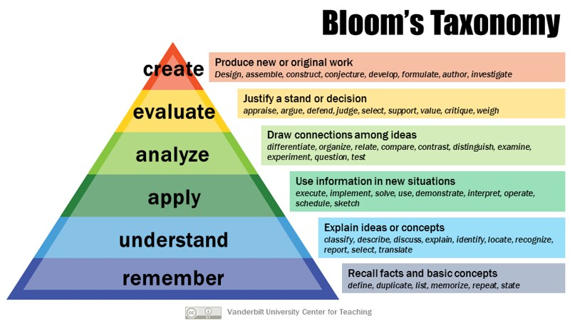
Drafting objectives
Notes:
Taxonomy, in a broad sense the science of classification.
A framework for categorizing educational/training goals: Taxonomy of Educational Objectives.

Slide 10
And the « H »: How
Training modalities
How long?
Distance?
Face to face?
Blended approach?
Number of days: four sessions a day
Facilitators
Budget: room, food, per diem…at a minimum
Advocacy and Awareness raising
Training
Capacity building

Slide 11
Pre training assessments Checklist
Why?
What?
What are the training needs?
What is the main goal of the training?
Learning needs Assessment and report
Objectives
Who?
How?
Who is the target audience?
What is the participant’s profile
Modalities
Length and timing
Budget

Slide 12
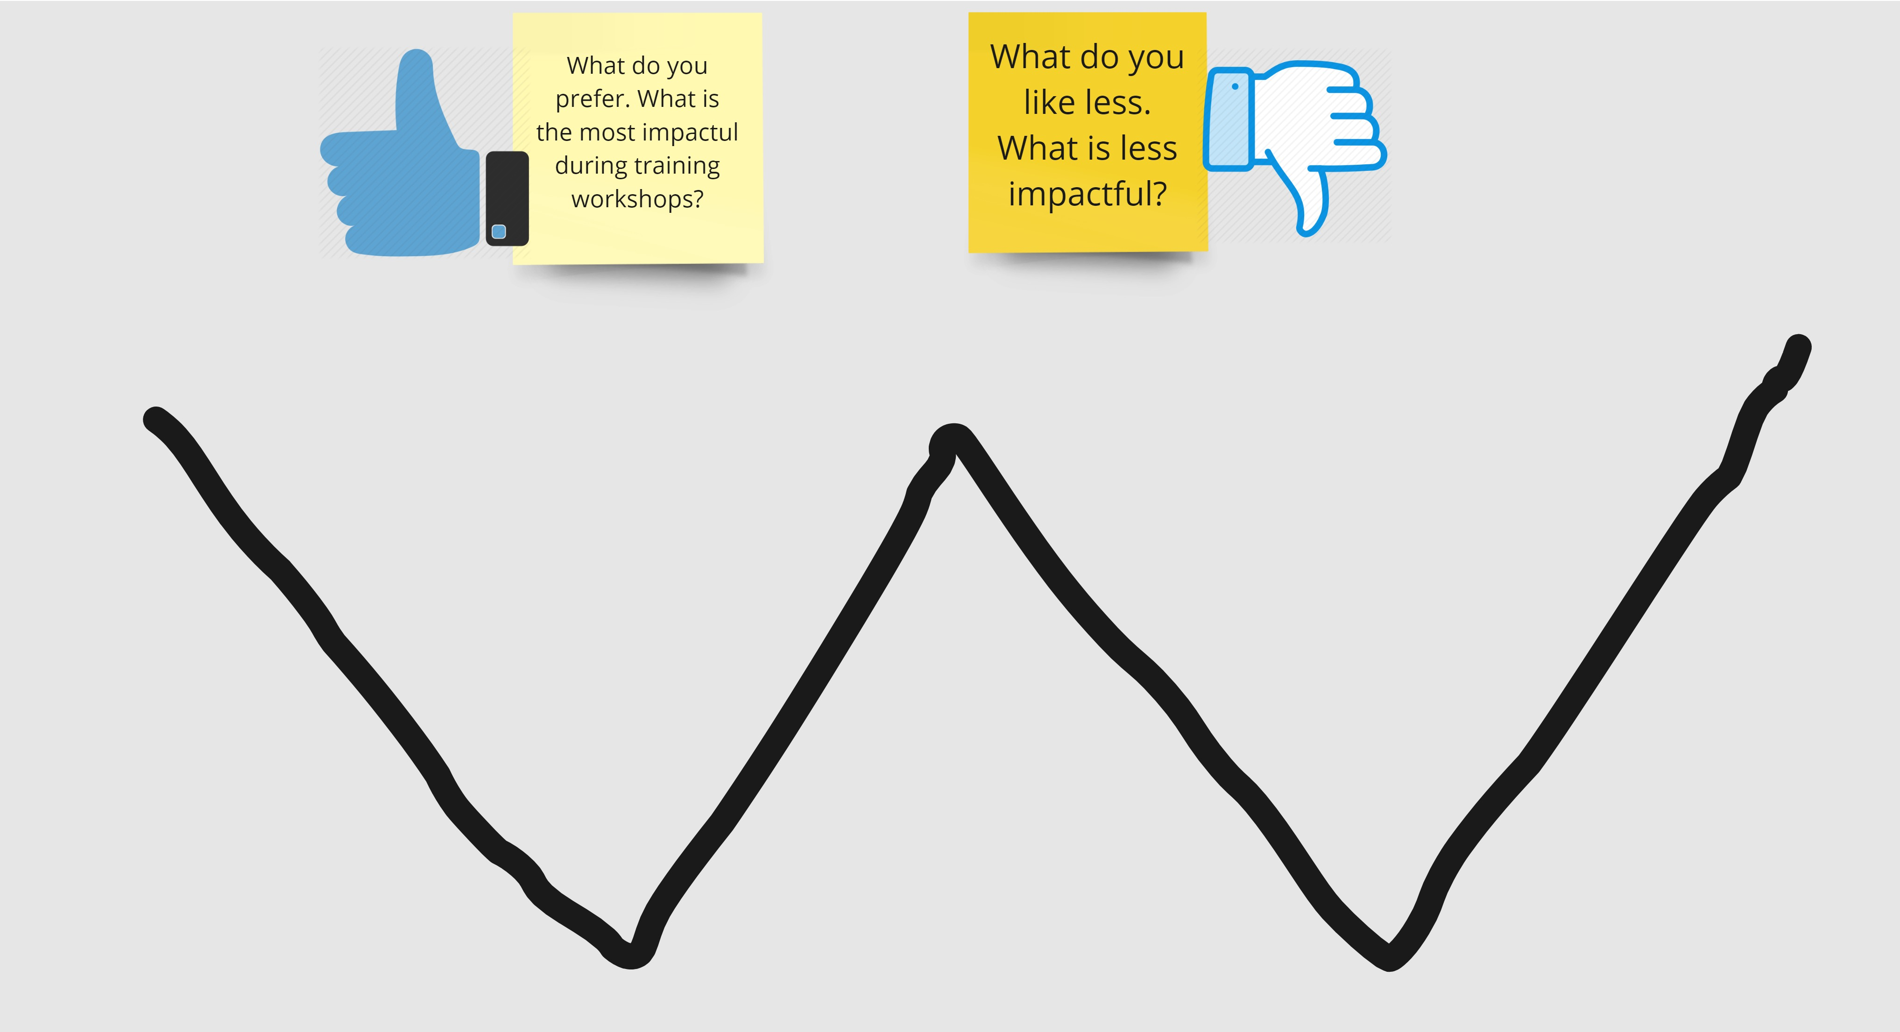
Ups and downs W!
Notes:
Based on the W model used for the reintegration follow up at individual (economoc aspect of reintegration) in the handbook.

Slide 13
Adult learning principles
Relevant
Involving
Based on experience
Problem solving
Immediate value
Notes:
When we learn as adults, it is a different experience than when we were children. We are better able to make decisions, draw conclusions, and recognise patterns. We are less likely to do something just because, because we expect logical reasons and arguments to do it. Malcolm Knowles, an expert in adult learning, identified five principles that help us create an environment where adults learn best.
The subject matter and methodology have an immediate value
Adults need to be involved in the planning and evaluation of their training.
Experience, including mistakes, provides the best basis for learning activities.
Adults are most interested in learning subjects that have immediate relevance and impact on their job or personal life.
Adult learning is problem-centered rather than content-oriented.
These are key principles that should always be kept in mind when designing training sessions, so getting these clarified early in the training program gives a useful reference point.
And now let’s review how to proceed with a full day that is dedicated to the topic of Training Design.

Slide 14
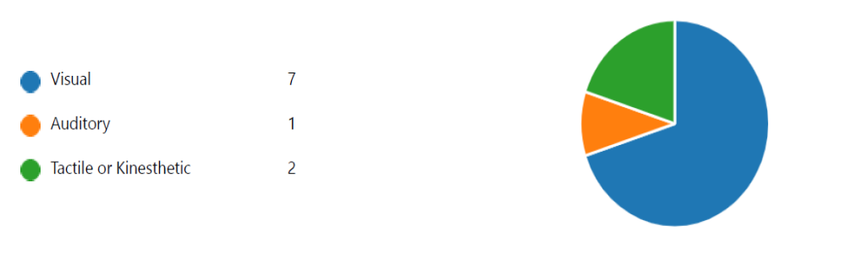
Learning Styles

Slide 15
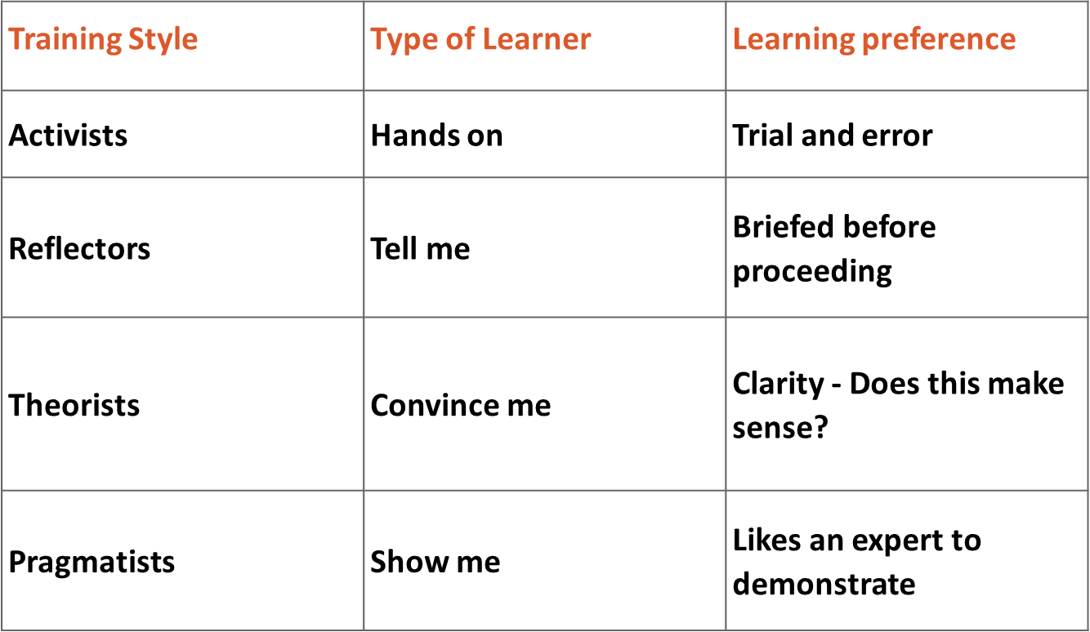
Training Style/Preferences

Slide 16

Experiential learning
“The process whereby knowledge is created through the transformation of experience. Knowledge results from the combinations of grasping and transforming experience.”

Slide 17
The learning cycle
Concrete Experience
Reflection Observation
Abstract Conceptualisation (Generalisation)
Experiment or Application
Activists
Pragmatists
Reflectors
Theorists

Slide 18

Activity
Let’s dissect session 1!
Notes:
In the next slides, we will explore the underlying concepts and definition of reintegration, and how reintegration processes can be supported.

