Slide 1

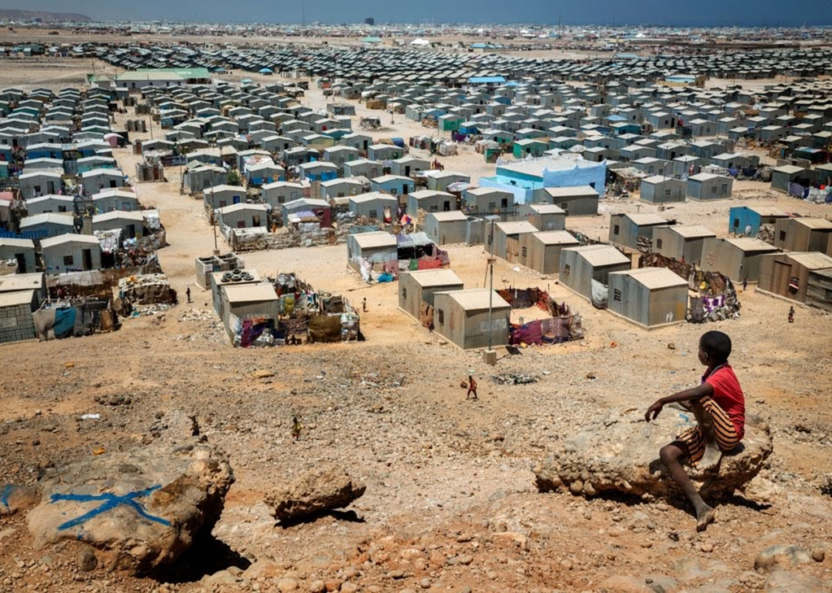
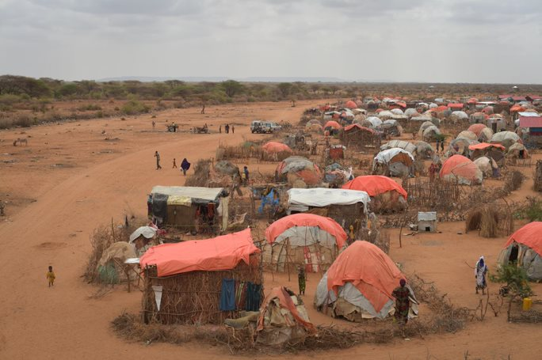
ReDSS durable solutions training of trainers workshop
Finding Durable Solutions for Displacement Affected Communities in Somalia

Slide 2

Training Techniques

Slide 3
The training cycle
The training cycle
Assessment
Design and planning
Facilitation
Evaluation
Follow up

Slide 4
Objectives of Session
Develop a training agenda based on your objectives, target audience and timing;
Structure and time each session to make sure that it meets adult and experiential learning principles

Slide 5
Agenda development
Think about your target audience and the results of your LNA
Think about your objectives
Identify the topics to be covered based on the training curriculum and potential additions
Translate topics into sessions based on the training curriculum and additions
Make sure that the number of sessions matches the planned length of the workshop: Four sessions a day!
Draft your agenda !

Slide 6
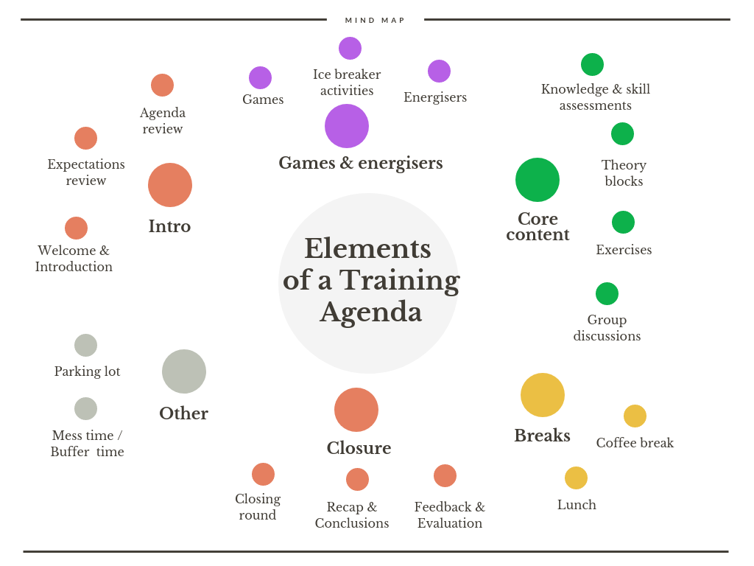
Elements of a training agenda

Slide 7
The learning cycle
Concrete Experience
Reflection Observation
Abstract Conceptualisation (Generalisation)
Experiment or Application

Slide 8
Example of training agendas
 | Day 1 | Day 2 | Day 3
8.45 – 9.00 | Registration | Recap of day 1 and warm up | Recap of day 2 and warm up
9h00-10h30 | Welcoming remarks +introduction and icebreaker (the power walk) | Module 1: Session 4: What are the principles and criteria governing DS planning? | Module 2. Session 4: Involving DAC through Community Action Plans
10h30-11h00
11h00-12h30 | Module 1. Session 1: What is displacement and Who are DAC? | Module 2: Session 1: Adopting an area-based approach | Module 3: What is HLP and why is it key to durable solutions?
12h30-14h00
14h00-15h30 | Module 1. Session 2. What do we mean by Durable Solutions? | Module 2: Session 2: Adopting a multi stakeholder and multi sectoral approach | Module 3: Enhancing security of tenure and HLP rights in Somalia
15h30-16h00
16h00-17h30 | Module 1. Session 3: What are the legal framework underpinning durable solutions? | Module 2: Session 3: Assessing and measuring durable solutions | Conclusions and closing

Slide 9
How is a session structured?
You will be assigned a session. Individually :
Identify its main components
What type of activity is used?

Slide 10
Session outline
Learning Objectives | Main Topics (Structure) | Subtopics (for each topic) | Key Messages (serve as conclusion) | Delivery modalities: learning cycle | Activities | Content Source

Slide 11
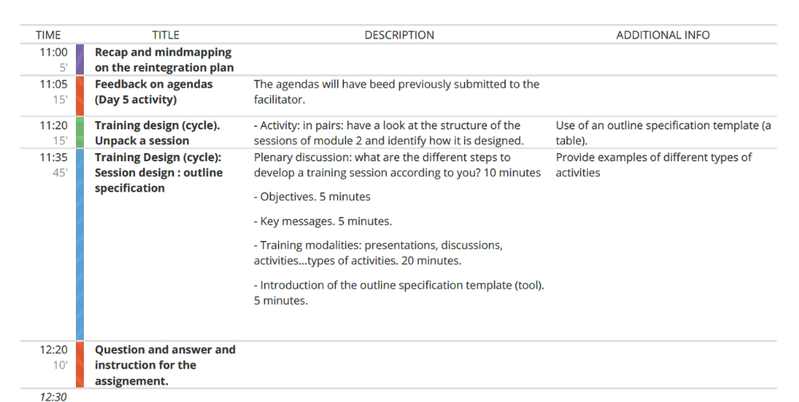
Training blocks and timing
Exercise
Theory
Discussion / debriefing
Break
Energizer / icebreaker

Slide 12
Types of activities
Quiz
Power walk
Ideation: brainstorming - categorization/clustering activities.
Problem solving: mind mapping - plan design, issue mapping-solutions.
Fast idea generating: 1-2-4 activity
Mapping: actors mapping, coordination mapping
Experience sharing: fish bowl
Case studies
Simulation or role play

Slide 13
Activity: prepare, prepare, prepare!
What is the goal of the activity?
Material
Goup composition
Room setting
Timing
Template for the results
Format and timing of the feedback
Notes:
Plus: stay in the groups during the activity: picture

Slide 14
Feedback and debrief
Never skip feedback
No judgement
Constructive comments based on thorough preparation
Comments from other participants
Thanking and applauding
How did it go?
How did you feel?
What did we learn from this activity?
Relate it to the substance and the rest of the session/training

