Slide 1
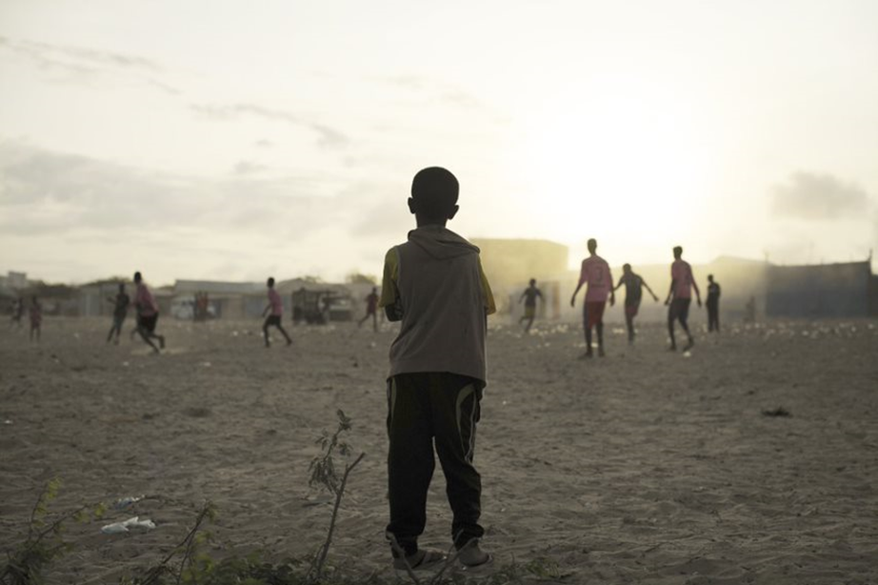
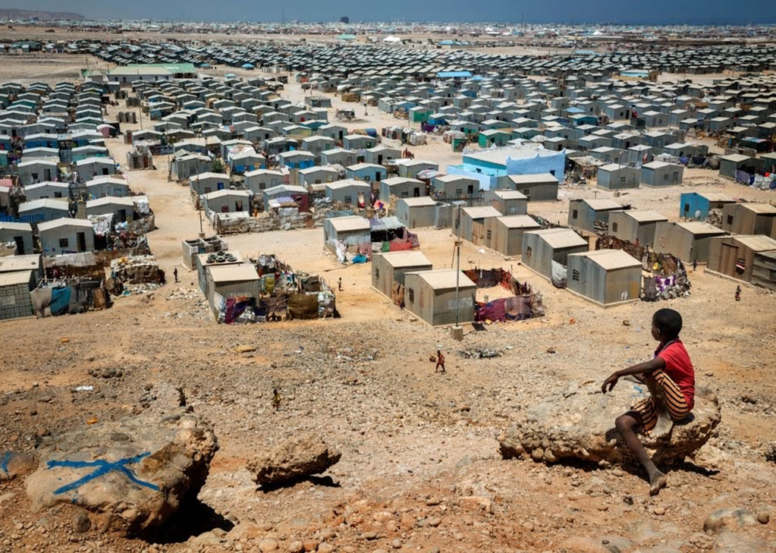
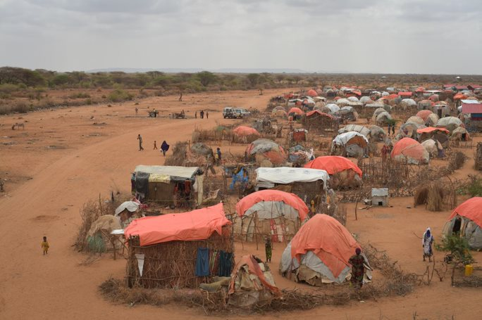
ReDSS durable solutions training of trainers workshop
Finding Durable Solutions for Displacement Affected Communities in Somalia

Slide 2

Training Techniques

Slide 3
The training cycle: setting up and safe environment
Assessment
Design and planning
Facilitation
Evaluation
Follow up
The training cycle

Slide 4
Objectives of Session
Reflect on and identify what makes participants feel safe and confident in a participatory training workshop
Create a safe learning environment for your training workshops
Explain the role of a trainer/facilitator
Examine the skills a trainer/facilitator needs to train/acquire

Slide 5



During a training workshop, what makes you feel:
  Safe and confident
  Unsafe and unconfident / unsecure

Slide 6
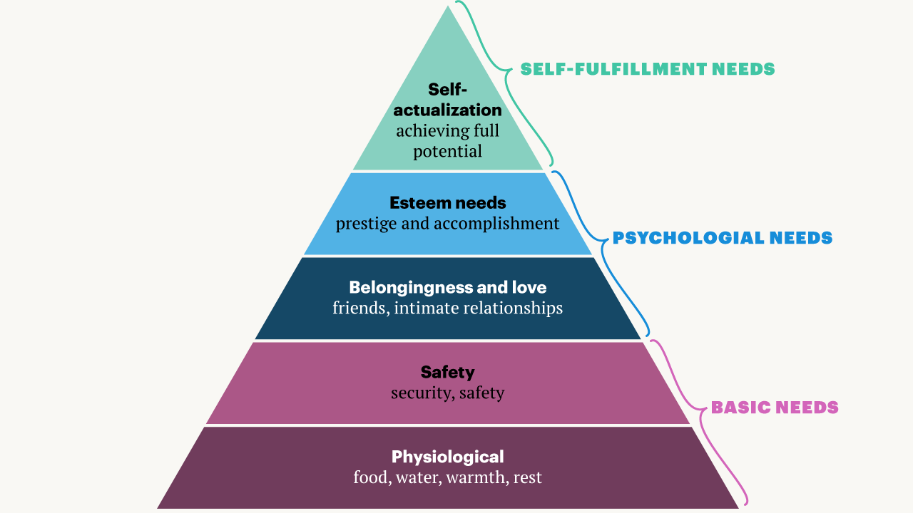
Maslow’s pyramid of needs

Slide 7
Select the right participants!
Why?
Who?
What?

Slide 8



Involve participants
Learning Needs Assessment
Comments on the agenda
Evaluations and follow up
Preworkshop reading
Value participation and experience

Slide 9
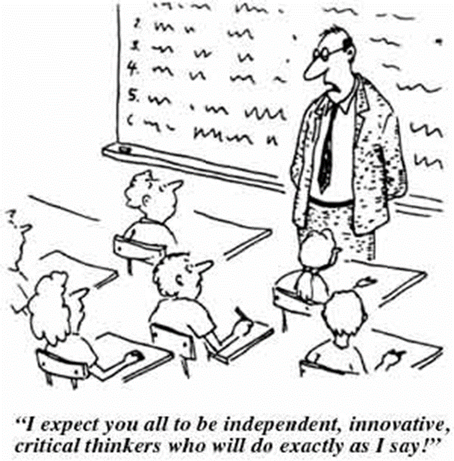
Create a positive learning environment
The look and feel of the space
The learner’s relationship with the facilitator/trainer
The learner’s relationships with other learners

Slide 10
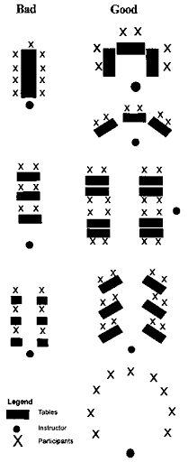
Look and feel of the space: Room Setting

Slide 11
Futile but essential
Where are the toilets?
Who can I ask for any admin/financial/logistic issue?
At what time do we start, break, eat, finish?
House rules and potential head of village.
Where can I find the training resources?
Parking lot
I am going to get a certificate?
What awaits me after the workshop? Follow up project, etc.

Slide 12
Key principles of experiencial learning
The learner (participant) is central
Mixture of content and process
Absence of excessive judgment
Big picture perspective
The role of reflection
Creating emotional investment
The re-examination of values
The presence of meaningful relationships
Learning outside one’s perceived comfort zones

Slide 13

What are the qualities of a trainer / facilitator?

Slide 14
Who is a teacher? Who is the facilitator?
Who is the trainer?
1
2
3
Notes:
Plus a poll

Slide 15
Teacher
Deep knowledge of the subject matter
Aims to transfer knowledge
Trainer
Knows the subject matter
Transfers knowledge through activities
Facilitator
Has the skills to moderate sessions
Aims to extract knowledge from the participants
Lectures through presentations
Focus on knowledge
Is between a teacher and a facilitator
Focus on interaction and knowledge
Not a subject matter expert
Uses participative techniques
Focus on interaction

Slide 16

Training and facilitation skills

Slide 17
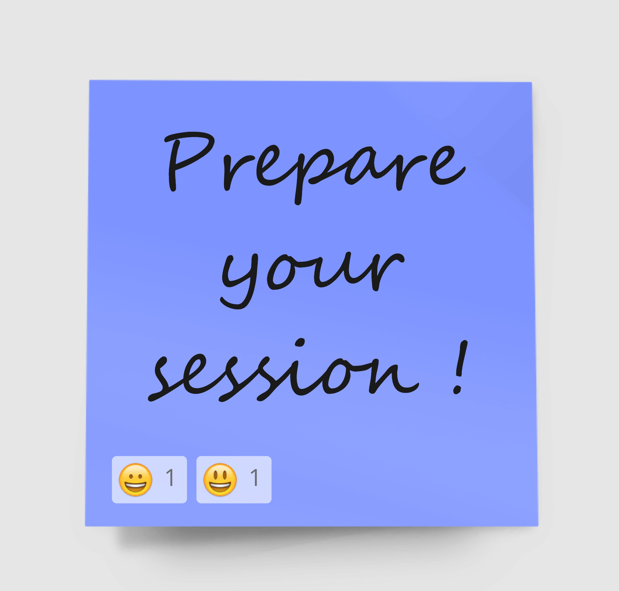
Guess what?
Objectives
Goals and outcomes
Timing
Material
Questions
Techniques
Last minute change…

Slide 18
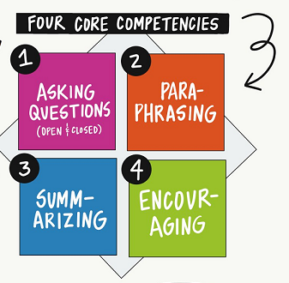
Communication

Slide 19

Effective questioning
A
P
P
L
E

Slide 20
Effective questionning
Asking
Pausing
Picking
Listening
Elaborating

Slide 21

Active listening
Body language that shows attention from the facilitator: eye contact, facing group
Withhold judgement
Summarize, paraphrase, clarify, reflect, share/elaborate
Take note on a flipchart or other
Be present all the time, even during group work

Slide 22
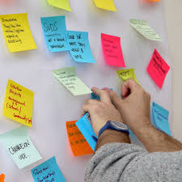
Build relationship and bring your stationary
Use humour when you think it is appropriate
Act naturally, be yourself!
Remain neutral (although you might have an agenda)
Learn names or have name tags.
Mention, refer to participants’ interventions
Thank, be kind and positive

Slide 23

Leadership
Clear instructions
Manage time
Manage group creation
Smoothly lead the training process
Avoid conflict

Slide 24
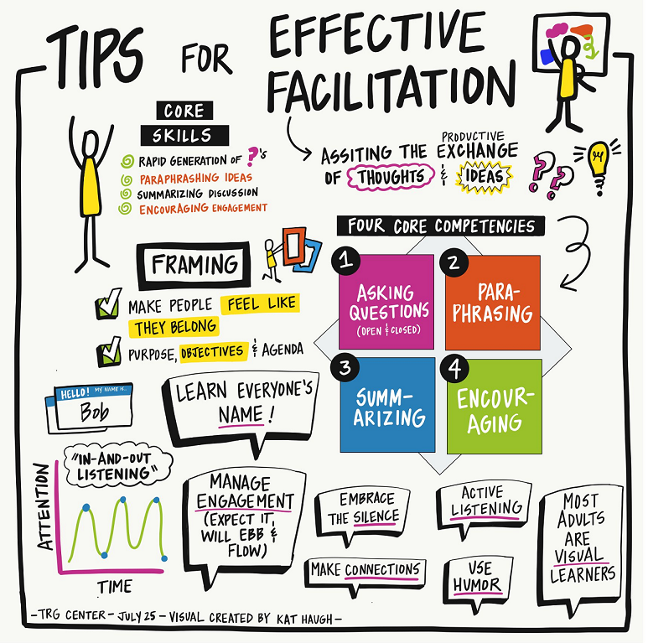
Conclusion

