Slide 1
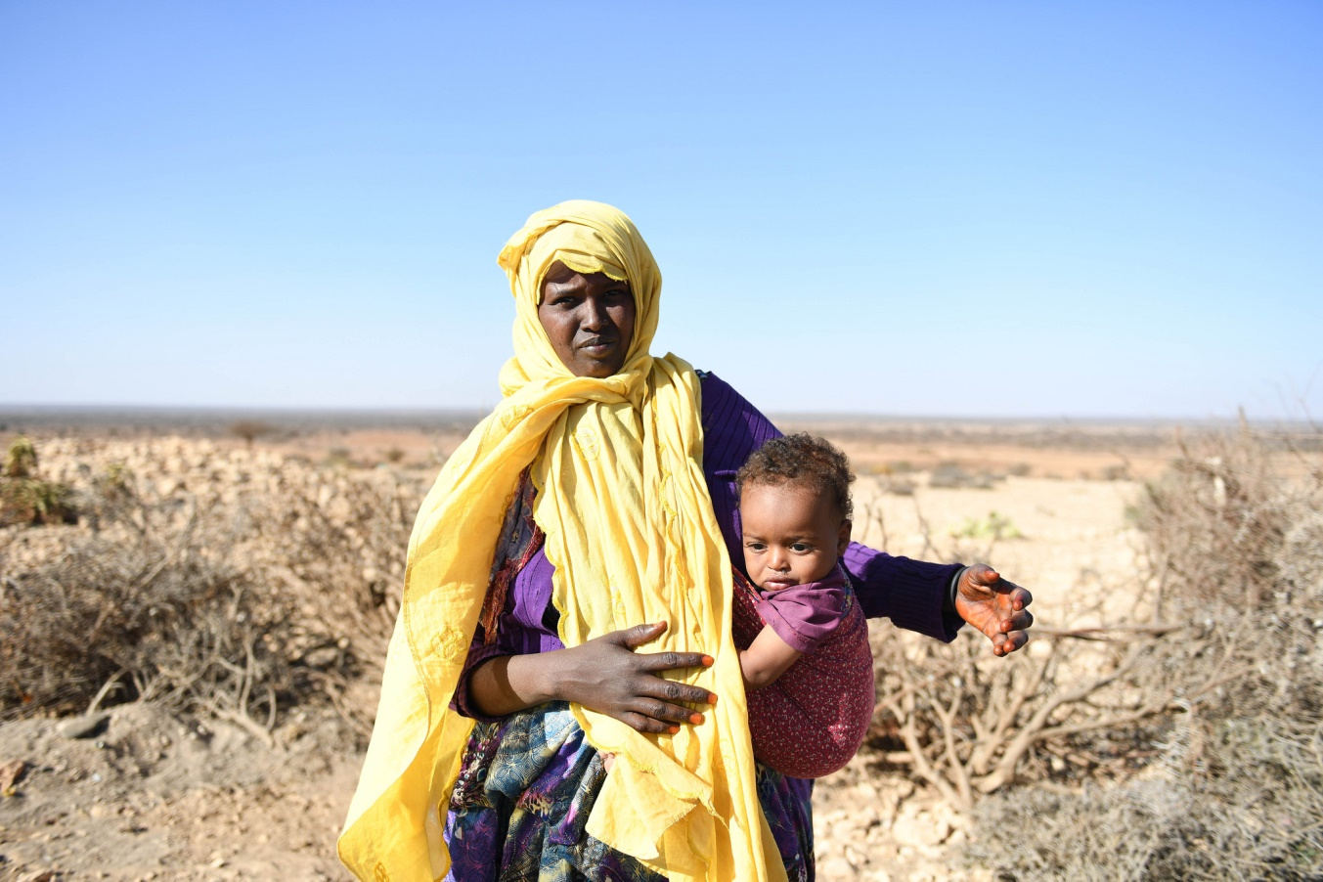
Xal waara uraadinta Bulshooyinka uu saameyey Barakacaee Soomaaliya

Slide 2

Xeeladaha Tababarka

Slide 3
The training cycle: setting up and safe environment
Wareegga tababarka
Sahan Qiimayn
Naqshadayn iyo qorshayn
Fududeyn
Qiimeyn
Dawagal

Slide 4
Ujeedooyinka Kulanka
Dhamaadka kulankan waxaad awoodi doontaa inaad:
Si wax ku ool ah u qiimeyso tababarka
Diyaariso qorshayaasha dabagalka iyo mashaariicda
Ka qaybgalayaasha uga dhig tababarka iyo barashada khibrad waarta

Slide 5
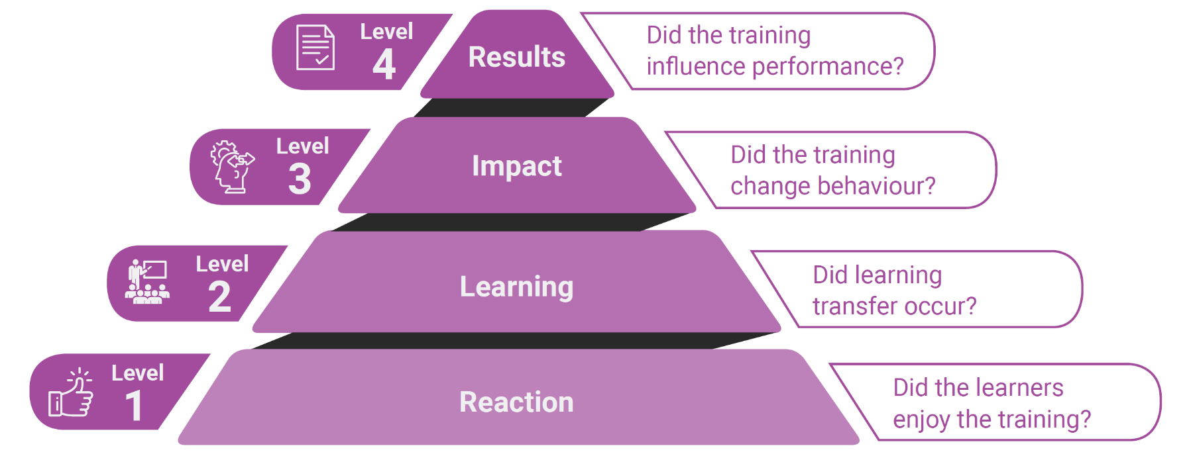
Maxaad qiimaynesaa?

Slide 6
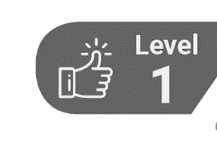
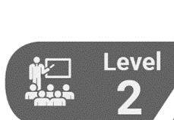


Goorma ayaad qiimeynaysaa?
Inta tababarku socday
Dhamaadka tababarka
Saddex bilood tababarka kadib
Lix ilaa sideed bilood tababarka kadib

Slide 7


Zoom: Maxaan qiimeynaa?
Ujeedooyinka:
Cad
Ku haboon
Fulin
Tababarka:
Ku haboon
Cad
Tayada casharada
Fududeyn
Tayada
Fududeeye
Ka qaybqaadasho/Is-dhexgal
Saadka
Aragtida Guud
In yar la jecelyahay
Saamaynta laga filayo inuu tababarka u keeno shaqadooda

Slide 10
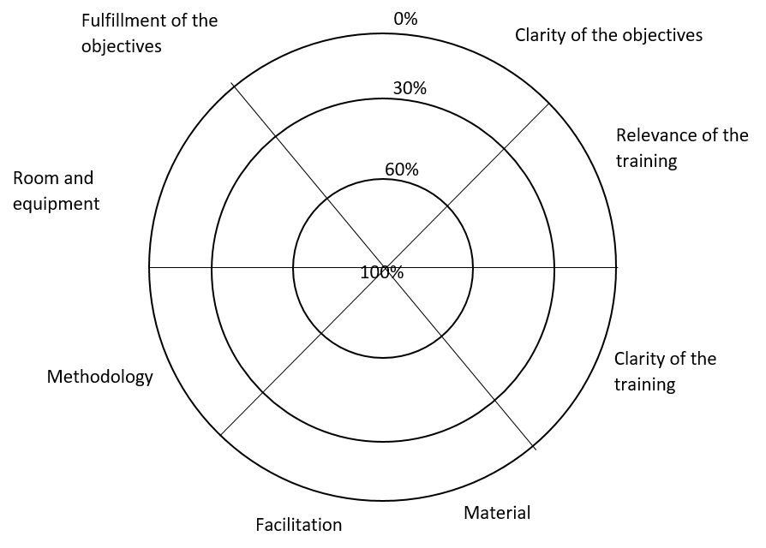


Sideed u qiimeyneysaa?

Slide 11
CERTIFICATE
This is to certify that
Name of Participant
successfully completed the Training Programme on
Title of Event
organized in location on day month year.
_________________________
Name of training instructor
Date Issued

Slide 12


Sideed u qiimeyneysaa?
Qiimaynta saamaynta saddex bilood ka dib: warqadaha su'aalo-waydiinta, wada-hadal lala yeesho asxaabta, maareeyayaasha iyo la-hawlgalayaasha, wadahadala kooxeedyada
Mashruuca la xiriira tababarka yar: shaqsi ahaan ama koox ahaan
Saameynta ama qiimeynta waxqabadka lix ilaa sideed bilood kadib: warqadaha su'aalo-waydiinta oo la siinayo kaqeybgalayaasha ama maareeyayaasha / la-hawlgalayaasha, natiijooyinka kormeerka iyo qiimeynta.

Slide 13


Ma waxaa tiri dawagal?

Slide 14




Joogtee xawaaraha!
U dir sawirro, warbixin iyo warar
Tababar laga sameeye ayadoo la adeegsanayo shabakadaha internetka ama Qahwo / cunto fudud / wada hadal fiidkii ah oo ku saabsan arrimo la xushay ama khibrad wadaag
Bulshada dhaqanka:
Ku Xidhnow Bulshada
Kooxo ama WhatsApp groupyo
Dabagal iyo jawaab celin ku saabsan mashaariicda yar-yar oo gooni gooni ah ama koox ah

