Slide 1

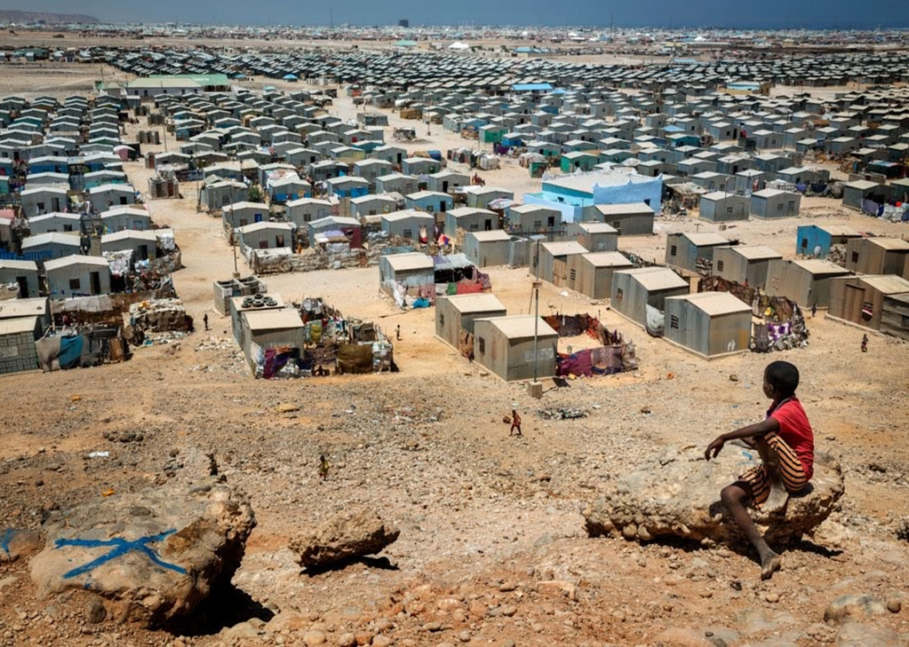
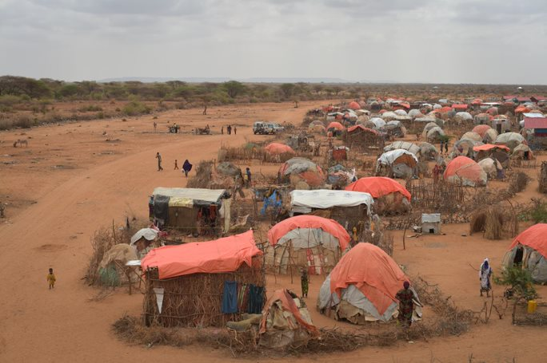
ReDSS durable solutions training of trainers workshop
Finding Durable Solutions for Displacement Affected Communities in Somalia

Slide 2

Training Techniques

Slide 3
The training cycle: setting up and safe environment
Assessment
Design and planning
Facilitation
Evaluation
Follow up
The training cycle

Slide 4
Objectives of Session
Effectively evaluate training workshop
Prepare follow-up plans and projects
Examine case studies and lessons learnt from relocation and inclusion of settlement in urban planning projects.

Slide 5
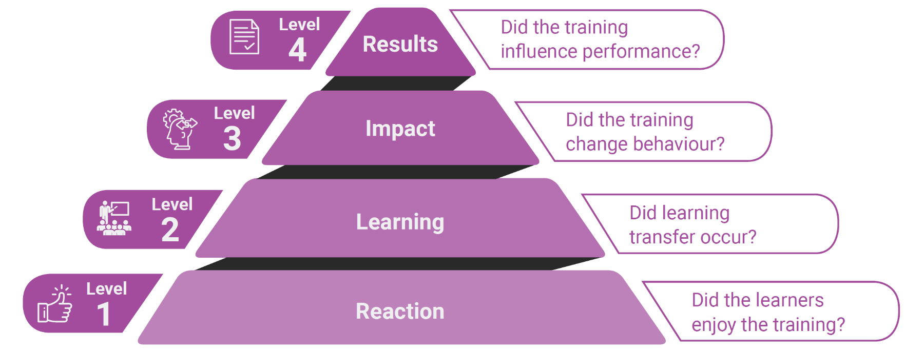
What do you evaluate?

Slide 6
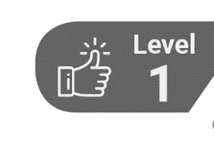
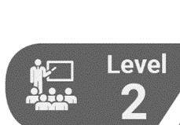
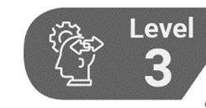

When do you evaluate?
During the training
At the end of the training
Three months after the training
Six to eight months after the training

Slide 7


Zoom: What do we evaluate?
Objectives:
Clarity
Relevance
fulfillment
Training:
relevance
clarity
quality of the material
Facilitation
quality
facilitator
participation/interaction
Logistics
Overall impression
Less liked
The expected impact of the training workshop on their work.

Slide 8
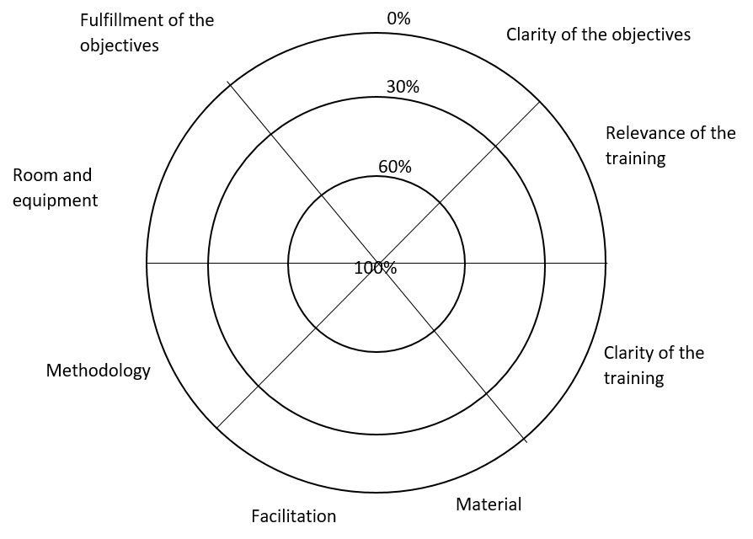


How do you evaluate?

Slide 9
CERTIFICATE
This is to certify that
Name of Participant
successfully completed the Training Programme on
Title of Event
organized in location on day month year.
_________________________
Name of training instructor
Date Issued

Slide 10


How do you evaluate?
Impact assessment after three months: questionnaire, discussion with colleagues, managers and partners, focus group discussions.
Mini training related project: individual or in group.
Impact or performance assessment after six to eight months: questionnaires to participants or managers/partners, results of monitoring and evaluations.

Slide 11


You said follow up?

Slide 12




Maintain the momentum!
Send pictures, report and news
Webinars or coffee/snack/evening discussions on selected issues or experience sharing
Community of practice:
Connect Community
Teams or WhatsApp group
Follow up and feedback on mini-individual or group projects

