Slide 1
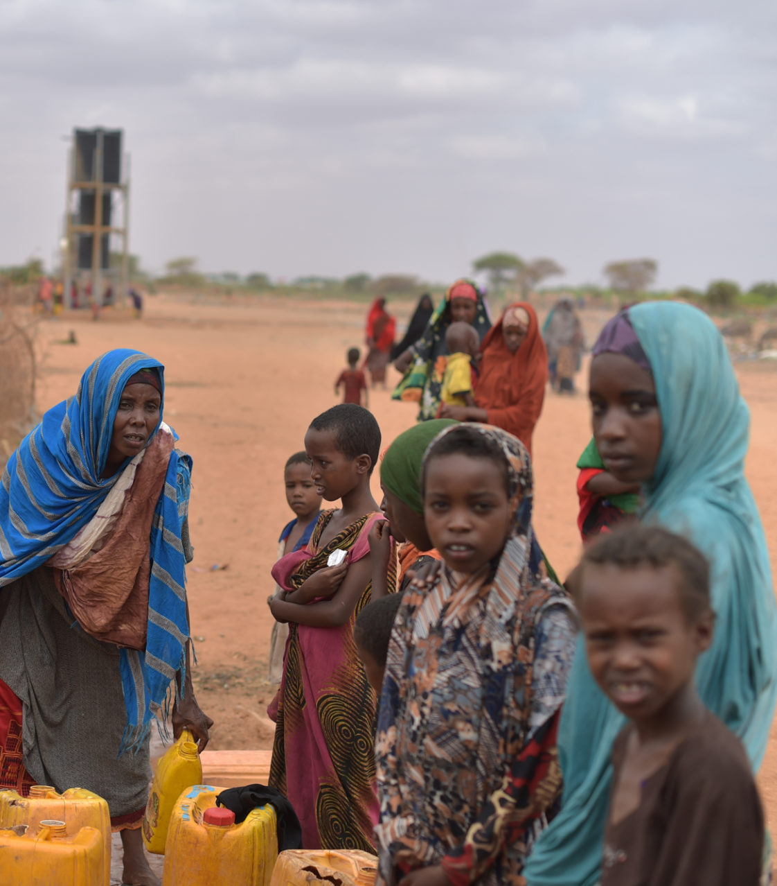
Session 3: A multi sectoral and multi stakeholder planning process

Slide 2
A step by step methodology
1. Preparation: A multi sectoral and multi stakeholder planning process
2.Preparation:Data and analysis to inform joint area –based solutions planning
Plan development based on Community Action Plans
Inclusive and participatory monitoring and Evaluation

Slide 3




Priority policy processes
Objectives
Multi-stakeholder process: Who is in?
Who is doing what?
How to coordinate?
Area-based approach
Nationally-owned-process

Slide 4
Multi sectoral and multi stakeholder approach
Why?
How?
To address a variety of needs identified in a specific area
Meet a wide range of protection, social, economic, humanitarian and development objectives
Leverage the expertise of various actors within an area to work towards a common vision/collective outcomes
Notes:
Key messages:
Multi-stakeholder, multi-sectoral approach is needed to address a variety of needs, embracing a range of social, economic and physical, humanitarian and development objectives. You can refer to the 8 IASC criteria and highlight that they cover a wide range of protection, socio and economic dimensions that can only be addressed by a multi sectoral approach.
The multi-sectoral, multi-agency approach should focus on leveraging the expertise of various actors within an area and to work towards a common vision/collective outcome
A key aspect on this approach is how to build synergies based on the different expertise and to ensure that the various agencies involved in an area-based planning approach do not work in silos

Slide 5
Multi stakeholder approach: key steps to success
Identify actors
1
Identify coordination mechanisms and potential gaps and opportunities
2
Strengthen collective understanding of the concepts and tools
3
Develop evidence and analysis
4
Develop long-term capacity development strategy
5
Notes:
Here are key steps to ensure a multi-sectoral approach.
Explain that:
The first two steps will be covered in this session.
Step 3 is covered by this workshop and other events and capacity building workshops targeting a wide range of key stakeholder with a view to ensure that all potential solutions actors have a shared understanding of what protection, solutions, area-based-approach and other displacement related concepts and policies mean. The ultimate goal is that all relevant actors speak the same language, use common tools to develop a common vision and joint outcome to support the progression of durable solutions for DAC in a selected area.
Step 4 was covered in the precedent session and is key in ensuring that all actors share a common vision and joint outcome.
- Step 5 highlights the need to invest in longer term, sustainable and locally appropriate capacity building; not only on one-off trainings or periodic secondment, but also ongoing, peer-to-peer learning. For this to happen, you have to carefully identify strategic stakeholders, assess their learning/capacity development needs and develop a long-term strategy in accordance.
It is also a paramount to ensure complementarity of capacity building efforts between different actors, with better appreciation of already existing capacity and learning opportunities for humanitarian and development alike.

Slide 6

Step 1: identify actors
Actors
Actors
Actors
Actors
Actors
Actors
Actors mapping: who is in?
Comparative advantages?
Notes:
Key message:
Cross sector actors mapping and capacity assessment are key steps in the process of developing an area-based planning.
Activity 1:Based on a definite selected area, ask the participants to map all the actors present in this area who should be part to the solutions planning process and its implementation.
You can opt to do this activity in plenary: ask the participants to propose actors to the rest of the participants; once the proposition is approved in plenary, ask the initiator to write it down on a coloured paper and stick it on the wall or on a sticky wall. Make sure that the papers form a circle with an empty centre.
You can add an extra dimension to the exercise with a colour code based on the category of actors: blue for humanitarian actors, green for development actors, pink for private sector, yellow for national or local authorities, orange for DAC, white for civil society and civil society organisations. It could help ensure that the multi stakeholder and multi sectoral dimension of the ABA approach is well understood and applied.
You can also opt for a group exercise with each group mapping one or two categories of actors. Assign one or two categorie(s) of actors listed above to each group of participants and ask them to list and write them down on the corresponding coloured papers in about 15 minutes, one actor per paper. They will then propose their actors to the rest of the participants and stick them on the wall. Make sure that the papers form a circle with an empty centre.
At the end of the activity, make the question on comparative advantages appear on the screen (animation already inserted) and reiterate the fact that all the actors, from different sectors will be involved in the planning, implementation and monitoring based on comparative advantages.
What does it mean, and what does it mean in the context where the workshop is organised?
Elements of answer: the relevant actors will be involved to respond to the vulnerabilities and needs and to build on capacities identified based on their:
Expertise in the sectors where needs are identified
Presence and experience in the area
Experience and proximity with DAC
Capacities, capacities to scale up, capacity to ensure sustainability, hence the importance to ensure that national and local NGOs, CSOs are involved.
Flexibility to adapt to changes…

Slide 7
Step 2: Coordination mechanisms
Complementarity between actors and programmes
Existing
Gaps
Opportunities
Support coordination capacities
Notes:
Key messages:
Area-based approach programming requires the creation or support of institutional mechanisms for more effective information flows and coordination between the many different actors and sectors
An effective area-based approach is dependent on ensuring complementarity with other actors and programs within the defined geographical area;
Collaboration between sectors is essential to deliver a more coherent and unified response and to contribute to a common vision on durable solutions.
Existing community structures, capacities and power dynamics should be mapped at the start of a solutions-focussed programme and new groups mechanisms should not be formed unless they fill gaps and bring significant added-value
A key learning from various area-based programs has been the need to develop, implement and support institutional mechanisms for more effective information flows and coordination between the many different actors and sectors.
Activity 2: What are the existing coordination mechanisms or programmes involving the actors previously listed in the defined geographical area?
First step: mapping: Ask each group to list the relevant and existing coordination mechanisms or programmes involving the actors previously listed and to write their names and their chairs and co-chairs on white papers, one programme/mechanism per paper. Then, ask them to list their members on coloured papers using the colour code of the previous exercise.
Debriefing: ask a group to present their results and to stick the coordination systems/programmes names and their members in columns on the wall. Ask the other groups to complete, amend the table.
Second step: analysis:
- Ask the participants what color is missing and what color is overrepresented in the table. This can be the first gap identified.
- Ask the participants if they see other potential gaps. For instance, none of the coordination mechanisms include all the actors previously listed or if they do, they are not really functioning, the leadership is not effective or some of its members are not active, involved or effectively participating.
Third step: what are the opportunities?
1. What are the existing coordination mechanisms or programmes that could be used/strengthened/tapped into to support the development of our area-based solutions plan?
2. What could be their role? What opportunities do this group offer?
3. Do we need to create a new platform/group?
4. What actors are absent from these groups and should be brought to our area-based solutions coordination platform/group?

Slide 8
A nationally owned process
?
Actors
Actors
Actors
Actors
Actors
Actors
Notes:
Key messages:
National authorities have the primary responsibility to find durable solutions to displacement situations on their territory;
A wide range of actors across sectors are involved in area-based planning under the leadership of national and local authorities;
Show the visuals first (the animation is already inserted) and ask the participant what or who should be at the center of the circle, in a leadership role, and why.
Interactivity: You can continue the discussions about the national and local context:
Who leads durable solutions planning at the national and local level?
Who are the key national actors in a leading and coordinating position at the local level?
Who are or could be our solutions champions ie. Supporter and key allies for area-based planning: from previous experiences, district mayors have been key supporters/champion or area-bases solutions initiatives.

Slide 9
Strengthened leadership
Strengthened technical capacities
Strengthened coordination capacities
Improved trust, credibility and legitimacy with citizens
Strengthened ownership and sustainability beyond the project timeline
Lead joint and sustainable planning, implementation, monitoring, evaluation and learning
Notes:
This slide shows different ways to help strengthen the leading role and ensuing responsibilities of national and local actors in area-based solutions planning and potential scaling up.
You can give examples for each type of support aiming at strengthening the capacities of national authorities:
Strengthened technical capacities: Housing land and property assessments, law and policy development, data collection and analysis, support to national statistic institutes, etc.
Strengthened coordination capacities: set up/reinforcement of coordination mechanisms, improvement of information flow, capacity building and knowledge improvement to ensure collective understanding of the concepts and tools, soft skills training on interagency communication and relation etc.
Improved trust, credibility and legitimacy with citizens: support in setting up and implementing participatory systems to ensure meaningful and efficient participation of DAC.
Strengthened ownership and sustainability beyond the project timeline: law and policy development, capacity building of national actors both national authorities and local NGOs and CSOs, etc.

Slide 10




Who does what in the end ?
Leading
Coordinating
Supporting
Participating and informing
Notes:
Activity 3 : Who does what in the end? Prepare a four-column table with the four headings (leading; coordinating; supporting; participating and informing) on the wall. In plenary, ask participants what is or would be the roles of the actors previously listed (activity 1) in the area-based planning process and place them accordingly.

Slide 11

Principles of engagement with national authorities
Notes:
A multi stakeholder and multi sectoral approach involving a wide range of actors from different background under the leadership of and in close collaboration with national authorities may require agreed upon principles of engagement to ensure efficient, effective, trustful and meaningful partnership, in line with international standards and national frameworks.
Activity 4 (optional): What could be the principles guiding the engagement with national authorities in your context? Distribute the list of principles of engagement as an indicative one, a starting point for the participants to develop their own.
Give them 7 minutes to read them individually and 10 minutes to discuss them in group by answering the following questions:
Which one would you discard?
Which one would you keep? Would you amend it?
What would you add?
Ask a first group for their feedback and only ask the other groups for comments to start a discussion.
You can simultaneously amend the list in track changes in the projected Word document or write down the new list of engagement on a flip chart paper.

