Slide 1
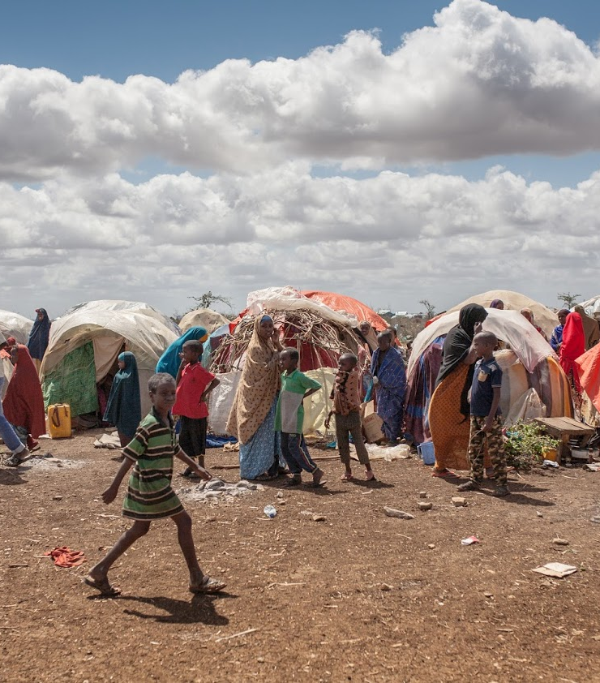
Session 4: Preparing for an evidence-based planning: durable solutions analysis for area-based planning

Slide 2
A step by step methodology
1. Preparation: Actors mapping, mobilisation, leadership and coordination
Preparation: Data and analysis to inform joint area –based solutions planning
Plan development based on Community Action Plans
Inclusive and participatory monitoring and Evaluation

Slide 3




Priority policy processes
Objectives
Why collecting and
analyzing data?
Solutions analysis and the SDGs: Activity
What data do we need?
Area-based approach
Methodology and tools for area-based solutions analysis

Slide 4
Why do we need data and analysis?
To understand the vulnerabilities, needs and capacities of the DAC
To better understand conflict dynamics to mitigate them
To map the availability, accessibility and functioning of services
To set SMAT benchmarks and indicators to monitor progress towards solutions
Notes:
Make this section participatory by showing and the title + the question mark icon (animation already inserted) of the slide first and asking the question to the participants. Only show the bullet points after you managed to get sufficient good/relevant arguments/answers.

Slide 5








Area-based solutions analysis
An area-based analysis utilizes a defined spatial area as the entry point for understanding:
the characteristics and conditions
of target populations
the specific characteristics of the areas hosting them, such as service and infrastructure capacity
Notes:
This slide is animated slide : each sentence on the left is illustrated by icons on the right appearing simultaneously.
The main messages here is that:
- The selected area will be the entry point for data collection and analysis on:
The different categories of populations (refugees, IDPs, host communities) to be able to compare the common and different needs of the different segment of populations;
Characteristics of the location’s structures and services.
A detailed list of the types of data for each side (population and location) is provided in the following slide.

Slide 6

What data?
Data on Places/ the supply side
Infrastructure mapping/damage assessment
Service availability & provision
Livelihood / labour market
Housing Land and Property regime
Governance structures
Data on Populations/demand side
Disaggregated demographics
Access to services
Access to livelihoods
Access to HLP
Community cohesion
Notes:
Here is a comprehensive approach to bring data on people and data on locations together.
This entails collecting macro data on the places and micro data on the population.
It is also a combination of quantitative and qualitative data.
Secondary data: We don’t automatically need to collect all the data. Part of it maybe available with partners.
We don’t need to collect and search for all the data, only the data and information that we need!
Activity 1: scattered data.
In plenary, ask who collects this data for IDPs, refugees, host communities in the context where the workshop is organized, who has access to it, and shares it?
If you have time, write the different sets of data and the different segments of population on flip chart papers and write down the answers of the participants as they come during the discussion.
Let the participants discuss during 5 to 7 minutes and conclude the activity by saying that ideally data collection and analysis should be concerted and shared to inform a joint vision and planning as area-based planning is an approach including 1. the whole population in a 2. given location, is 3. multi-stakeholder and 4. multi-sectoral. Most studies conducted/data sources in the region are organization centric, with ensuing duplication and contradiction, leading to a lack of common analysis and undermining the development of a common narrative and planning.
Source: Based on Jips presentation on area-based solutions analysis.

Slide 7

Durable solutions data
Comparison between different populations
Long-term quality data on DAC’s profiles
to inform development planning
Concerted and shared data that informs joint analysis and planning
Needed! Only the data we need, based on clear objectives!
Disaggregated by Age, sex/gender
Notes:
This is a recap slide that enables the facilitator to summarize the key elements of data collection and analysis for solutions area-based planning.

Slide 8
Schematic: conceptualizing DATA IN refugee-affected areas
a few
Kebeles
Woreda
Regional
National
(Zonal)
eg. 15 km
Refugee
Camp
Directly-impacted host area
Indirectly-impacted host area
Regional Development Planning (GTP)
National Development Planning (GTP)
Data monitored by UNHCR / partners
Data monitored by local authorities (namely woreda sector bureaus).
UNHCR / partner support to capacity.
UNHCR can ideally access data.
Data complied by reg. authorities. UNHCR capacity support. Ideally UNHCR accesses data.
Data complied by National authorities.
Fig. 2
Notes:
This slide is context specific. It was borrowed from UNHCR Ethiopia and will only be screened during the pilot workshop on Jijiga. The main goal of presenting this slide is to show the current restricted and siloed on access to data in and outside the camp.
Ideally, there should be a shared and concerted data collection and analysis strategy and plan among all relevant a actors under the leadership of local authorities at the Kebele level. It would ensure that the area-based-plan is informed by shared and concerted data and analysis, a common vision and shared outcomes.
Source: UNHCR Ethiopia.

Slide 9




Area-based solutions analysis: Tools
Interagency indicators library
ReDSS framework
Profiling
Inclusion in national statistics :
/ Poverty assessment
Notes:
Here are the different tools that have been developed to support joint area-based solutions analysis. The first three are based on the 8 IASC criteria.
The interagency indicators library that was recently developed by many UN agencies and international NGOs based on the 8 IASC criteria + basic demographics and intention survey.
The Durable Solutions Indicator Library presents agreed-upon indicators that can be used to measure durable solutions outcomes. It can inform solutions-related policy, strategy processes, as well as programming and advocacy efforts.
ReDSS seeks to examine the conditions for durable solutions for displaced persons in East and Horn of Africa, and to highlight the important roles and contributions of the various sectors (humanitarian, development, human rights and peace-building) in creating favourable conditions in the search for durable solutions.
Affirming that the three solutions (voluntary repatriation, local (re)integration or resettlement elsewhere) are processes leading to (re)integration, ReDSS operationalized the IASC Framework for Durable Solutions for IDPs to develop the ReDSS Solutions framework for displacement affected communities.
It is a practical, rapid and adaptive tool with a simple visual, that can be used to:
Establish a common understanding on the opportunities and challenges to address the different components of durable solutions processes
Inform coordination and prioritisation among different stakeholders and with national and local authorities
to focus and prioritize investments based on gaps and challenges
Inform the design and adaptation of durable solutions programing and strategies
Profiling: is a collaborative process for analysing displacement situations. This entails gathering information on populations affected by displacement, including local populations. The process requires the establishment of a collaborative platform early on to guide decision-making and to share ownership and responsibility. Partners work together and with affected populations to create an evidence base on the displacement situation. Different actors including government authorities as well as humanitarian and development actors work together throughout the process and agree on the results. Hence, this can be an important step in establishing a shared understanding of the situation and therefore a starting point for joint and effective responses.
Inclusion in national statistics:
- Data collected on displacement is mainly tailored to informing humanitarian responses and data systems are shaped accordingly. Displaced persons should not be researched/ data collected in isolation but mainstreamed into national data collection systems through area-based approaches
- It is critical to transition to systems that provide for longer-term information needs in order to better understand IDPs and other displaced persons profiles and issues through a multi-stakeholder data system. Governments should be supported with expertise and funding to be able to put in place a national statistical system that is accessible to all stakeholders, with relevant data protection and safeguard mechanisms.
- Expert Group on Refugee and IDP statistics (EGRIS) is a platform that is working on developing international standards for IDP statistics and could be used to strengthen the capacity of governments and provide the relevant tools and frameworks to harmonise data collection inclusive of displacement
- Such a system will ensure that existing data being collected by operational agencies from humanitarian and development sectors can fit and contribute to the national systems
World Bank micro data analysis for Somalia (displacement indicators in poverty assessments)
Socio-economic micro-data analysis based on IASC framework to create a holistic profile of IDPs that links the causes of their displacement with their current needs, assets, and aspirations.
Micro-data is individual and household-level data that includes host communities and displaced for comparison.

Slide 10
Zoom: Interagency Indicators library: Measuring progress towards solutions for IDPs
Agreed upon set of data
Meant for collecting data directly from displaced and displacement-affected populations using quantitative methods
To be complemented by macro level data and analysis and quantitative data
Module A: Core demographic indicators
Module B: future preference and plans
Module C: 8 IASC durable solutions criteria
Notes:
The interagency indicators library that was recently developed by many UN agencies and international NGOs based on the 8 IASC criteria + basic demographics and intention survey.
The Durable Solutions Indicator Library presents agreed-upon indicators that can be used to measure durable solutions outcomes. It can inform solutions-related policy, strategy processes, as well as programming and advocacy efforts.

Slide 11




Activity
Criteria | Sub criteria (IASC)
 | 1. SAFETY & SECURITY/ PROTECTION/ SOCIAL COHESION
 | 2. ACCESS TO BASIC SERVICES
 | 3. ACCESS TO JOB CREATION/ ECONOMIC OPPORTUNITIES
 | 4. RESTORATION OF HOUSING, LAND & PROPERTY
 | 5. ACCESS TO DOCUMENTATION
 | 6. FAMILY REUNIFICATION
 | 7. PARTICIPATION IN PUBLIC AFFAIRS
 | 8. ACCESS TO EFFECTIVE REMEDIES AND JUSTICE
Notes:
- ReDSS framework is a tool that contributes to increasing the availability of data on displacement-affected communities, thereby supporting the development of more solutions-oriented responses; It was designed to support the development of solutions strategies and plans.
- The ReDSS Solutions Framework indicators measure the extent to which the 8 IASC criteria have been satisfied.
- The indicators are intended to be adaptable and contextualized- the analysis team may decide that certain indicators need to be tailored to the context to fit the theory of change of the solutions programme;
- In most of the context it is relevant to draw linkages between the ReDSS/IASC indicators and SDGs or other national indicators to facilitate their inclusion in local and national plans.
This is what the following activity proposes:
Activity 2: The main goal of this activity is for the participants to link the IASC criteria and related indicators developed by ReDSS to the SDGs and to identify whether or not this data is available, in their context, disaggregated (age and sex) and in a way that allows for a comparison between displaced and non displaced persons.
Divide the participants in four to five group, each group will work on one or two criteria depending on the number of participants.
Assign one or two criteria and related indicators to each group. Distribute both the list of ReDSS framework indicators as a handout and the activity 1 sheet (table) that will help participants list their findings.
Project the 17 SDGs on the wall and ask the participants to:
Make each criteria and if possible, some indicators match the corresponding SDG(s)
Determine whether corresponding data, allowing for a comparison between displaced and nondisplaced living in the area is accessible, shared and concerted among actors in the area. Is this data disaggregated (by sex, age and diversity)?
Which actor has collected and has the data? If data/information is unavailable, who, based on comparative advantages, could collect and analyse this type of data among partners, to inform joint outcomes?
You can add a more general question at the end : generally speaking, is data and analysis concerted among a wide range of actors involved in the area and ready to inform joint outcomes in the context where the workshop is applied?

Slide 12
Activity
Notes:
You can show this slide during the activity if you don’t want to print the SDGs.

Slide 13
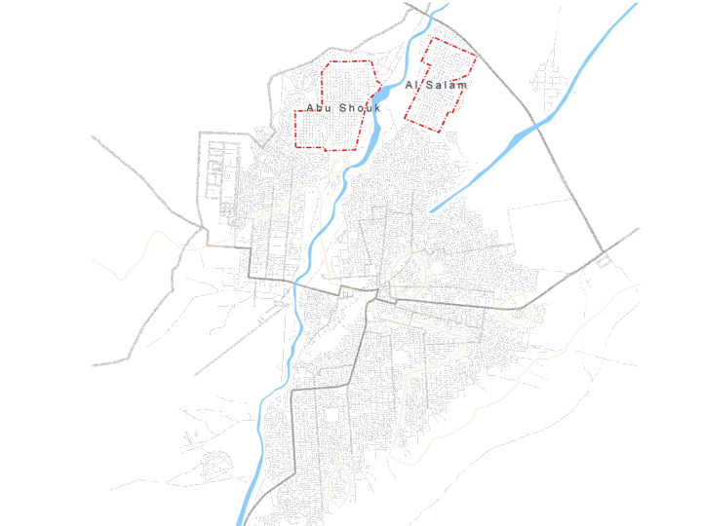

Focus : Area-based durable solutions analysis in El Fasher, Sudan
IDP CAMPS
Research question:
What is the progress towards local integration amongst IDPs in the camps?
Approach:
- Comparative analysis of IDPs and non-displaced to assess progress across IASC criteria for solutions by location.
- Urban analysis with UN-Habitat and the Ministry of Urban Planning.
PERI-URBAN
URBAN
Sample based HH survey – 4 comparative strata
Urban Peri-urban IDP camps
Notes:
Case study (optional): This case study showcases a solutions analysis project carried out in Darfour Sudan, in El Fasher, where IDPs have been living in settlements at the outskirt of the city, outside the peri urban area that local authorities are planning to connect to the city through a new urban plan.
An analysis combining both demand and supply side was attempted in El Fasher, where the analysis of the populations (IDPs and non) was combined with an urban analysis of the HLP situation and the services.
One of the goals has been to inform the local integration strategy of turning the 2 IDP camps into parts of the city.
If you have time and if it is relevant to the context, you can show the full infographic of the project accessible there (online and offline): http://dswgsudan.org/en/2019-progress-towards-durable-solutions-abushouk-elsalam-idp-camps/#section=0&page=3&subpage=0

Slide 14
Recap
Data needs on demand and supply sides are carefully assessed based on clear common objectives
Existing data and analysis on the different segments of the population and on the characteristics of the area is shared
Only necessary data is collected by relevant actors, based on comparative advantages
Data and analysis inform joint planning

