Slide 1
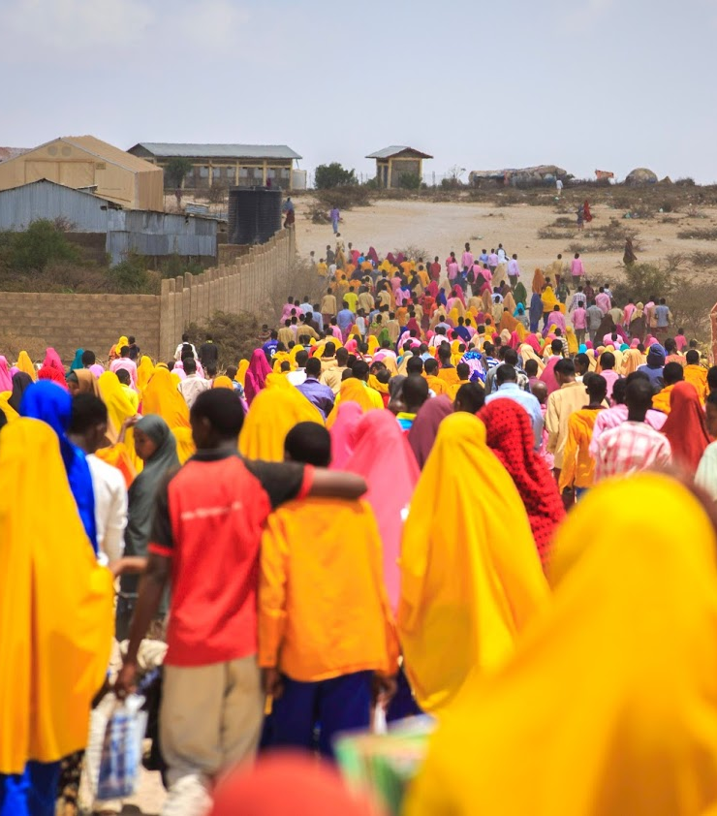
Session 5: Community-based planning and Community Action Plan

Slide 2


The Copernican Revolution
Notes:
The Copernican Revolution (optional):
This slide, inspired by People First Impact method (http://p-fim.org/) is there to illustrate an icebreaker aiming at highlighting the paramount importance of including DAC in area-based solutions planning.
The key message here is that “people come first, and communities are at the centre.
To introduce this point you can start with the Copernican revolution: “For over 1,000 years we believed that the earth was the centre of our universe and that the sun revolved around the earth. In the 16 th century Nicolaus Copernicus proposed that in fact the sun is the centre of the universe and not the earth. This we now know to be true. In terms of our work and the organisations we work for what is the centre of the universe? Is it the community or our organisation and our projects? Think carefully about this. The voice and perspective of communities is too often almost totally missing or limited to an agency or programme centred focus. We need to see the world through the eyes of communities and not our own. Agency interventions are only part of a wider context and often only a small part. P-FIM helps us to be open, humble and honest about what is happening and the kind of impact that we as agencies, donors and government are having. It builds an appreciation for the role of others especially the central role of the community. By properly putting communities at the centre, we challenge conventional wisdom that perceives expertise as external and allow a true understanding of the need to engage in two-way communication - with communities playing a lead role. This increases ownership and responsibility among the staff of organisations.

Slide 3
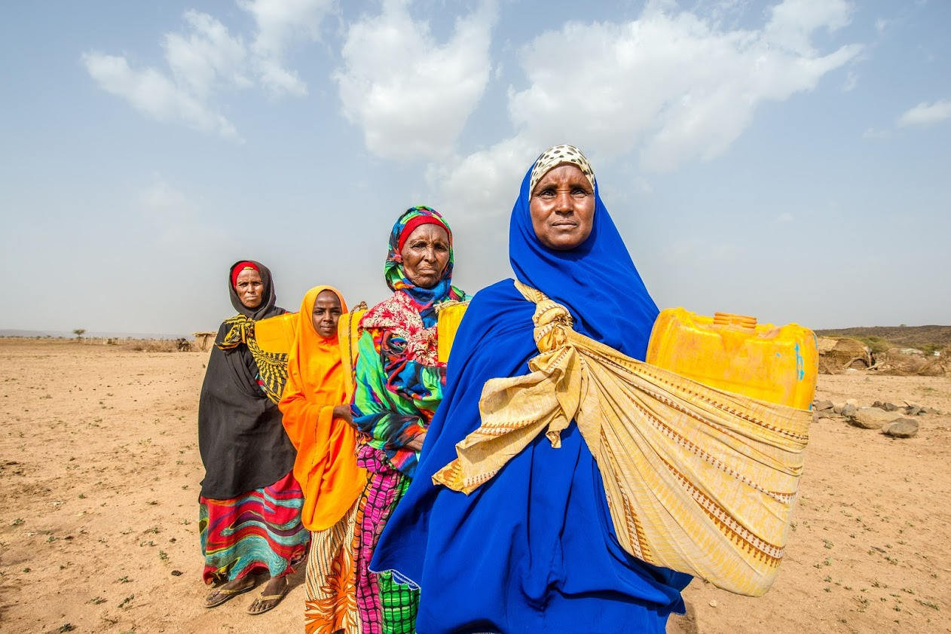
DAC mobilization
Inform
Consult
Empower
Involve
Collaborate
Notes:
Another short energizer to start with (optional) :
Only shows the title of the slide at the end of the energizer. The animation is inserted.
Graphic facilitation: ask 5 groups to find a good way to draw/find a visual for the following terms, each group is assigned a term:
Inform
Consult
Empower
Involve
Collaborate
Give them 5 to 10 minutes, show the different drawings and ask the participants why, in their opinion, they were asked to work on these specific words?
Explain that informing, consulting, empowering, involving and collaborating with DAC are the main ways to ensure their participation to the planning, implementation and monitoring of an Area-based plan.
Key message: Throughout this session, we will try and find ways to inform, consult, empower, involve and collaborate with DAC to develop area-based plan reflecting their needs, vulnerabilities, capacities and concerns.

Slide 4
A step by step methodology
1. Preparation: Data and analysis to inform joint area –based solutions planning
2. Preparation: A multi sectoral and multi stakeholder planning process
3. Community based panning and action plan
Inclusive and participatory monitoring and Evaluation
Notes:
A short energizer to start with:
Graphic facilitation: ask 5 groups to find a good way to draw/find a visual for the following terms, each group is assigned a term:
Inform
Consult
Empower
Involve
Collaborate
Give them 5 to 10 minutes, show the different drawings and ask the participants why, in their opinion, they were asked to work on these specific words?
Explain that informing, consulting, empowering, involving and collaborating with DAC are the main ways to ensure their participation to the planning, implementation and monitoring of an Area-based plan. Throughout this session, we will try and find ways to inform, consult, empower, involve and collaborate with DAC to develop area-based plan reflecting their needs, vulnerabilities, capacities and concerns.

Slide 5




Priority policy processes
Objectives
AAP and Community based approach
Community Action planning workshop
Community Action Plan
Area-based approach
DAC mobilization

Slide 6
Accountability to affected population
Participation and inclusion: effective and meaningful engagement of all DAC members in all stages of CAPs
Communication and transparency: clear information on their rights, entitlements and on the programme through accessible communication channels in a language they understand
Feedback and response system
Notes:
Accountability to affected population is not more than ensuring that people are at the centre of the area-based approach and that partner organisations are not only accountable to donors but first and foremost to the population that they are working with.
Accountability refers to the responsible use of power (resources, decision making) by humanitarian and development actors, combined with effective and quality programming that recognizes a community’s dignity, capacity, and ability to be independent. Area-based project partners commit to ‘putting people first' and drawing on the rich range of experiences, capacities, and aspirations of refugee, displaced and hosts women, men, girls and boys. In addition, they are committed to being accountable to the people they serve by listening and responding to their needs, perspectives, and priorities.
These can be done through three types of enablers listed on the slide.
UNHCR's AAP framework and these values are outlined in UNHCR's Policy on Age, Gender and Diversity (AGD, 2018), specifically core actions 2-5:

Slide 7

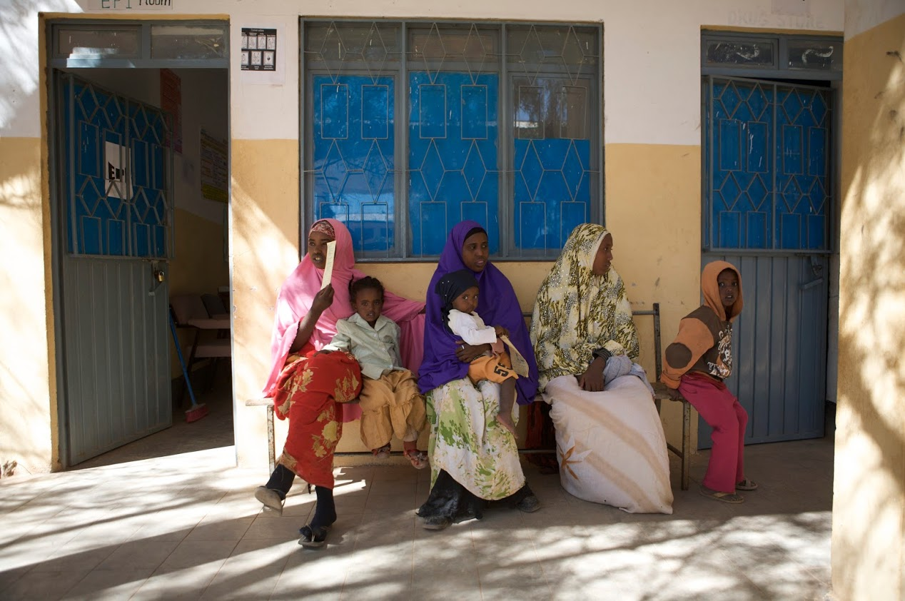
Community-based approach. What is it?
An approach in which communities have an active role and participate in highlighting and addressing the issues that matter to them
Notes:
Adopting a community-based approach throughout the area-based planning process is the best way to ensure DAC effective involvement and participation and real Accountability to Affected Populations.

Slide 8




A twofold dimension
1
2
Empowering communities to take part to area-based participatory planning processes directly affecting their life
Strengthening the capacities of national and local authorities and partners to lead, plan and coordinate for community-based interventions
Notes:
Key message:
Community-based approach entails communities to take part to area-based participatory planning processes directly affecting their life and strengthening the capacities of local actors to lead such participatory process to ensure that interventions will respond to the needs of the DAC. To this end, community-based interventions should also strengthen local coordination and planning capacities. This is a great way for national ad local authorities to strengthen social cohesion between different groups, reinforce their legitimacy and improve their relationship with DAC.
Plenary discussion: Ask about relevant/successful examples of initiatives at local level involving a community-based approach.

Slide 9


Zoom: Common Social Accountability Platform (CSAP)
Radio to build dialogue and gather public opinion on issues related to durable solutions
Developed by Africa’s Voices Foundation
Launched in partnership with ReDSS and the Banadir Regional Administration
"Yes, I feel involved because community consultation is always the best thing to do and I personally believe that I am part of the decisions in
the community and we appreciate a lot those who made this safe spaces to talk like the radio presenters, the leaders involved and those aid organisations who are involved as well."
Female participant, Mogadishu, Somalia

Slide 10


TOOL: Community action plan
DAC participate in the area-based planning, implementation and monitoring through:
Identification of their vulnerabilities, needs and capacities
Identification of potential solutions
Preparation, consolidation and validation of the community action plan
Participation in the implementation
Active participation in the monitoring and evaluation
Resources
Objects
Notes:
Key messages:
- In the Community Action Planning process DAC are the primary resource rather than the objects of solutions planning. This approach motivates them to take the lead in the planning and implementation of solutions activities.
- Community Action Planning develops the capacity of the communities to take appropriate actions for their own solutions
- It is important that the DAC itself prepares the Community Action Plan as it helps to internalize the plans and to take responsibility for implementation and maintenance.
- The planning process is carried out in the form of workshops under the lead of the local Government, in which the DAC members and other partner organizations participate.

Slide 11
Who is in the CAP?
Joint process involving local partners, refugees, IDPs, returnees and hosts communities
How to ensure the CAP is inclusive?
How to ensure the CAP is representative?
Who should lead it?
Who should coordinate it?
Social mapping and mapping of the community structures: build on the existing!
Inclusion of the excluded
Led and coordinated by local authorities to ensure alignment with existing plans or the creation a locally-own ones
Notes:
Show the dark grey block first (the animation is already inserted). You can throw the questions to the audience as a preliminary discussion before the following activity which goal will be to map the CAP participants.

Slide 12
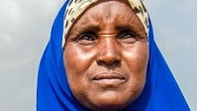

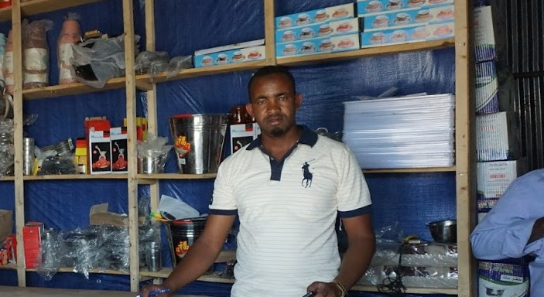
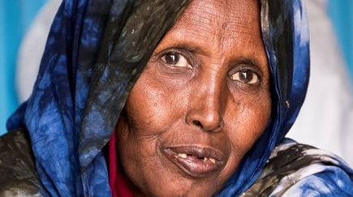

Activity: Who is in the CAP?
Notes:
Activity 1: Who is in the CAP? Group activity aiming at listing potential CAP in the context where the workshop takes place.
Assign each group a category of actors (depending on the context) and ask them to list from 5 to 7 existing structures (community group, organisation, agency) that should take part to an area-based Community Action Plan. Note that the total number of participants should not exceed 30.
Here are the main criteria that will guide the selection: You can write them down on a flip chart paper.
Representativity
Popularity
Proximity with the community they represent
Gender and age balance
Potential capacity to take part to a simple planning development process
- The list should ensure that excluded, vulnerable and “invisible” persons are represented!
If there is no existing community structure or organisation meeting this requirement, ask the participants to think about ways to include relevant participants into the CAP.
Here are examples of categories of populations to be represented:
IDPs
Refugees
Host community
Persons with disabilities
Inhabitant of a specific zone in the delimitated area: informal settlement, persons at risk of evictions, etc.
Local NGOs and CSOs
Partner organisations
Local authorities

Slide 13
CAP
Make it work step by step
1. Social and area mapping
2. Guiding principles
3. CAP workshop(s) preparation
4. CAP workshop(s)
5. Implementation and monitoring plan
6. Consolidation and dissemination
7. Linking to local and national development plans
Notes:
You can distribute and refer to the Checklist (in handouts) to provide more details about each phase. Insist on the fact that the checklist is indicative and should be adapted to the context.
Interactivity: It is possible here to start a discussion with participants on whether they have previously taken part to an inclusive CAP and included/linked this CAP with their development planning, and if so, how?

Slide 14
CAP Matrix
Issues | Causes of the problem | Proposed solutions | Actions to be taken | Prioritization
IASC Criteria 1
IASC criteria 2
IASC criteria 3 …
“What do we need to overcome our displacement related issues”
Notes:
Here is an example/sample of the matrix that can be used to guide and list the participants discussions. The guiding question on the right is to be adapted to the context of t he workshop.

Slide 15
Consolidation matrix
Objective or IASC criteria | Activities | Sectors | Timeline | Indicators
Actors | Lead
Reference planning framework for actors and donors
To form or be linked to local sectoral or development plans
Notes:
Here is an example of a consolidation matrix to be developed based on shared and concerted data and the results of the CAP.
This will need to be disseminated at community level and put in a format that can be used by local authorities to link it to existing local plan or as a district/local plan.

Slide 16
CAP
Make it work
with Tips
Government and partners to support the process
Flexibility
Patience
Creativity
Representativity
Coordination to avoid duplication
Notes:
Government through local authorities should have the capacity to lead, coordinate and support the process with the support of local and international partners. It is a great opportunity to build trust, strengthen its relationship with local citizens and reinforce its leadership.
Community Action Planning demands considerable flexibility, patience and creativity from the project staff. Flexibility is required because each community is different in its problems, needs and solutions. Patience is needed, because every community has to go through a similar process of understanding its situation, identifying its problems, setting its priorities and mobilizing its resources. Creativity is necessary, because Community Action Planning often does not fit into the existing procedures, rules and regulations of the government or development partners.
Representativity is key as highlighted before and coordination with other programmes and all key actors is crucial to avoid duplication, in line with the principles of engagement with national authorities.

Slide 17
Concerted data and analysis
Community Action Plan
Local development planning
Data, analysis, CAP and local plan
Government led with multi stakeholder and multi sectoral support
Notes:
This slide summarizes how one or several well consolidated area-based plan(s) grounded in sound concerted data and analysis and community planning processes can be linked to or inform government led local development planning.

Slide 18
Integrated District Community Action Plans in Somalia
Baidoa and Kismayo
CAP
IOM/UN Habitat Midnimo community action in Baidoa and Kismayo
Consolidation
Danwadaag supported the municipalities to consolidate these and other CAPs into integrated district-level plans.
Local Planning
Tool for local authorities to coordinate activities of various humanitarian and development partners and avoid duplication.
Plug in
World Bank, GIZ and UN Habitat use the CAPs when designing and planning infrastructures and resilience programmes
Notes:
Case study : Integrated Community Action Plans (CAPs): have been adopted by many aid actors in Somalia, albeit with different community engagement models and structures. While they have proven an important tool to ensure more participatory and inclusive prioritisation and planning processes, they have often been uncoordinated and disjointed, with many parallel processes in the same locations. Building on learning from this, several durable solutions actors have adopted a more coordinated approach together with the municipalities, on which it is possible to build. For example, the IOM/UN Habitat Midnimo project has developed community action plans for Baidoa and Kismayo. The Danwadaag consortium then supported the municipalities in Baidoa and Kismayo to consolidate these and other existing CAPs into integrated district-level plans. These have become an important tool for the local authorities to coordinate activities of various humanitarian and development partners in their area and ensure avoidance of duplication. While not all actors base their engagement on these plans yet, and many aid actors continue to have different community engagement modalities, several development partners such as the World Bank, Deutsche Gesellschaft fuer Internationale Zusammenarbeit (GIZ) and UN-HABITAT have now started using the CAPs when designing and planning their urban infrastructure and resilience programmes.
Source: Advancing multi stakeholder engagement to sustain solutions, ReDSS briefing paper, Dec. 2019, accessible there: https://regionaldss.org/index.php/research-and-knowledge-management/redss-publications/
Activity 2: Activity in plenary: map local development and sectoral planning agenda and opportunities for a CAP or several CAPs to be linked to local planning processes.
First step:
Are there local development and sectoral planning processes and agenda in the area where the ABA will be applied? Who leads and coordinates them?
Are there other CAPs processes or CAPs already developed/implemented?
Second step.
What would be the opportunities to link the area-based solutions CAP to local development or sectoral planning processes or to consolidate this CAP and potential others into an integrated local plan?
Would this CAP be compiled with others?
What are the existing programmes that could be linked to the consolidated plan? Potential actors who could engage in such a plan?

