Slide 1

Session 6: Monitoring and evaluating

Slide 2
A step by step methodology
1. Preparation: Data and analysis to inform joint area –based solutions planning
2. Preparation: A multi sectoral and multi stakeholder planning process
3. Community based panning and action plan
4. Monitoring, evaluation and adaptative management

Slide 3




Priority policy processes
Objectives
Why monitoring and evaluating?
Accountability and accountability tools
How to monitor and evaluate
Area-based approach
Flexibility and adaptative management of area-based plans

Slide 4

Why monitoring and evaluating?
Accountability
Learning and flexibility
Strengthening data systems
Notes:
Accountability: Measure in a transparent way and communicate on progress of the plan against the results that we committed to achieve with the resource we are provided.
Learning: Evidence that is needed to help manage project and activities, be able to adapt the project if need be and improve strategic approach
Strengthening data systems through the collection data and analysis needed to plan, monitor and evaluate.

Slide 5
Monitoring Evaluation
Learning
System
Results framework
Performance monitoring
Evaluation
Learning agenda
Strengthened data system
Notes:
These are key elements of monitoring, evaluation and learning systems:
Results framework: a joint vision, a theory of change (what you want to change and how you intend to make it change), common goals or outcomes and corresponding activities and performance indicators. This results framework should be flexible and up for changes if need be.
Performance monitoring: Ongoing and systematic tracking of data relevant to strategies and activities using performance indicators. This monitoring should allow for flexibility and adaptative management.
Evaluation: Evaluation on whether the programme or plan is effective using specific questions relevant to the plan and the context. There are two types of evaluations: performance evaluation that evaluate the progress of the programme/plan and impact evaluation that evaluate the actual impact/changes brought by the plan/programme.
Learning agenda: Key evidence gap to be assessed and addressed.

Slide 6

“Whatever the quality of information, no assumption can be made that the increased availability of good information and analysis will in itself result in better informed decisions.” ACAPS - TUFTS, 2013
Notes:
Source: The Use of Evidence in Humanitarian Decision Making, ACAPS Operational Learning Paper, January 2013
Read the quote and tell the participants that gathering and analysing data and information, regularly monitoring the implementation of the solutions plans might not lead to better decision making if there is no flexibility in the way area-based solutions plans are implemented. The implementation of area-based solutions plans requires capacities and resources to adapt the plan to changes and/or potential and unexpected adverse effets of the activities. This is what is called « adaptative management ».

Slide 7
What is adaptative management?
Learn
Reflect
Decide
Act
Adaptive management involves testing, monitoring, getting feedback and making adaptations and corrections if necessary
An adaptive programme learns, has opportunities to use that learning and actually adjusts (Bond)
Notes:
This slide goes a bit more in depth in what adaptative management is.
Bond is the civil society network for global change. bond.org.uk. Their report on “Adaptive management What it means for CSOs” can be found there: https://www.bond.org.uk/sites/default/files/resource-documents/adaptive_management_-_what_it_means_for_csos_0.pdf

Slide 8

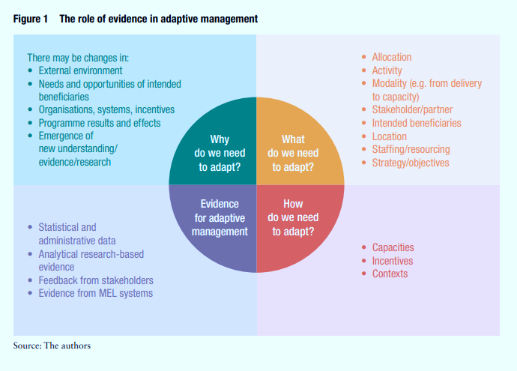
Flexible programming: adaptive management
Notes:
Flexible programming is one of the 10 elements of the area-based approach that we examined in session 2.
We can apply adaptative management techniques to solutions area-based planning to ensure flexibility and iterative improvement when needed.
ODI uses research on adaptative management in the business sector in its working paper « Towards evidence-informed adaptive management A roadmap for development and humanitarian organisations”. Managers and leaders in adaptative management need to provide evidence to answer the key questions highlighted in the coloured visual. Answering these questions requires to gather evidence and information from different sources: MEL, feedback from clients, research etc. assemble and synthetize them.
Activity 1: 4 steps brainstorming: Why, What, How and based on what evidence?
Prepare four flip chart papers with “Why, What, How and based on What evidence” as titles and facilitate a four steps brainstorming session in plenary.
Step 1: Why do we need to adapt? List 4 to 7 reasons why we may need to adapt our area-based plan based on the discussions in plenary.
Step 2. What do we need to adapt?
Step 3: How do we need to adapt?
Step 4: Based on what type of evidence can we make the decision to make corrections to the plan/the activities?
To complete the information shared on the slide here are four steps provided by ODI for strengthening evidence-informed adaptive management (step 4 of the activity) :
1. Establish the need for evidence in adaptive management (why, what and how).
2. Consider the appropriate types and levels of evidence.
3. Assess the robustness of that evidence, including whether and how it can be used for decision-making.
4. Ensure the basis of adaptive management decision-making is sound, transparent and documented.
ODI working paper is accessible here: https://www.odi.org/sites/odi.org.uk/files/resource-documents/12985.pdf

Slide 9
Flexible programming: adaptive management. Recap
Notes:
This is a recap slide to show after the activity to check on whether all the relevant points have been mentioned.

Slide 10
Characteristics of adaptive management
Treating the problems as “complex” in nature
Focusing on “course-correction” of activities within the lifetime of the program and from one program to the next
Rapid learning and feedback to inform changes
Flexibility in implementation including within budgets and results frameworks
Responsibility for decision-making with implementing staff
Focus on problems that are identified at local level – context specific
A politically-smart or power-sensitive approach : problems look different depending on whose perspective they are viewed from. Explore the politics underpinning a problem and emerging contextual opportunities for action
Focus on progress towards results and on learning, rather than on pre-defined implementation plans and milestones (asking “did we do the right thing?” rather than “did we do what we said we would do?”)
Notes:
These are some of the characteristics or rules to be applied to make adaptative management concrete as an organisation or group of organisation involved in the implementation of an area-based plan.

Slide 11
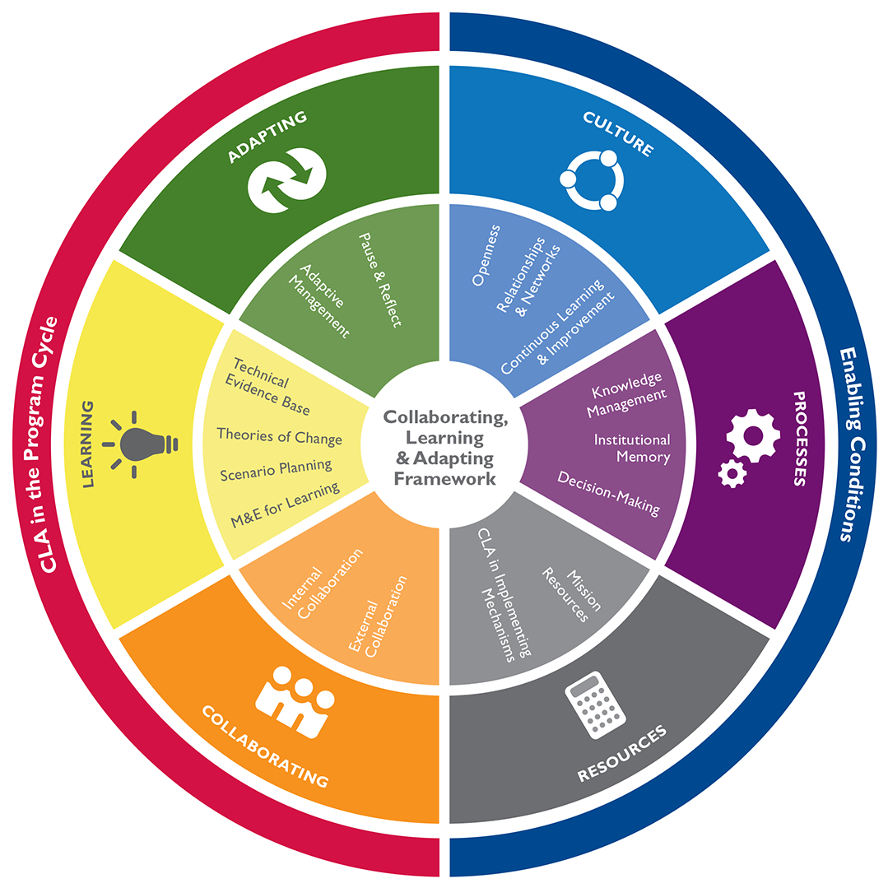
USAID CollaborationLearning and Adapting (CLA)
Notes:
USAID collaboration, learning and adaptative framework can be useful in that it helps implementers become nimbler, knowledge-driven and responsive to the evolving challenges that programs and projects face in achieving development objectives. With CLA, the causal pathway to desired program outcomes is continuously assessed and adjusted to yield the most effective course of action. Here is a visual that well sums up the CLA enabling conditions and ways to include collaboration, learning and adaptation in the programme cycle.
Activity 2 (optional): Form 6 groups and assign one colour/theme to each of them. Ask them to think about the main obstacles and opportunities in the context where the workshop is rolled out for each CLA key element:
Culture
Processes
Resources
Collaborating
Learning
Adaptating

